Slide 1



Tracking Bad Apples:
Reporting the Origin of Null & Undefined Value Errors
Michael D. Bond UT Austin | Nicholas Nethercote National ICT Australia | Stephen W. Kent UT Austin
Samuel Z. Guyer Tufts University | Kathryn S. McKinley UT Austin

Slide 2
Example Code
User code:
float[][] data =
{{1.0f, 2.0f}, {3.0f, 4.0f}};
ScatterPlot plot =
new ScatterPlot(data, null);
...
plot.draw(...);

Slide 3
Example Code
User code:
float[][] data =
{{1.0f, 2.0f}, {3.0f, 4.0f}};
ScatterPlot plot =
new ScatterPlot(data, null);
...
NullPointerException
at ScatterPlot.draw():315
at Test.doStuff():124
plot.draw(...);

Slide 4
Example Code
User code:
Library code:
float[][] data =
{{1.0f, 2.0f}, {3.0f, 4.0f}};
ScatterPlot plot =
new ScatterPlot(data, null);
...
ScatterPlot {
draw(...) {
...
xaxis.draw();
...
}
}
NullPointerException
at ScatterPlot.draw():315
at Test.doStuff():124
plot.draw(...);

Slide 5
Unusable Value
Null is unusable value
  Use causes error
How/why did it become null?
  Null’s origin?
ScatterPlot {
draw(...) {
...
xaxis.draw();
...
}
}
NullPointerException
at ScatterPlot.draw():315
at Test.doStuff():124
plot.draw(...);

Slide 6
Origin of Unusable Value
float[][] data =
{{1.0f, 2.0f}, {3.0f, 4.0f}};
ScatterPlot plot =
new ScatterPlot(data, null);
...
ScatterPlot {
draw(...) {
...
xaxis.draw();
...
}
}
Origin: Test.init():37
plot.draw(...);

Slide 7
Origin of Unusable Value
ScatterPlot {
ScatterPlot(data, xaxis) {
this.data = data;
this.xaxis = xaxis;
}
...
draw(...) {
...
xaxis.draw();
...
}
}
float[][] data =
{{1.0f, 2.0f}, {3.0f, 4.0f}};
ScatterPlot plot =
new ScatterPlot(data, null);
...
Origin: Test.init():37
plot.draw(...);
Origin: Test.init():37

Slide 8
Origin Tracking
ScatterPlot {
ScatterPlot(data, xaxis) {
this.data = data;
this.xaxis = xaxis;
}
...
draw(...) {
...
xaxis.draw();
...
}
}
float[][] data =
{{1.0f, 2.0f}, {3.0f, 4.0f}};
ScatterPlot plot =
new ScatterPlot(data, null);
...
Origin: Test.init():37
Track every unusable value’s origin for 4% overhead
Key: store origin in place of unusable value
plot.draw(...);
Origin: Test.init():37

Slide 9
Outline
Introduction
Unusable values
Instances of origin tracking
  Null pointer exceptions (Java)
  Undefined value errors (C/C++)
Redefining program operations
Evaluation
  Performance
  Usefulness
Related Work

Slide 10
Unusable Values
Using value causes error
Examples:
  Null values
  Undefined values
Tough bugs: no info
Why is value unusable?
  Where did unusable value originate?

Slide 11
Unusable Values
Using value causes error
Examples:
  Null values
  Undefined values
Tough bugs: no info
Why is value unusable?
  Where did unusable value originate?
Opportunity:
Store info in place of value

Slide 12
Origin Tracking Implementations
Null pointers (Java)
  Jikes RVM
Undefined values (native code)
  Valgrind’s MemCheck

Slide 13
Origin Tracking Implementations
Null pointers (Java)
  Jikes RVM
Undefined values (native code)
  Valgrind’s MemCheck
Jikes RVM Research Archive
Valgrind Source Code Repository

Slide 14
Origin Tracking Implementations
Null pointers (Java)
  Jikes RVM
Undefined values (native code)
  Valgrind’s MemCheck
  Identifies origin for 32-bit values
    47 of 147 are 32-bit
    For 32-bit: 34 of 47 identified
  Adds negligible overhead (28X → 28X)
Jikes RVM Research Archive
Valgrind Source Code Repository

Slide 15
Storing Origins in Null Values
Requirements
  Need bits in null values → multiple null values
  Program operations support null values
  Recover origin at exception

Slide 16
Storing Origins in Null Values
Requirements
  Need bits in null values → multiple null values
  Program operations support null values
  Recover origin at exception
Null ⬄ high 5 bits are zero (27 bits available)
Reserve & protect address range: 0x00000000–0x07ffffff
00000₂
Method ID
Bytecode index
5 bits
14 bits
13 bits

Slide 17
Implementing Java Operations
 | Java semantics | Standard VM | Origin tracking
Assignment of null constant | obj = null; | obj = 0; | obj = this_location;
Object allocation | obj = new Object(); | foreach ref slot i obj[i] = 0; | foreach ref slot i obj[i] = this_location;
Null reference comparison | if (obj == null) { | if (obj == 0) { | if ((obj & 0xf8000000) == 0) {
General reference comparison | if (obj1 == obj2) { | if (obj1 == obj2) { | if (((obj1 & 0xf8000000) == 0) ?
 |  |  | ((obj2 & 0xf8000000) == 0) : (obj1 == obj2)) {

Slide 18
Implementing Java Operations
 | Java semantics | Standard VM | Origin tracking
Assignment of null constant | obj = null; | obj = 0; | obj = this_location;
Object allocation | obj = new Object(); | foreach ref slot i obj[i] = 0; | foreach ref slot i obj[i] = this_location;
Null reference comparison | if (obj == null) { | if (obj == 0) { | if ((obj & 0xf8000000) == 0) {
General reference comparison | if (obj1 == obj2) { | if (obj1 == obj2) { | if (((obj1 & 0xf8000000) == 0) ?
 |  |  | ((obj2 & 0xf8000000) == 0) : (obj1 == obj2)) {

Slide 19
Implementing Java Operations
 | Java semantics | Standard VM | Origin tracking
Assignment of null constant | obj = null; | obj = 0; | obj = this_location;
Object allocation | obj = new Object(); | foreach ref slot i obj[i] = 0; | foreach ref slot i obj[i] = this_location;
Null reference comparison | if (obj == null) { | if (obj == 0) { | if ((obj & 0xf8000000) == 0) {
General reference comparison | if (obj1 == obj2) { | if (obj1 == obj2) { | if (((obj1 & 0xf8000000) == 0) ?
 |  |  | ((obj2 & 0xf8000000) == 0) : (obj1 == obj2)) {

Slide 20
Implementing Java Operations
 | Java semantics | Standard VM | Origin tracking
Assignment of null constant | obj = null; | obj = 0; | obj = this_location;
Object allocation | obj = new Object(); | foreach ref slot i obj[i] = 0; | foreach ref slot i obj[i] = this_location;
Null reference comparison | if (obj == null) { | if (obj == 0) { | if ((obj & 0xf8000000) == 0) {
General reference comparison | if (obj1 == obj2) { | if (obj1 == obj2) { | if (((obj1 & 0xf8000000) == 0) ?
 |  |  | ((obj2 & 0xf8000000) == 0) : (obj1 == obj2)) {

Slide 21
Implementing Java Operations
 | Java semantics | Standard VM | Origin tracking
Assignment of null constant | obj = null; | obj = 0; | obj = this_location;
Object allocation | obj = new Object(); | foreach ref slot i obj[i] = 0; | foreach ref slot i obj[i] = this_location;
Null reference comparison | if (obj == null) { | if (obj == 0) { | if ((obj & 0xf8000000) == 0) {
General reference comparison | if (obj1 == obj2) { | if (obj1 == obj2) { | if (((obj1 & 0xf8000000) == 0) ?
 |  |  | ((obj2 & 0xf8000000) == 0) : (obj1 == obj2)) {

Slide 22
Implementing Java Operations
 | Java semantics | Standard VM | Origin tracking
Assignment of null constant | obj = null; | obj = 0; | obj = this_location;
Object allocation | obj = new Object(); | foreach ref slot i obj[i] = 0; | foreach ref slot i obj[i] = this_location;
Null reference comparison | if (obj == null) { | if (obj == 0) { | if ((obj & 0xf8000000) == 0) {
General reference comparison | if (obj1 == obj2) { | if (obj1 == obj2) { | if (((obj1 & 0xf8000000) == 0) ?
 |  |  | ((obj2 & 0xf8000000) == 0) : (obj1 == obj2)) {
General assignment | obj1 = obj2; | obj1 = obj2; | obj1 = obj2;

Slide 23
Outline
Introduction
Unusable values
Instances of origin tracking
  Null pointer exceptions (Java)
  Undefined value errors (C/C++)
Redefining program operations
Evaluation
  Performance
  Usefulness
Related Work

Slide 24
Methodology
Adaptive methodology
  Mix of application & compilation time
  Single iteration; 25 trials
DaCapo, SPEC JBB2000, SPEC JVM98
3.6 GHz Pentium 4 w/Linux

Slide 25
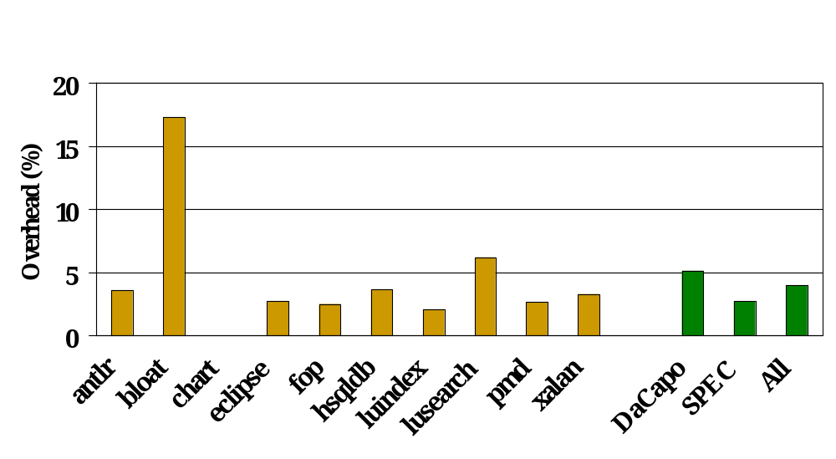
Performance of Java Implementation

Slide 26
Finding and Fixing Bugs
12 real NPEs from SourceForge
  Origin: identified by origin tracking?
  Triviality: origin obvious by inspection?
  Usefulness: origin useful for fixing bug?

Slide 27
Null Pointer Exceptions
Program | Lines | Exception description | Origin? | Trivial? | Useful?
Mckoi SQL DB | 94,681 | Access closed connection | Yes | Nontrivial | Definitely useful
FreeMarker | 64,442 | JUnit test crashes unexpectedly | Yes | Nontrivial | Definitely useful
JFreeChart | 223,869 | Plot without x-axis | Yes | Nontrivial | Definitely useful
JRefactory | 231,338 | Invalid class name | Yes | Nontrivial | Definitely useful
Eclipse | 2,425,709 | Malformed XML document | Yes | Nontrivial | Most likely useful
Checkstyle | 47,871 | Empty default case | Yes | Nontrivial | Most likely useful
JODE | 44,937 | Exception decompiling class | Yes | Nontrivial | Most likely useful
Jython | 144,739 | Use built-in class as variable | Yes | Nontrivial | Potentially useful
JFreeChart | 223,869 | Stacked XY plot with lines | Yes | Somewhat nontrivial | Marginally useful
Jython | 144,739 | Problem accessing __doc__ | Yes | Somewhat nontrivial | Marginally useful
JRefactory | 231,338 | Package and import on same line | Yes | Trivial | Not useful
Eclipse | 2,425,709 | Close Eclipse while deleting project | Yes | Trivial | Not useful

Slide 28
Null Pointer Exceptions
Program | Lines | Exception description | Origin? | Trivial? | Useful?
Mckoi SQL DB | 94,681 | Access closed connection | Yes | Nontrivial | Definitely useful
FreeMarker | 64,442 | JUnit test crashes unexpectedly | Yes | Nontrivial | Definitely useful
JFreeChart | 223,869 | Plot without x-axis | Yes | Nontrivial | Definitely useful
JRefactory | 231,338 | Invalid class name | Yes | Nontrivial | Definitely useful
Eclipse | 2,425,709 | Malformed XML document | Yes | Nontrivial | Most likely useful
Checkstyle | 47,871 | Empty default case | Yes | Nontrivial | Most likely useful
JODE | 44,937 | Exception decompiling class | Yes | Nontrivial | Most likely useful
Jython | 144,739 | Use built-in class as variable | Yes | Nontrivial | Potentially useful
JFreeChart | 223,869 | Stacked XY plot with lines | Yes | Somewhat nontrivial | Marginally useful
Jython | 144,739 | Problem accessing __doc__ | Yes | Somewhat nontrivial | Marginally useful
JRefactory | 231,338 | Package and import on same line | Yes | Trivial | Not useful
Eclipse | 2,425,709 | Close Eclipse while deleting project | Yes | Trivial | Not useful

Slide 29
Null Pointer Exceptions
Program | Lines | Exception description | Origin? | Trivial? | Useful?
Mckoi SQL DB | 94,681 | Access closed connection | Yes | Nontrivial | Definitely useful
FreeMarker | 64,442 | JUnit test crashes unexpectedly | Yes | Nontrivial | Definitely useful
JFreeChart | 223,869 | Plot without x-axis | Yes | Nontrivial | Definitely useful
JRefactory | 231,338 | Invalid class name | Yes | Nontrivial | Definitely useful
Eclipse | 2,425,709 | Malformed XML document | Yes | Nontrivial | Most likely useful
Checkstyle | 47,871 | Empty default case | Yes | Nontrivial | Most likely useful
JODE | 44,937 | Exception decompiling class | Yes | Nontrivial | Most likely useful
Jython | 144,739 | Use built-in class as variable | Yes | Nontrivial | Potentially useful
JFreeChart | 223,869 | Stacked XY plot with lines | Yes | Somewhat nontrivial | Marginally useful
Jython | 144,739 | Problem accessing __doc__ | Yes | Somewhat nontrivial | Marginally useful
JRefactory | 231,338 | Package and import on same line | Yes | Trivial | Not useful
Eclipse | 2,425,709 | Close Eclipse while deleting project | Yes | Trivial | Not useful

Slide 30
Null Pointer Exceptions
Program | Lines | Exception description | Origin? | Trivial? | Useful?
Mckoi SQL DB | 94,681 | Access closed connection | Yes | Nontrivial | Definitely useful
FreeMarker | 64,442 | JUnit test crashes unexpectedly | Yes | Nontrivial | Definitely useful
JFreeChart | 223,869 | Plot without x-axis | Yes | Nontrivial | Definitely useful
JRefactory | 231,338 | Invalid class name | Yes | Nontrivial | Definitely useful
Eclipse | 2,425,709 | Malformed XML document | Yes | Nontrivial | Most likely useful
Checkstyle | 47,871 | Empty default case | Yes | Nontrivial | Most likely useful
JODE | 44,937 | Exception decompiling class | Yes | Nontrivial | Most likely useful
Jython | 144,739 | Use built-in class as variable | Yes | Nontrivial | Potentially useful
JFreeChart | 223,869 | Stacked XY plot with lines | Yes | Somewhat nontrivial | Marginally useful
Jython | 144,739 | Problem accessing __doc__ | Yes | Somewhat nontrivial | Marginally useful
JRefactory | 231,338 | Package and import on same line | Yes | Trivial | Not useful
Eclipse | 2,425,709 | Close Eclipse while deleting project | Yes | Trivial | Not useful

Slide 31
Null Pointer Exceptions
Program | Lines | Exception description | Origin? | Trivial? | Useful?
Mckoi SQL DB | 94,681 | Access closed connection | Yes | Nontrivial | Definitely useful
FreeMarker | 64,442 | JUnit test crashes unexpectedly | Yes | Nontrivial | Definitely useful
JFreeChart | 223,869 | Plot without x-axis | Yes | Nontrivial | Definitely useful
JRefactory | 231,338 | Invalid class name | Yes | Nontrivial | Definitely useful
Eclipse | 2,425,709 | Malformed XML document | Yes | Nontrivial | Most likely useful
Checkstyle | 47,871 | Empty default case | Yes | Nontrivial | Most likely useful
JODE | 44,937 | Exception decompiling class | Yes | Nontrivial | Most likely useful
Jython | 144,739 | Use built-in class as variable | Yes | Nontrivial | Potentially useful
JFreeChart | 223,869 | Stacked XY plot with lines | Yes | Somewhat nontrivial | Marginally useful
Jython | 144,739 | Problem accessing __doc__ | Yes | Somewhat nontrivial | Marginally useful
JRefactory | 231,338 | Package and import on same line | Yes | Trivial | Not useful
Eclipse | 2,425,709 | Close Eclipse while deleting project | Yes | Trivial | Not useful

Slide 32
Debugging Timeline
Language design
Static analysis
Deployment
Testing
Early
Late

Slide 33
Debugging Timeline
Language design
Static analysis
Deployment
Testing
Early
Late
Prevent bugs
Memory bugs [Java & C#]
Null pointer exceptions [Chalin & James ‘06]
  Add “never null” types to Java
  Programmer effort
  Exceptions still possible
Functional languages

Slide 34
Debugging Timeline
Language design
Static analysis
Deployment
Testing
Early
Late
Detect errors in any execution
[FindBugs] [PMD] [ESC/Java] [JLint] [Metal]
Dataflow analysis & pattern matching
Program complexity → conservative (false positives)
Some intentionally unsound (false negatives)

Slide 35
Debugging Timeline
Language design
Static analysis
Deployment
Testing
Early
Late
Catch errors in real executions
Assertions
Checking tools [Valgrind] [Purify]
Dynamic slicing [Agrawal & Horgan ’90] [Zhang et al. ‘07]
Powerful but high overhead

Slide 36
Debugging Timeline
Language design
Static analysis
Deployment
Testing
Early
Late
Ideal environment for debugging?
Stack/dump reporting
Invariant-based bug detection [Liblit et al. ’05]
  Many executions
Limited dynamic slicing
[TaintCheck] [Chilimbi & Hauswirth ’04] [Origin tracking]
  Single execution
  Narrow focus

Slide 37
Summary
Unusable values: tough bugs
  Error stack trace not enough
  Opportunity: store origin in place of unusable value
  Managed and native implementations
Java null origins: fast, useful, silent
Add it to your VM today!

Slide 38
Summary
Unusable values: tough bugs
  Error stack trace not enough
  Opportunity: store origin in place of unusable value
  Managed and native implementations
Java null origins: fast, useful, silent
Add it to your VM today!
Thank you!

Slide 39
Extra slides

Slide 40
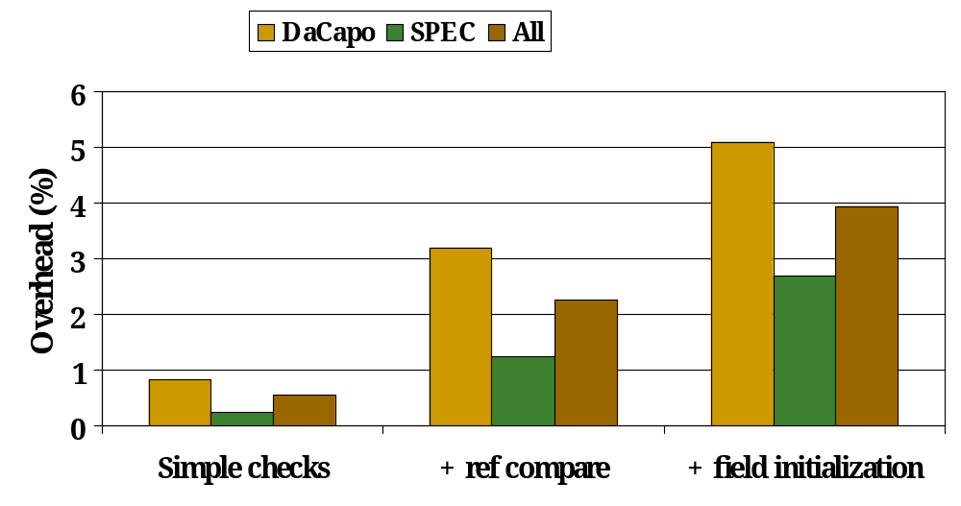
Runtime Overhead
(origin tracking)

