Slide 1
Path &
Edge
Profiling
Continuous
Michael Bond, UT Austin
Kathryn McKinley, UT Austin

Slide 2
Why profile?
Inform optimizations
  Target hot code
  Inlining and unrolling
  Code scheduling and register allocation
Increasingly important for speculative optimization
  Hardware trends → simplicity & multiple contexts
  Less speculation in hardware, more in software

Slide 3
Speculative optimization
Less speculative
More speculative
Superblocks
[Hwu et al. ’93]
Hyperblocks
[Mahlke et al. ‘92]
MSSP tasks
[Zilles & Sohi ’02]
rePLay frames
[Patel & Lumetta ’99]
Dynamo fragments
[Bala et al. ’00]

Slide 4
Speculative optimization
Less speculative
More speculative
Superblocks
[Hwu et al. ’93]
Hyperblocks
[Mahlke et al. ‘92]
MSSP tasks
[Zilles & Sohi ’02]
rePLay frames
[Patel & Lumetta ’99]
Dynamo fragments
[Bala et al. ’00]

Slide 5
Profiling requirements
Predict future with representative profile
  Accurate
  Continuous

Slide 6
Profiling requirements
Predict future with representative profile
  Accurate
  Continuous
Other requirements
  Low overhead
  Portable
  Path profiling
Previous work struggles to meet all goals

Slide 7
PEP: continuous path and edge profiling
Predict future with representative profile
  Accurate: 94-96%
  Continuous: yes
Other requirements
  Low overhead: 1.2%
  Portable: yes
  Path profiling: yes

Slide 8
PEP: continuous path and edge profiling
Combines all-the-time instrumentation & sampling
New!

Slide 9
PEP: continuous path and edge profiling
Combines all-the-time instrumentation & sampling
  Instrumentation computes path number
  Sampling updates profiles using path number
r=0
New!
r=r+2
r=r+1
SAMPLE r

Slide 10
PEP: continuous path and edge profiling
Combines all-the-time instrumentation & sampling
  Instrumentation computes path number
  Sampling updates profiles using path number
  Overhead: 30% → 2%
r=0
New!
r=r+2
r=r+1
SAMPLE r

Slide 11
PEP: continuous path and edge profiling
Combines all-the-time instrumentation & sampling
  Instrumentation computes path number
  Sampling updates profiles using path number
  Overhead: 30% → 2%
Path profiling as efficient means of edge profiling
r=0
New!
r=r+2
r=r+1
New!
SAMPLE r

Slide 12
Outline
Introduction
Background: Ball-Larus path profiling
PEP
Implementation & methodology
Overhead & accuracy

Slide 13
Ball-Larus path profiling
Acyclic, intraprocedural paths
Instrumentation maintains execution frequency of each path
  Each path computes unique integer in [0, N-1]

Slide 14
Ball-Larus path profiling
4 paths → [0, 3]
Notes:
TODO: better explanation of Ball-Larus path profiling

Slide 15
Ball-Larus path profiling
4 paths → [0, 3]
Each path sums to unique integer
2
0
1
0
Notes:
TODO: better explanation of Ball-Larus path profiling

Slide 16
Ball-Larus path profiling
4 paths → [0, 3]
Each path sums to unique integer
Path 0
2
0
1
0
Notes:
TODO: better explanation of Ball-Larus path profiling

Slide 17
Ball-Larus path profiling
4 paths → [0, 3]
Each path sums to unique integer
Path 0
Path 1
2
0
1
0
Notes:
TODO: better explanation of Ball-Larus path profiling

Slide 18
Ball-Larus path profiling
4 paths → [0, 3]
Each path sums to unique integer
Path 0
Path 1
Path 2
2
0
1
0
Notes:
TODO: better explanation of Ball-Larus path profiling

Slide 19
Ball-Larus path profiling
4 paths → [0, 3]
Each path sums to unique integer
Path 0
Path 1
Path 2
Path 3
2
0
1
0
Notes:
TODO: better explanation of Ball-Larus path profiling

Slide 20
Ball-Larus path profiling
r: path register
  Computes path number
count: frequency table
  Stores path frequencies
2
0
1
0

Slide 21
Ball-Larus path profiling
r: path register
  Computes path number
count: frequency table
  Stores path frequencies
r=0
2
0
1
0
count[r]++

Slide 22
Ball-Larus path profiling
r: path register
  Computes path number
count: frequency table
  Stores path frequencies
r=0
r=r+2
r=r+1
count[r]++

Slide 23
Ball-Larus path profiling
r: path register
  Computes path number
count: frequency table
  Stores path frequencies
  Array by default
  Too many paths?
    Hash table
r=0
r=r+2
r=r+1
count[r]++

Slide 24
Outline
Introduction
Background: Ball-Larus path profiling
PEP
Implementation & methodology
Overhead & accuracy

Slide 25
Motivation for PEP
r=0
r=r+2
Computes path
r=r+1
Updates path profile
count[r]++

Slide 26
Motivation for PEP
Where have all the cycles gone?
r=0
cheap <10%
r=r+2
r=r+1
expensive >90%
count[r]++

Slide 27
What PEP does
r=0
All-the-time instrumentation
r=r+2
r=r+1
Sampling (piggybacks on existing mechanism)
SAMPLE r

Slide 28
What PEP does
r=0
All-the-time instrumentation
r=r+2
Overhead: 30% → 2%
r=r+1
Sampling (piggybacks on existing mechanism)
SAMPLE r

Slide 29
Profile-guided profiling
Existing edge profile informs path profiling [Joshi et al. ’04]
freq = 30
freq = 70
freq = 90
freq = 10

Slide 30
Profile-guided profiling
Existing edge profile informs path profiling [Joshi et al. ’04]
Assign zero to hotter edges
2
0
0
1

Slide 31
Profile-guided profiling
Existing edge profile informs path profiling [Joshi et al. ’04]
Assign zero to hotter edges
  No instrumentation
r=0
r=r+2
r=r+1
SAMPLE r

Slide 32
Profile-guided profiling
Existing edge profile informs path profiling [Joshi et al. ’04]
Assign zero to hotter edges
  No instrumentation
From practical path profiling [Bond & McKinley ’05]
r=0
r=r+2
r=r+1
SAMPLE r

Slide 33
Outline
Introduction
Background: Ball-Larus path profiling
PEP
Implementation & methodology
Overhead & accuracy

Slide 34
Implementation
Jikes RVM
  High performance, Java-in-Java VM
  Adaptive compilation triggered by sampling
Two compilers
  Baseline compiles at first invocation
    Adds instrumentation-based edge profiling
  Optimizer recompiles hot methods
    Three optimization levels
PEP implemented in optimizing compiler

Slide 35
PEP sampling
Piggybacks on existing thread-switching mechanism

Slide 36
PEP sampling
if (flag)
handler();
Piggybacks on existing thread-switching mechanism
Jikes RVM inserts yieldpoints at loop headers and method entry & exit
  Yieldpoint handlers switch threads and update profiles
if (flag)
handler();
if (flag)
handler();

Slide 37
PEP sampling
if (flag)
handler();
Piggybacks on existing thread-switching mechanism
Jikes RVM inserts yieldpoints at loop headers and method entry & exit
  Yieldpoint handlers switch threads and update profiles
PEP samples r at headers and method exit
  Updates path and edge profiles
if (flag)
handler(r);
if (flag)
handler(r);

Slide 38
Sampling methodology
Classic

Slide 39
Sampling methodology
Classic
Arnold-Grove sampling: invaluable for PEP
  Multiple samples per timer tick
  Strides to reduce timer-based bias

Slide 40
Sampling methodology
Classic
Arnold-Grove sampling: invaluable for PEP
  Multiple samples per timer tick
  Strides to reduce timer-based bias
PEP strides before first sample only, not between samples
  Timer goes off every 20 ms
  Stride 0 -16 samples, then 64 consecutive samples
  PEP sampling rate: 3200 paths/second

Slide 41
Execution methodology
Adaptive: normal adaptive run
  Different behavior from run to run
Adaptive execution
Adaptive run

Slide 42
Execution methodology
Adaptive: normal adaptive run
  Different behavior from run to run
Replay: deterministic compilation decisions
  First run includes compilation
  Second run is application only [Eeckhout et al. 2003]
Optimization decisions
Adaptive execution
Replay execution
Adaptive run
Edge profile
First run
(includes compiler)
Second run
(application only)
Call graph profile

Slide 43
Benchmarks and platform
SPEC JVM98
pseudojbb: SPEC JBB2000, fixed workload
DaCapo Benchmarks
  Exclude hsqldb
3.2 GHz Pentium 4 with Linux
  8K DL1, 12Kμop IL1, 512K L2, 1GB memory

Slide 44
Outline
Introduction
Background: Ball-Larus path profiling
PEP
Implementation & methodology
Accuracy & overhead

Slide 45
Path accuracy
Compare PEP’s path profile to perfect profile
Wall weight-matching scheme [Wall ’91]
  Measures how well PEP predicts hot paths
Branch-flow metric [Bond & McKinley ’05]
  Weights paths by their lengths

Slide 46
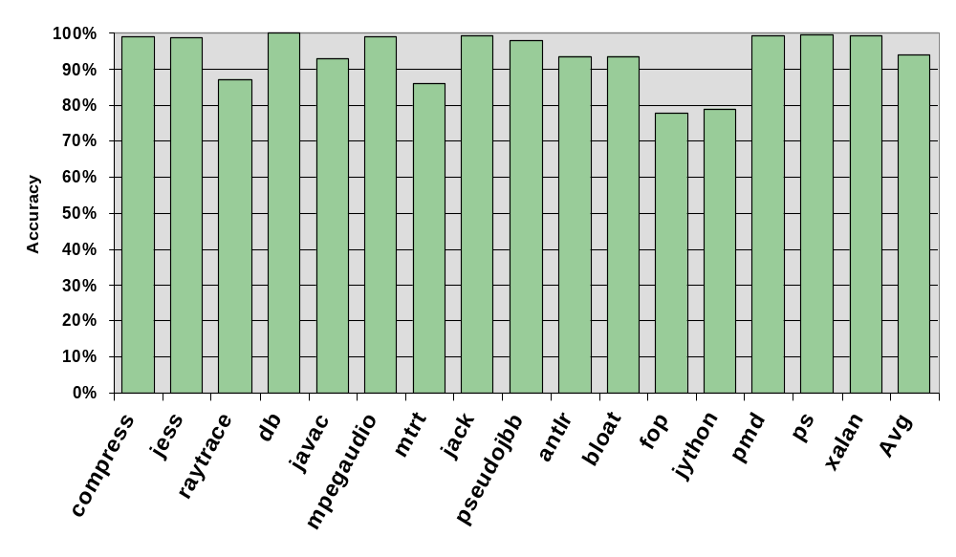
Path accuracy

Slide 47
Edge accuracy
Compare PEP’s edge profile to perfect profile
Relative overlap
  Measures how well PEP predicts edge frequency relative to source basic block
  Jikes RVM uses relative frequencies only

Slide 48
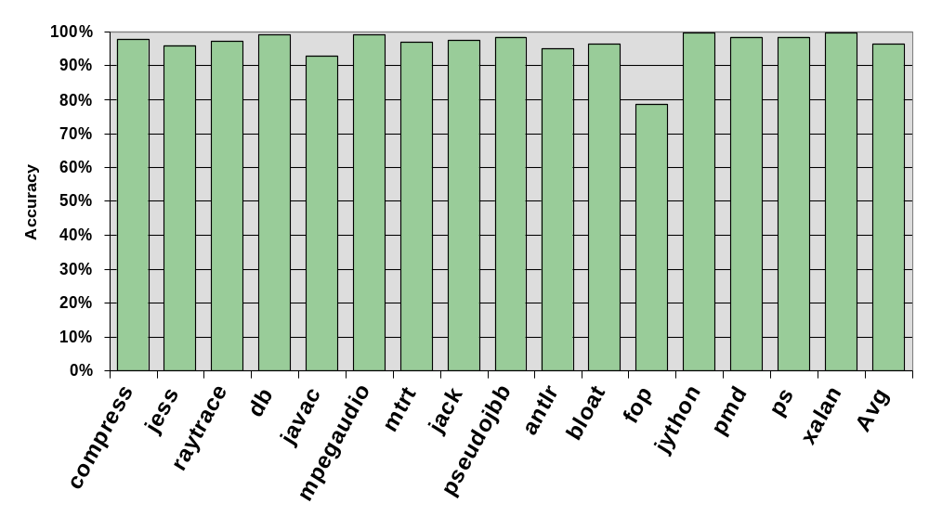
Edge accuracy

Slide 49
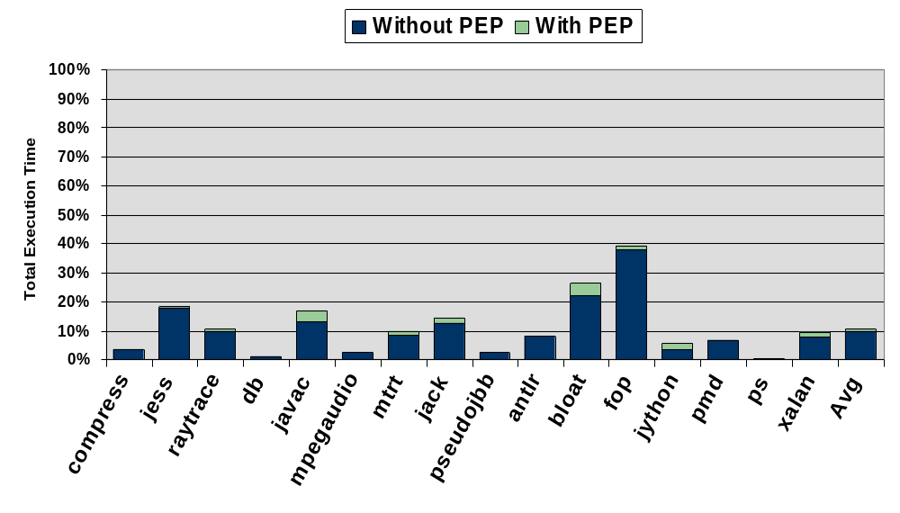
Compilation overhead

Slide 50
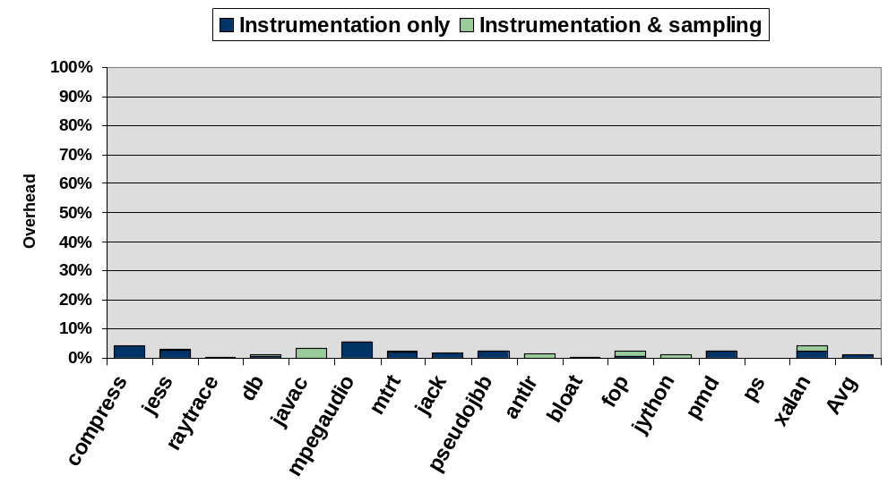
Execution overhead

Slide 51
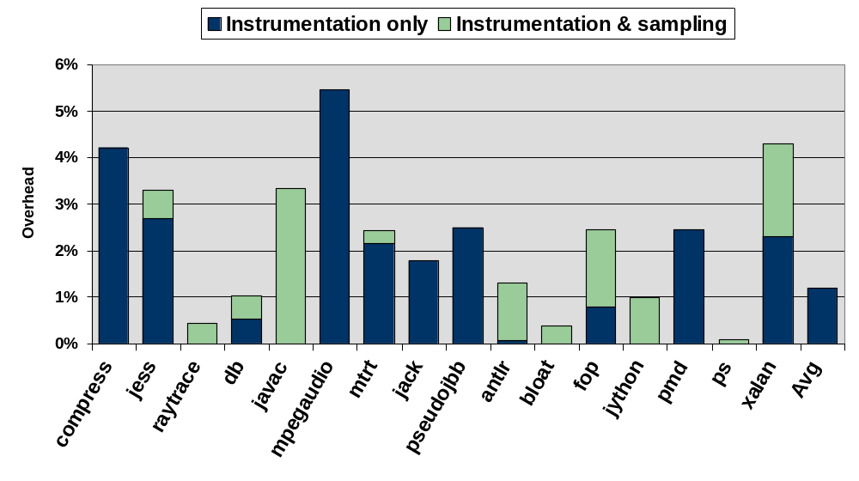
Execution overhead

Slide 52
Related work
Instrumentation [Ball & Larus ’96]
  High overhead
One-time profiling [Jikes RVM baseline compiler]
  Vulnerable to phased behavior
Sampling
  Code sampling [Anderson et al. ’00]
    No path profiling
  Code switching [Arnold & Ryder ’01, dynamic instrumentation]
Hardware [Vaswani et al. ’05, Shye et al. ‘05]

Slide 53
Summary
Continuous & accurate profiling needed for aggressive, speculative dynamic optimization
PEP: continuous, accurate, low overhead, portable, path profiling

Slide 54
Thank you!
Questions?

