Slide 1
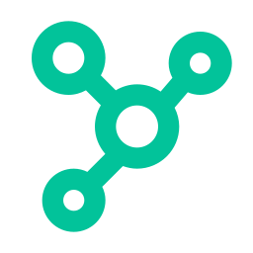
NMRA Prototype
MVP Architecture
Cross-border medicines regulatory data sharing
Powered by Ontology Layer + RAG AI
Next.js
Laravel
Python FastAPI
PostgreSQL
pgvector
Ollama

Slide 2
The Problem We Are Solving
22.6%
122,000
54
of medicines in Africa are substandard or falsified
children under 5 die annually from fake antimalarials
countries assessing the same dossier independently
Root cause: data exists — it is siloed
1
GMP ban in Country A — Country B has no idea, still imports from same manufacturer
2
ADR signal in Kenya too weak to detect alone — Tanzania + Uganda see the same signal, nobody pools it
3
Same dossier reviewed 15× across continent — 24 months per country — supply gap filled by fakes
4
Recalled batch crosses border before alert reaches neighbouring NMRA

Slide 3


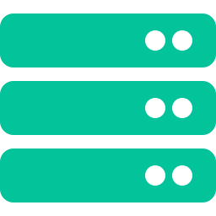

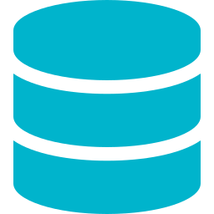

MVP Architecture — Full Picture
NMRA A
Ontology + AI Service
NMRA B
Next.js Frontend
Python FastAPI
Next.js Frontend
Laravel Backend
Ontology Logic
Laravel Backend
publishes →
← publishes
pgvector Search
Postgres DB (A)
Postgres DB (B)
Ollama LLM + Embed
Products · ADRs · Inspections
GMP Results · Import Permits
Shared objects · Cross-org links
Markings · Vector embeddings
Products · ADRs · Inspections
GMP Results · Import Permits

Slide 4
Data Flow — How Information Moves
1
NMRA stores its own data
2
Laravel publishes a projection
Each NMRA writes products, ADRs, inspections into their private Postgres DB via Laravel. No other party has access.
Laravel calls POST /ontology/publish — sending only the allowed fields (excludes cost, internal notes). Python service stores this in the shared Ontology DB.
3
Python embeds and indexes
4
Cross-org link is created
The published object is chunked into text, embedded via Ollama nomic-embed-text, and stored in pgvector. The object is now semantically searchable.
When NMRA A's Product and NMRA B's ADRReport refer to the same real-world product, a LinkType object is created in the Ontology DB connecting them.
5
Analyst queries via AI
6
Grounded answer with citations
Analyst types a question. Laravel calls POST /ai/query with nmra_context=NMRA_A. Python retrieves relevant chunks — enforcing markings — and sends to Ollama LLM.
LLM returns answer citing object IDs (e.g. [Product PRD-001] [ADR-441]). Laravel renders these as clickable links back to source records.

Slide 5
Ontology + AI Service — Internal Detail
FastAPI Endpoints
Ontology Database Schema (Postgres + pgvector)
POST
/ontology/publish
published_objects
NMRA pushes objects into shared space
id · source_nmra · object_type
GET
/ontology/objects/{id}
source_id · properties (JSONB)
marking · created_at
Fetch one object (enforces markings)
object_links
GET
/ontology/linked/{id}
id · from_object_id · to_object_id
Get cross-org linked objects
link_type · created_by_nmra
POST
/ontology/link
created_at
Create a cross-org link type
object_markings
POST
/ai/query
object_id · nmra_id · can_read
can_write · property_exclusions[]
RAG query — returns cited answer
POST
/ai/ingest
embeddings
Embed and index new objects
id · object_id · chunk_text
embedding vector(768)
metadata (JSONB)

Slide 6


GitHub Repo Structure
nmra-prototype/ (monorepo)
docker-compose.yml — one command to run all
├─ nmra-a/
postgres-a
:5432
NMRA A database
│ ├─ frontend/
│ │ └─ pages/index.tsx
│ ├─ backend/
postgres-b
:5433
NMRA B database
│ │ └─ routes/api.php
├─ nmra-b/
postgres-onto
:5434
Ontology + vectors
│ ├─ frontend/
│ ├─ backend/
laravel-a
:8001
NMRA A API
├─ ai-ontology-service/
│ ├─ main.py
│ ├─ ontology.py
laravel-b
:8002
NMRA B API
│ ├─ retrieve.py
│ ├─ generate.py
ai-service
:8000
Python FastAPI
├─ db/
│ ├─ nmra_a_schema.sql
│ ├─ nmra_b_schema.sql
nextjs-a
:3000
NMRA A frontend
│ ├─ ontology_schema.sql
├─ docker-compose.yml
nextjs-b
:3001
NMRA B frontend
├─ README.md
ollama
:11434
Local LLM host

Slide 7
Build Order — What to Do First
Phase 1 — Foundation
Phase 2 — AI Service
Phase 3 — NMRA A Backend
✓
GitHub monorepo created
✓
FastAPI skeleton — /health endpoint
✓
Laravel A — products + ADR routes
✓
docker-compose.yml with 3 Postgres DBs
✓
Embed function using Ollama
✓
POST /ontology/publish integration
✓
Three SQL schemas written
✓
pgvector schema + store function
✓
POST /ai/query integration
✓
Ollama running — llama3.1:8b + nomic-embed-text pulled
✓
Ingest script — loads seed data + embeds
✓
Basic auth with Laravel Sanctum
Phase 4 — NMRA A Frontend
Phase 5 — Mirror + Link
✓
Next.js A — product list view
✓
Repeat Phase 3+4 for NMRA B
✓
ADR report view
✓
Ontology link creation between A and B objects
✓
AI query chat interface
✓
Cross-org query demonstration
✓
Source citations rendered inline
✓
Demo scenario: GMP ban → border alert

Slide 8
The Demo Scenario — What the Prototype Must Show
Scenario: GMP-banned manufacturer still exporting
NMRA A (Kenya) bans manufacturer PharmaCo after GMP inspection failure. NMRA B (Tanzania) is about to approve an import permit from the same manufacturer. Without the shared ontology — they have no way to know.
NMRA A / Kenya
Inspector files GMP failure for PharmaCo Ltd in Laravel A. Status → BANNED.
Laravel A
Automatically publishes updated Manufacturer object to Ontology Service with new gmp_status = banned.
Ontology Service
Re-embeds the updated chunk. Cross-org link to NMRA B's pending import permits is traversed.
NMRA B / Tanzania
Analyst asks: 'Should we approve import permit for PharmaCo Ltd?' AI query fires.
AI Service
Retrieves Manufacturer object + GMP inspection finding from NMRA A's published objects. Surfaces ban to LLM context.
Answer
Analyst receives: 'PharmaCo Ltd was issued a GMP ban by NMRA Kenya on [date] — Inspection ID INS-441. Recommend hold on import permit.' [CITED]

