Slide 1
Student Name: Breno Silva Brito Student ID: 2023462

Slide 2
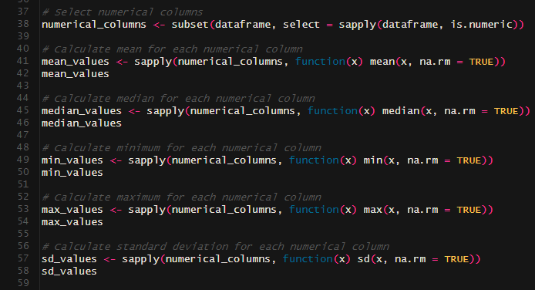
Statistical Parameters
With the following code I was able to provide some of the statistical paraments for the project, such as the mean, median, minimum, maximum, and the standard deviation for each numerical variable in the dataset.

Slide 3
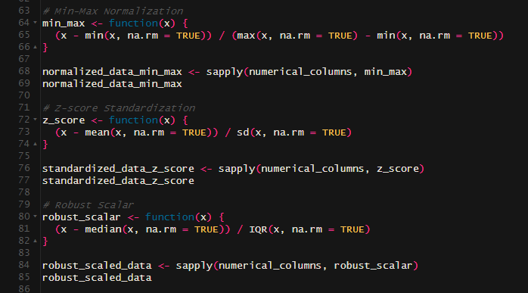
Min-Max Normalization, Z-score Standardization and Robust scalar
With the following code I was able to provide tables for the Min-Max Normalization, Z-score Standardization and Robust scalar, which would help for some data analysis calculation eventually.

Slide 4
Line, Scatter and Heatmaps plots
I have created three different plot (Line, Scatter, and Heatmap), however those three plot have the same purpose, which is to create a visualisation to a specific type of crime ("Attempts/threats to murder, assaults, harassments and related offences"), in a specific Garda station in Ireland located in Limerick over the years (2003 – 2022).

Slide 5
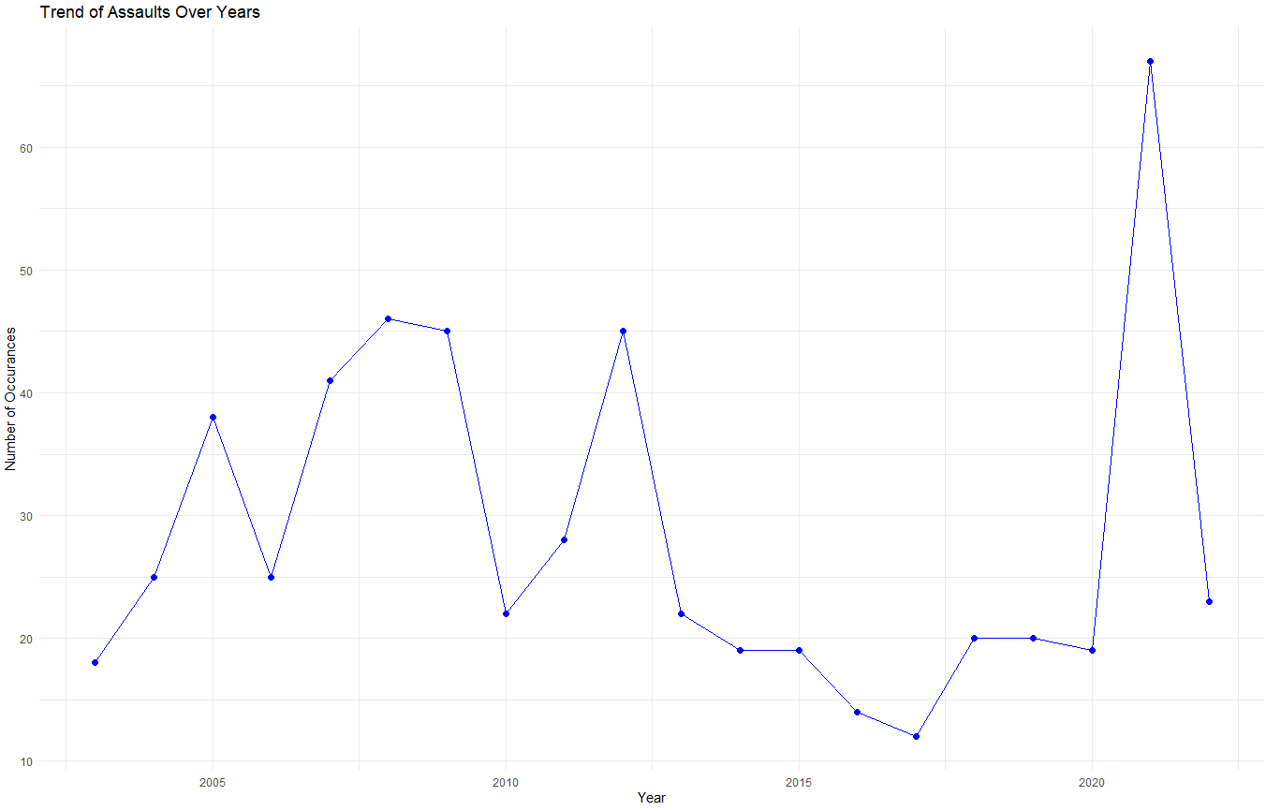
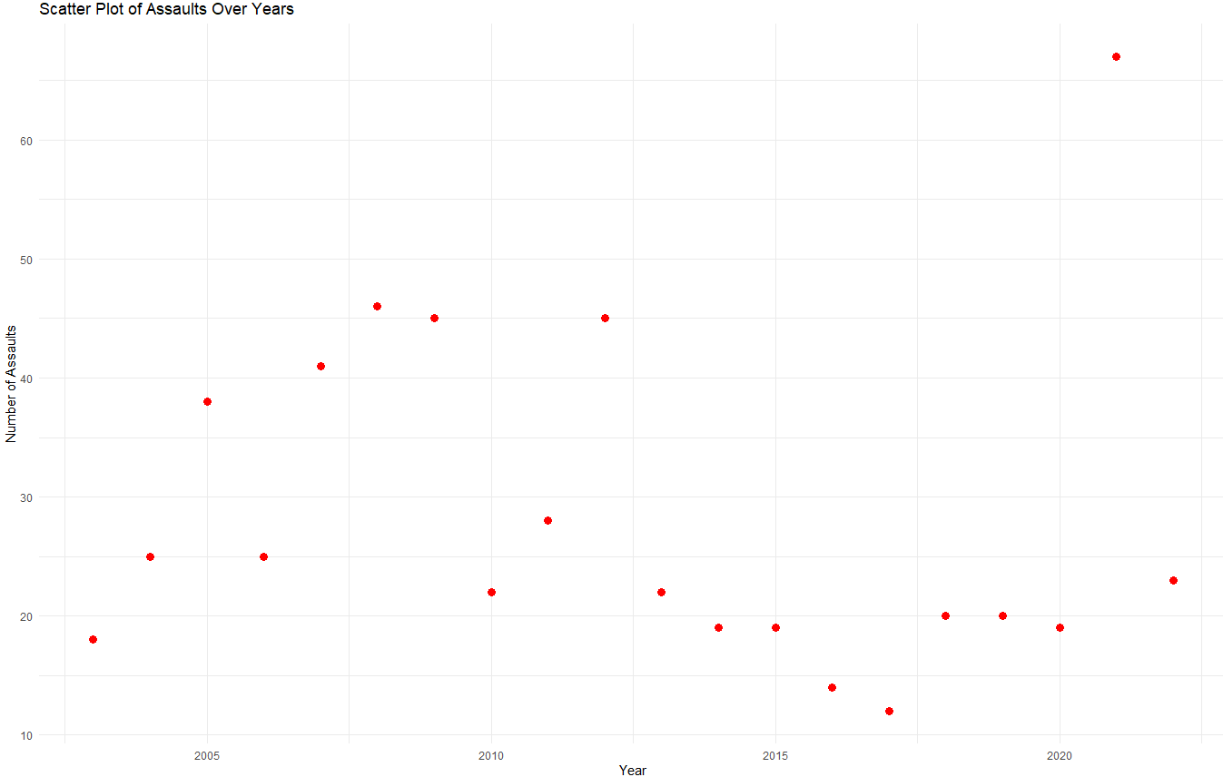
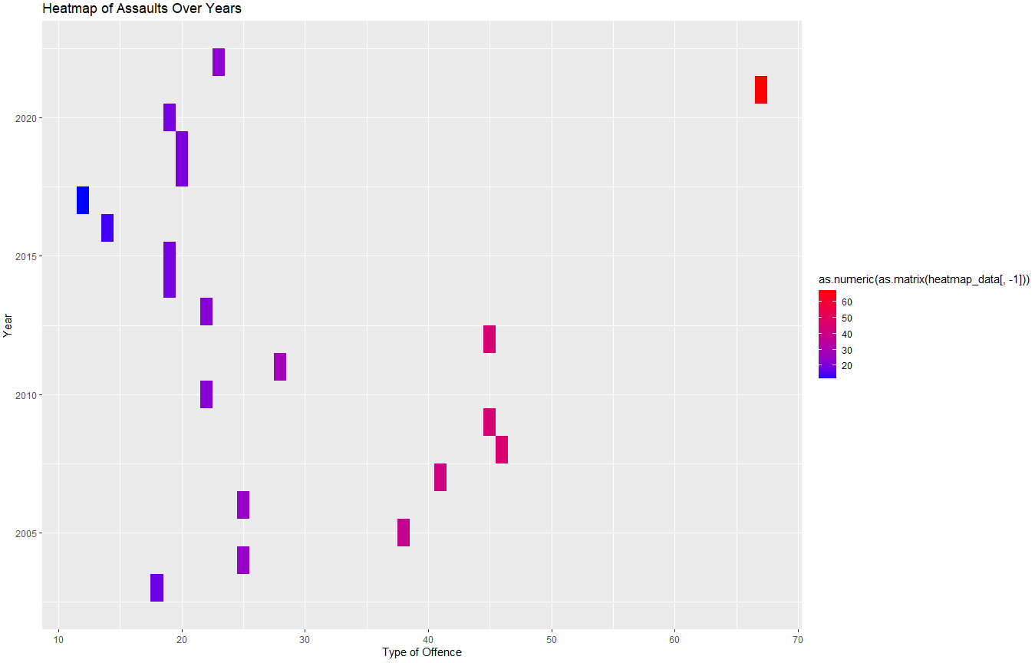
Line, Scatter and Heatmaps plots

