Slide 1
LCLS BPM
DIGITAL INTERFACE
Jeff Olsen
Nov 13, 2006

Slide 2
REQUIREMENTS
Control settings of Attenuators
Control Calibration Cycle
Control Trip Reset
Provide interface to PAD
Provide diagnostic interface

Slide 3
REGISTER MAP
Register | Function
0x00 | CSR | Control and Status Register
0x01 | CAL | Calibration Attenuation Register
0x02 | ATT1 | Attenuation Register
0x03 | ATT2 | Attenuation Register
0x04 | LMT | Limit Trip Register
0x05 | VER | Version Register
0x06 | TRG | Self Trigger Register
0x3E | BOOT | Boot control | *Future feature
0x3F | JTAG | JTAG Reprogram control | *Future feature

Slide 4
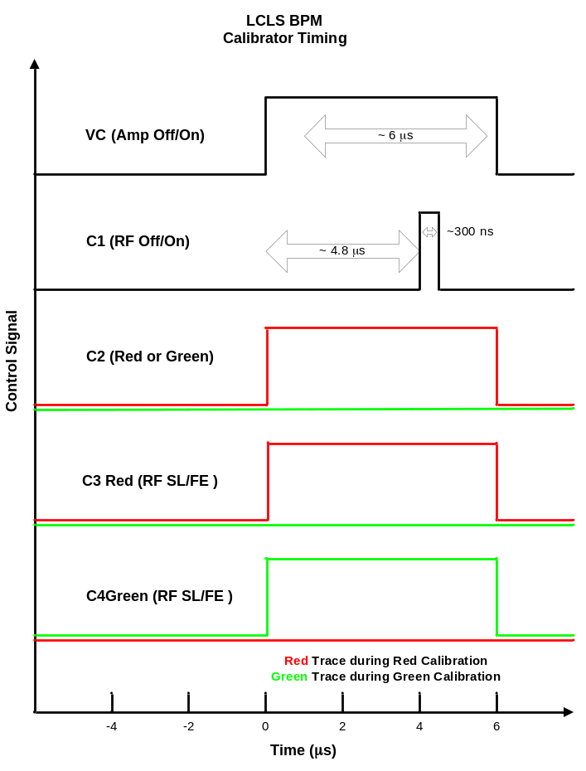
CALIBRATION TIMING

Slide 5
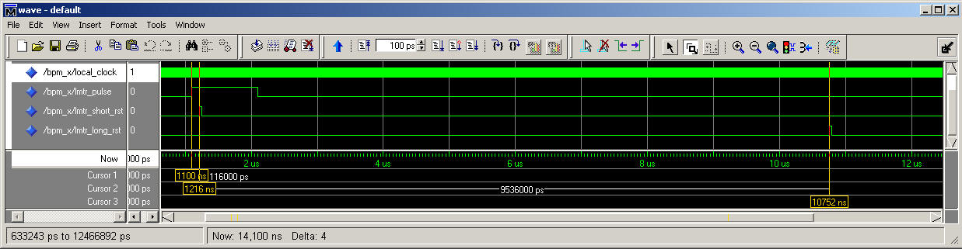
LIMIT TRIP RESET
Limit to Short Reset ~100ns
Limit to Long Reset ~10us

Slide 6
PAD INTERFACE
8 Bit QSPI Interface Write Sequence
/cs
clk
1
0
5…0
7…0
din
8 bit command
8 bit data
Write Sequence

Slide 7
PAD INTERFACE
8 Bit QSPI Interface Read Sequence
/cs
clk
1
1
5…0
din
8 bit command
7…0
dout
8 bit data
Read Sequence

Slide 8
PAD INTERFACE
Command Format
Bit | Function
[7] | Start Bit | ‘1’
[6] | R/W | ‘1’ => Read Register ‘0’ => Write Register
[5..0] | Register | Select Register to read or write
Data Format
Bit | Function
[7..0] | Data

Slide 9
Diagnostic Interface
RS232
  HEX ASCII Mode
  Binary Mode

Slide 10
HEX ASCII
Standard Terminal Interface
  TeraTerm
  115200 BAUD
  Even Parity
  8 Bytes to transfer data
Format 0XAADD <CRLF>
  AA is the 6 bit Address in hex from 0 to 3F
  Bit 6 indicates a write or a read
  DD is the 7 bit Data in hex from 00 to FF

Slide 11
BINARY RS232 MODE
Computer interface
Format AD
A
7 | 6 | 5..0
1 | 0 => Write 1 => Read | Register Address
D
7 | 6..0
0 | Data

Slide 12
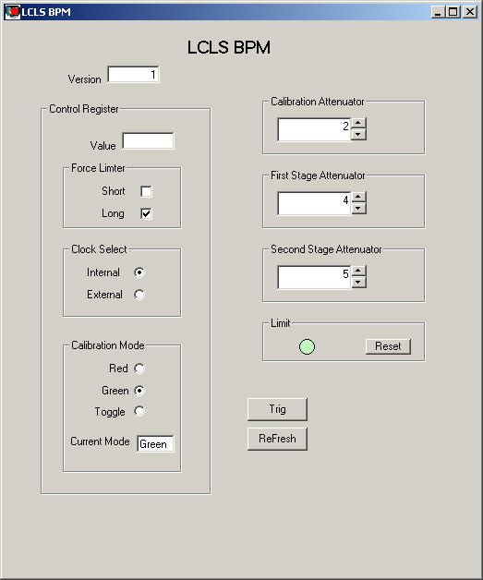
Diagnostic GUI
RS232 in either Hex ASCII or Binary Mode

