Slide 1

Data Science Salaries
Project 3

Slide 2
The Team
Name | Email Address
Ariel Jones | anicolejones2@gmail.com
Joe Liang | zyl6842@gmail.com
Kristina Mulholland | mulhollandkristina@gmail.com
Jeff Pinegar | jeffpinegar1@gmail.com

Slide 3

The Data Set
Data Science Job Salaries 2020-2022
Data Set Variables:
Salary
Job Title
Company Size
Company Location
Experience Level
Employment Type
Remote work
Year
Source: https://www.kaggle.com/datasets/saurabhshahane/data-science-jobs-salaries

Slide 4
(ETL) Data Preparation Tools
Excel
xlookup to translate 8 columns of abbreviations to plain text and added 3-char country code
Calculation of overview statistics and figures testing the data set.
Export CSV data set
Python
Clean data and load the Postgres database
Export data set as an HTML table to be added to the HTML data tab
Merge country geoJSON with Data Science salary data and export new geoJSON
Postgres – load data set

Slide 5
Structure and Visuals
https://jeffpinegar.github.io/Index.html
Bootstrap
D3
Plotly js
Leaflet
Chroma.js
Postgres
Darkmode.js (https://darkmodejs.learn.uno/)
JavaScript plugin/library, which adds a button to the bottom right of the screen to toggle between normal and dark mode.

Slide 6
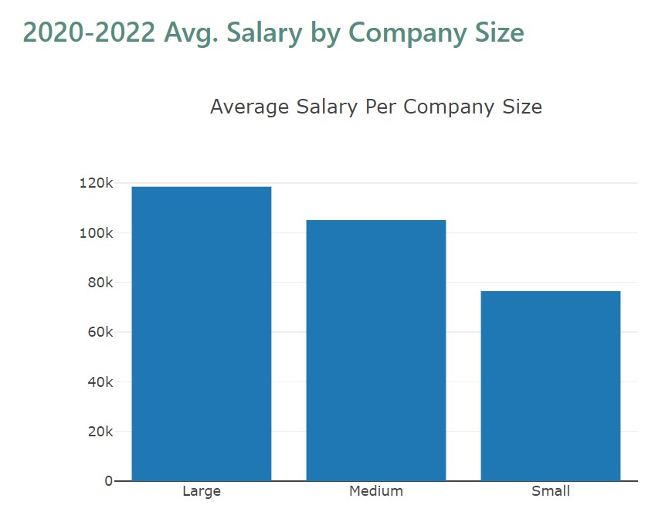
Average Salaries by Company Size
https://jeffpinegar.github.io/Ariel.html
Questions explored:
How do average data science salaries vary by the size of the company?
How do average data science salaries vary by each year and company size?
Large companies have more than 250 employees, Medium companies have 50-250, and Small companies have less than 50 employees.
Higher salaries are reported at larger companies, and within the larger companies, the average salaries steadily grew each year.
Small companies had salaries that remained relatively consistent

Slide 7
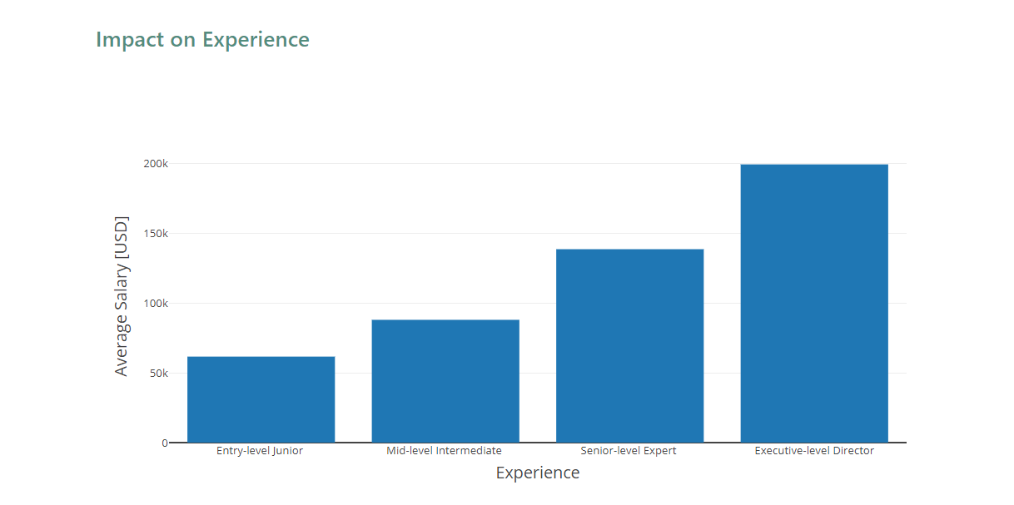
Average Salaries by Experience
https://jeffpinegar.github.io/Joe_Experience_Impact.html
Questions explored:
How does salary vary by experience level in the Data Science/Data Analytics field?
According to the data, salary increases with more experience in the field of Data Science/Data Analytics.
Salary for entry-level is around $61k.
Salary for mid-level is around $88k.
Salary for senior-level is around $139k.
Salary for executive-level is around $200k.

Slide 8
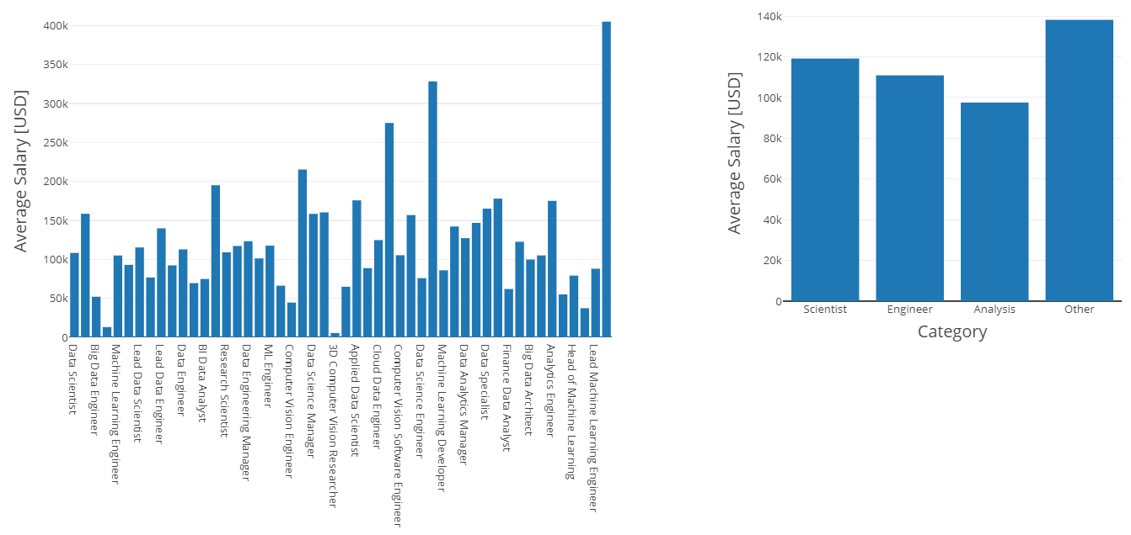
Average Salaries by Job Titles
https://jeffpinegar.github.io/Joe_Position_Impact.html
Questions explored:
How does salary vary by job titles in the Data Science/Data Analytics field?
How does salary vary by job category in the Data Science/Data Analytics field?
First graph shows the average salary for different positions in the Data Science/Data Analytics field.
Second graph shows the average salary for different each job category. Category “Other” includes job titles Data Architect, ETL Developer, Machine Learning Developer, Head of Data, etc.

Slide 9
Average Salaries by Location
https://jeffpinegar.github.io/Kristina_Location.html
Questions explored:
How do average data science salaries vary by country?
Which countries have the highest data science salaries?
Which countries have the lowest data science salaries?
Creating the Choropleth:
JavaScript
Create path to the geoJSON
Create map object: L.map
Add tile layer: openstreetmaps
Read in the geoJSON and console.log to check
Create Choropleth layer: L.choropleth
valueProperty: Avg Salary
chroma.js
quantile data distrubution
HTML
Leaflet js: correct version for import of L.choropleth function
Bootstrap containers
Legend insert to match chroma colors
CSS
styling to align basemap with choropleth:
.leaflet-tile{
margin-top: auto;
}

Slide 10
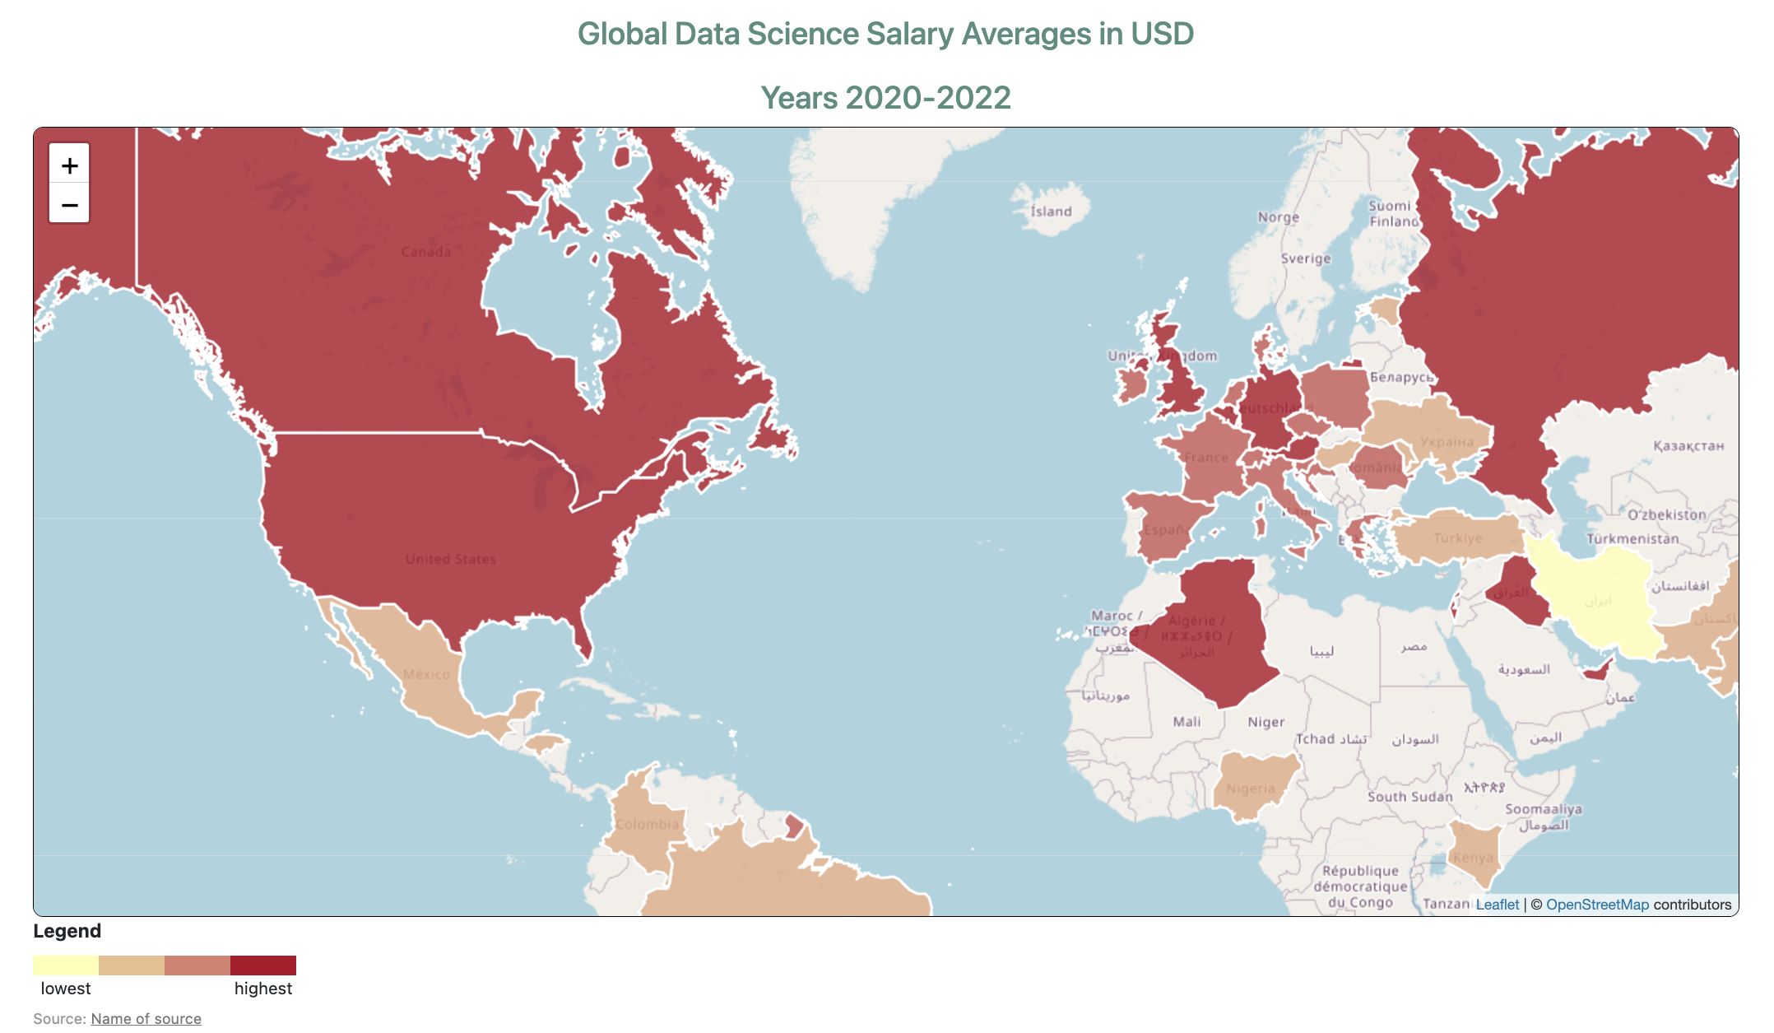
Average Salaries by Location
https://jeffpinegar.github.io/Kristina_Location.html
The Story
607 reported salaries, 50 different countries
Years 2020-2022 collectively averaged
Country with the highest amount of collected data: US (840)
Country with the least amount of collected data: Afghanistan (4)
Year with the highest amount of reported data: 2022
Highest reported salary: $157, 500 (Russia)
Lowest reported salaries: $4000 (Vietnam & Iran)
Countries that pay the most: Russia, the US, New Zealand, Israel, Japan
Countries that pay the least: Ukraine, Pakistan, Kenya, Vietnam, Iran
The best places to work as a data scientist if the salary were the only factor are Russia, the United States, New Zealand, Israel, and Japan.

Slide 11
Machine learning
https://jeffpinegar.github.io/Jeff_Machine_Learning.html
Questions explored:
How does salary vary by experience level?
How has the level of employment changed with time?
How do salaries vary by job title
The questions were examined for the whole data set and for USA alone

Slide 12
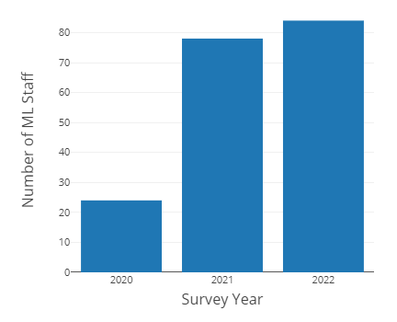
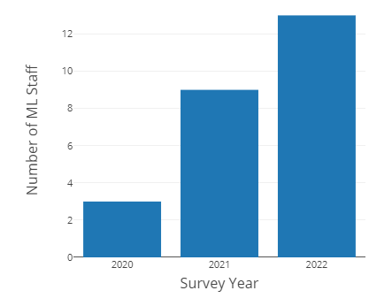
Machine learning
https://jeffpinegar.github.io/Jeff_Machine_Learning.html
How has the level of employment changed with time?
Full Data Set
United States

Slide 13
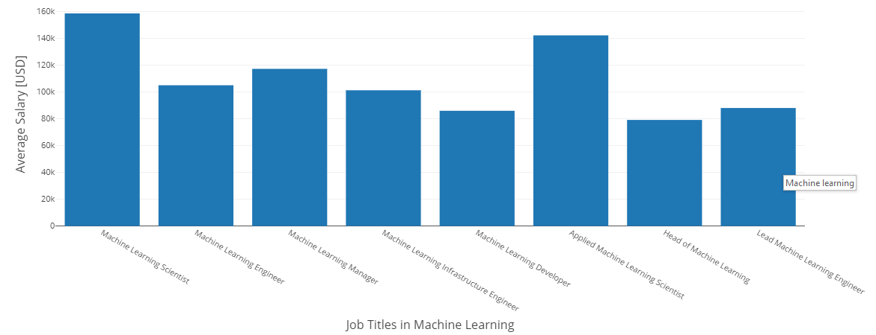
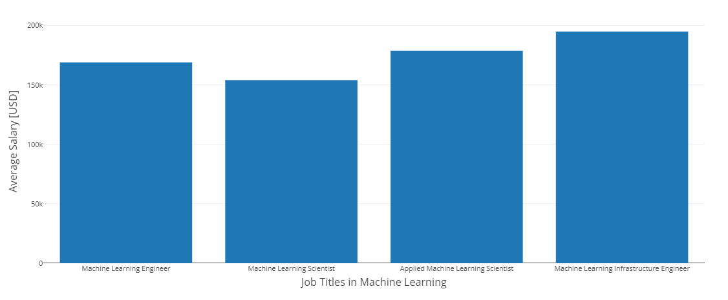
Machine learning
https://jeffpinegar.github.io/Jeff_Machine_Learning.html
How do salaries vary by job title?
Full Data Set
United States

Slide 14
Summary
Employment in Data Science is increasing
The highest paying jobs are at large companies (> 250 Emp.)
Average Salaries are increasing significantly with experience
People described as Scientists and Engineers are the highest-paid individual contributors.
Russia, the United States, New Zealand, Israel, or Japan are the highest paid§
Machine learning in the USA appear more concentrated in ML development compared to the rest of the world, which has more employment in ML application.
§ Observations USA 355; Russia 2; Japan 6, New Zealand 1

Slide 15


