Slide 1

Final Project Image Colorization using Convolutional Neural Networks
Downing, Jeffery
CSCI E-89 Deep Learning, Fall 2025
Harvard University Extension School
Prof. Zoran B. Djordjević & prof. Rahul Joglekar

Slide 2
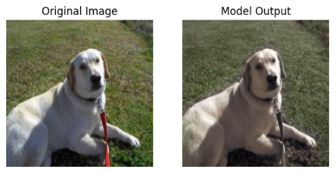
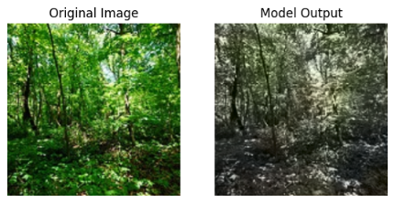
Introduction
This project explores how convolutional neural networks can be used to add color to black-and-white images.
Applications include restoring historical photos, making them more engaging.
Color can be added to photos taken in low light environments like security footage.
Colorization is a challenging problem, requiring contextual and domain knowledge to accurately color images.
This project focused on colorizing two types of images: dogs and landscapes.
Research Question: How does model architecture and dataset bias impact the performance and generalization of CNN-based image colorization.

Slide 3
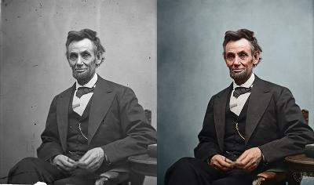
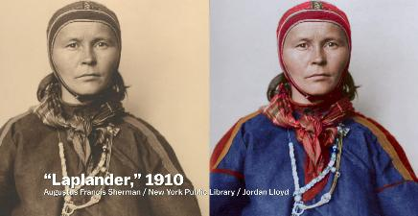
History and Challenges
Image colorization dates back to photography itself in the 1800s.
Artists would manually paint color onto images, or use a process like photochrom.
Nowadays, colorization is done through software.
However, ensuring color accuracy is still a challenge.
Requires contextual knowledge and research
Knowledge of a tribe’s colors is needed to accurately colorize their clothing.

Slide 4
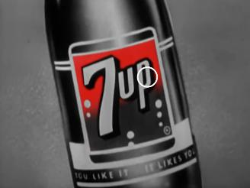
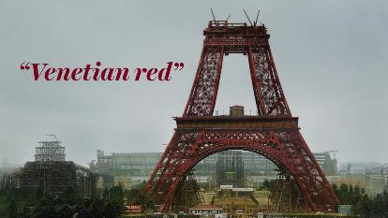
History and Challenges
However, ensuring color accuracy is still a challenge.
7up’s logo used to be red. An artist today may accidentally color it green.
The Eiffel tower was painted red before completion.
Our CNN models will struggle in these areas as they cannot research or use external knowledge to guide their decisions.
CNNs will base its predictions exclusively on its training data, which can add modern-day biases into the model.

Slide 5
Running Demo Code
Create a folder called ‘data’ in the same directory as the notebook files.
Download the dog_vs_cats.zip file from Canvas.
https://canvas.harvard.edu/courses/164142/pages/week-5-2?module_item_id=1976712
In the dogs_vs_cats.zip file, extract train.zip
In the train.zip file, extract the train folder and put it in the ‘data’ folder.
Download the landscapes dataset from Kaggle.
https://www.kaggle.com/datasets/theblackmamba31/landscape-image-colorization/data
Extract the ‘landscape Images’ folder and put it in the ‘data’ folder.
Run all the cells in the Image_Colorization_Data_Setup.ipynb.
This will create two new folders (‘dog_images’ and ‘landscape_images’) in the main directory. These contain the training and validation subsets.

Slide 6
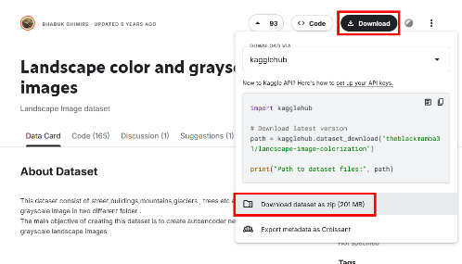
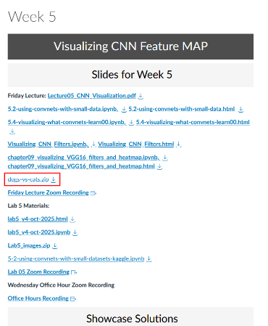
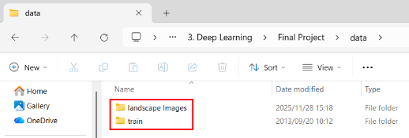
Datasets and Data Preparation

Slide 7
Model 1: RGB model for Dogs
Grayscale Input
I trained my first model using images of dogs.
1000 training images and 500 for validation.
A grayscale image was used for the input and the RGB color channels were used as the output.
An overcomplete autoencoder was used.
Each layer used 3x3 convolutions with a large amount of nodes in the bottleneck.
32 Conv2D
MaxPooling at each encoder layer to reduce image size
64 Conv2D nodes
128 Conv2D nodes
256 Conv2D nodes
128 Conv2D nodes
64 Conv2D nodes
UpSampling at each decoder layer to increase image size
32 Conv2D
Red
Blue
Green

Slide 8
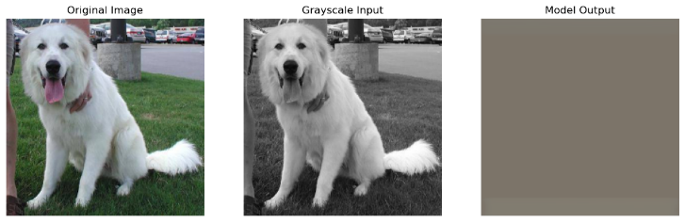
Model 1: RGB model for Dogs
Unfortunately, the model did not work.
The model failed to reconstruct the image and only produced a brown box.
I reconsidered my approach

Slide 9
Model 2: LAB model for Dogs
Grayscale Input
For my second model, I utilized the LAB color format.
Light channel (L): The grayscale image
Two color channels (AB): The red-green and blue-yellow axes
This way the model can focus on colors and does not need to completely reconstruct the image
32 Conv2D
MaxPooling at each encoder layer to reduce image size
64 Conv2D nodes
128 Conv2D nodes
256 Conv2D nodes
128 Conv2D nodes
64 Conv2D nodes
UpSampling at each decoder layer to increase image size
32 Conv2D
A Channel
B Channel

Slide 10
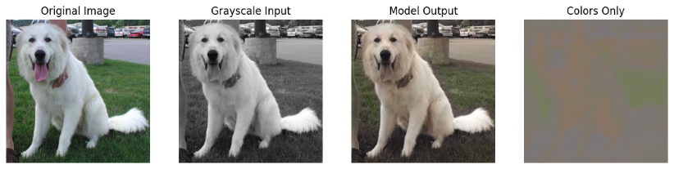
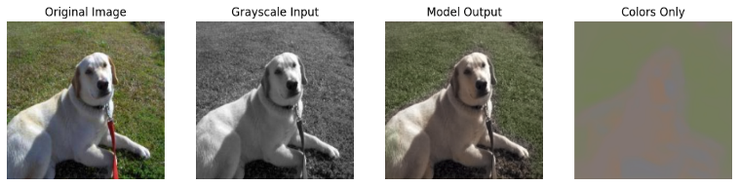
Model 2: LAB model for Dogs
This model performed much better and produced decent results.
A reasonable color was used for the dog
The backgrounds were colored green regardless of what was there.
The model was unable to color other scenes and appears to be heavily influenced by its training data.

Slide 11
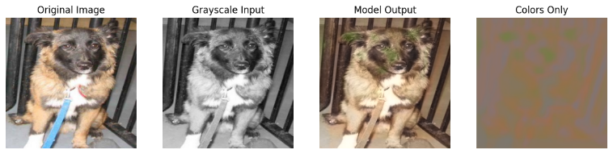
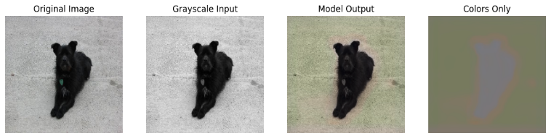
Model 2: LAB model for Dogs
Sometimes the model would apply patches of green to the dog itself
In one image, the model painted the white concrete green

Slide 12
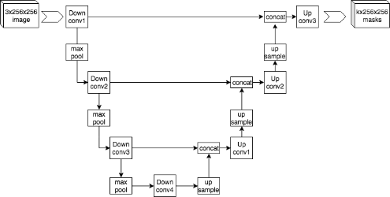
Model 3: Complex LAB model
For my third model, I incorporated the skip connections used in the U-Net architecture.
Each layer had two Conv layers with BatchNormalization
The outputs of each encoder block are concatenated with the corresponding decoder block.
This allows the model to reuse any information that may have been lost in the encoder.
U-Net architecture [4]

Slide 13
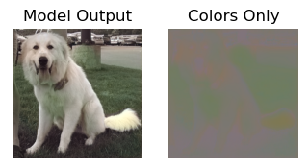
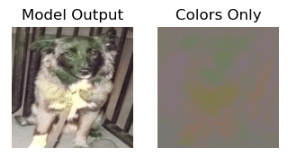
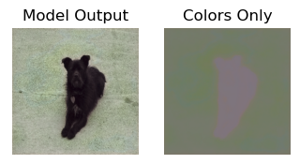
Model 3: Complex LAB model
Despite these changes, the model performed worse than Model 2.
Given this, I chose to abandon this architecture and continue with the simpler autoencoder.

Slide 14
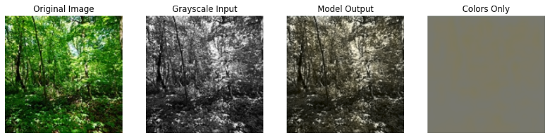
Model 4: LAB model for Landscapes
It was clear that models relied heavily on their training set to make predictions
This time, I used a variety of different landscapes including:
Beaches. Oceans. Forests, and Urbain buildings.
The goal was to see if the model’s architecture could learn the colors of each environment.
Unfortunately, the model struggled to learn each environment’s colors and defaulted to blue and yellow tones.

Slide 15
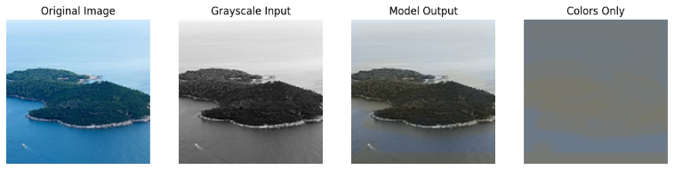
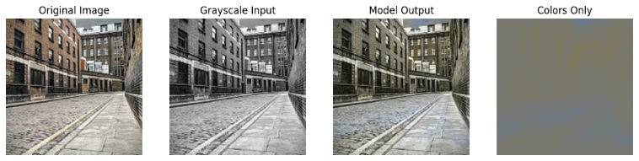
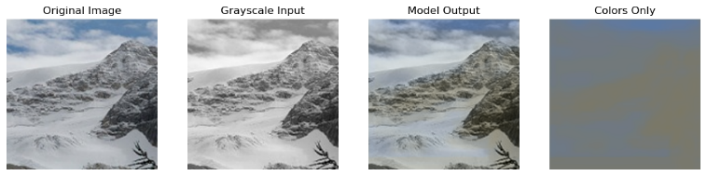
Model 4: LAB model for Landscapes

Slide 16
Model 5: VGG16 model for Landscapes
For my final model, I implemented a transfer learning model
VGG16 was used as the encoder
The grayscale image was copied to all three color channels to use as input for VGG16
The “block5_conv3” layer was extracted.
The same decoder as the previous models was used.
The VGG16 layers were frozen. Only the decoder was trained.
Grayscale Input
Grayscale Copy
Grayscale Copy
Grayscale Copy
VGG16
block5_conv3
256 Conv2D nodes
128 Conv2D nodes
64 Conv2D nodes
UpSampling at each decoder layer to increase image size
32 Conv2D
A Channel
B Channel

Slide 17
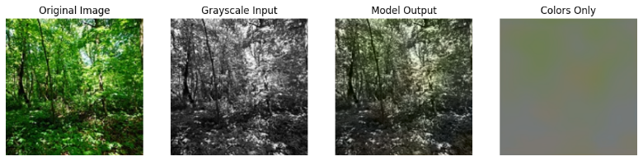
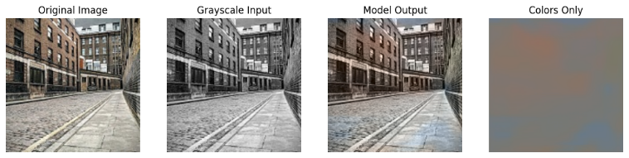
Model 5: VGG16 model for Landscapes
While not perfect, the results improved significantly.
The model was now able to use colors other than blue and yellow
The model could color forests with green for leaves, and brown for dirt
The model colored the brick building red.

Slide 18
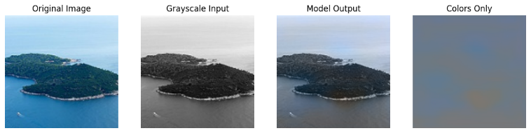
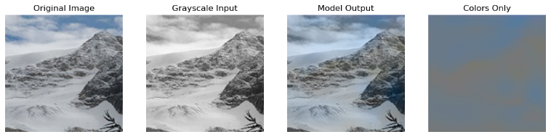
Model 5: VGG16 model for Landscapes
The model still had some difficulties with coloring in the ocean, and snow.
It was able to identify blue as an important color
Transfer learning allowed the model to identify more features and learn diverse color patterns

Slide 19
Conclusion and Future Work
Summary
Overcomplete autoencoders worked well with identifying color patterns, but increasing model complexity did not improve performance.
Utilizing LAB color channels helped the model focus on predicting color rather than reconstructing full RGB images.
Models are highly dependent on the training set, making generalization outside the training domain unreliable.
Transfer learning improved performance of models trained with different types of images in its training set.
Future work
Expand the size and diversity of the training set.
Tune the pretrained VGG16 layers instead of freezing them.
Incorporate a form of human guidance to guide the model.
Allowing the user to specify objects and their colors.

Slide 20
YouTube URLs
2 minute (short): https://youtu.be/FuStEo3ykBc
15 minutes (long): https://youtu.be/4kajcQwvSkM
Sources
[1] Vox. How obsessive artists colorize old photos https://youtu.be/vubuBrcAwtY
[2] NumberAnalytics. The Ultimate LAB Color Guide https://www.numberanalytics.com/blog/ultimate-lab-color-guide
[3] medium.com. The U-Net: A Complete Guide https://medium.com/@alejandro.itoaramendia/decoding-the-u-net-a-complete-guide-810b1c6d56d8
[4] Wikipedia: U-Net. https://en.wikipedia.org/wiki/U-Net
Dog_vs_cats dataset: https://canvas.harvard.edu/courses/164142/pages/week-5-2?module_item_id=1976712
Landscape dataset: https://www.kaggle.com/datasets/theblackmamba31/landscape-image-colorization/data

