Slide 1
Simulating the Evolution of Two Competing Populations
CMSE Semester Project
Section 2
Jeff Valentic

Slide 2
Project Objective
Create a complex model of an ecosystem that contains 2 species competing for limited resources (water)
how will each population evolve to better suit their environment?
What are the optimal traits for each of the different species to thrive in this environment.
Are the results able to be replicated?

Slide 3
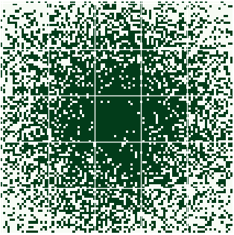
The Process
This simulation begins by creating a population of 2 species.
50 Zebras
50 Lions
Next a map is created.
This map is a 100 x 100 grid
”Water” is placed in various locations on the map, weighted to appear most often at the center, and least often at the edges.
Every day the lions and zebras leave their homes and travel around the map looking for water until they either find some, or run out of energy
Below is a GIF of the map over 50 days

Slide 4
Rules for Survival
Zebras and Lions have different strategies for survival.
Zebras
Will share water locations with other zebras if they both find the same location
Lions
Lions are greedy, if they encounter another lion, they will fight over who gets the water location and end up splitting it.
Because they wasted so much energy fighting, they have a lower chance to survive this round.
Zebra vs Lion
If a zebra and a lion land on the same water location, the lion will come out victorious and have a good chance of surviving, and maybe even creating an offspring.
The zebra will always die if it tries to come between a lion and his watering hole.

Slide 5
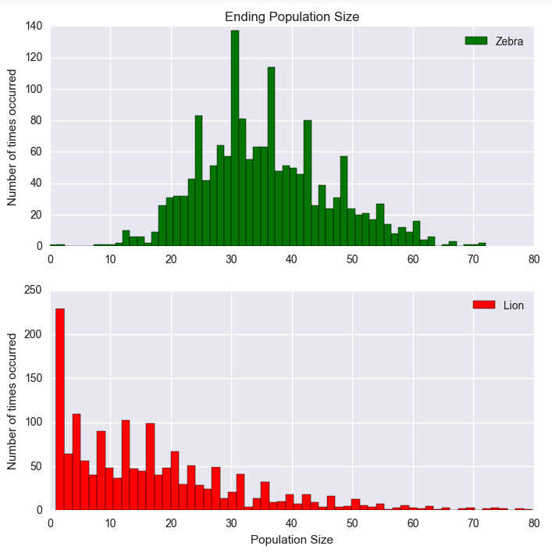
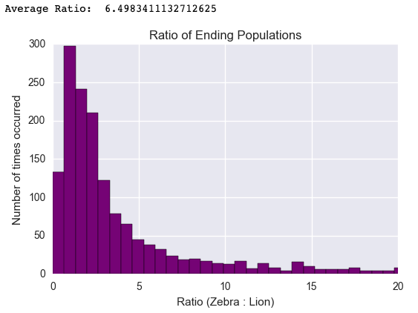
Results - Population
Avg Zebra Population: 35
Avg Lion Population: 15

Slide 6
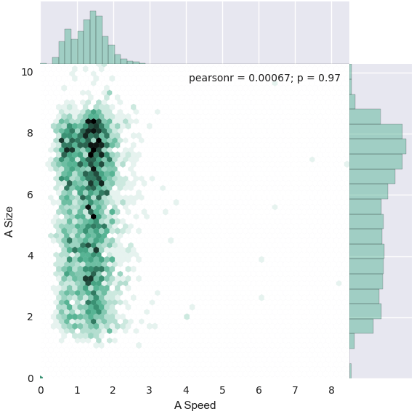
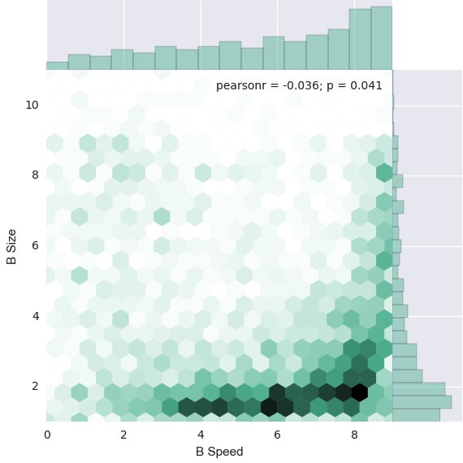
Results - Traits
Avg Zebra Speed: 1.39
Avg Zebra Size: 5.58
Avg Lion Speed: 3.74
Avg Lion Size: 2.18
Traits:
Speed – Correlates to possible travel distance
Size – Correlates to amount of total energy
Notes:
More food eaten = more chance of reproduction

Slide 7
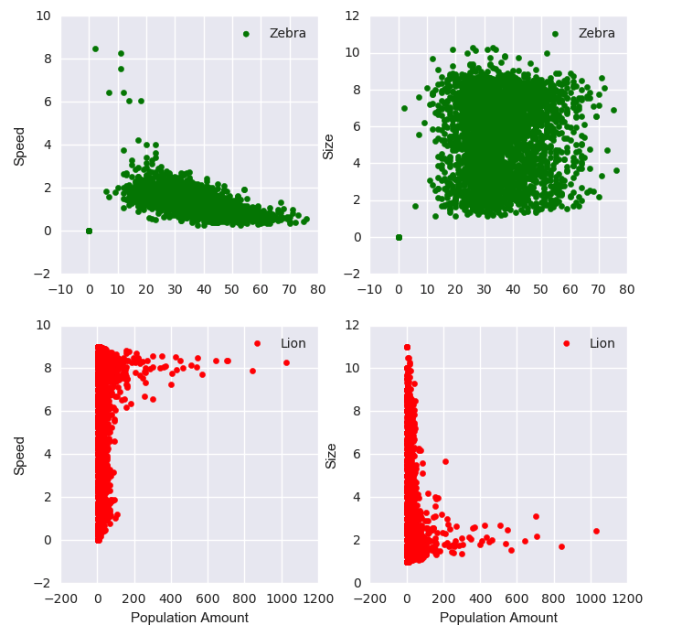
Conclusion
Zebras
Low Speed
Generally larger size
Lions
High Speed
Low Size
Out of 5000 generations, 65% were able to survive this environment

Slide 8
Notable facts
All traits are initialized at a random value between 1 and 10
One generation = 50 days
Total amount of generations collected: 25,000 generations
Times my laptop could not handle the amount of data: 4
Lines of code: 828
Functions: 15
Classes: 2
Lions actually live in prides with an average of 15 lions! How neat!

Slide 9
Resources
https://matplotlib.org/3.2.1/contents.html
https://seaborn.pydata.org/
https://pandas.pydata.org/docs/
https://giphy.com/

