Slide 1
110-1 QMDM
Video 1
電子所ICS組
吳諺倫
R08943016

Slide 2
Outline
dplyr::percent_rank
dplyr::ntile
dplyr::cume_dist
dplyr::if_else
dplyr::case_when
Practice

Slide 3

Resources
All the resources are on Github
https://github.com/b04901043/110-1_Quantitative_Methods_For_Decision_Making/tree/main/Video1
https://reurl.cc/vgx96A
Files
Video1.R
The script for this tutorial
Video.pptx
The content of this tutorial
Readme.md
Notes for Video 1
MRT_data_2021.csv
Taipei Metro 2021 data for practice
Open source from: https://www.metro.taipei/cp.aspx?n=FF31501BEBDD0136

Slide 4
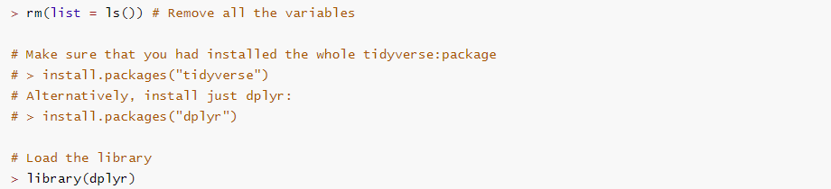
Prepare

Slide 5
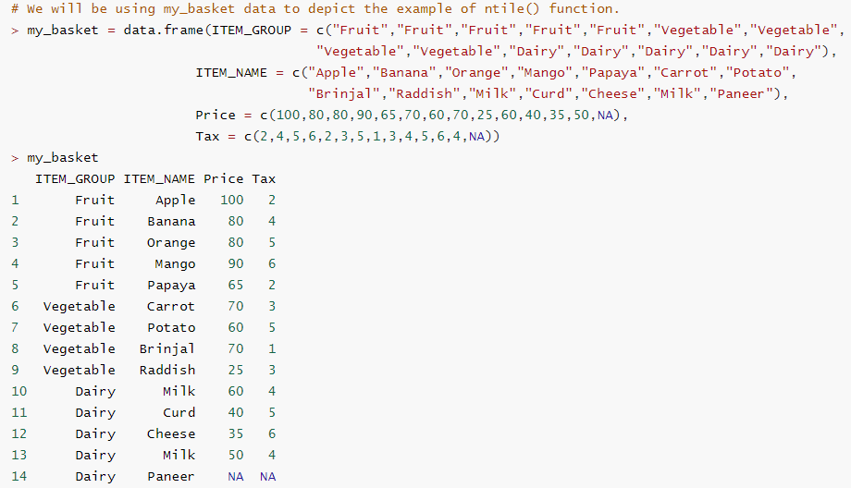
Data for example

Slide 6
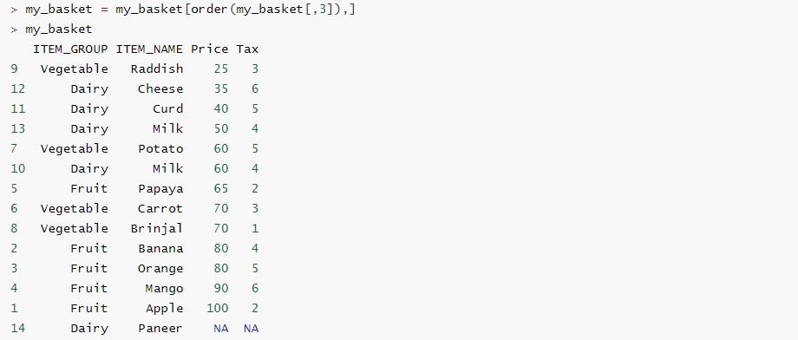
Re-order the data

Slide 7
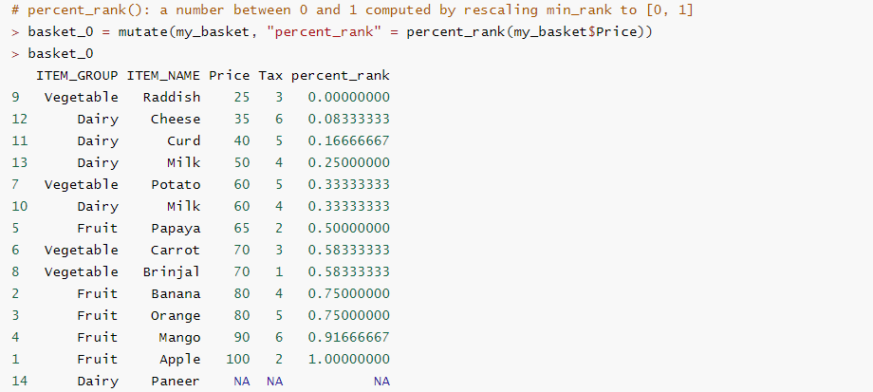
No.1 dplyr::percent_rank
percent_rank(x)

Slide 8
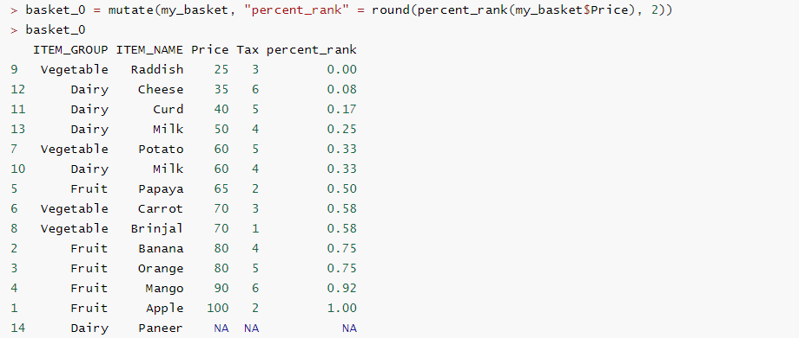
No.1 dplyr::percent_rank
percent_rank(x)

Slide 9
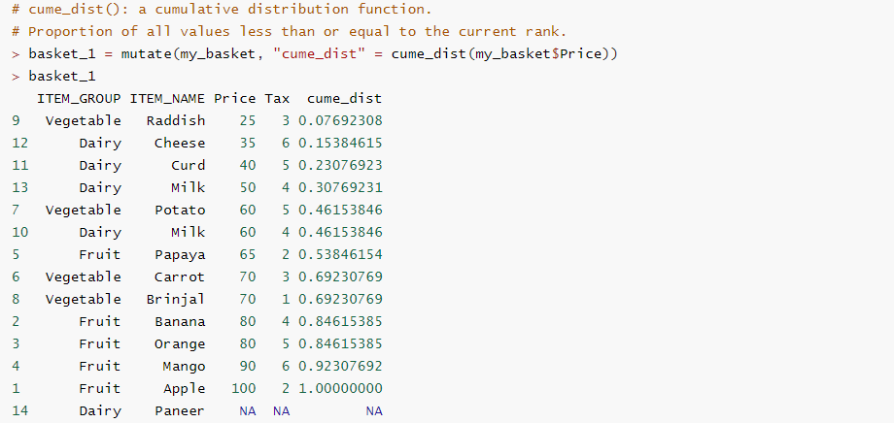
No.2 dplyr::cume_dist
cume_dist(x)

Slide 10
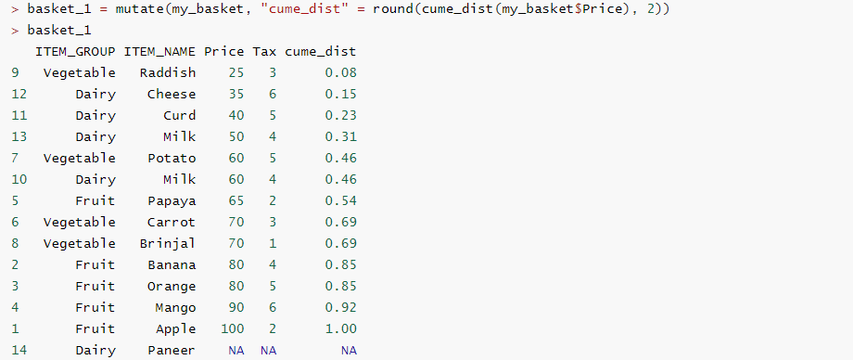
No.2 dplyr::cume_dist
cume_dist(x)

Slide 11
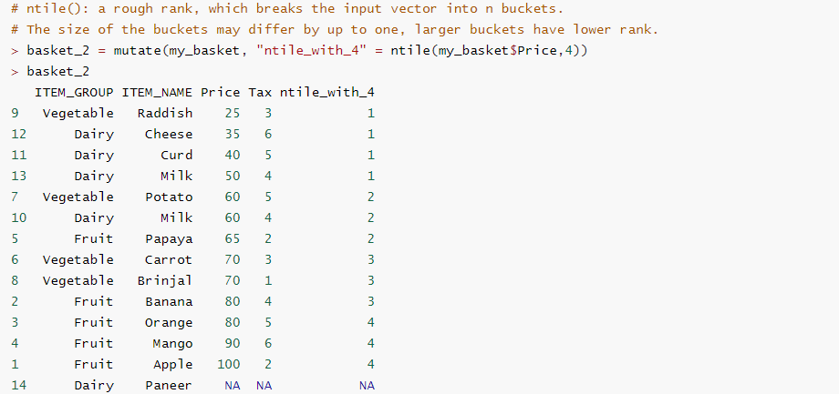
No.3 dplyr::ntile
ntile(x = row_number(), n)

Slide 12
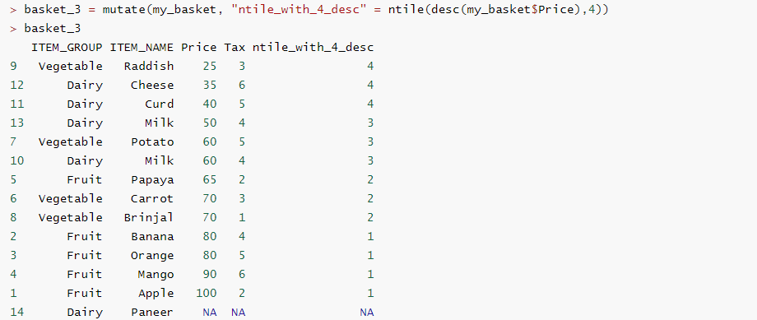
No.3 dplyr::ntile
ntile(x = row_number(), n)

Slide 13
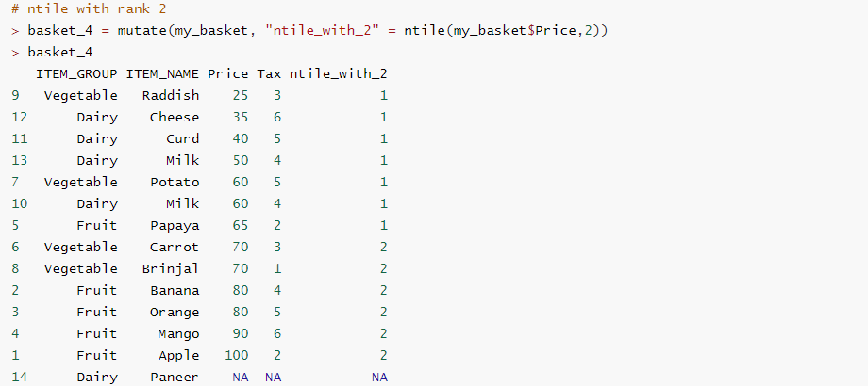
No.3 dplyr::ntile
ntile(x = row_number(), n)

Slide 14
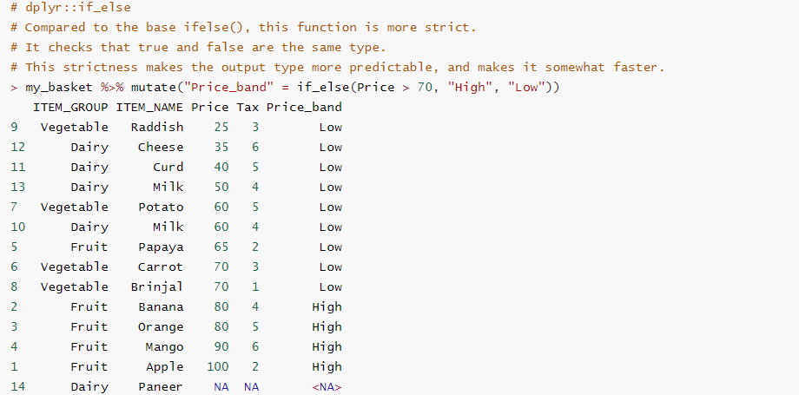
No.4 dplyr::if_else
if_else(condition, true, false, missing = NULL)

Slide 15
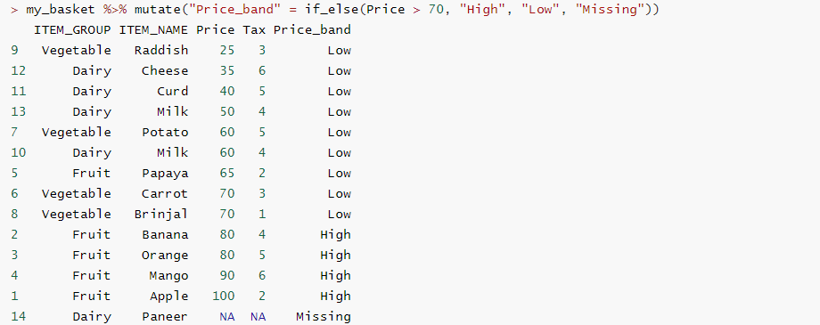
No.4 dplyr::if_else
if_else(condition, true, false, missing = NULL)

Slide 16
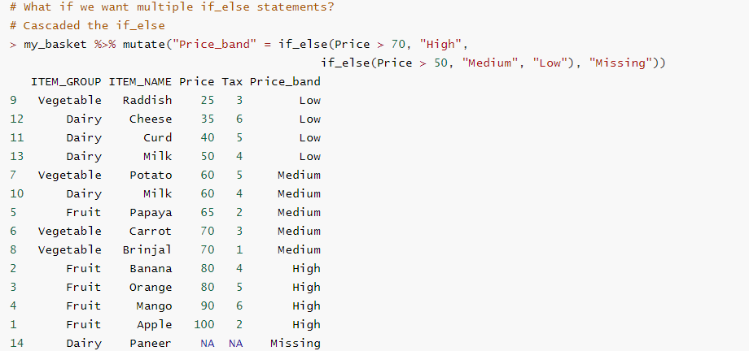
No.4 dplyr::if_else
if_else(condition, true, false, missing = NULL)

Slide 17
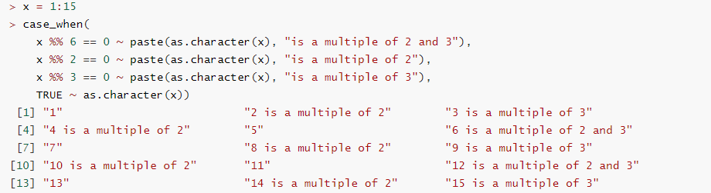
Backup case_when
case_when(...)

Slide 18
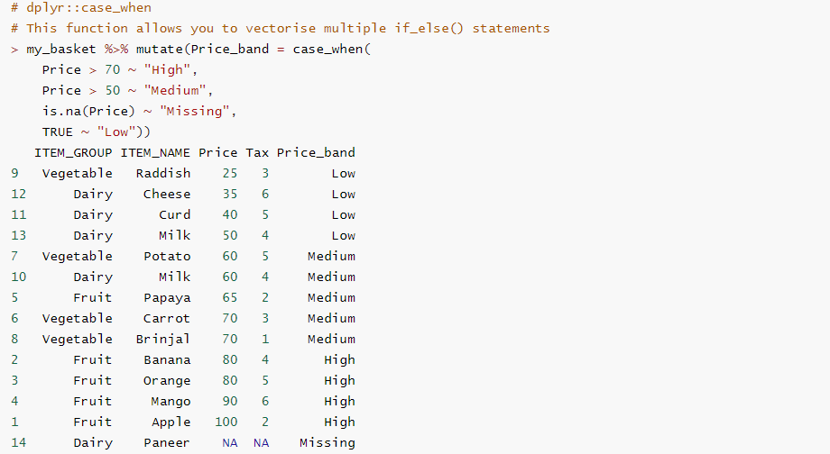
No.5 dplyr::case_when
case_when(...)

Slide 19
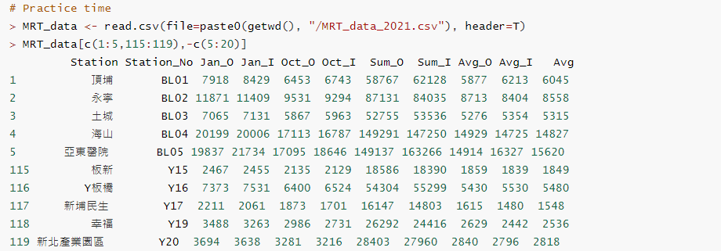
Practice Data
case_when(...)

Slide 20
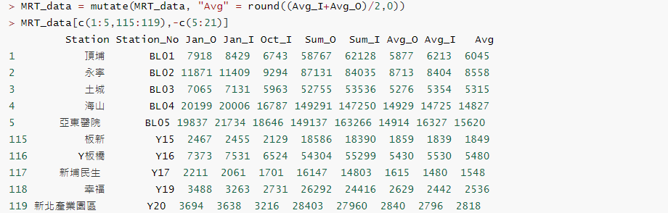
Create new data

Slide 21
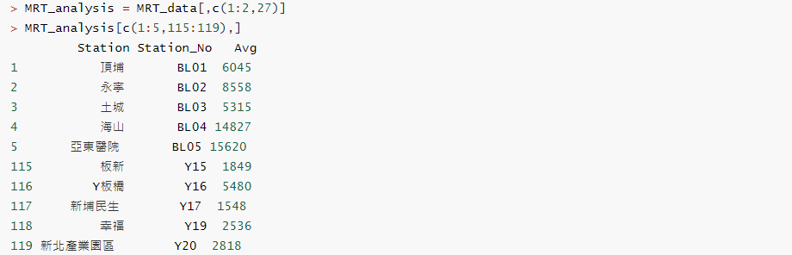
Retrieve data

Slide 22
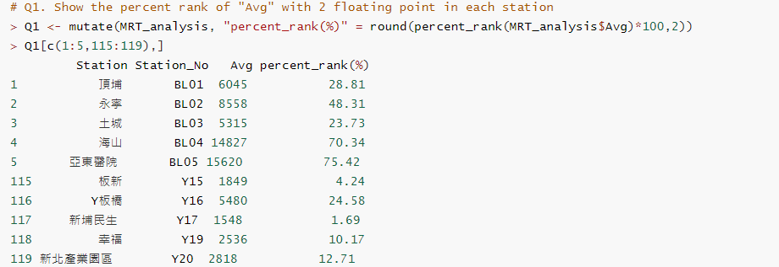
Question 1
percent_rank(x)

Slide 23
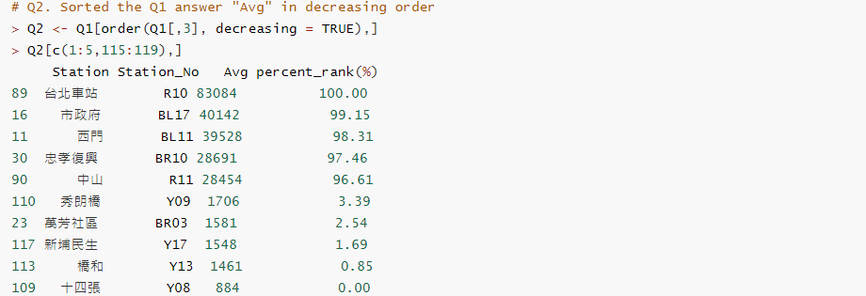
Question 2

Slide 24
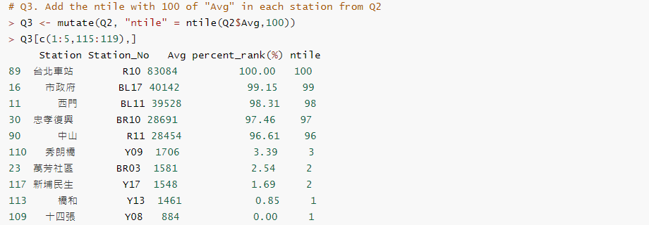
Question 3
ntile(x = row_number(), n)

Slide 25
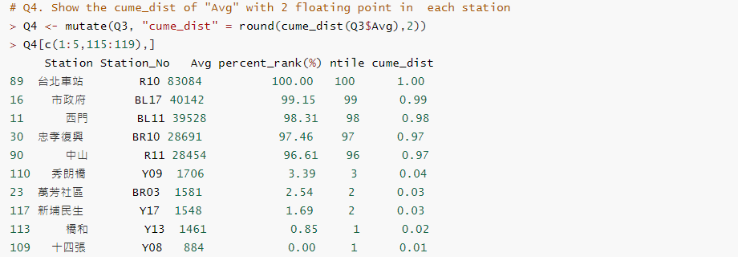
Question 4
cume_dist(x)

Slide 26
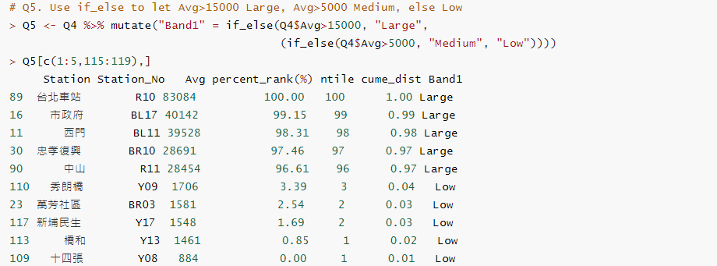
Question 5
if_else(condition, true, false, missing = NULL)

Slide 27
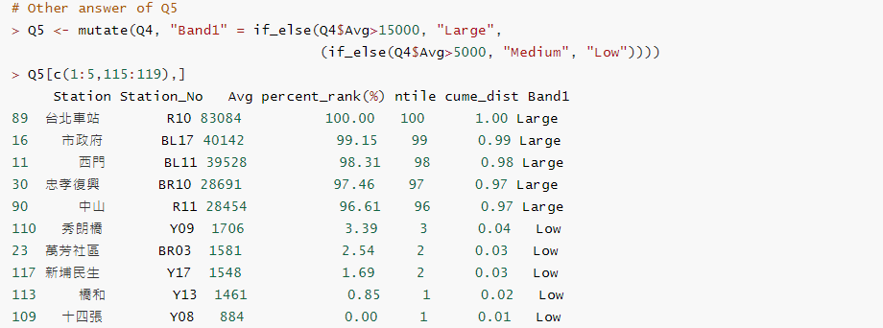
Question 5
if_else(condition, true, false, missing = NULL)

Slide 28
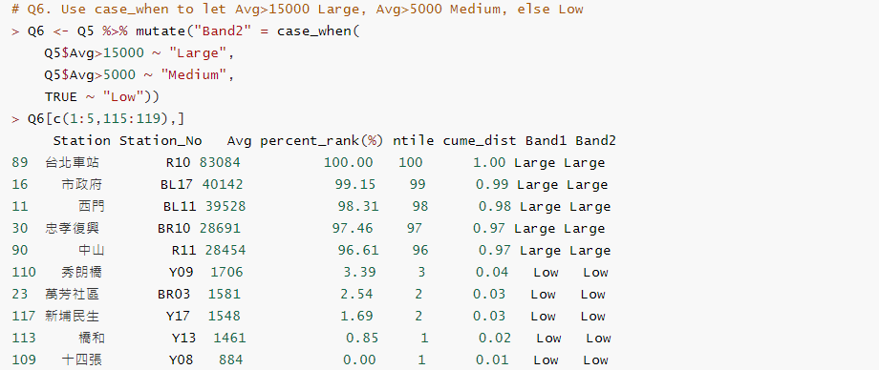
Question 6
case_when(...)

Slide 29
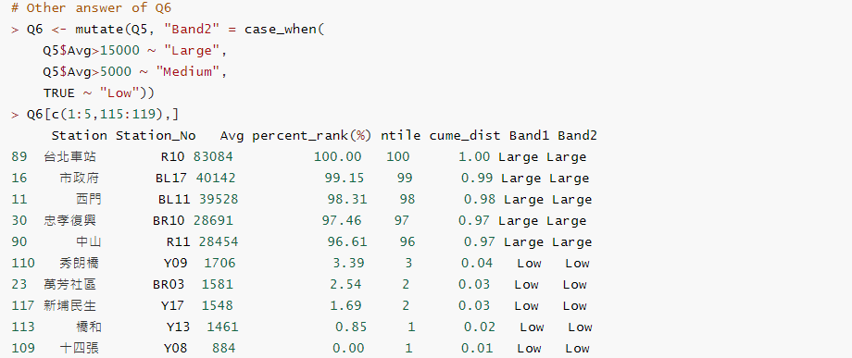
Question 6
case_when(...)

Slide 30
Thank You
Any question please contact: r08943016@ntu.edu.tw
吳諺倫

Slide 31
Reference
https://www.datasciencemadesimple.com/calculate-percentile-quantile-n-tile-of-dataframe-in-r-using-dplyr-create-column-with-percentile-rank/
https://www.datasciencemadesimple.com/case-statement-r-using-case_when-dplyr/
https://www.metro.taipei/cp.aspx?n=FF31501BEBDD0136
https://dplyr.tidyverse.org/
https://www.rstudio.com/wp-content/uploads/2015/02/data-wrangling-cheatsheet.pdf

