Slide 1
110-1 QMDM
2021/11/26
R08943016
吳諺倫

Slide 2
Outline
dplyr::percent_rank
dplyr::ntile
dplyr::cume_dist
dplyr::if_else
dplyr::case_when

Slide 3
Resources
All the resources are on github

Slide 4
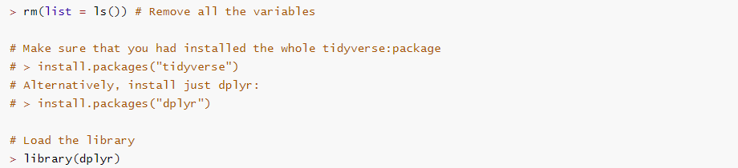
Prepare

Slide 5
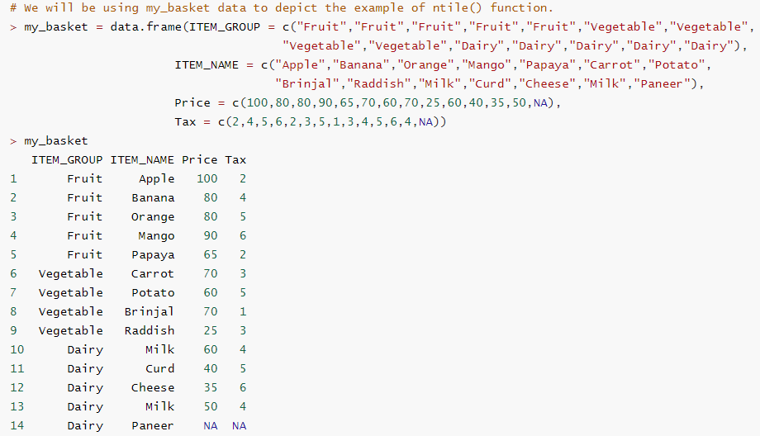

Slide 6
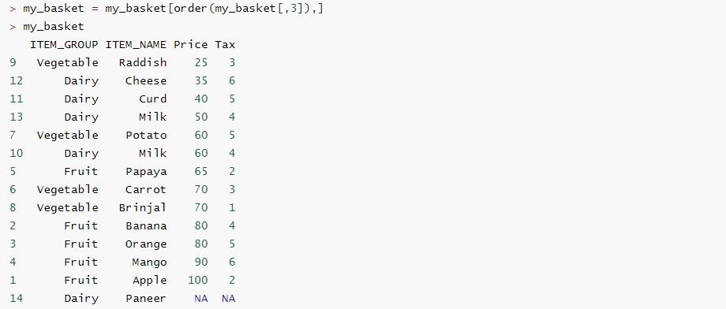

Slide 7
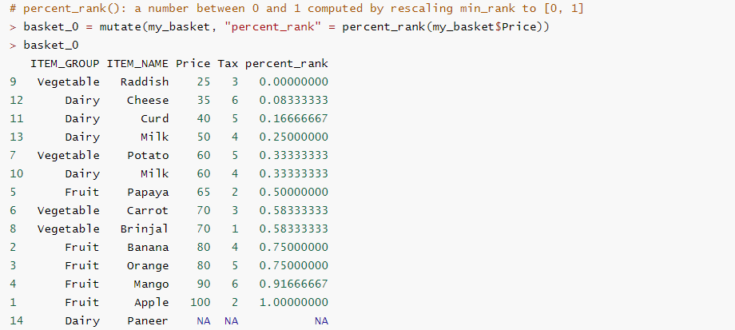

Slide 8
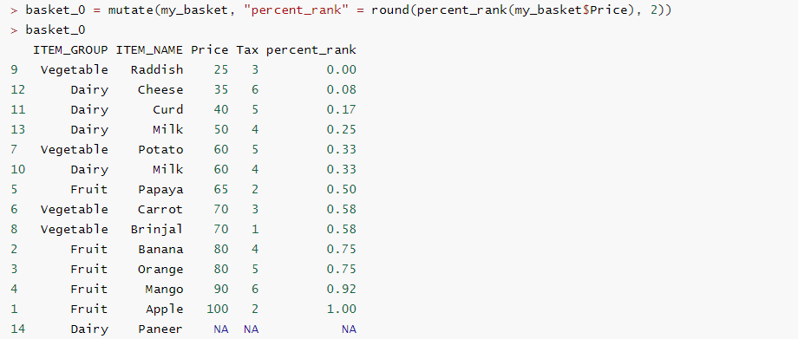

Slide 9
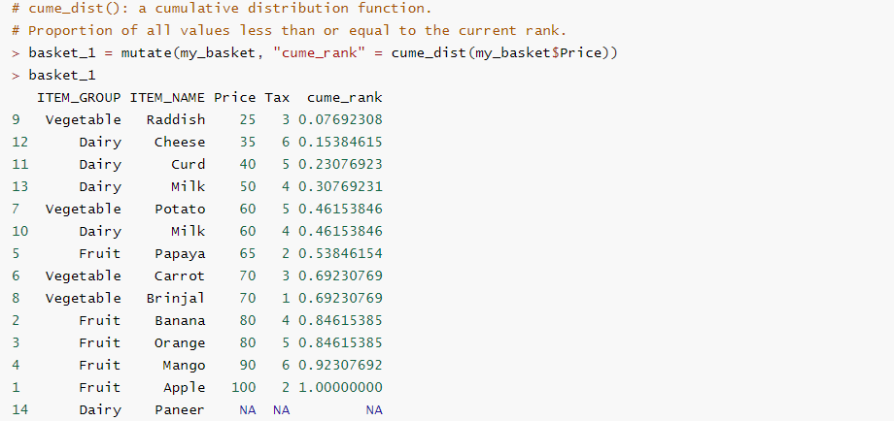

Slide 10
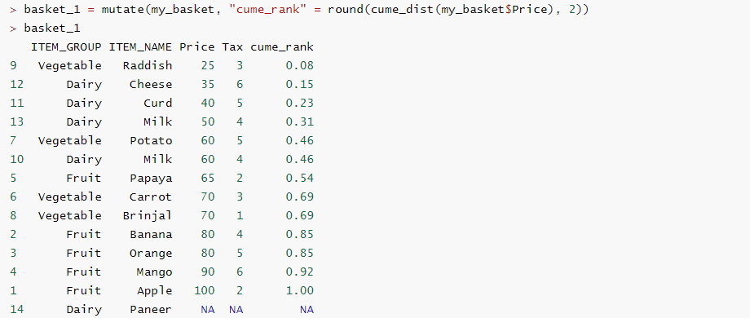

Slide 11
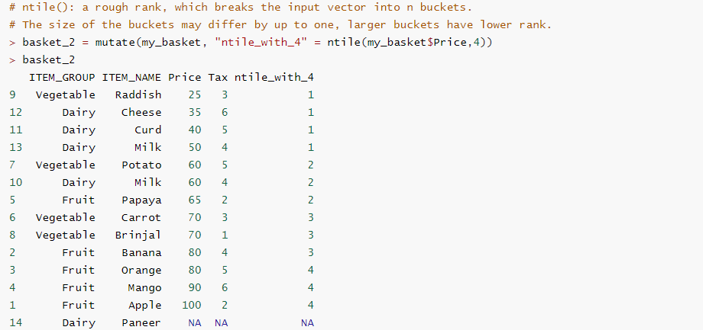

Slide 12
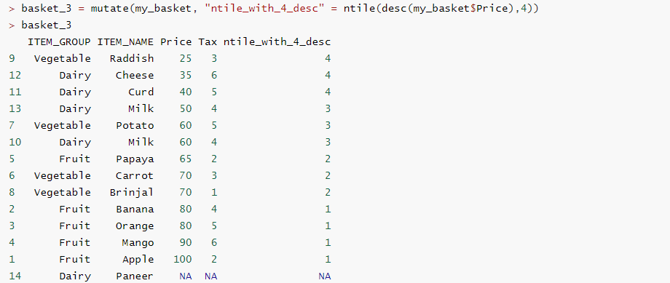

Slide 13
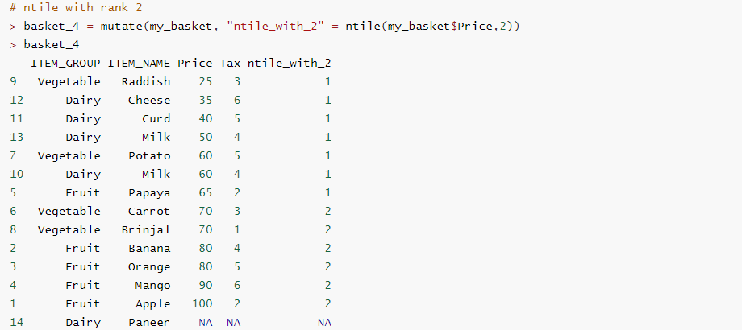

Slide 14
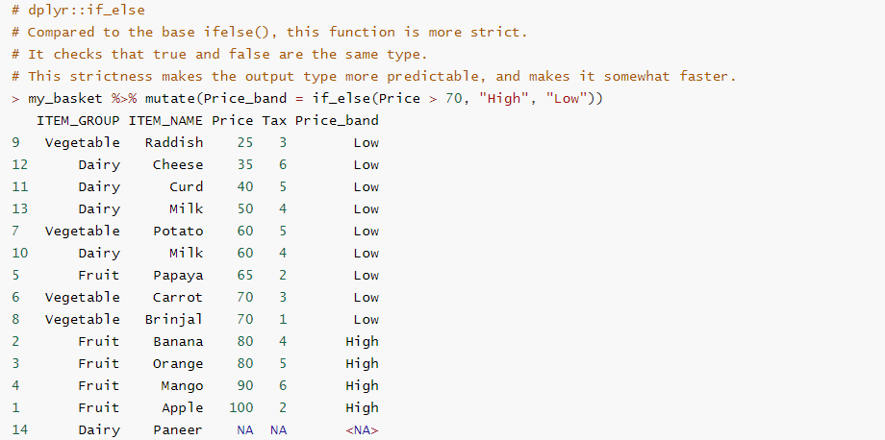

Slide 15
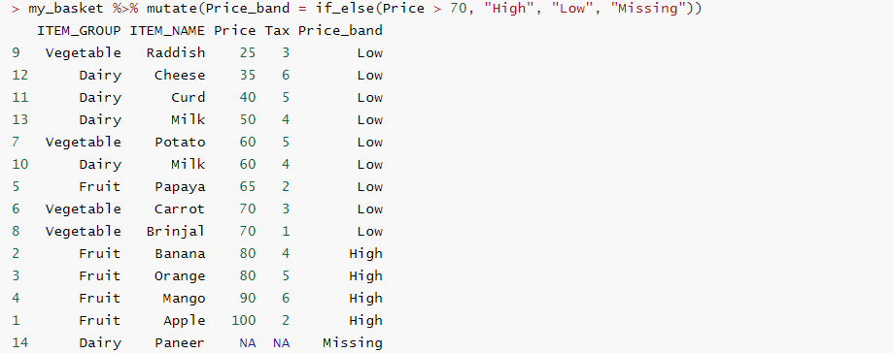

Slide 16
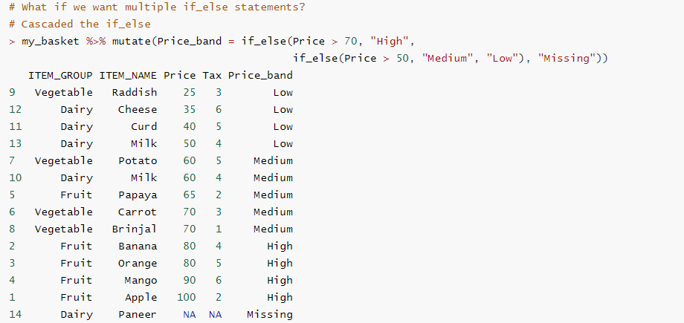

Slide 17
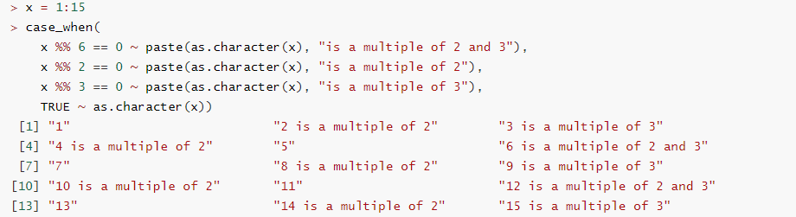

Slide 18
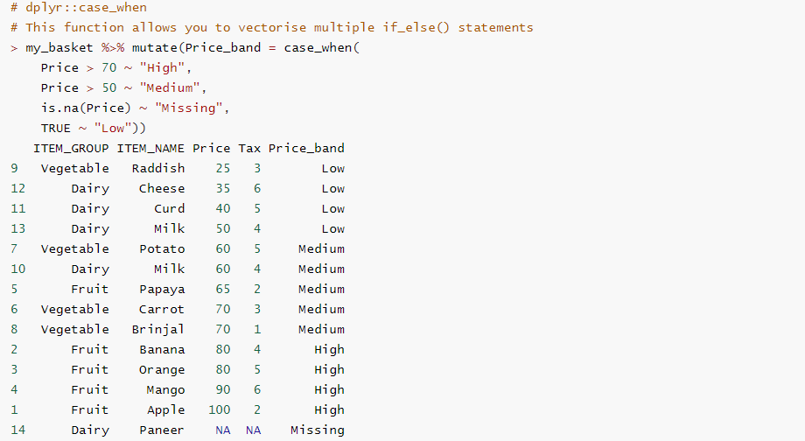

Slide 19
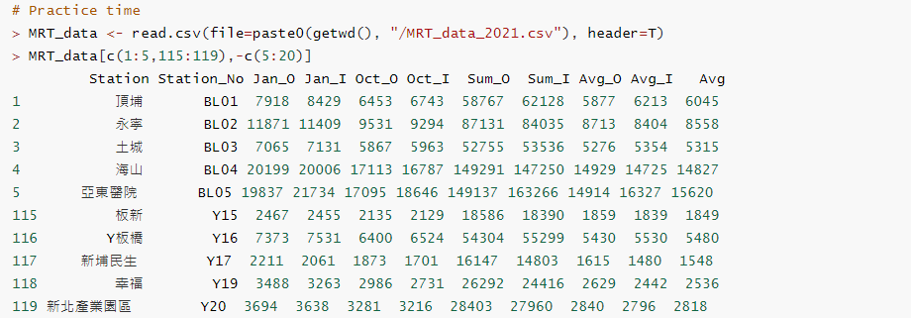

Slide 20
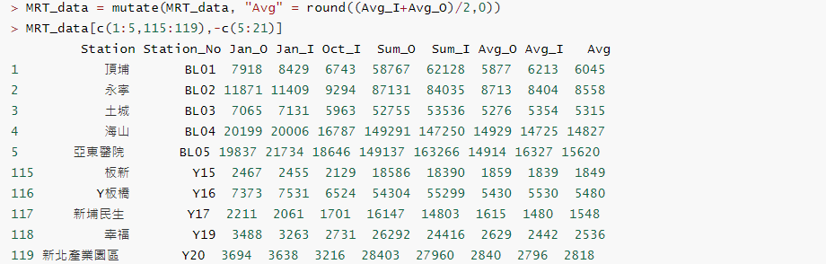

Slide 21
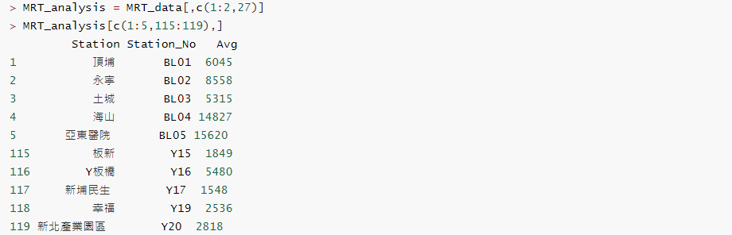

Slide 22
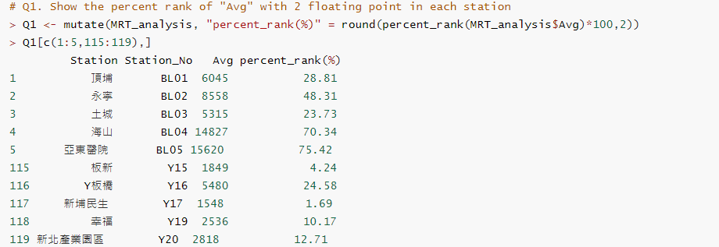

Slide 23
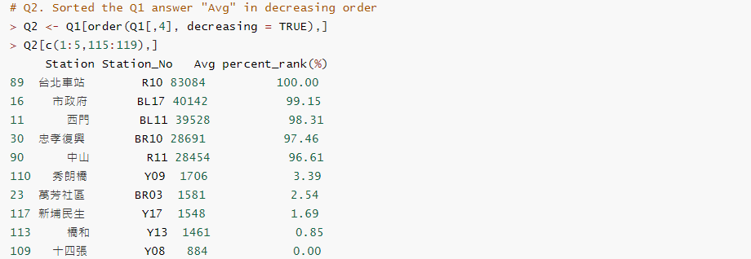

Slide 24
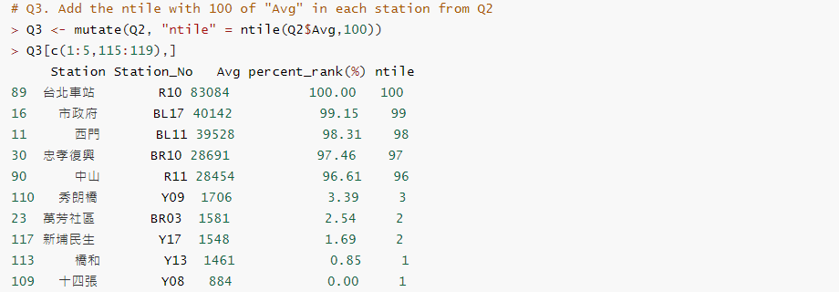

Slide 25
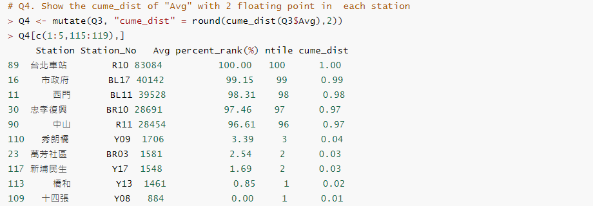

Slide 26
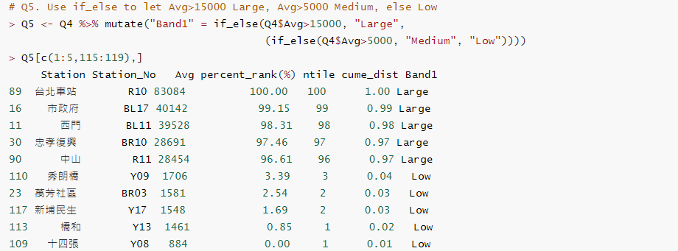

Slide 27
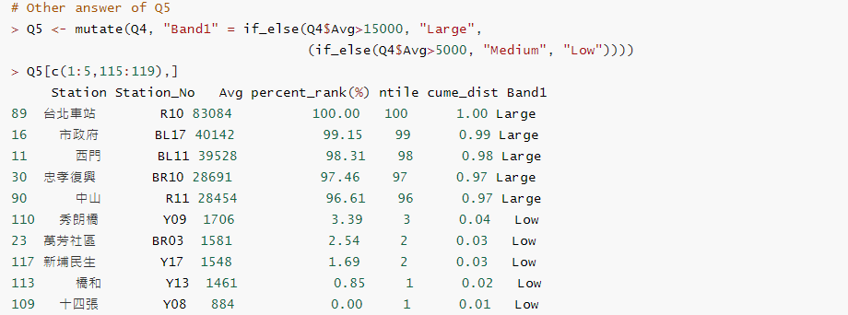

Slide 28
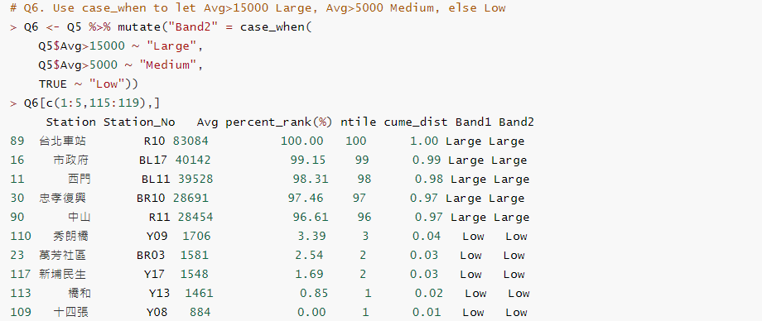

Slide 29
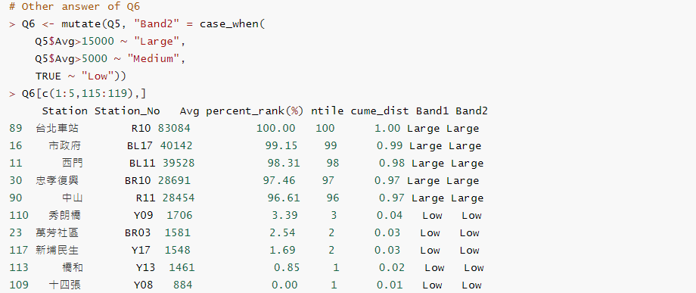

Slide 30
if_else (condition, true, false, missing_value = NULL
if else vs if_else
https://stackoverflow.com/questions/24459752/can-dplyr-package-be-used-for-conditional-mutating

Slide 31
Practice
https://www.metro.taipei/cp.aspx?n=FF31501BEBDD0136

Slide 32
https://www.datasciencemadesimple.com/calculate-percentile-quantile-n-tile-of-dataframe-in-r-using-dplyr-create-column-with-percentile-rank/
https://www.datasciencemadesimple.com/case-statement-r-using-case_when-dplyr/

