Slide 1
TRAVEL AGENCY MANAGEMENT SYSTEM
GROUP 21 MEMBERS
1032791 – JEFFA MUGOMATI NGASE
1049384 – JAMES MAINA
1050652 – KHANYANJI AMANI LUGOSE
1050099 – FAITH LEMAYIAN
1049215 – MARION KAGEHA
11/22/2024

Slide 2
INTRODUCTION
OVERFIEW
Group 21 worked on creating a database management system for business management, specifically a Travel Agency Management System.
RATIONALE
This is a system that allows for travelers and adventurers to fully customize their trip by selecting from multiple packages on offer.

Slide 3
OBJECTIVES
Allows the logging of customer details – The system should be capable of registering new customers by capturing their personal information.
Booking of flights – New customers should be able to choose a date and destination, then select from a list of available flights
Booking of select hotels – A customer should be able to book a room from a list of partnered hotels

Slide 4
OBJECTIVES (CONT…)
Connection of customers to agents – A travel agent will be assigned to a group of customers based on availability of the agent and the Itinerary booked for that date
Booking of Itineraries – A list of Itineraries will be provided based on the date of the customer’s trip
Calculating of Price – a final price can be calculated based on a customer’s trip details.
Processing of payments – Payments received can be cataloged and linked to the customers who made them

Slide 5
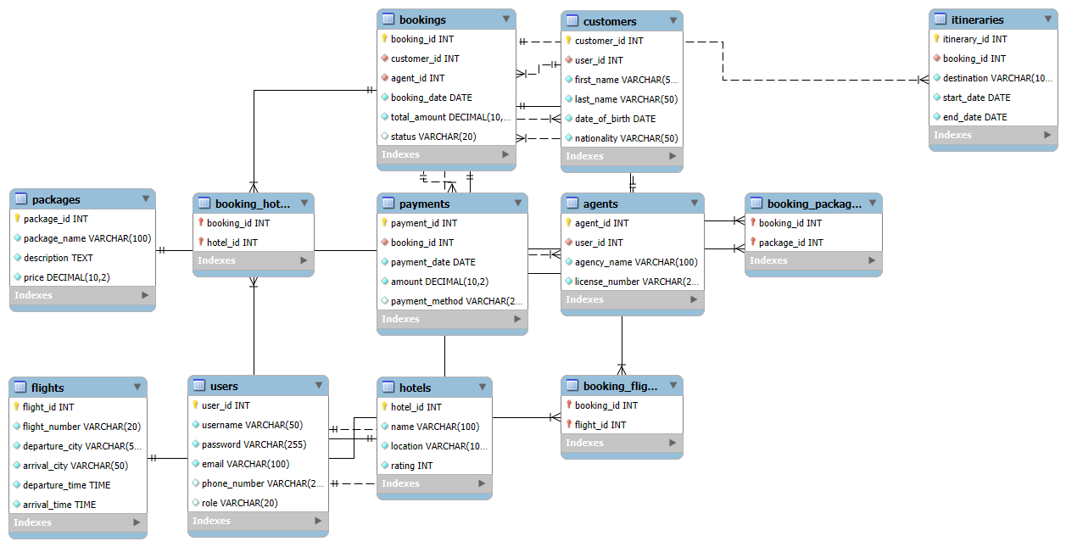
TABLES AND ERD

Slide 6
TABLE CREATION CODE (Users)
CREATE TABLE Users ( user_id INT PRIMARY KEY, username VARCHAR(50) NOT NULL, password VARCHAR(255) NOT NULL, email VARCHAR(100) NOT NULL, phone_number VARCHAR(20), role VARCHAR(20) CHECK(role IN ('customer', 'agent', 'admin')));
INSERT INTO Users ( user_id,username, password, email, phone_number)VALUES ( '001','Jeff', ('123456'), 'jeffamudasia@gmail.com', '0712345678');
INSERT INTO Users ( user_id,username, password, email, phone_number)VALUES ( '002','James', ('12342346'), 'jamesmaina@gmail.com', '0712345178');
INSERT INTO Users (user_id,username, password, email, phone_number)VALUES ( '003','Khanyanji', ('1235456'), 'khanyanjiamani@gmail.com', '0712145678')
;INSERT INTO Users ( user_id,username, password, email, phone_number)VALUES ( '004','Faith', ('12367856'), 'faithlemayian@gmail.com', '0712346678');
INSERT INTO Users ( user_id,username, password, email, phone_number)VALUES ('005','Marion', ('138393456'), 'marionkageha@gmail.com', '0712395678');

Slide 7
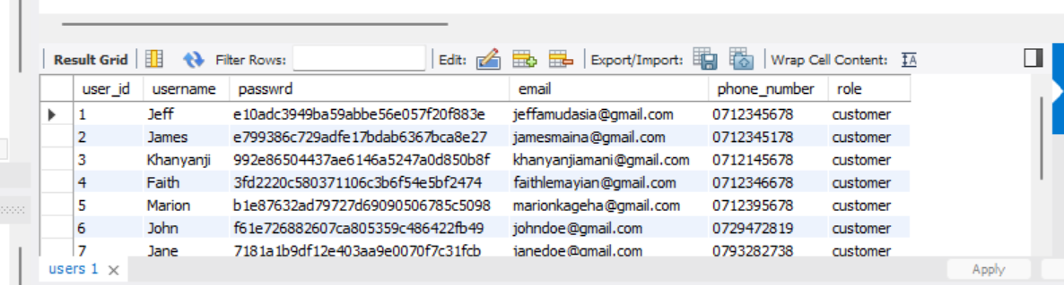
TABLE SNIPPET (Users)

Slide 8
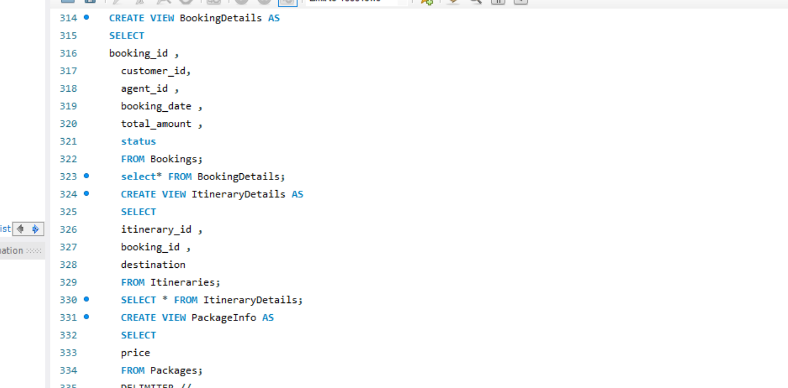
VIEWS CREATION CODE

Slide 9
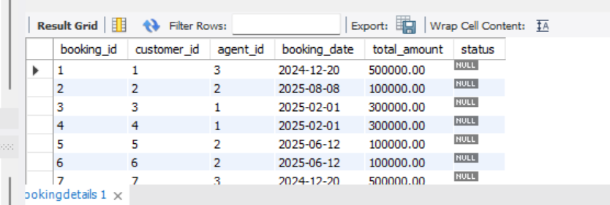
VIEWS SNIPPET

Slide 10
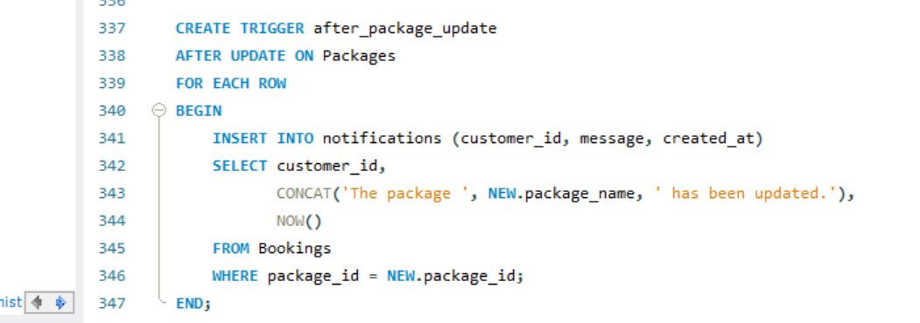
TRIGGERS

Slide 11
TESTING AND VALIDATION
Each user Account is password protected which is encrypted and can therefore not be viewed directly in plain text – On displaying off the code the real passwords inserted are Hashed out.

Slide 12
RECOMMENDATIONS FOR FUTURE IMPROVEMENTS
To expand on services offered – these are services that enhance the customer experience such as ability to opt for airport pick-up and drop-off.
Cataloging of material and staff that provide services such as Tour Vehicles, Drivers etc.
Use automation tools to generate and manage itineraries based on the customer’s travel preferences and booking.
Improve integration with airlines, car rental services, tour operators, and other service providers to enable real-time availability and pricing updates.

Slide 13
REFERENCES
https://travelshoppe.co.ke/
https://www.safaribookings.com/operators/kenya
https://elisatravel.co.ke/

Slide 14
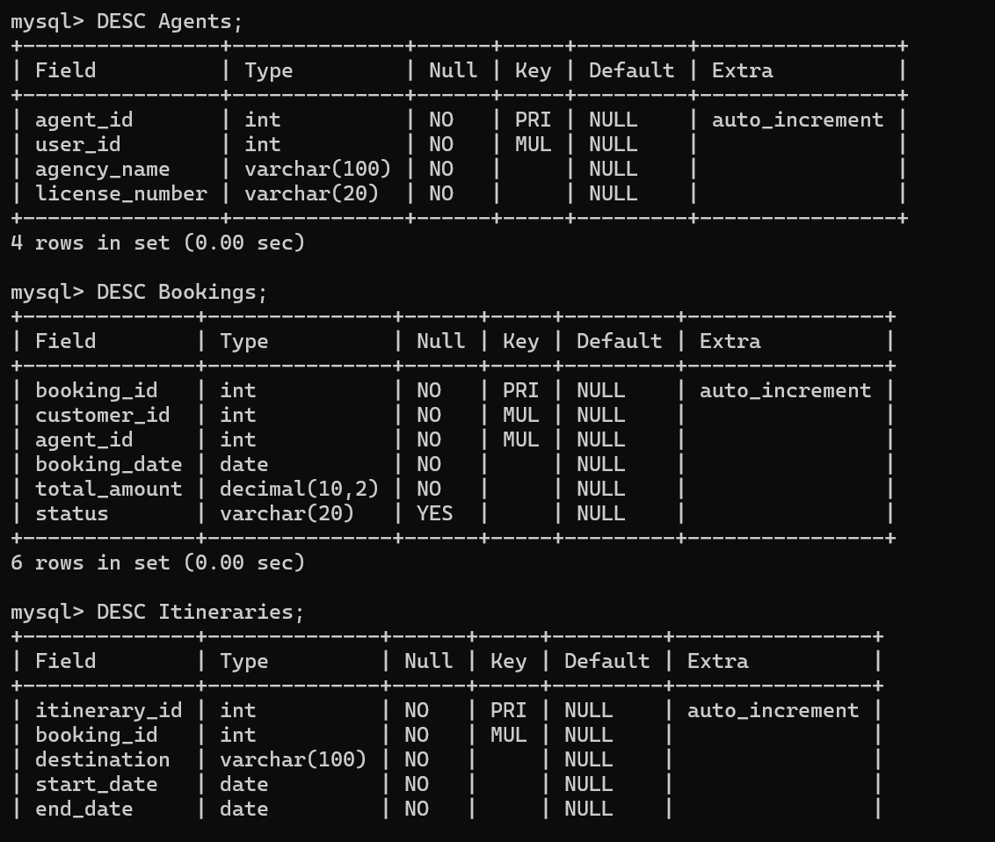
APPENDICES

Slide 15
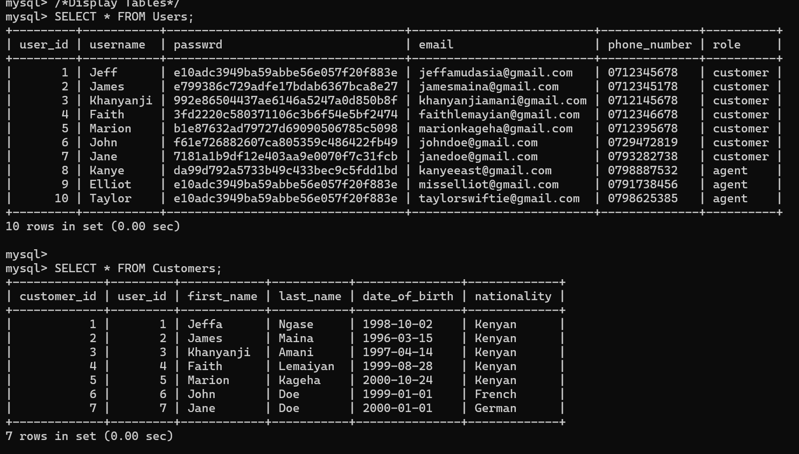
APPENDICES (CONT…)

