Slide 1

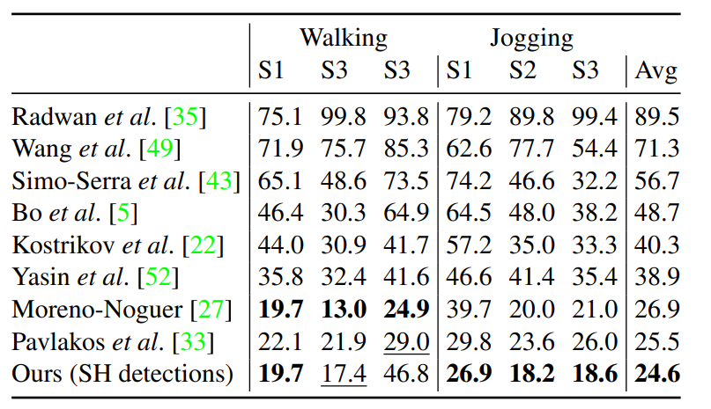
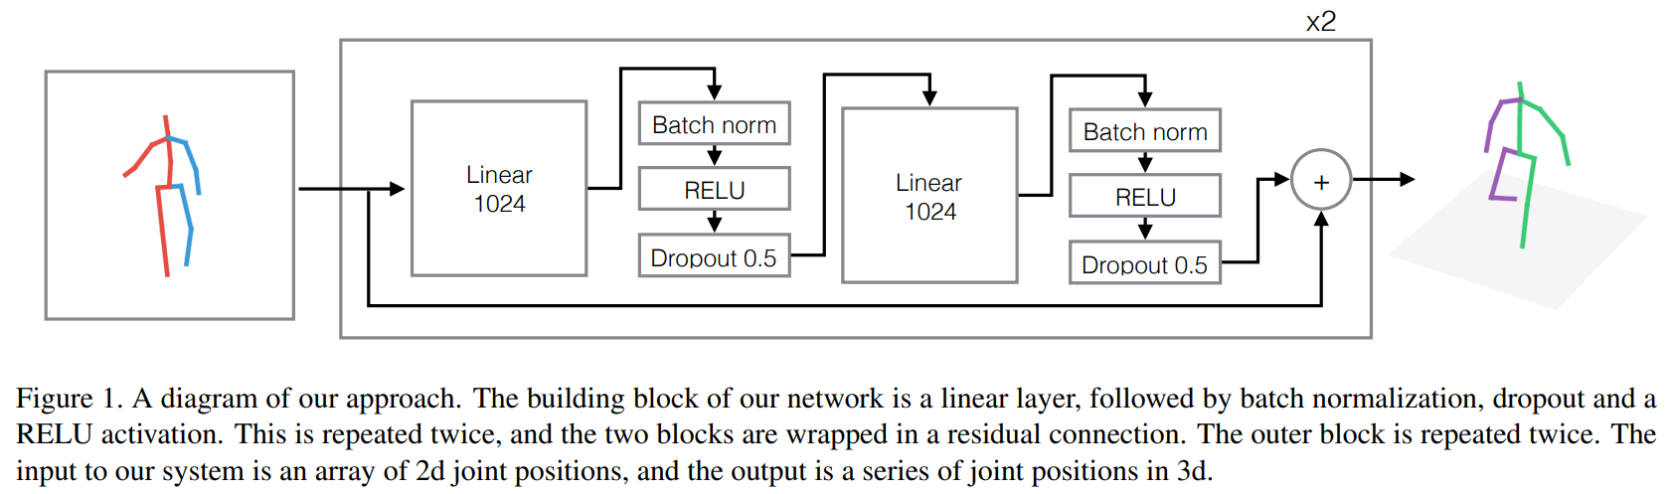
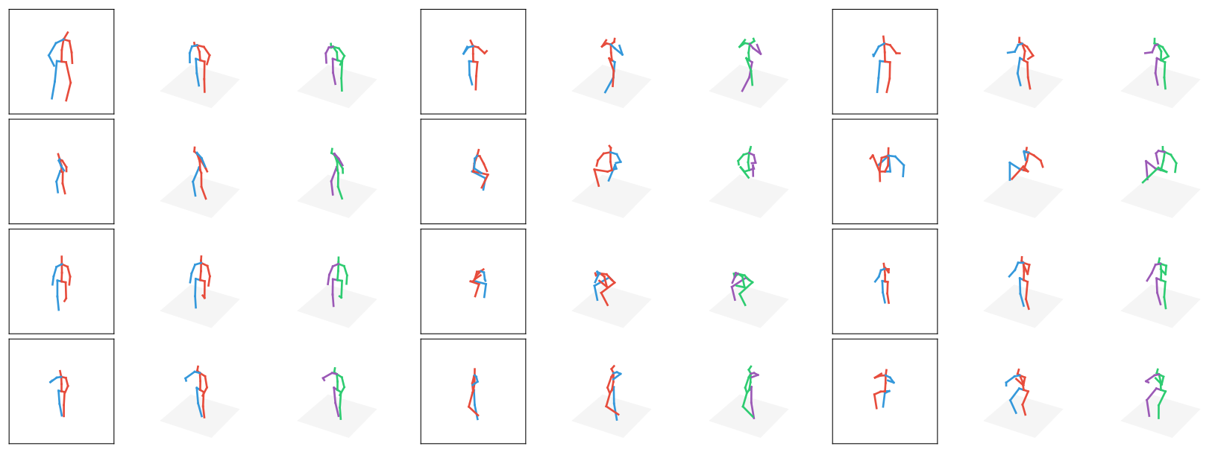
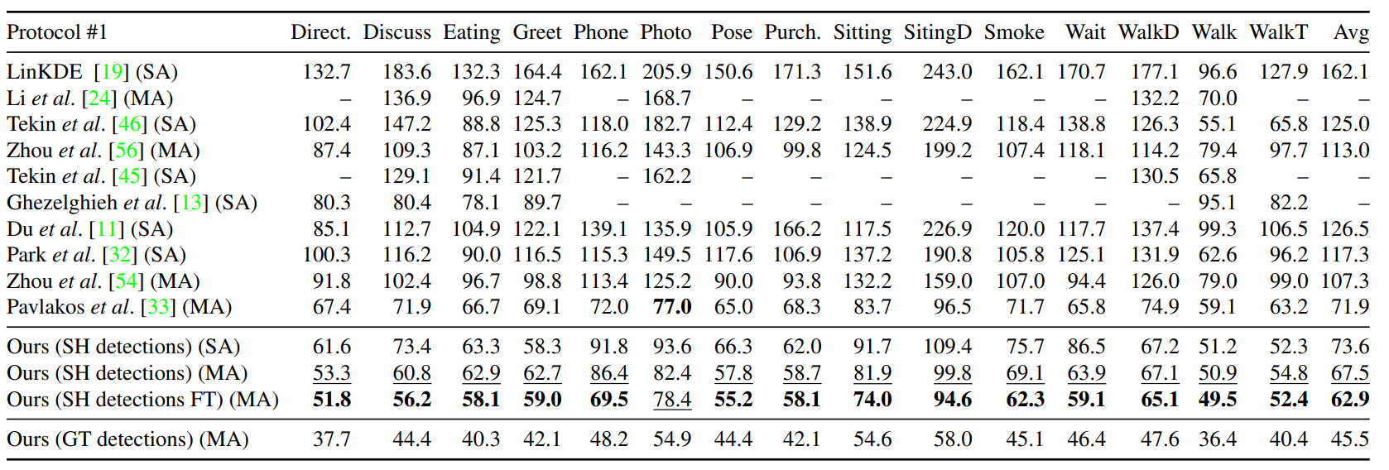
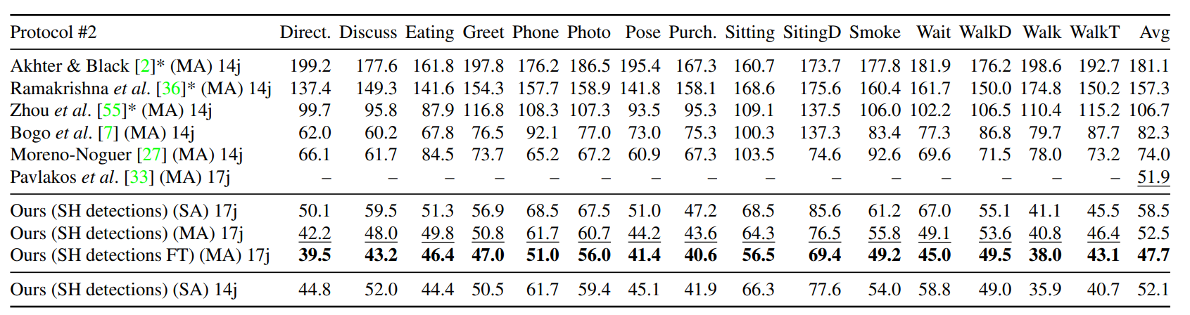
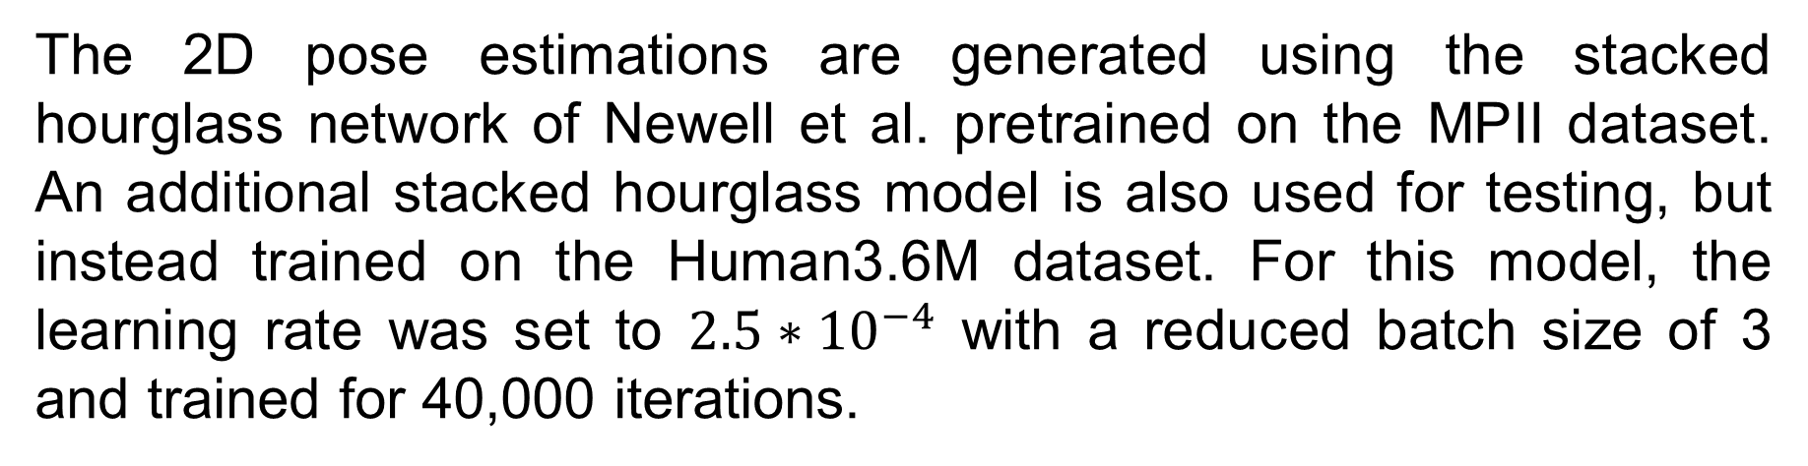
Single Person 3D Human Pose Estimation
Jeff Dong
The University of Texas at San Antonio, San Antonio TX, 78249
Jeff.Dong@utsa.edu
Abstract
Methods
Results - con’t
3D human pose estimation, which involves estimating the 3D joint locations of a human from images, has recently garnered increasing attention in the computer vision community due to both the advances in 2D pose estimation and the abundance of applications that 3D pose estimation provides. One paper published by Martinez et al. in 2017 was able to successfully leverage the advances of 2D pose estimation in 3D pose estimation, leading to the popularization of “lifting” 2D poses to estimate 3D poses. Rather than predicting 3D joint locations directly from raw pixel inputs, Martinez et al. proposed a simple yet very effective neural network that would instead take in an existing 2D pose as an input to predict the 3D pose.
The 2D pose estimations are generated using the stacked hourglass network of Newell et al. pretrained on the MPII dataset. An additional stacked hourglass model is also used for testing, but instead trained on the Human3.6M dataset. For this model, the learning rate was set to $2.5∗{10}^{−4}$ with a reduced batch size of 3 and trained for 40,000 iterations.
Introduction
The model for 2D to 3D post estimation is depicted above, with 2D points as inputs and 3D points as outputs. Since this method is no longer using any image data for this section, a CNN is no longer required and can be replaced with simpler and computationally less expensive linear layers.
The two datasets used for evaluation are Human3.6M and HumanEva. The reported error is the average error in millimeters between the ground truth and the prediction across all joints. Additionally, a standard z-score normalization is applied to all 2D inputs and 3D outputs, with the 3D poses centered around the hip.
Table 4. Results on the HumanEva dataset, and comparison with previous work.
Comparable to 2D pose estimation, 3D pose estimation also has several unique challenges. Challenges including but not limited to diverse appearances, occlusion, wide variations and ambiguity in body poses, and the lack of “in the wild” datasets to use for training/testing. Unlike 2D pose estimation, “in the wild” data sets are much harder to procure for 3D pose estimation given the availability and use of natural 3D data making it the greatest obstacle. Whereas a 2D dataset can be scrapped and easily annotated off the internet by finding countless videos and images online like MPII, it becomes a much harder task for 3D data.
Considering 3D pose estimation using a single image for a single human, there have been 2 main methods that have been used to tackle this problem. The first method is akin to 2D pose estimation, where the input is raw image data to predict either a 3D skeleton or a SMPL model. The second method instead segments the process into two parts. First, taking advantage of the progress in the 2D pose estimation field, a 2D skeleton is generated from image data. Then using the 2D skeleton generated, the 3D joint locations are estimated to produce the final output.
The paper, method, and implementation proposed by Martinez et al. in 2017 this poster focuses on is part of the latter method and is in fact one of the main progenitors of the method.
Figure 2. Example output on the test set of Human3.6M. Left: 2d observation. Middle: 3d ground truth. Right (green): our 3d predictions
Results
Conclusions
Simple, lightweight models can achieve high accuracy in 2D to 3D pose estimation
Segmenting 3D pose estimation can lead to relatively less complex and easier to solve problems
Current implementation lacks context or visual cues that can potentially be added to boost performance
Table 2. Detailed results on Human3.6M under Protocol #1 (no rigid alignment in post-processing). SH indicates that we trained and tested our model with Stacked Hourglass detections as input, and FT indicates that the 2D detector model was fine-tuned on H3.6M. GT detections denotes that the ground truth 2D locations were used. SA indicates that a model was trained for each action, and MA indicates that a single model was trained for all actions.
References
Purpose
Jinbao Wang, Shujie Tan, Xiantong Zhen, Shuo Xu, Feng Zheng, Zhenyu He, Ling Shao, Deep 3D human pose estimation: A review, Computer Vision and Image Understanding, Volume 210, 2021, 103225, ISSN 1077-3142, https://doi.org/10.1016/j.cviu.2021.103225.
Martinez, Julieta, et al. "A simple yet effective baseline for 3d human pose estimation." Proceedings of the IEEE international conference on computer vision. 2017.
Wang, J., Huang, S., Wang, X., Tao, D., 2019a. Not all parts are created equal: 3D pose estimation by modelling bi-directional dependencies of body parts. arXiv preprint arXiv:1905.07862.
Luvizon, D.C., Picard, D., Tabia, H., 2018. 2d/3d pose estimation and action recognition using multitask deep learning. In: Proceedings of the IEEE Conference on Computer Vision and Pattern Recognition. pp. 5137–5146.
The process of 3D pose estimation can be successfully decoupled into the two problems of 2D pose estimation and 3D pose estimation from 2D joints to produce effective models for 3D pose estimation. As such, the problem of 3D pose estimation from 2D joints can be solved with a relatively simple model with a low error rate.
Acknowledgements
This poster is part of the final research project assigned for the class CS-3794 (Artificial Intelligence) at UTSA during the summer 2022 semester taught by Dr. Kevin Desai.
All figures and statistics are pulled directly from the paper “A simple yet effective baseline for 3d human pose estimation.” by Martinez et al. (2017)
Table 3. Detailed results on Human3.6M under protocol #2 (rigid alignment in post-processing). The 14j (17j) annotation indicates that the body model considers 14 (17) body joints. The results of all approaches are obtained from the original papers, except for (*), which were obtained from Bogo et al.

