Slide 1
Exact Inference
Images to help understand the representation of clique trees

Slide 2
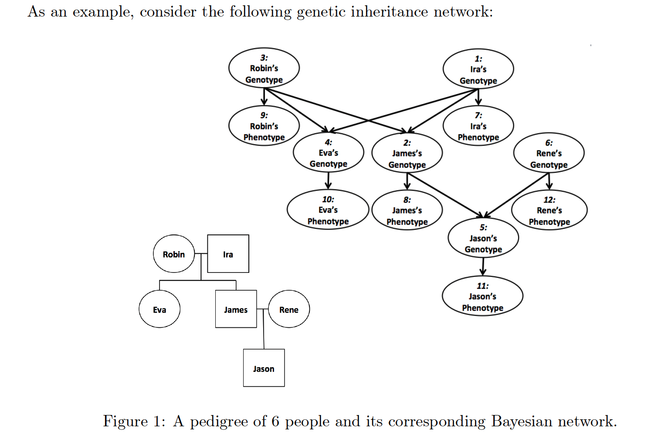
Bayesian Network

Slide 3
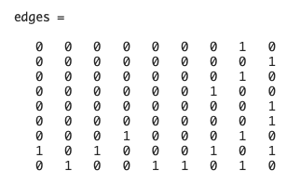
Adjacency Matrix
1: 1,7
2: 2,8
3: 3,9
4: 4,10
5: 5,11
6: 6,12
7: 1,3,4
8: 1,2,3
9: 2,5,6

Slide 4
Clique Tree from Adjacency Matrix
9: 2,5,6
2: 2,8
5: 5,11
6: 6,12
8: 1,2,3
1: 1,7
3: 3,9
7: 1,3,4
4: 4,10

Slide 5
Blue numbers indicate the order in which we look for the next message to pass (don’t confuse blue numbers for indices in the matrix `Messages`).
The direction the message is passed is pass will still be the (i, j) indices of the original `Messages` matrix. Note: this may be much easier to implement by simply iterating across the upper-triangular portion of the matrix row-by-row and then the lower-triangular portion row-by-row, but I haven’t checked if that would raise any issues in certain cases.
Message Passing order for passing UP the tree
Message Passing order for passing DOWN the tree
Messages=
Messages=
1 2 3 4 5 6 7 8
8
7
6
5
4
3
2
1

Slide 6
Clique Tree from Adjacency Matrix
9: 2,5,6
2: 2,8
6: 6,12
5: 5,11
8: 1,2,3
1: 1,7
3: 3,9
7: 1,3,4
4: 4,10

Slide 7
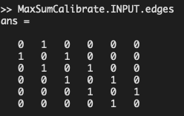
Max Sum Tree
1: 1,2
2: 2,3
3: 3,4
4: 4,5
5: 5,6
6: 6,7

Slide 8
Max Sum Tree
6: 6,7
5: 5,6
4: 4,5
3: 3,4
2: 2,3
1: 1,2

