Slide 1
Infi coding dojo – event sourcing

Slide 2

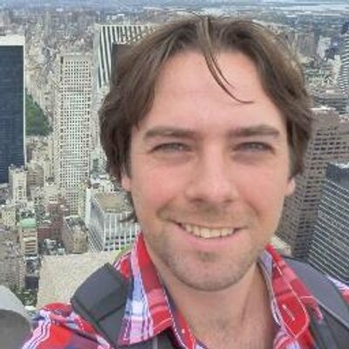

Jiri
Freek

Slide 3
agenda
18:00 Food
18:30 Intro <- you are here
18:45 Start
21:00(ish) Discussion and drinks

Slide 4
Why Coding dojo
Learning new stuff
Meeting new people
Having fun
It’s not a competition!

Slide 5
Tonight: Nerddinner
Organize dinners for nerds
Make dinners
RSVP
Cancel
Etc
Canonical ASP.NET MVC example
ASP.NET MVC 3
Entity Framework 5
[Demo]

Slide 6
Event sourcing
Traditional models model the current state using mutable state.
Event Sourcing: Infer the current state using a history of changes (events)
event sourcing retains the history

Slide 7
Example
Created
RSVPed
RSVPed
Address
Changed
RSVP Canceled
Address: a
RSVPs: 0
Address: a
RSVPs: 1
Address: a
RSVPs: 2
Address: b
RSVPs: 2
Address: b
RSVPs: 1
State
Event
Traditional models store blue
Event sourcing stores orange

Slide 8
Nerddinner & Event sourcing
Goal: learn about the concepts of Event Sourcing, not the technology
Infra is provided (if you find yourself working on infra, raise your hand)
Not production quality (just barely working ☺)
Hybrid state / event sourcing

Slide 9
How does it work (Command)
1. HTTP POST
RegisterRSVP Action
2. Dinner.RSVP()
Dinner
6. Return raised
events
5. Apply events to self
7. Persist state
and events
3. Run logic &
4. Raise Event(s)
DinnerRepository

Slide 10
How does it work (GET)
1. HTTP GET
3. Db.FindDinner
4. Db.FindEventsFor
DinnerDetails
Action
2. Repo.Find()
Dinner Repository
Database
(EF DbContext)
6.Return
dinner
4. dinner.Hydrate(events)
Dinner
5. Apply events to self

Slide 11
The concept
Find a team mate
Make sure one of you has basic understanding of ASP.NET
Clone code from github: https://github.com/infi-nl/coding-dojo-event-sourcing
Get code running (wave your hand if it doesn’t work)
Work on assigments (see readme) in pairs
Ask questions!

Slide 12
The assignments
Implement canceling your RSVP using event sourcing
Show an activity history based on events
Change the address of a dinner using an event
(If time) Use projections to optimize the popular dinners or my events queries
There are tests to get you on your way!

Slide 13
Any questionS?

Slide 14
Have fun!

