Slide 1
UML Class Diagrams

Slide 2
Why UML Class Diagrams
A class diagram depicts classes and their interrelationships
Used for describing structure and behavior in the use cases
Provide a conceptual model of the system in terms of entities and their relationships
Used for requirement capture, end-user interaction
Detailed class diagrams are used for developers

Slide 3
Identifying UML Classes
Based on the system descriptions, using object-oriented analysis (OOA), identify classes, attributes, and operations
For example, nouns / objects that share common properties and are used to enable system functionality become classes
Other nouns related to class nouns become class attributes
Verbs related to class nouns become class operations
After identifying classes, identify applicable relationships
For example, identify cases where objects of one class reference (are associated with) the objects of another
Also identify shared (inherited) behavior between classes.

Slide 4

Overview of UML Diagrams
Structural
: element of spec. irrespective of time
Class
Behavioral
: behavioral features of a system / business process
Activity
Use case
Interaction
: emphasize object interaction
Collaboration
Sequence

Slide 5
Classes
ClassName
A class is a description of a set of objects that share the same attributes, operations, relationships, and semantics.
Graphically, a class is rendered as a rectangle, usually including its name, attributes, and operations in separate, designated compartments.
attributes
operations

Slide 6
Class Names
ClassName
The name of the class is the only required tag in the graphical representation of a class. It always appears in the top-most compartment.
attributes
operations

Slide 7
Class Attributes
Person
An attribute is a named property of a class that describes the object being modeled.
In the class diagram, attributes appear in the second compartment just below the name-compartment.
name : String
address : Address
birthdate : Date
ssn : Id

Slide 8
Class Attributes (Cont’d)
Attributes are usually listed in the form:
attributeName : Type
A derived attribute is one that can be computed from other attributes, but doesn’t actually exist. For example, a Person’s age can be computed from his birth date. A derived attribute is designated by a preceding ‘/’ as in:
/ age : Date
Person
name : String
address : Address
birthdate : Date
/ age : Date
ssn : Id

Slide 9
Class Attributes (Cont’d)
Person
+ name : String
# address : Address
# birthdate : Date
/ age : Date
- ssn : Id
Attributes can be:
+ public
# protected
- private
/ derived

Slide 10
Class Operations
Person
name : String
address : Address
birthdate : Date
ssn : Id
Operations describe the class behavior and appear in the third compartment.
eat
sleep
work
play

Slide 11
Depicting Classes
When drawing a class, you needn’t show attributes and operation in every diagram.
Person
Person
Person
name : String
birthdate : Date
ssn : Id
Person
name
address
birthdate
eat()
sleep()
work()
play()
Person
eat
play

Slide 12
Class Responsibilities
A class may also include its responsibilities in a class diagram.
A responsibility is a contract or obligation of a class to perform a particular service.
SmokeAlarm
Responsibilities
-- sound alert and notify guard station
when smoke is detected.
-- indicate battery state

Slide 13
Relationships
In UML, object interconnections (logical or physical), are modeled as relationships.
There are three kinds of relationships in UML:
  Dependencies
  Generalizations
  Associations

Slide 14
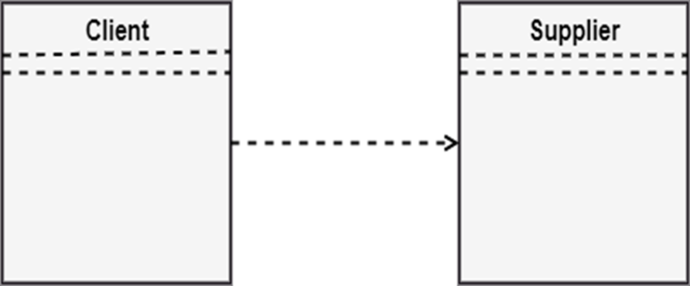
Dependency Relationships
A dependency indicates a semantic relationship between two or more elements. The dependency from CourseSchedule to Course exists because Course is used in both the add and remove operations of CourseSchedule.
CourseSchedule
Course
add(c : Course)
remove(c : Course)

Slide 15
Generalization Relationships
Person
A generalization connects a subclass to its superclass. It denotes an inheritance of attributes and behavior from the superclass to the subclass and indicates a specialization in the subclass of the more general superclass.
Student

Slide 16
Generalization Relationships (Cont’d)
UML permits a class to inherit from multiple superclasses, although some programming languages (e.g., Java) do not permit multiple inheritance.
Student
Employee
TeachingAssistant

Slide 17
Association Relationships
If two classes in a model need to communicate with each other, there must be link between them.
An association denotes that link.
Student
Instructor

Slide 18
Associations (cont.)
  Multiplicity Indicators
Exactly one | 1
Zero or more (unlimited) | * (0..*)
One or more | 1..*
Zero or one (optional association) | 0..1
Specified range | 2..4
Multiple, disjoint ranges | 2, 4..6, 8

Slide 19
Association Relationships (Cont’d)
We can indicate the multiplicity of an association by adding multiplicity adornments to the line denoting the association.
The example indicates that a Student has one or more Instructors:
Student
Instructor
1..*

Slide 20
Association Relationships (Cont’d)
The example indicates that every Instructor has one or more Students:
Student
Instructor
1..*

Slide 21
Association Relationships (Cont’d)
We can also indicate the behavior of an object in an association (i.e., the role of an object) using rolenames.
teaches
learns from
Student
Instructor
1..*
1..*

Slide 22
Association Relationships (Cont’d)
We can also name the association.
membership
Student
Team
1..*
1..*

Slide 23
Association Relationships (Cont’d)
We can specify dual associations.
member of
Student
Team
1..*
1..*
1
president of
1..*

Slide 24
Association Relationships (Cont’d)
We can constrain the association relationship by defining the navigability of the association. Here, a Router object requests services from a DNS object by sending messages to (invoking the operations of) the server. The direction of the association indicates that the server has no knowledge of the Router.
Router
DomainNameServer

Slide 25
Association Relationships (Cont’d)
We can model objects that contain other objects by way of special associations called aggregations and compositions.
An aggregation specifies a whole-part relationship between an aggregate (a whole) and a constituent part, where the part can exist independently from the aggregate. Aggregations are denoted by a hollow-diamond adornment on the association.
Car
Engine
Transmission

Slide 26
Association Relationships (Cont’d)
A composition indicates a strong ownership and coincident lifetime of parts by the whole (i.e., they live and die as a whole). Compositions are denoted by a filled-diamond adornment on the association.
Window
Scrollbar
1
1
Titlebar
1
1
Menu
1
1 .. *

Slide 27
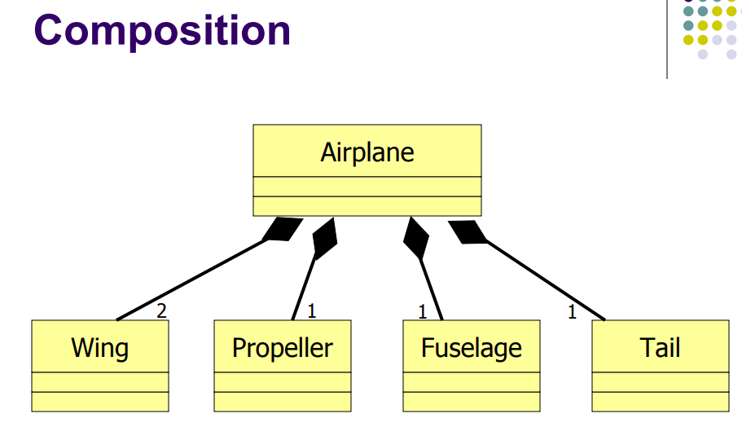

Slide 28
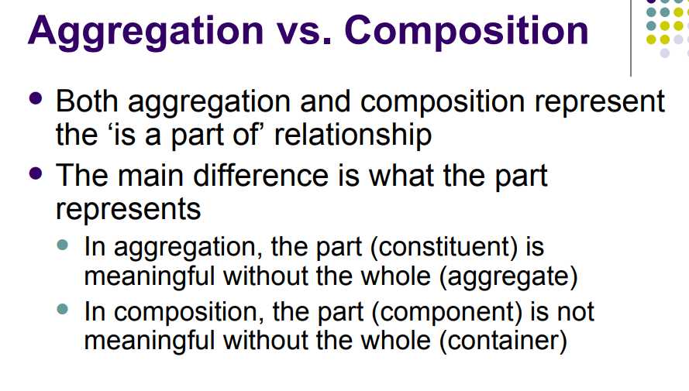

Slide 29
Aggregation vs. Composition
  Composition is really a strong form of aggregation
    components have only one owner
    components cannot exist independent of their owner
    components live or die with their owner
    e.g. Each car has an engine that can not be shared with other cars.
  Aggregations may form "part of" the aggregate, but may not be essential to it. They may also exist independent of the aggregate.
  e.g. Apples may exist independent of the bag.

Slide 30
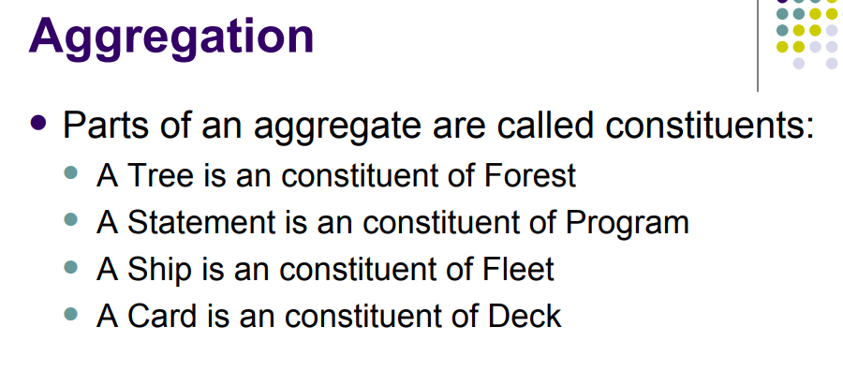

Slide 31
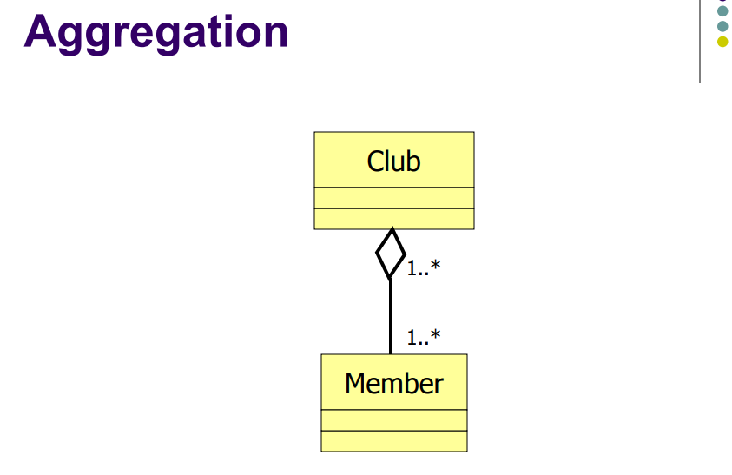

Slide 32
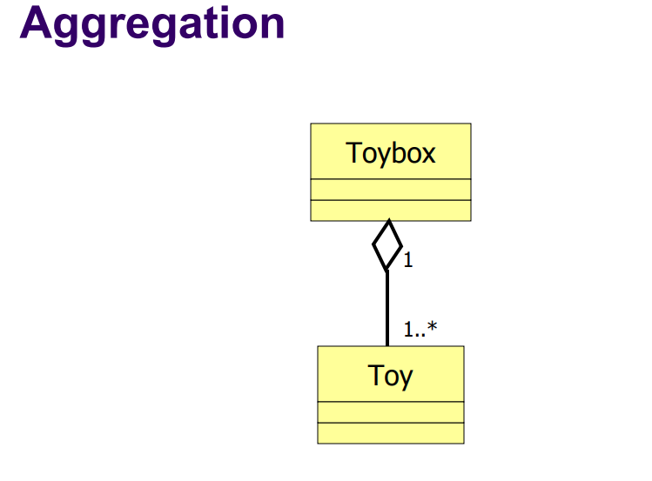

Slide 33
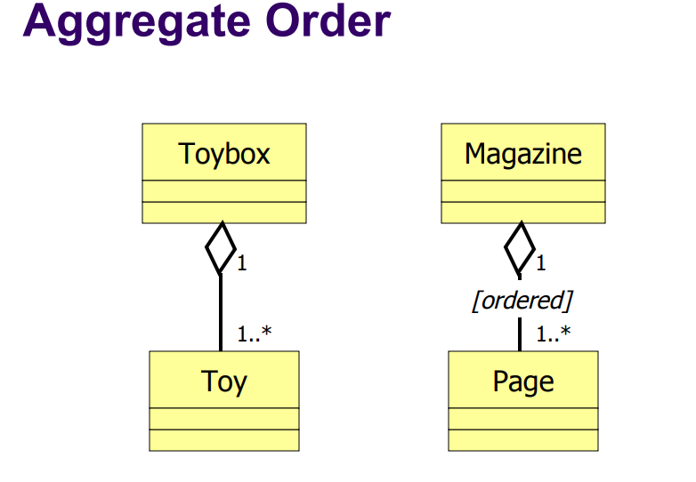

Slide 34
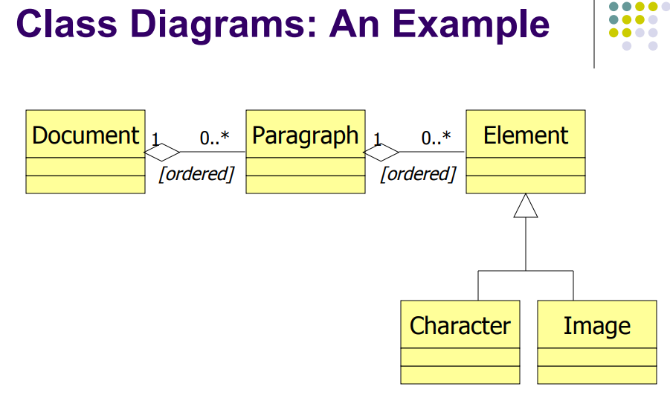

Slide 35
Association: Model to Implementation
*
4
Student
Course
has
enrolls
Class Student {
Course enrolls[4];
}
Class Course {
Student have[];
}

Slide 36
OO Relationships: Aggregation
Container Class
Class C
Aggregation: expresses a relationship among instances
of related classes. It is a specific kind of Container-Containee
relationship.
It expresses a relationship where an instance of the
Container-class has the responsibility to hold and maintain
instances of each Containee-class that have been created
outside the auspices of the Container-class.
Aggregation should be used to express a more informal
relationship than composition expresses. That is, it is an
appropriate relationship where the Container and its
Containees can be manipulated independently.
Aggregation is appropriate when Container and Containees have no special access privileges to each other.
AGGREGATION
Class E₁
Class E₂
Containee Classes
Example
Bag
Apples
Milk
[From Dr.David A. Workman]

Slide 37
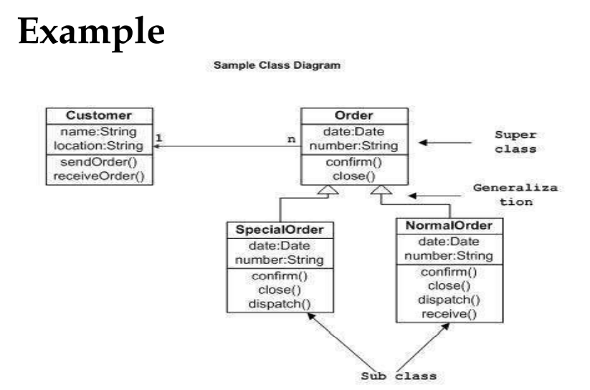

Slide 38
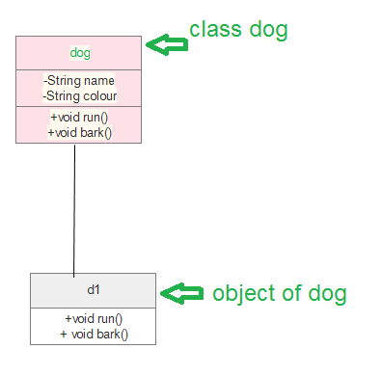

Slide 39
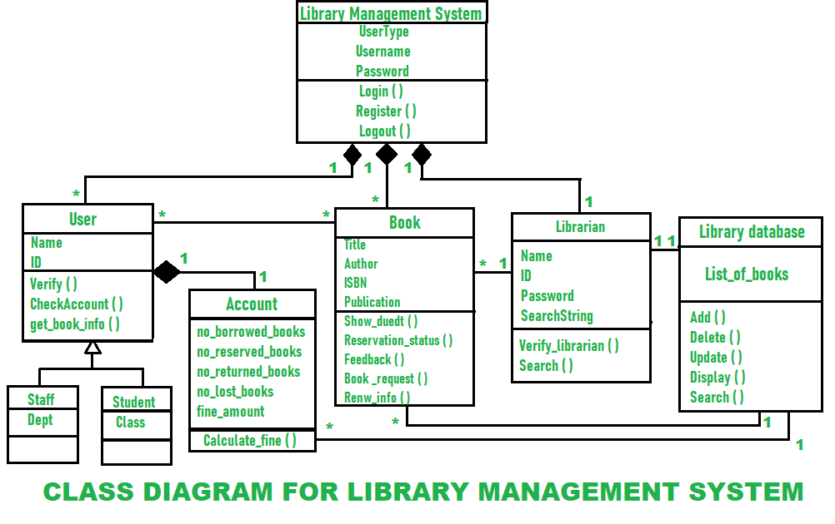

Slide 40
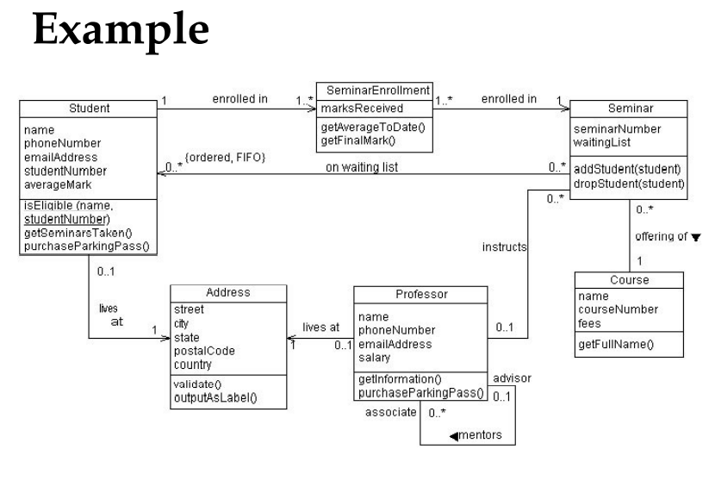
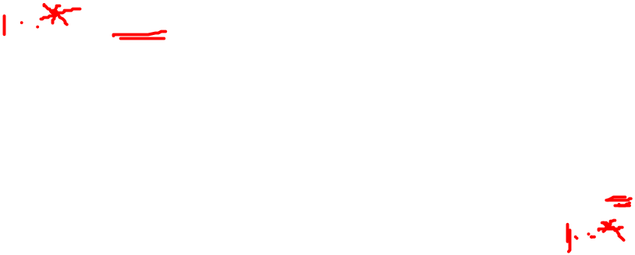

Slide 41
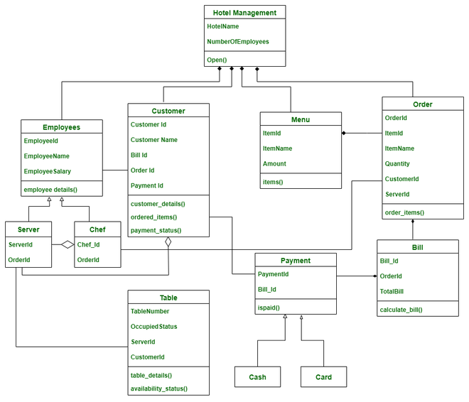
Class diagram for Hotel management system

Slide 42
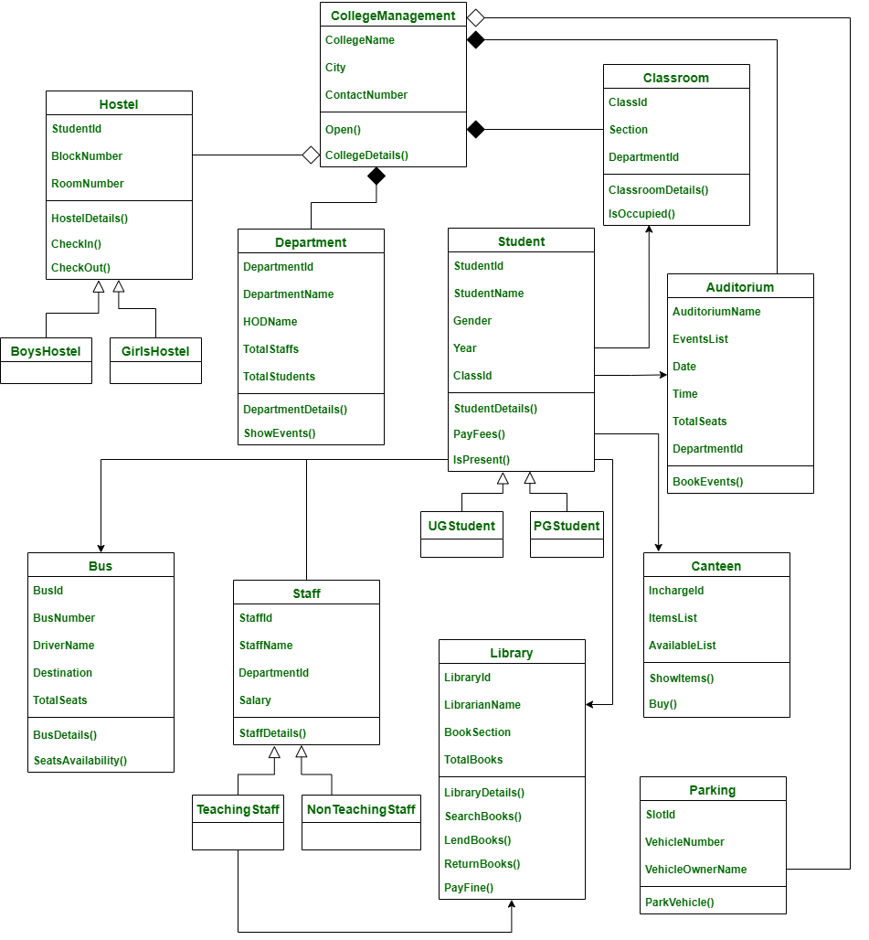
Class Diagram for College Management System

