Slide 1

101Companies Software Product Line
Jefferson Almeida – jra@cin.ufpe.br
Informatics Center
Federal University of Pernambuco

Slide 2
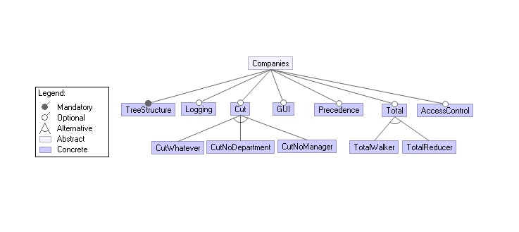
Feature model

Slide 3
Getting Started With Java
Setting up your Java environment:
• Get the suitable Java distribution from the Oracle/Java website.
• Run the installer.
• Add a new system variable with the name JAVA_HOME and the value of the directory Java was installed in.
• Add %JAVA_HOME%\bin to your system path.

Slide 4
Getting Started with Ant
To get up and running with the binary edition of Ant quickly, follow these steps:
1 - Make sure you have a Java environment installed.
2 - Download Ant.
3 - Uncompress the downloaded file into a directory.
4 - Set environmental variables ANT_HOME to your ANT. environment and add %ANT_HOME%/bin to your PATH.

Slide 5
Step 1: Set project.properties file
• Set the path to where this folder is located in your computer in all fields.
• Set the instance-model field to the instance you have chosen.
• Set the target-dir field to the directory where the project will be generated

Slide 6

Warning
• If you choose a target directory where a product has already been generated, clean the folder before generating a new product.
• Optionally, you can change the target-dir in project.properties.

Slide 7
Hephaestus Instance Model
Inside 101Companies\hephaestus folder, choose the product configuration between some of the existing instance models or create a new xml file following the same pattern of the existing instance models and save.

Slide 8
Step 2: Run Hephaestus tool
In your command line:
1 - Go to hephaestus folder.
2 - Run VMCODE.exe.
3 - Type project.properties and hit enter.
4 - When the program asks to generate the product, type y and hit enter.
5 - If no warnings appears, the product was generated with success.
* If you are interested to see configuration knowledge, in hephaestus folder type java -jar ckeditor.jar ck.xml

Slide 9
Step 3 – Run the generated product
In your command line go to the generated product directory.
Type:
ant t : To run the tests of the generated product.
ant r : To run the Main Class of the generated product.
ant ca : To clean all files of the product folder in order to generate another product in the same target.

Slide 10
Generating Products
Three Steps:
Step 1: Set project.properties file.
Step 2: Run Hephaestus tool*.
Step 3: Run the generated product.
* Hephaestus-code is currently available for windows.

Slide 11
101Companies Software Product Line
Jefferson Almeida – jra@cin.ufpe.br
Informatics Center
Federal University of Pernambuco

