Slide 1
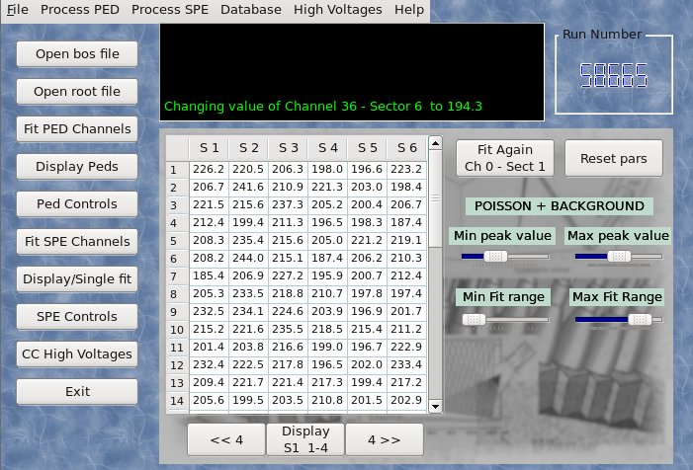
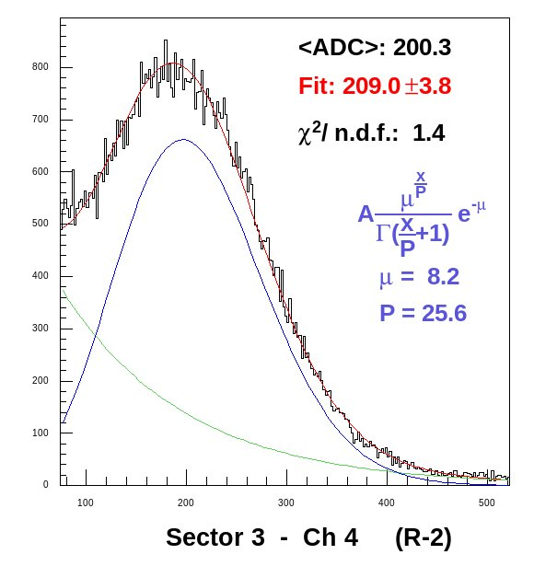
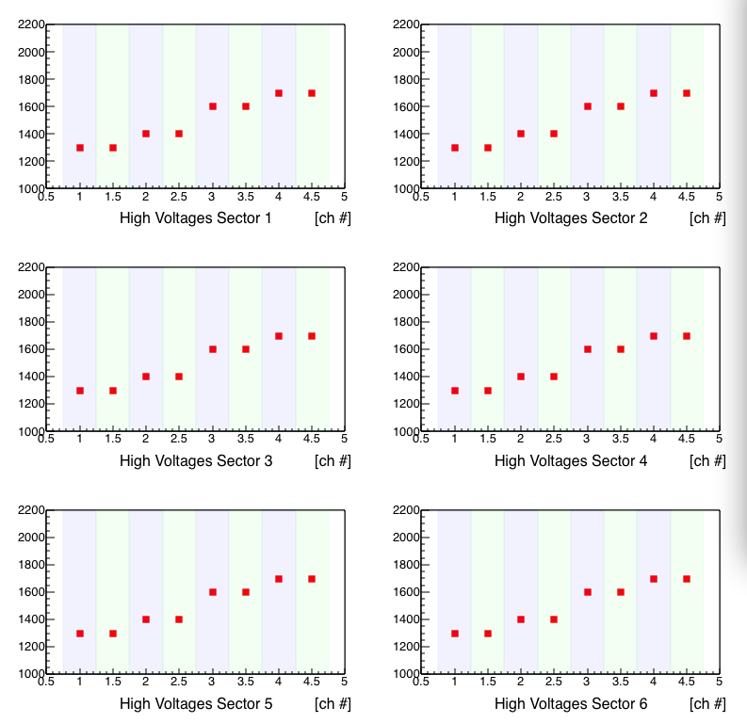
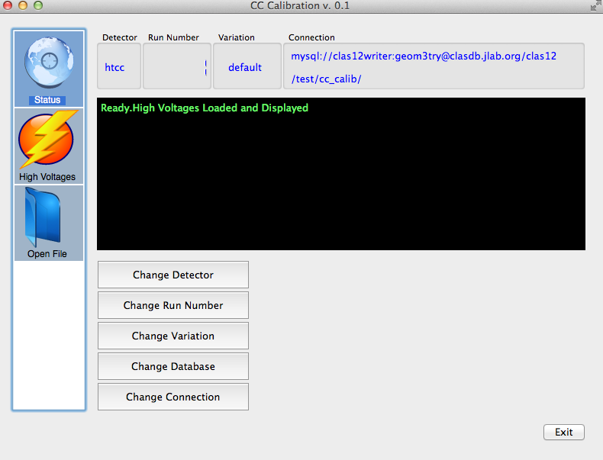
HTCC and LTCC Calibration
N. Markov, M. Ungaro
CLAS6 Calibrations:
HV Matching
Pedestals
SPE calibration
CALDB I/O
ROOT Output
CLAS12 Calibrations:
HTCC and LTCC
HV Matching
SPE analysis
Timing Calibration
CCDBI/O
CAEN SY4527 HV I/O
ROOT Output
Status:
GUI started
Can talk with CCDB
Working on CAEN I/O
Starting actual FADC acquisition, HTCC and LTCC calibrations

