Slide 1
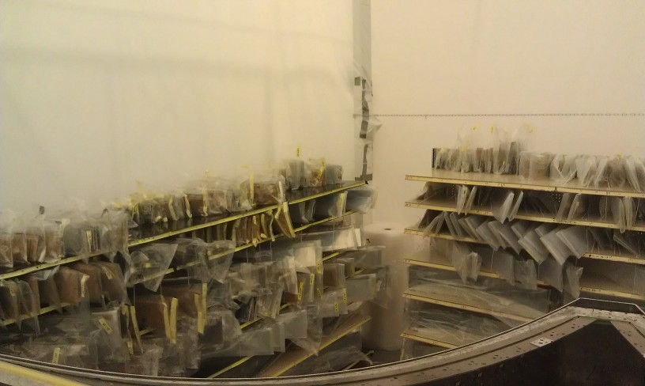
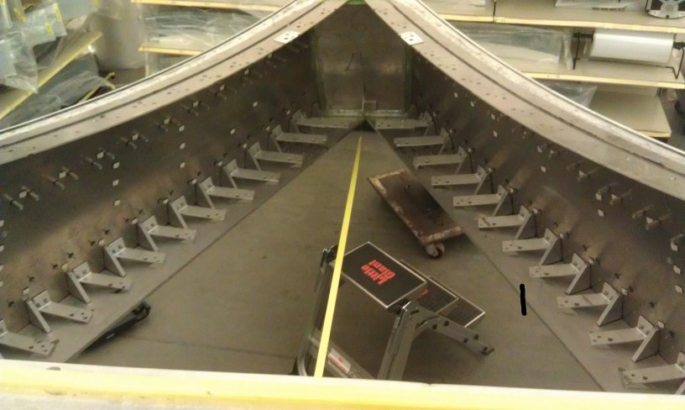
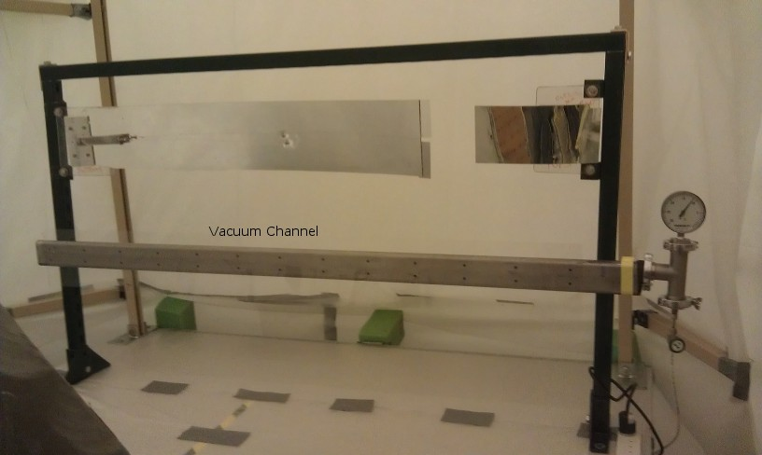
Status of LTCC Commissioning and Calibration
M. Ungaro
Sectors disassembled, cleaned.
Mirrors inspected, catalogued.
Mirrors tooling for re-coating ready.
PMT Wavelength shift tests successful.
Plans in place to cut Box, refurbish back-wall and spine.
Notes:
Questions and Answers

Slide 2
LTCC plans
Cut Box, refurbish back-wall
Re-coat mirrors
Coat PMTs with WLS.
Use HV C++ API to access and control HV
DAQ/Signal checkout
Online calibration / HV feedback based on SPE signal
Timeline: Dec. 2014
Manpower: M. Ungaro, S. Boyarinov. Techs: David Anderson, Todd Ewing

