Slide 1


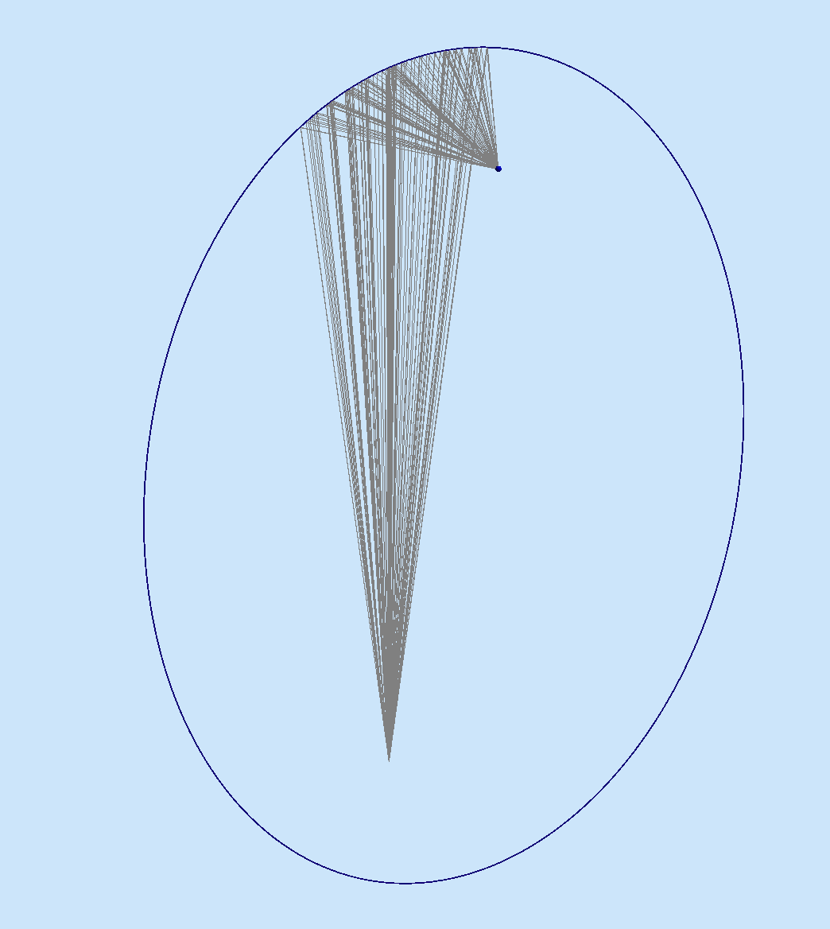
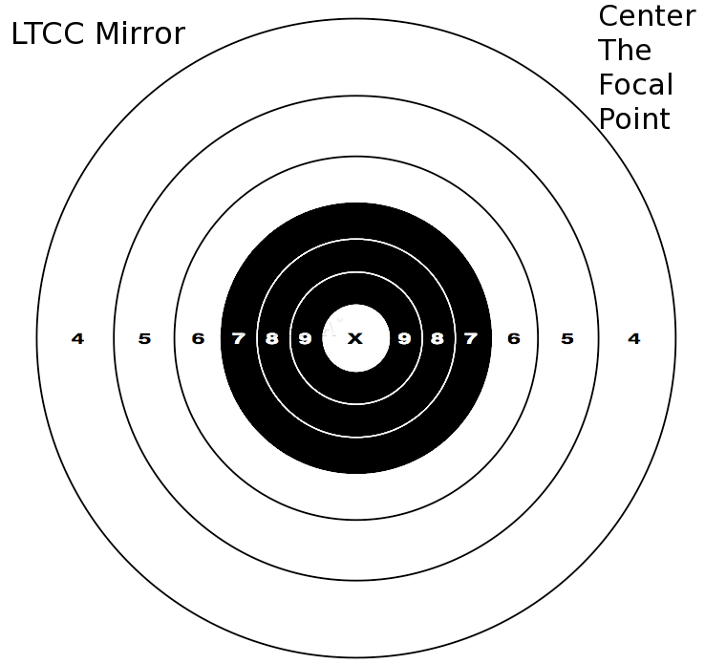
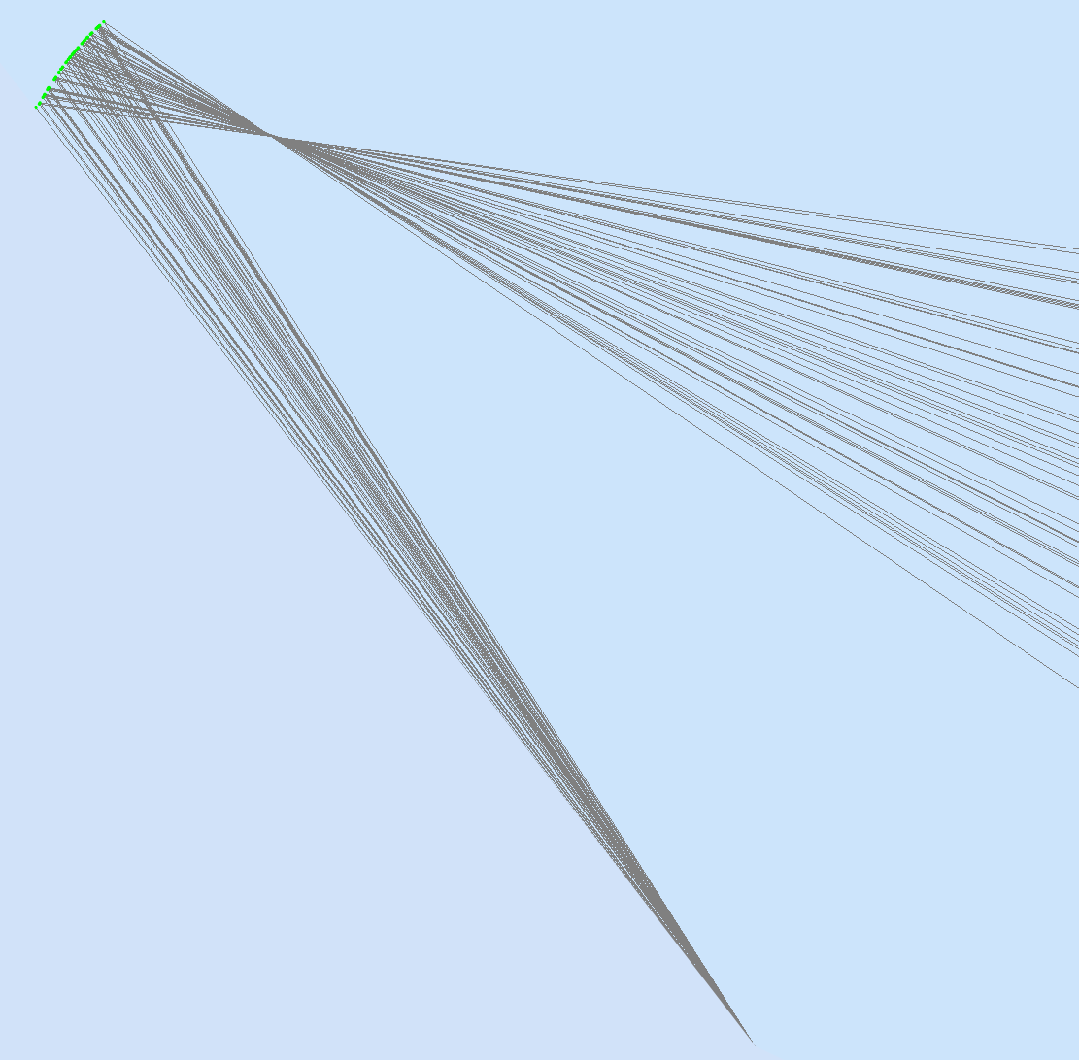
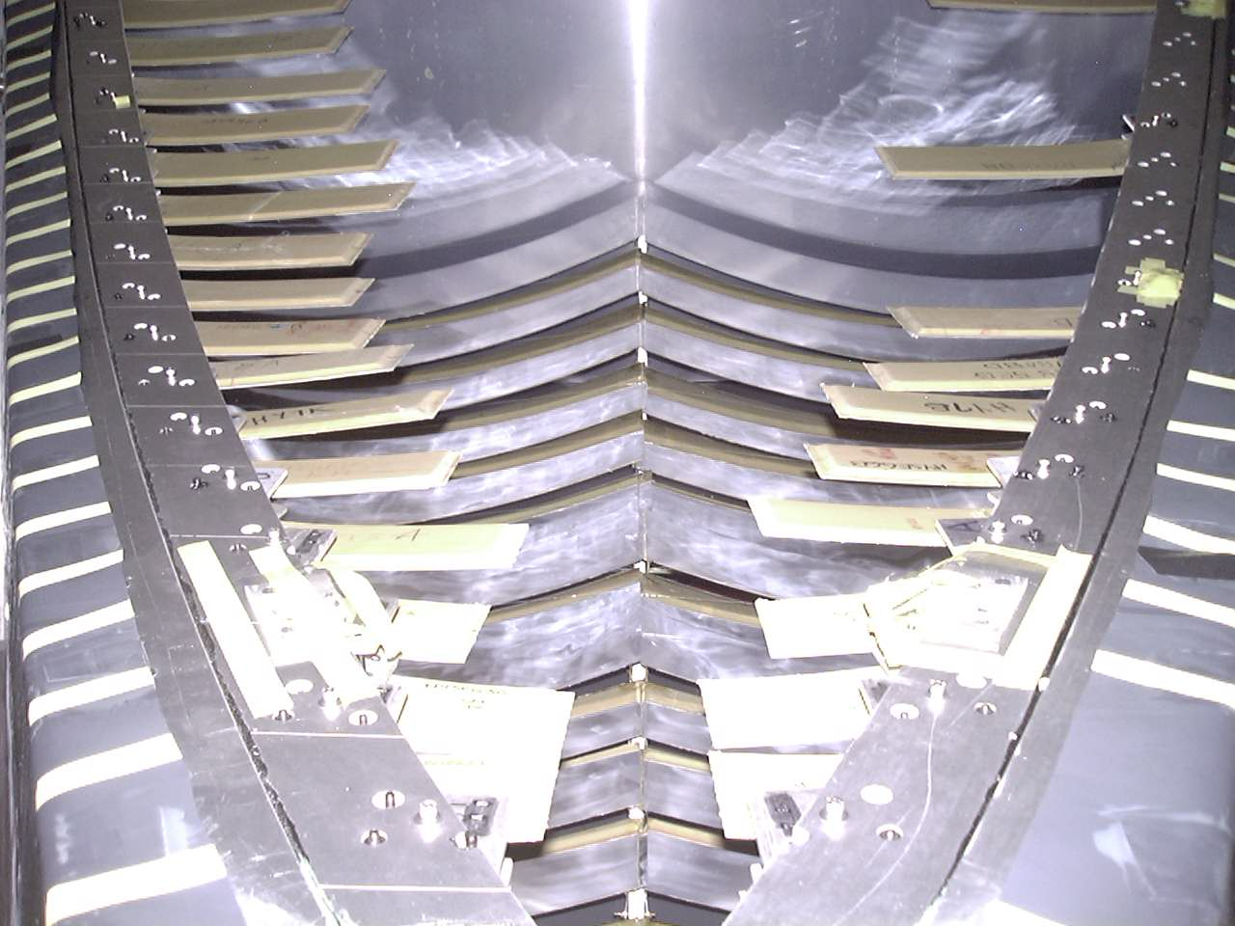
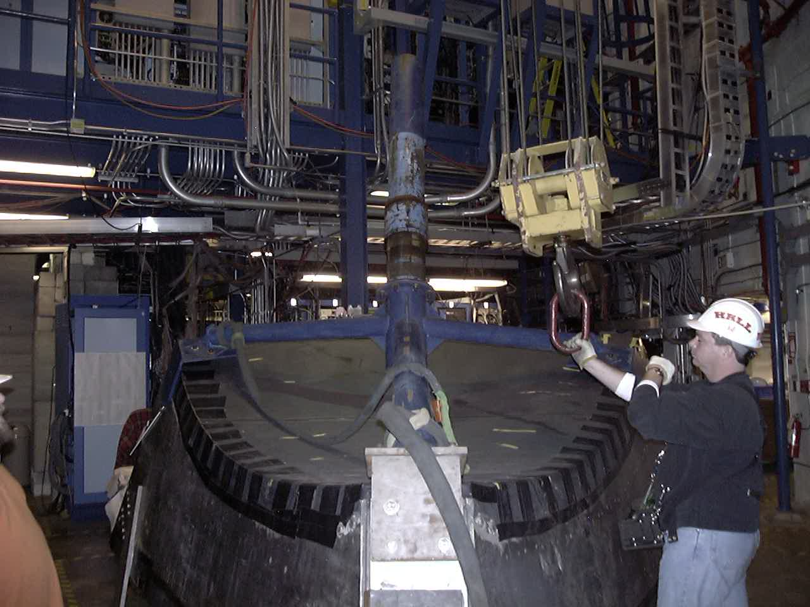
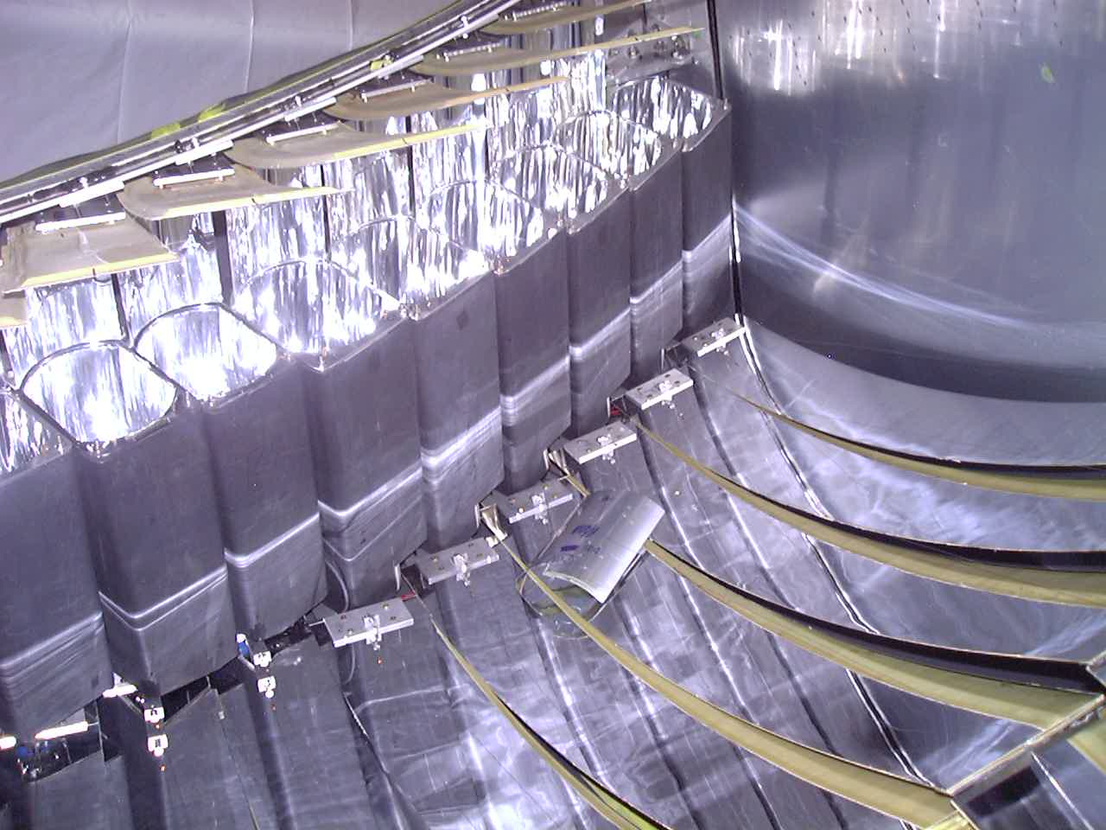
Foci hunter Game
Focal Point
Mirror
Ellipse:
Every photon will bounce from one focal point to the other!
We used this property to build MIRRORS that focus light at one particular location (detector)
We placed a laser line at one focal point directed at the mirror mirror
Find the other focal point!
Hint: it’s where the photons of the laser will focus the most
Focal Point
(laser position)
Ellipse
PMT Mirror
A few actual mirrors
And their light detectors
Photo-multipliers (PMT)
Our detector mirrors:
36 elliptical and 36 hyperbolical
Our detector, closed to make it light leak-tight

