Slide 1
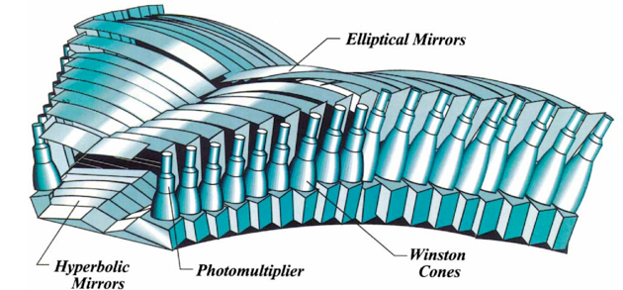
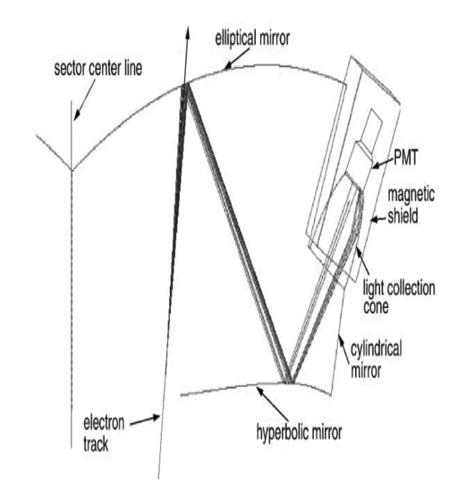
CLAS12 – Low Threshold Cerenkov Counter (LTCC)
The LTCC system is part of the forward CLAS12 detector and will be used to for pions/kaons discrimination. The LTCC consists of 6 sectors of lightweight mirrors, light collecting cones, 5’’ PMTs and magnetic shields. The sectors are filled with C₄F₁₀ gas, providing pion/kaon discrimination from 3.5 to 9 GeV/c. Each sector contains:
108 lightweight mirrors
36 Winston Cones
36 5’’ PMT
36 Magnetic Shields
The LTCC is required to have excellent efficiency over the forward angular acceptance available to CLAS12.
LTCC - TECHNICAL PARAMETERS
PARAMETER | DESIGN VALUE
Mirrors
Support Structure | 3 kevlar layers sandwiched with vinyl foam
Elliptical | Length = 6’’ to 55’’, Width = 8’’ to 11’’
Hyperbolic | Length = 12’’ to 30’’, Width = 8’’ to 9.25’’
Mirror Coating | Al/MgF2
Reflectivity | 90% from 250 to 650 nm
C₄F₁₀ Gas
Refraction Index | 1.00134
Transparency | 100% above 220nm
Density | 9.94 Kg/m³
Window Material | tedlar/mylar/tedlar composite
PMTs
200 | Photonis XP 4500B
16 | Photonis XP 4508 (Quartz Window)
Magnetic Shields
Material | Eagle AAA: 80% Ni, 4.20% Mo, and 15% Fe
Field Attenuation Factor | 85 Axial, 390 Transverse
PID:
π/K Separation | 3.5 to 9 GeV/c

Slide 2
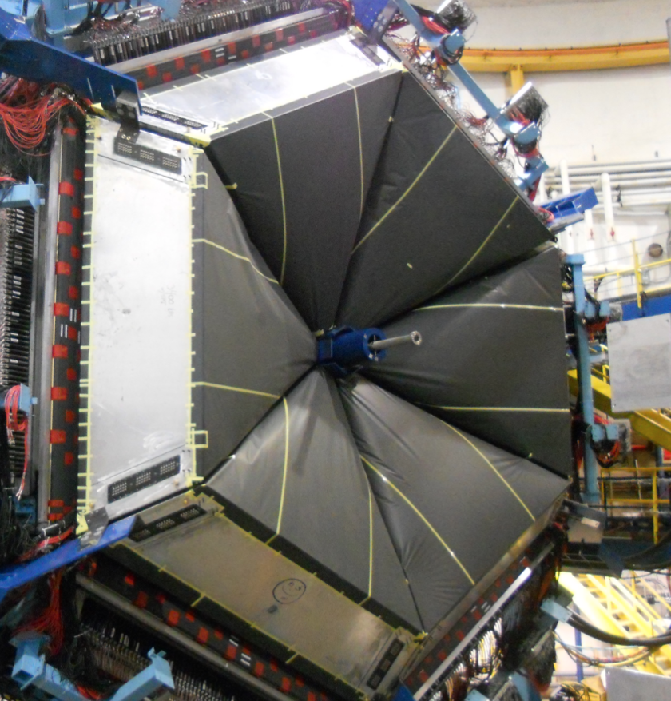
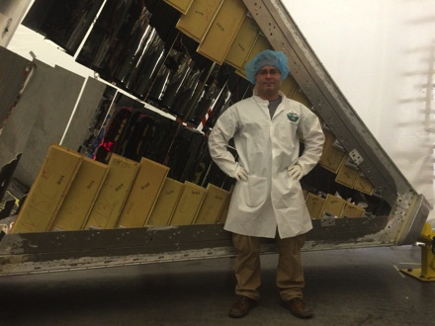



Construction Strategy and Project Leadership:
LTCC system Group Leader: Maurizio Ungaro. Tech Leader: David Anderson
Construction strategy, all at JLAB:
Strip all sectors of PMTs, Mirrors, WC and shielding.
Remodel the LTCC Box according to CLAS12 design.
Refurbish mirrors, PMTs, Box, WC and spine.
Align mirrors for max charged pion efficiency.
Significant dates
May 2013: All sectors stripped.
Feb 2014: Cylindrical Mirrors coated.
Nov 2014: All PMT, Mirrors refurbished
Aug 2015: First box completed.
Jan 2016: Last box completed.
May 2016: all sectors installed.
Project Status
Hardware:
Mirrors refurbished with new coating.
PMTs coated with wavelengthshifter.
New spine, new window, new patch panel
New in-base divider.
Software
Pre-gain matching completed
Ongoing calibration and reconstruction
EVMS (Latifa will complete this information)
EAC = ??, X % complete, Y % Obligated
SPI = X??, CPI =??,
ETC=??, Float=??, Contingency =??
Contact: M. Ungaro, LTCC Group Leader (ungaro@jlab.org) 757-269-7578
L. Elouadrhiri, Control Account Manager (latifa@jlab.org) 757-269-7303
G. Young, Associate Project Manager for Physics (young@jlab.org) 757-269-6904
V. D. Burkert, Hall B Group Leader (burkert@jlab.org) 757-269-7540

