Slide 1
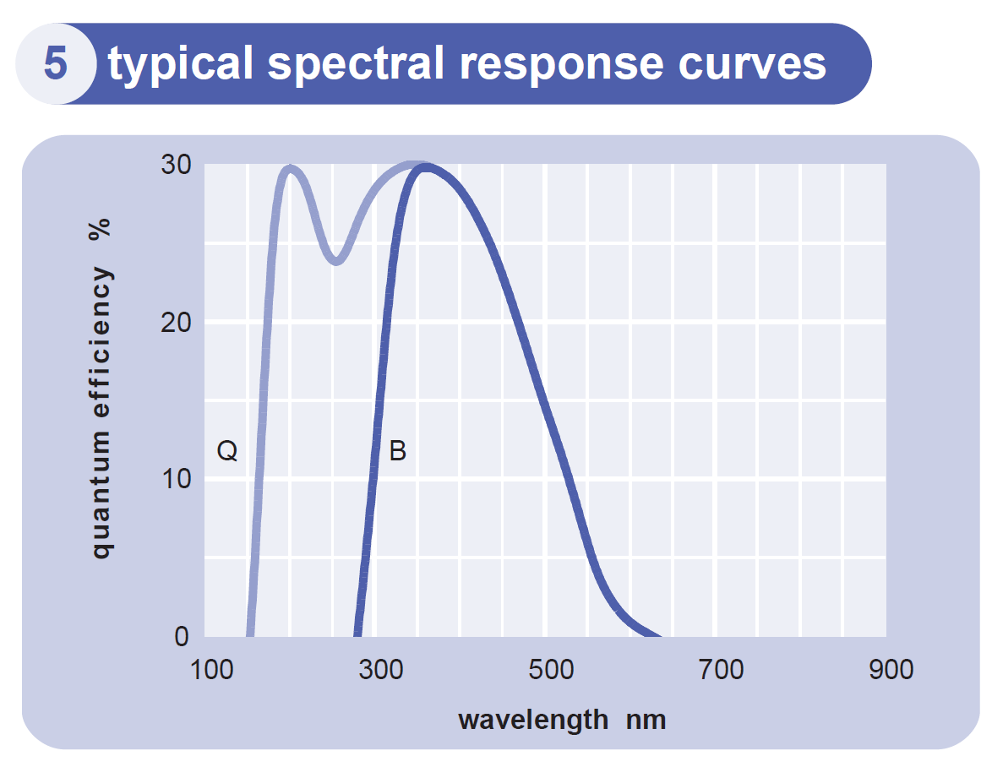
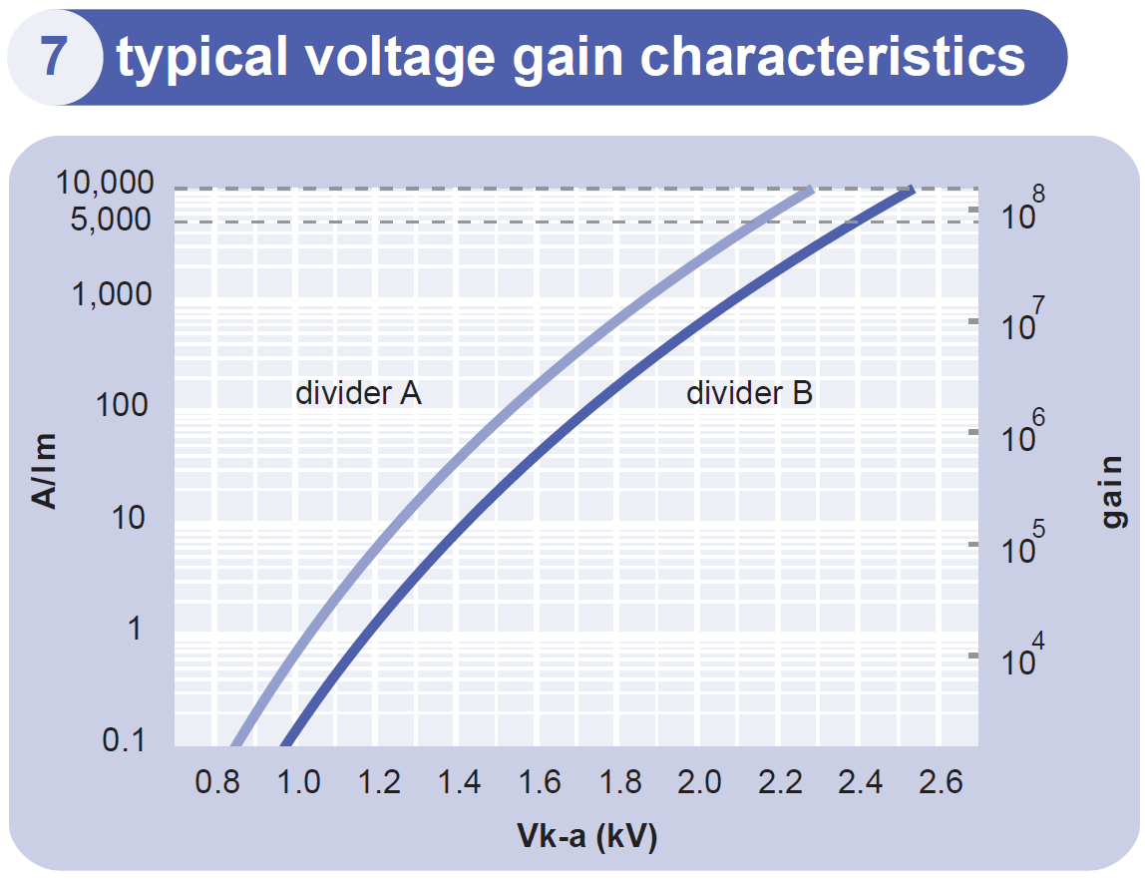
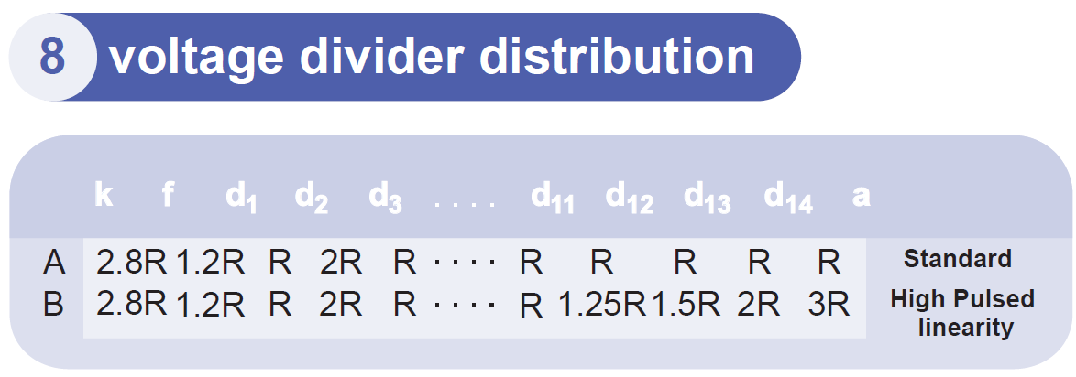
Initial test results of 130mm (5") in dia.9823BQ ET photomultiplier tube.
Description:
The 9823BQ is a 130mm (5”) diameter end-window
photomultiplier with blue-green sensitive bialkali photocathode
on a plano-concave window. It has 14 BeCu dynodes of linear
focused design for good linearity and timing. The 9823QB is a
variant for applications requiring uv sensitivity.
Anode output lin. Limit (5%) 50mA
(2.5V on 50Ω)
Note: V(f-d₁)=30%V(k-d₁)

Slide 2
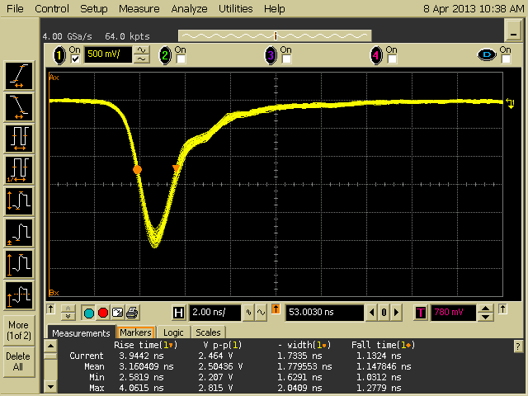
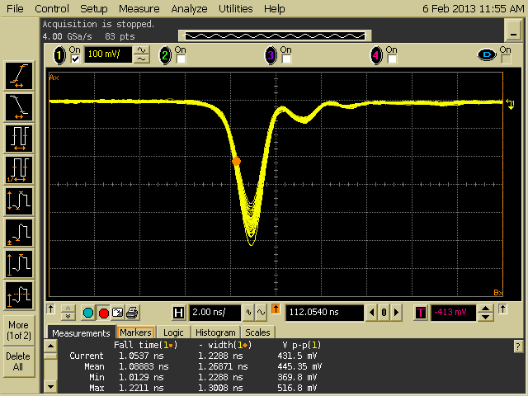
Fast LED light source vs. Hamamatsu Laser light source.
Pulses obtained with R9800 Hamamatsu photomultiplier tube.
LED light source
W=1.8ns, τ_{f}=1.15ns
Laser Light source
W=1.3ns, τ_{f}=1.09ns

Slide 3
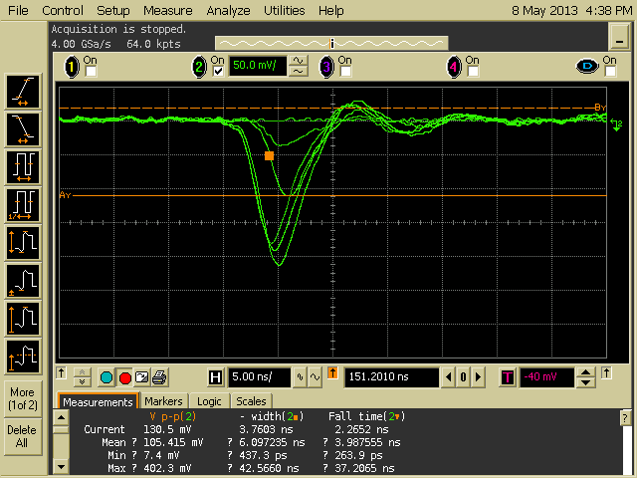
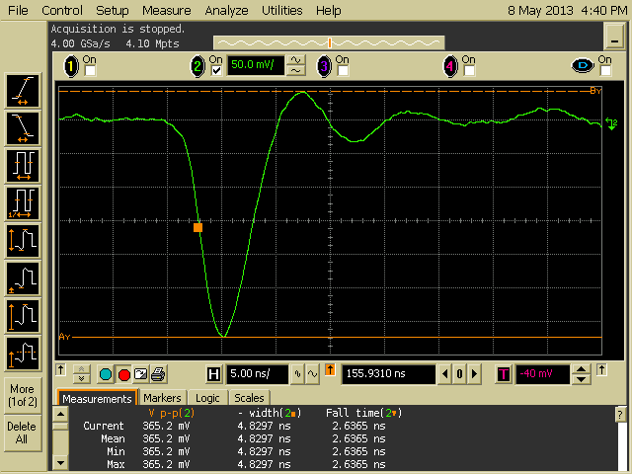
photocathode: bialkali
active diameter mm | 110
quantum efficiency at peak | 30%
anode sensitivity in divider B:
nominal anode sensitivity A/lm | 5000
max. rated anode sensitivity A/lm | 10000
overall V for nominal A/lm V | 2400 | 3000
overall V for max. rated A/lm V | 2550
gain at nominal A/lm x 10⁶ | 80
dark current at 20 ºC:
dc at nominal A/lm nA | 100 | 1000
dc at max. rated A/lm nA 200
dark count s⁻¹ | 1500
pulsed linearity (-5% deviation):
divider A mA | 50
divider B mA | 150
rate effect ( Ia for Δg/g=1%):
timing:
multi electron rise time ns | 3.5
multi electron fwhm ns | 6
single electron rise time ns | 2.7
single electron fwhm ns | 3.6
single electron jitter (fwhm) ns | 2.4
transit time ns | 55
maximum ratings:
anode current μA | 100
cathode current nA | 500
sensitivity A/lm | 10000
V (k-a) V | 2500
V (k-d1) V | 650

Slide 4
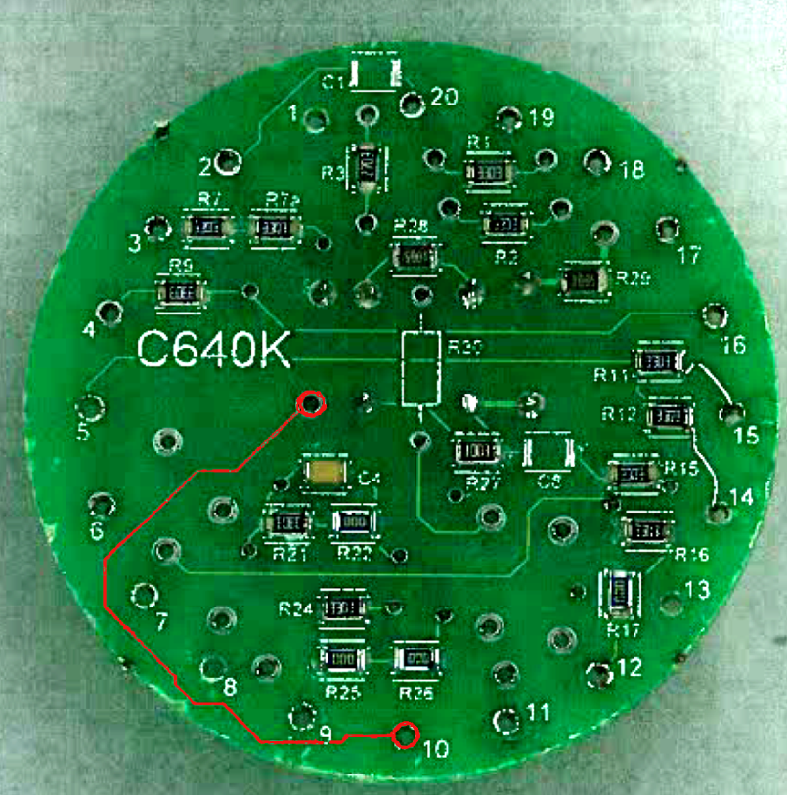
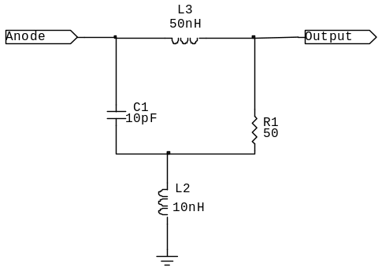
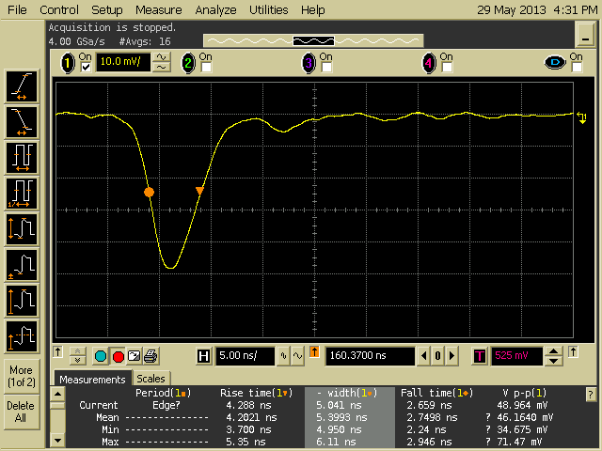
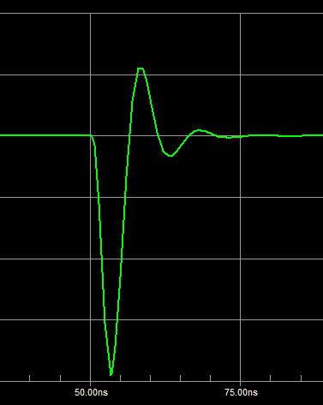
~10ns

Slide 5
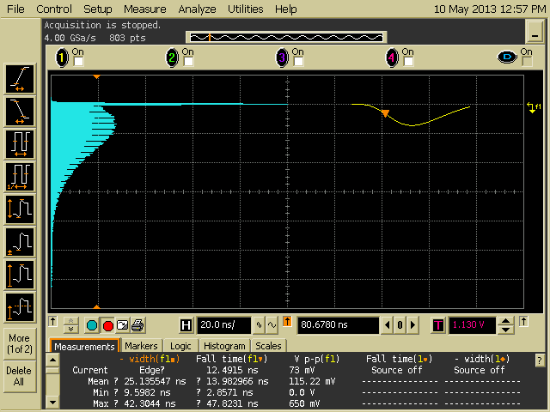
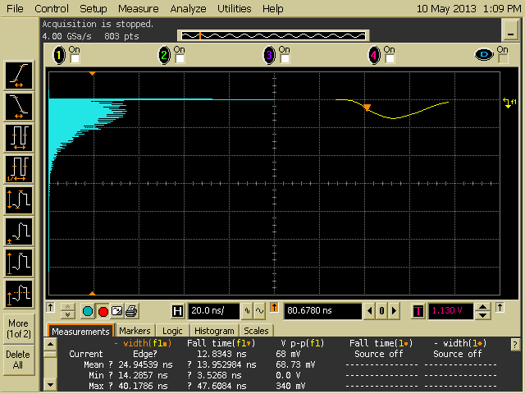
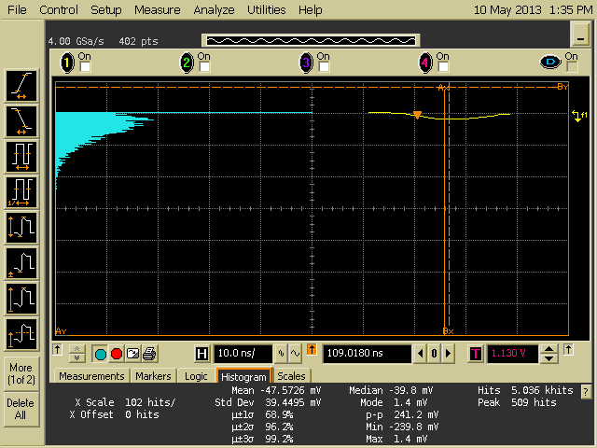
SE Pulse Height Distribution, 50kHz, HV=2.2kV, Digital LPF, 25ns.
HV=2.1kV
HV=1.9kV
LED with fast driver
Scope,
BW=1GHz, 4G/sec
PMT
10ns, TTL
Generator
Synch.

Slide 6
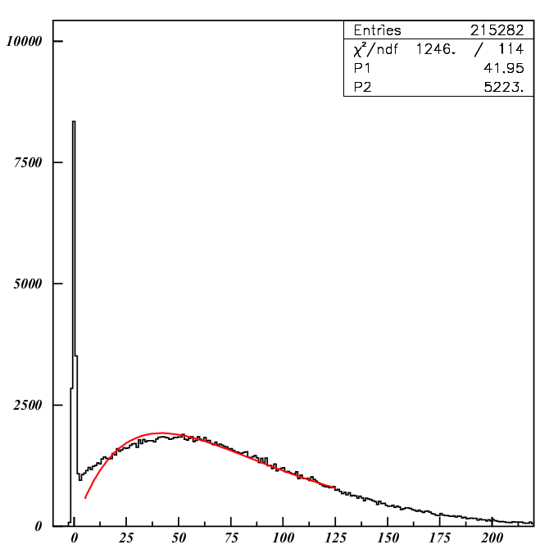
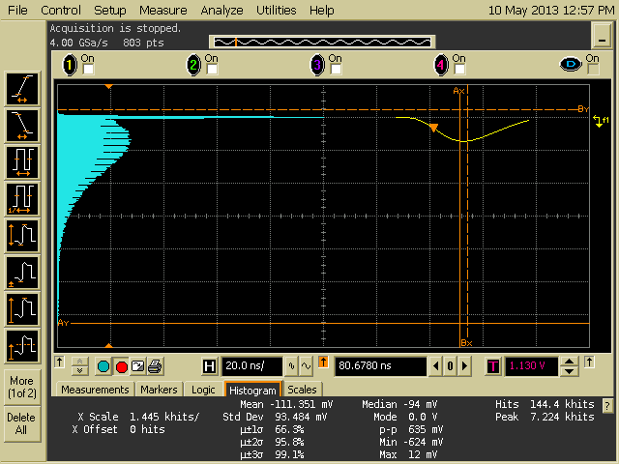
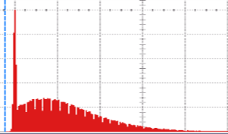
SE PHD, Blue LED, 50kHz, HV=2.2kV,

Slide 7
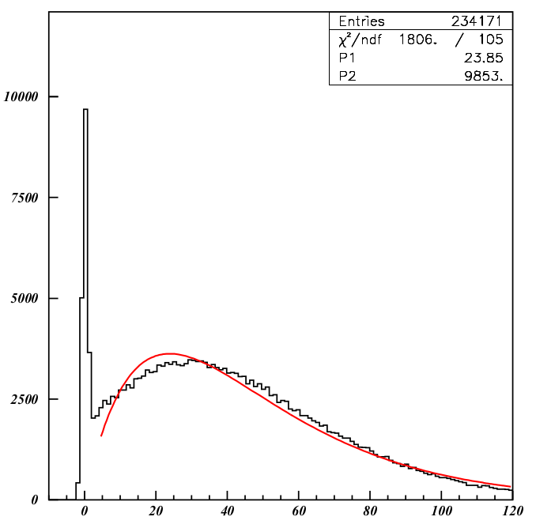
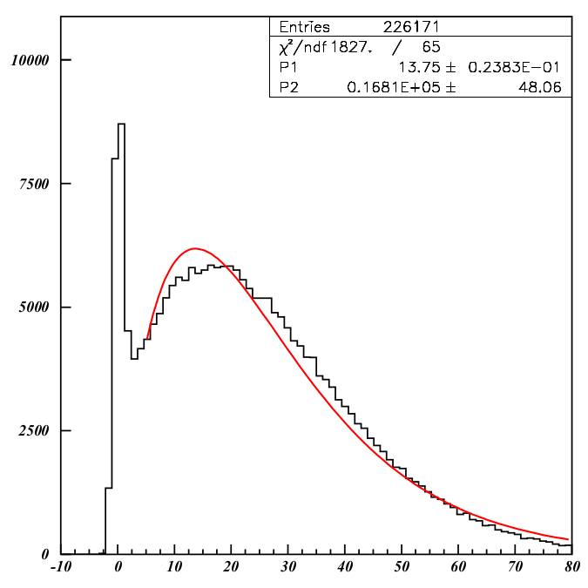
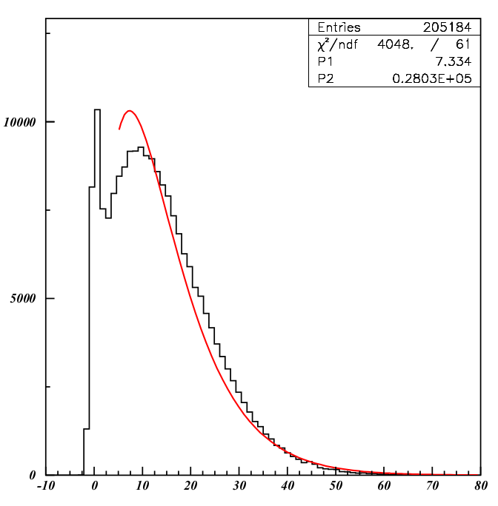
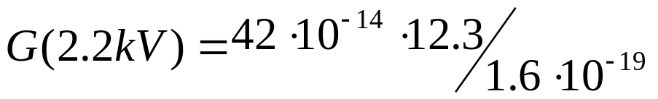
HV=2.2kV
HV=2.1kV
HV=2.0kV
HV=1.9kV
DAQ conv. factor
The SE peak could be observed at HV>1.7kV.

Slide 8
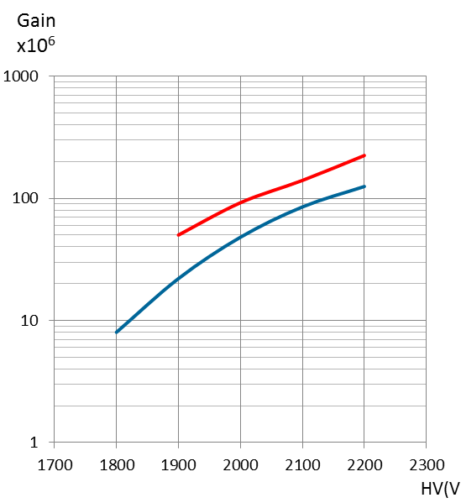
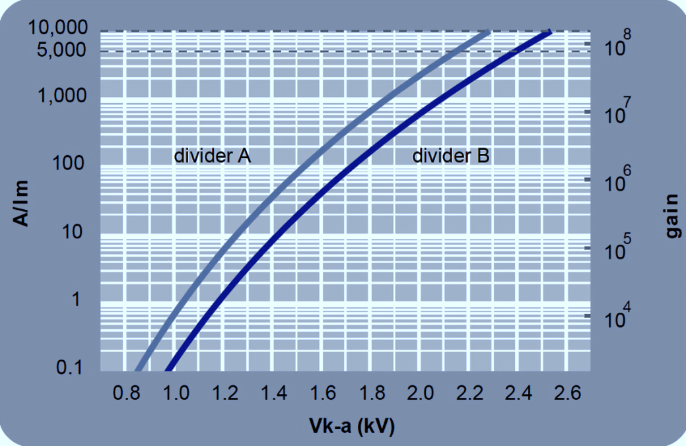
To get about 30 mV of SE pulse gain about (3…4)·10⁷ is require.
If the tube divider made with amplifier (gain factor 5…10), the tube gain below 10⁷
is needed. So the tube operation voltage will be in the range of 1600…1800V.
To get about 30 mV of SE pulse gain about (3…4)·107 is require.
If the tube divider made with amplifier (gain factor 5…10), the tube gain below 107
is needed. So the tube operation voltage will be in the range of 1600…1800V.
To keep the SE peak well resolved the divider chain need correction.
New division chain with 30% increased voltage on (f-d₁) and (k-d₁)
gaps is proposed and tested.
SE gain
Divider A

Slide 9
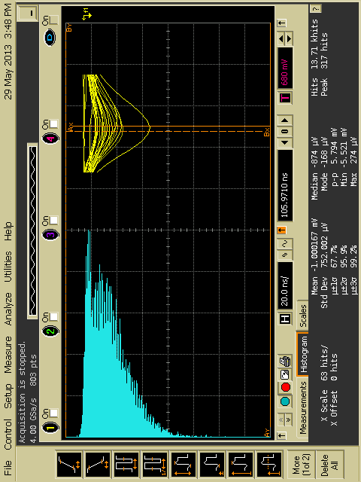
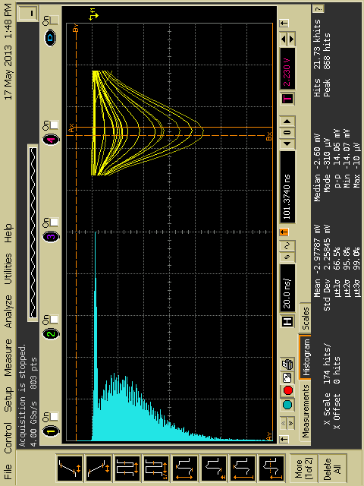
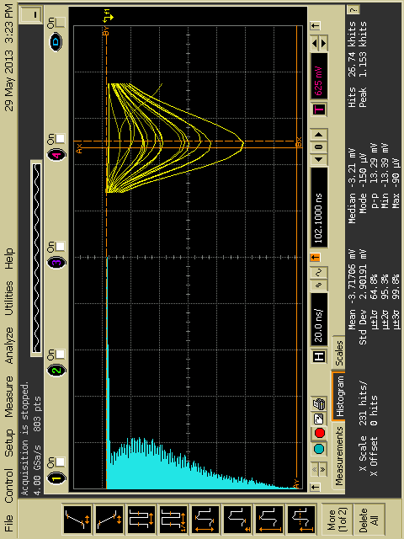
SE PHD spectra with modified divider.
HV=1.5kV
HV=1.6kV
HV=1.7kV

Slide 10
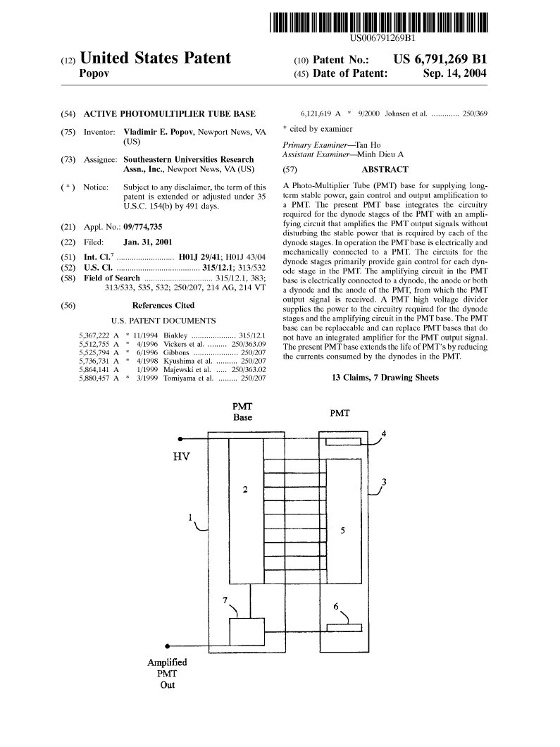
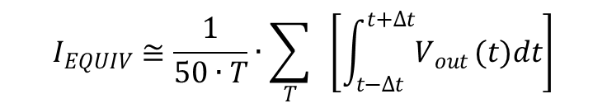
HV
Photomultiplier
Divider
I_{D} ≈ 400…800μA
Anode
Out.1
Amplifier
Out.2
I_{A} ≤ 20μA
Gnd

Slide 11
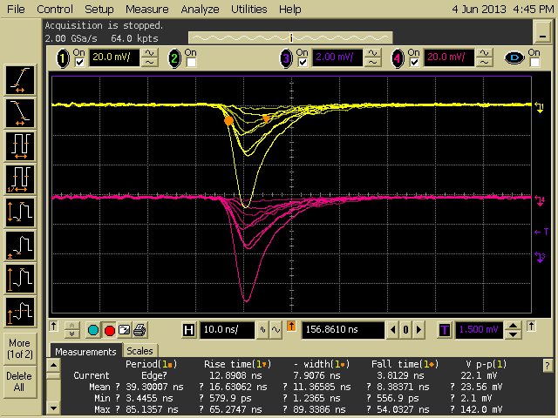
Base with amplifier, HV=1.7 kV

Slide 12
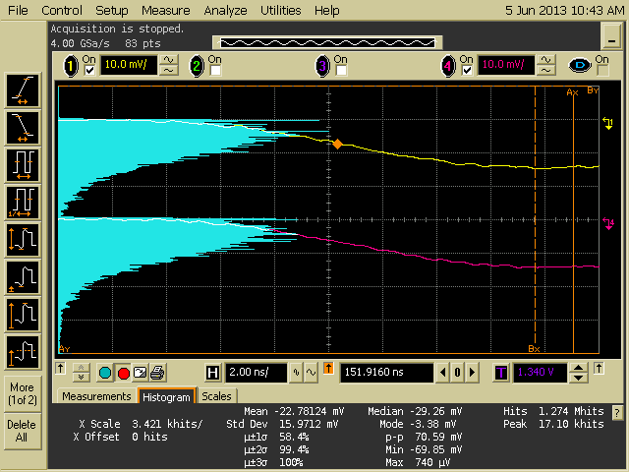
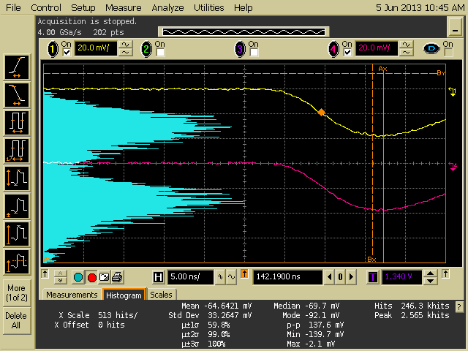
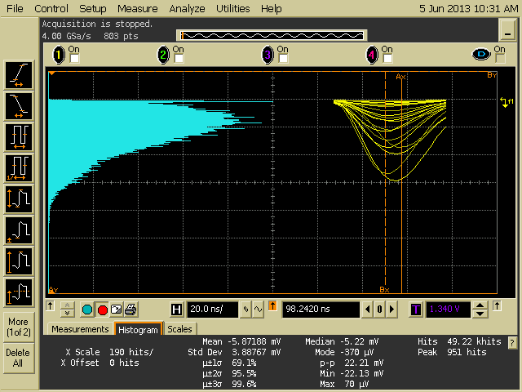
Single e
Multi e
Base with amplifier
HV=1.7 kV,
First Dynode and Focusing
Voltages are increased 30%
Divider current is about ≈ 700 μA
Overall gain is about 5·10⁷
The Amplifier gain ≈ 6

Slide 13
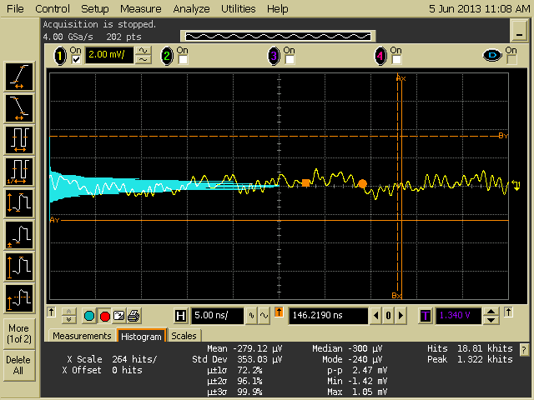
Active Base noise.

Slide 14

C640K by ET, 5.6Meg total
HV
Resistor chain is added. Total current is increased
from 300µA to 800µA.
Photomultiplier
Divider
I_{D} ≈ 400…800μA
Out.1
Amplifier
Out.2
Gnd

Slide 15
130mm (5") in dia.9823BQ ET Photomultiplier tube was tested with standard divider
The tube gain function was measured (calibrated) for low light (single photon) using LED light source with sub nanosecond light pulse width.
Single electron pulse height distribution spectra’s were obtained at different voltages and with modified high voltage divider. New voltage distribution function of PMT high voltage divider is suggested and tested. It helps obtaining better single electron spectra at lower voltage.
The standard ET divider shows a noticeable PMT pulse distortion due to bad PCB layout. (Possible solution proposed).
The photomultiplier base modification prototype (with amplifier powered by current flowing through the divider) was manufactured and tested.
Next steps
Design and manufacturing of PCB board with amplifier circuit and high voltage divider modification components.
Production of few modified photomultiplier bases for testing and final adjustment to meet all requirements (gain, single electron PHD quality etc).
Developing of calibration technique suitable for use in experiment (like obtaining the single electron spectra from thermal noise or other source).

