Slide 1
Coating and Performance tests of 5” PMTs for the Hall B LTC
Brandon Elman
Edward Kaczanowicz
Kyle Johnston
Zein-Eddine Meziani

Slide 2
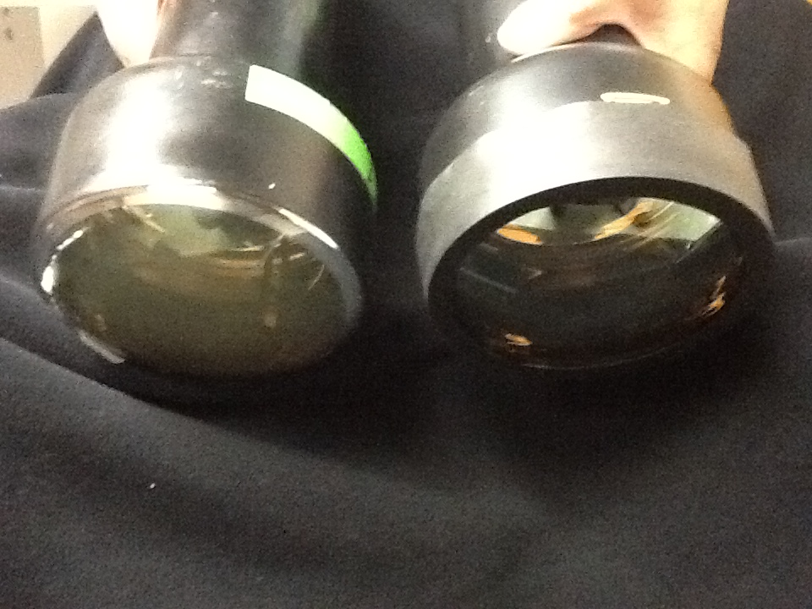
Bare and Coated PMT
PMT 1
PMT 2
After coating the face with
p-Terphenyl
Bare PMT
MgFl not yet applied

Slide 3
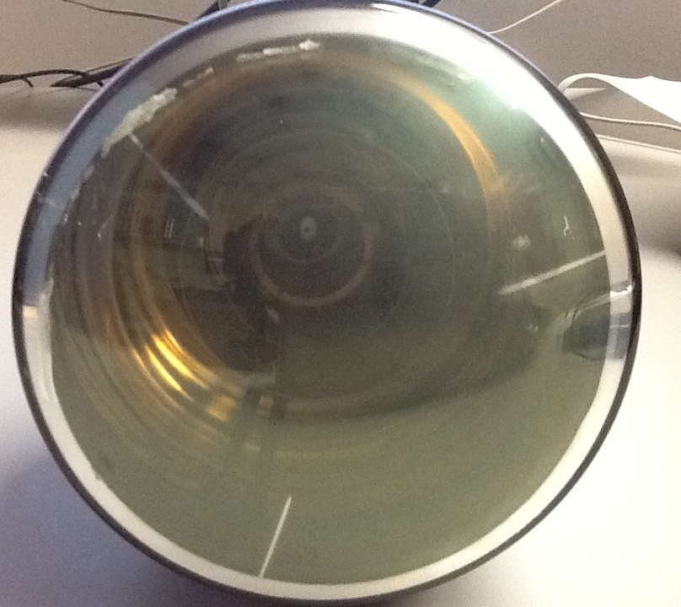
A better view of the p-Terphenyl coating

Slide 4
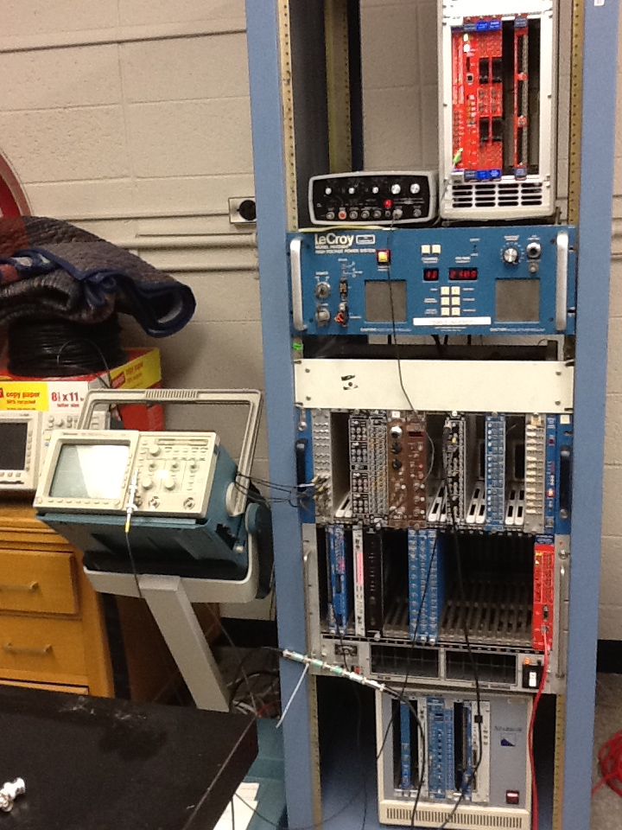
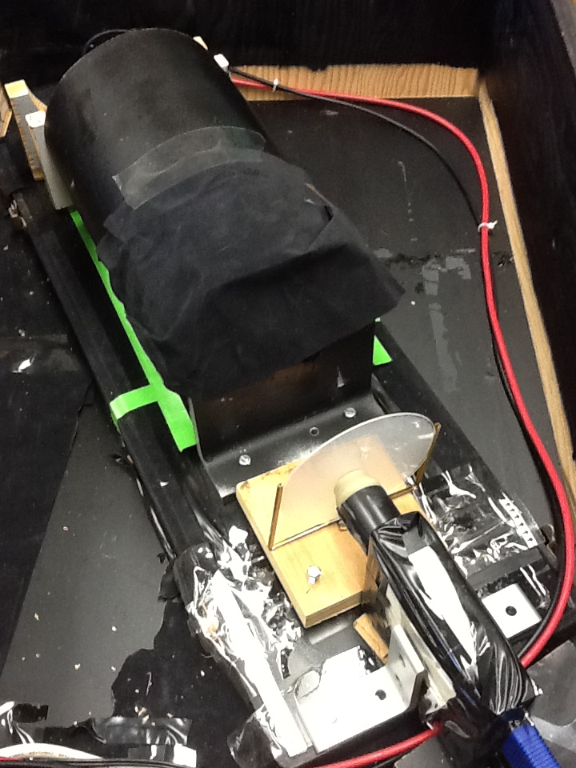
Flexible Setup for testing the PMTs*
PMT inside mu metal shield
Pinhole for
Light to reach
PMT
VME data aquisition
Coated quartz silica plate
UV lamp
Coated plates were used before the PMT was directly coated
We are in the process of improving the setup with a better UV lamp

Slide 5
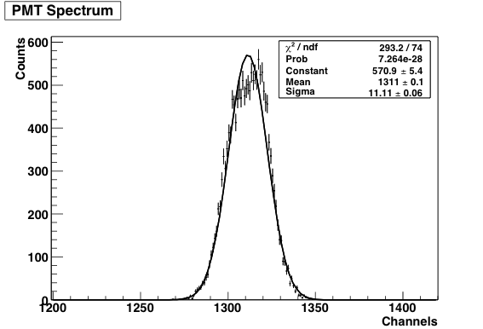
Bare PMT_1 spectrum using a Xenon lamp and a pinhole. a) PMT voltage at 2100 V b) Signal large but attenuated to less than 5V. Saturation could be an issue. The setup isn’t ideal in that the lamp is too powerful even with a small pinhole
Bare PMT spectrum

Slide 6
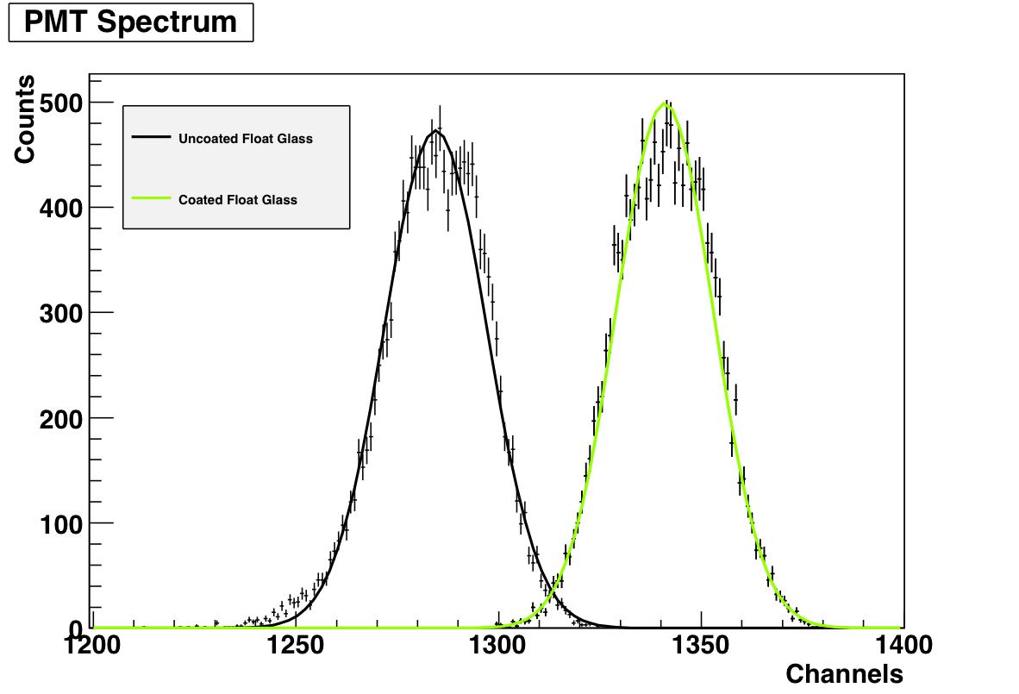
Blank UV glass: Mean: 1284.44 Sigma: 12.5793 Coated UV Glass: Mean: 1340.96 Sigma: 11.9620 Gain: ~21%
For a start the tube face isn’t coated.
We compare measurement with a coated UV glass plate
vs an uncoated UV glass plate.
We clearly see a 21% gain due to the WLS

Slide 7
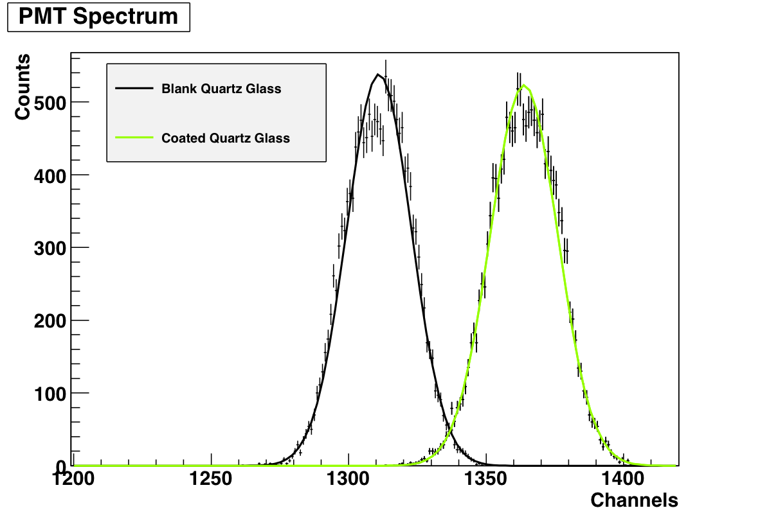
Same comparison as previously but here instead of UV glass plates we use quartz glass

Slide 8
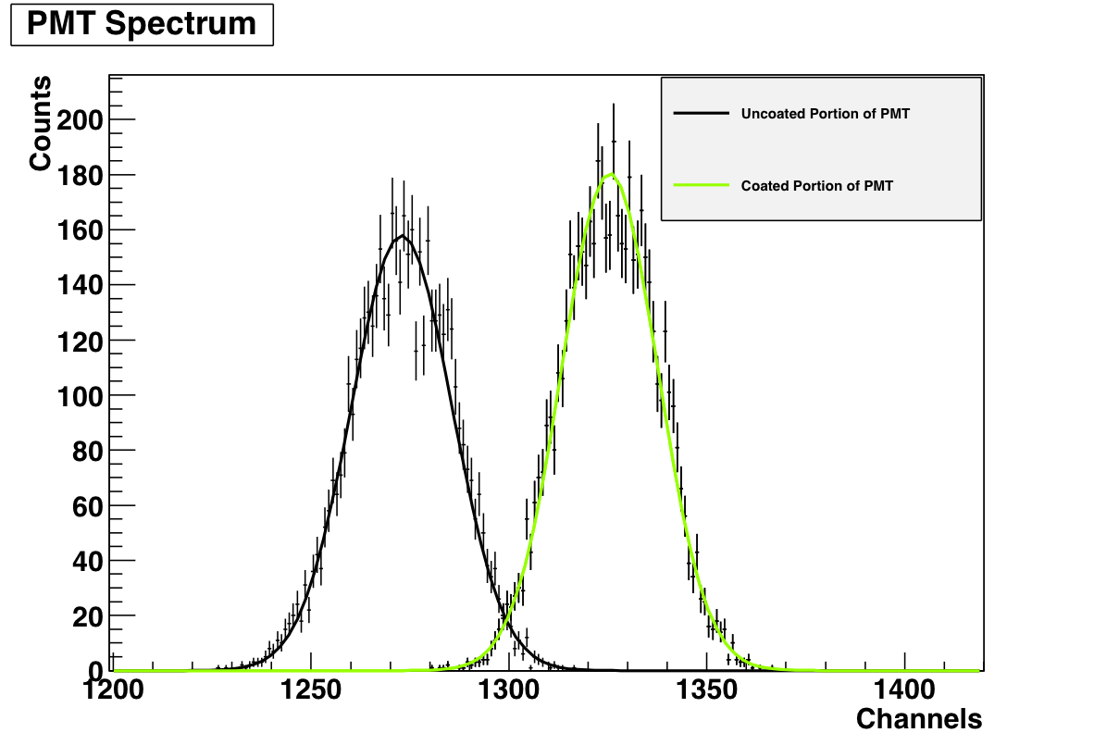
Uncoated portion of PMT Mean: 1272.88 Sigma: 12.759
Coated portion of PMT Mean: 1325.45 Sigma: 12.1560 Gain: 19%

Slide 9
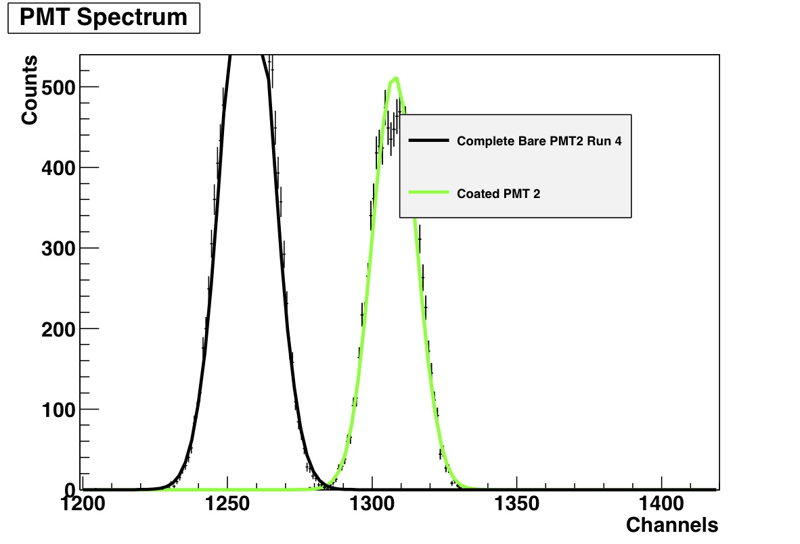
PMT 2: Comparison between response of bare PMT vs coated one
Uncoated:
Mean: 1256.87
Sigma: 8.63327
Coated:
Mean: 1307.65
Sigma: 7.67433
Gain: 37%

Slide 10
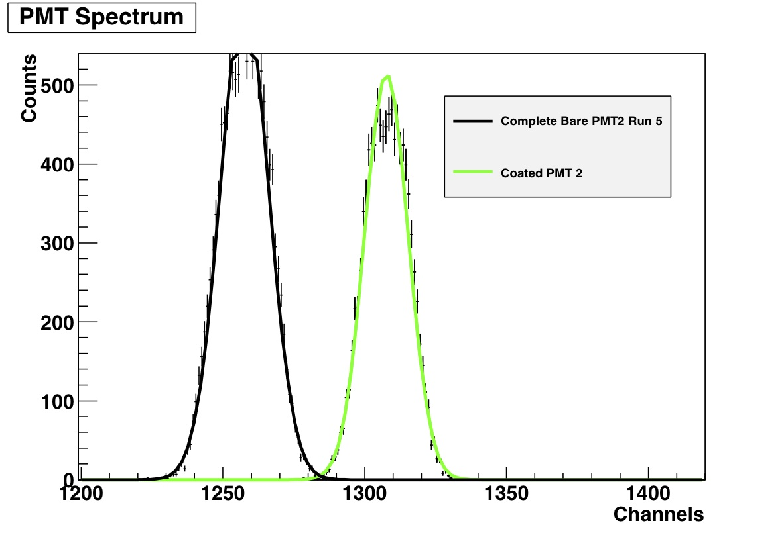
PMT 2: Comparison between response of bare PMT vs coated one
Uncoated:
Mean: 1257.57
Sigma: 8.59515
Coated:
Mean: 1307.65
Sigma: 7.67433
Gain: 36%

Slide 11
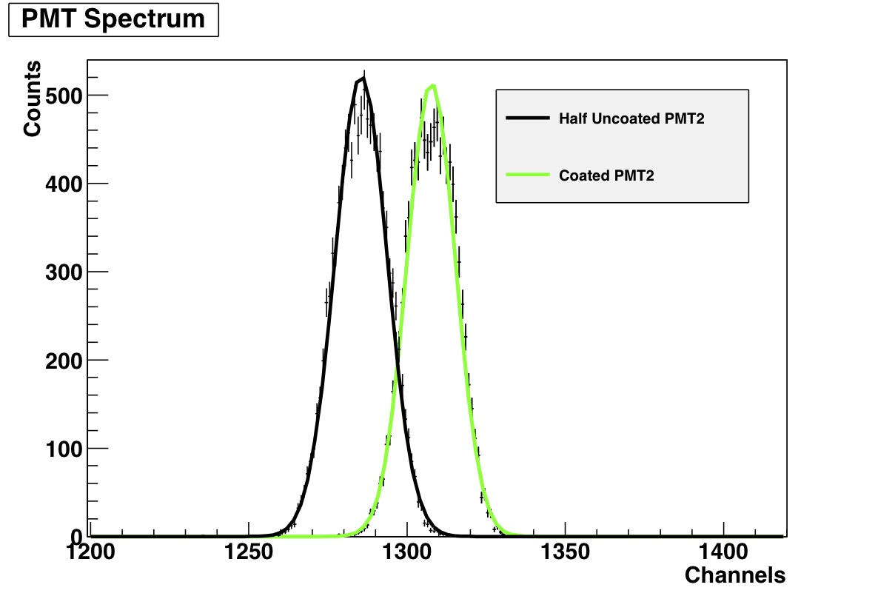
PMT2 was wiped across the diameter thus most of the light was going through an uncoated area however some of it still excited the p-Terphenyl
Uncoated:
Mean: 1285.47
Sigma: 8.23189
Coated:
Mean: 1307.65
Sigma: 7.67433
Gain: 20%

