Slide 1

Calibration database
Dmitry Romanov
October 4, 2012

Slide 2
Calibration Constants Data Base package
Calibrations storage
Calibrations management
API for JANA, C++, Python, Java
Simple and fast
CCDB
Package

Slide 3
Basic concepts
/path/name
Column 1 | Column 2 | Column 3 | Column 4 | Column 5
value 11 | value 12 | value 13 | value 14 | value 15
value 21 | value 22 | value 23 | value 24 | value 25
value 31 | value 32 | value 33 | value 34 | value 35
Column 1 | Column 2 | Column 3 | Column 4 | Column 5
value 1 | value 2 | value 3 | value 4 | value 5
Column 1 | Column 2 | Column 3 | Column 4 | Column 5
double 11 | double 12 | double 13 | int 14 | double 15
double 21 | double 22 | double 23 | int 24 | double 25
double 31 | double 32 | double 33 | int 34 | double 35
Data presented as tables
Identified by /name/paths
Versions
Branching (variations)
No Delete & “Update” (by adding new versions)

Slide 4
Branching and versioning
/simple/constants
Variations provide branching
Users can create variations to work with their versions of constants
Main branch is called “default” variation
X | Y | Z
01/01/2011
1 | 1 | 1
02/03/2011
1.1 | 1.2 | 1.3
Variation: “john”
Time line
03/11/2011
04/12/2011
3 | 4 | 5
1.11 | 1.22 | 1.33
05/15/2011
3.5 | 4.5 | 5.5
06/01/2011
3.5 | 4.5 | 5.5
…
User enters: /simple/constants User gets: 1.1 ; 1.2 ; 1.3;
User enters: /simple/constants variation: jhon User gets: 3 ; 4 ; 5;
User enters: /simple/constants variation: john User gets: 3.5 ; 4.5 ; 5.5;
User enters: /simple/constants User gets: 1.11 ; 1.22 ; 1.33;
User enters: /simple/constants User gets: 3.5 ; 4.5 ; 5.5;

Slide 5
Requesting particular constants
Simplest query (used most of the time):
/simple/constants /FDC/strip_calib
<name_path>
:
<run>
:
<variation>
:
<time>
Unique. Specifying all fields makes identifier for the constants.
Intelligent. One can skip any part on the right of the name
Unique constants id Latest constants for mc var.
Latest for November 2012-11 Latest constants for 2013 mc
/simple/constants : 101 : mc : 2012-11-21 20:19 /simple/constants : : mc
/simple/constants : : : 2012-11 /simple/constants : : mc: 2013

Slide 6

Files vs CCDB
Text files
Databases
No connection needed
No dependencies
Dead simple operations
SQL database engine.
Versioning
Branching
Changing
Logging
…
But needs connection

Slide 7

SQLite
The most widely deployed SQL db engine in the world
SQLite is a library that:
self-contained
serverless
zero-configuration
transactional
SQL database engine
It is a simple gluex.sqlite file!
SQLite is now embedded in CCDB

Slide 8
Network infrastructure
MySQL
Replica
Local CCDB usage
World
SQLite
JLab
MySQL

Slide 9
Switch to CCDB
Hall B people tested it for about a year
CCDB versions
0.4
0.5 (trunk)
0.6 switch
Last tag
Stable
Only MySQL
Current trunk
Try to test it
MySQL + SQLite
New features
Stable and tested 0.5 version
Default calib source
Release plan
Beta
Massive testing
Default

Slide 10
Goals of switching
Everything is thoroughly tested
No overhead of compiling and installing dependencies
For users – transparent switch. Only change connection: from file:///path/to/calib/dir to mysql://ccdb_user@server or sqlite:///path/to/gluex.sqlite
For constants makers - simple adding of constants

Slide 11
CCDB switch preparation plan
re-establish baseline
updated database
jana tests working
create automatic build procedure for trunk
file-based constants, update-able from database
SQLite
export to SQLite
SQLite tests
turn on web interface
advertise existence/features, find users
document for getting started for constants authors
update installation on JLab CUE
replicate to outward facing server (hallddb1)
switch authority from files to database
expand installation to other platforms (jlabl1)

Slide 12
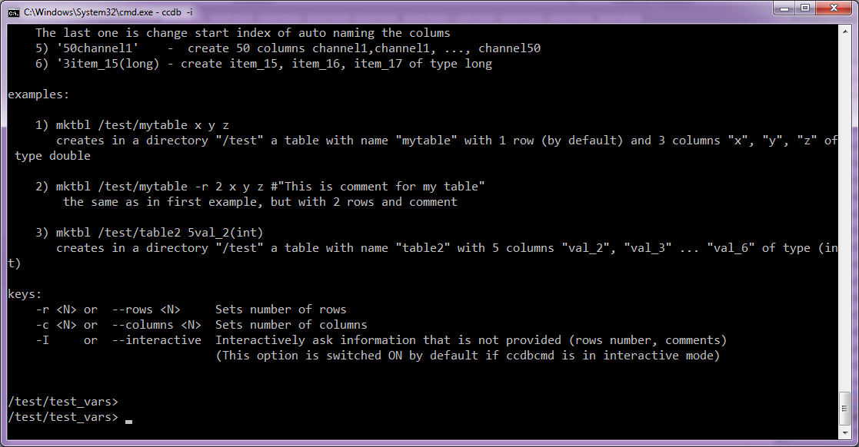
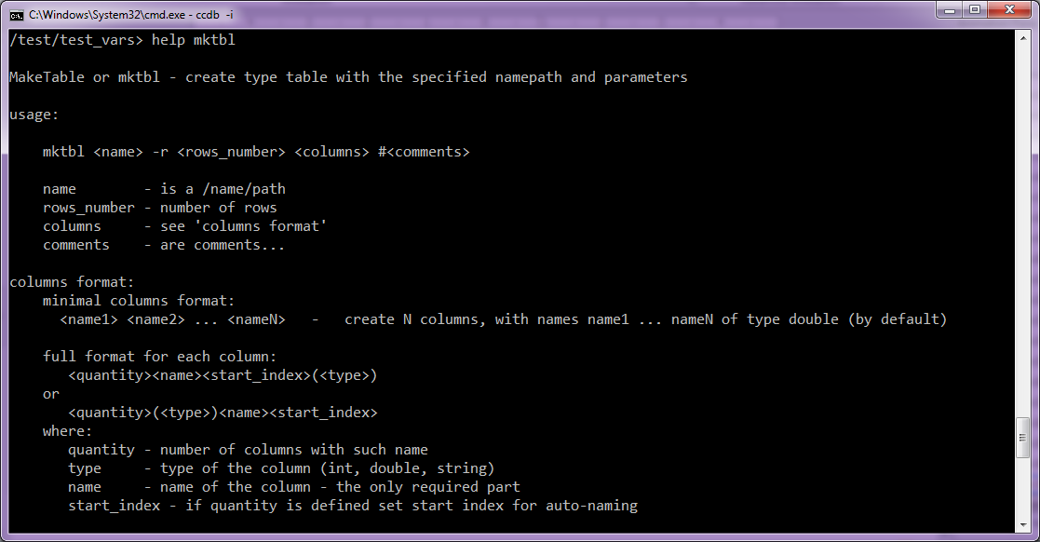
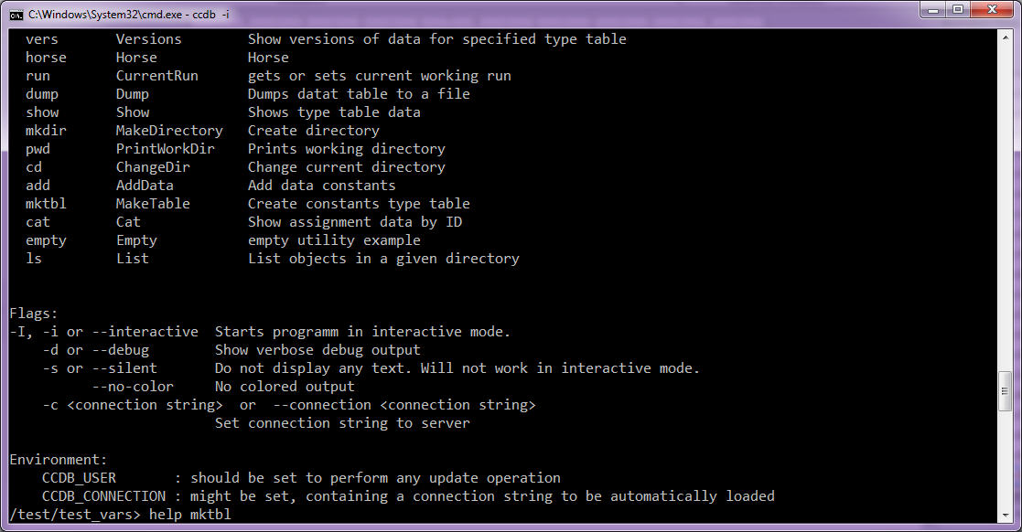
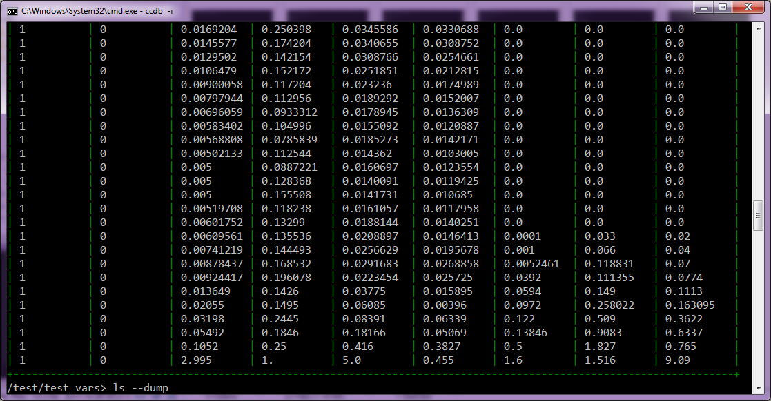
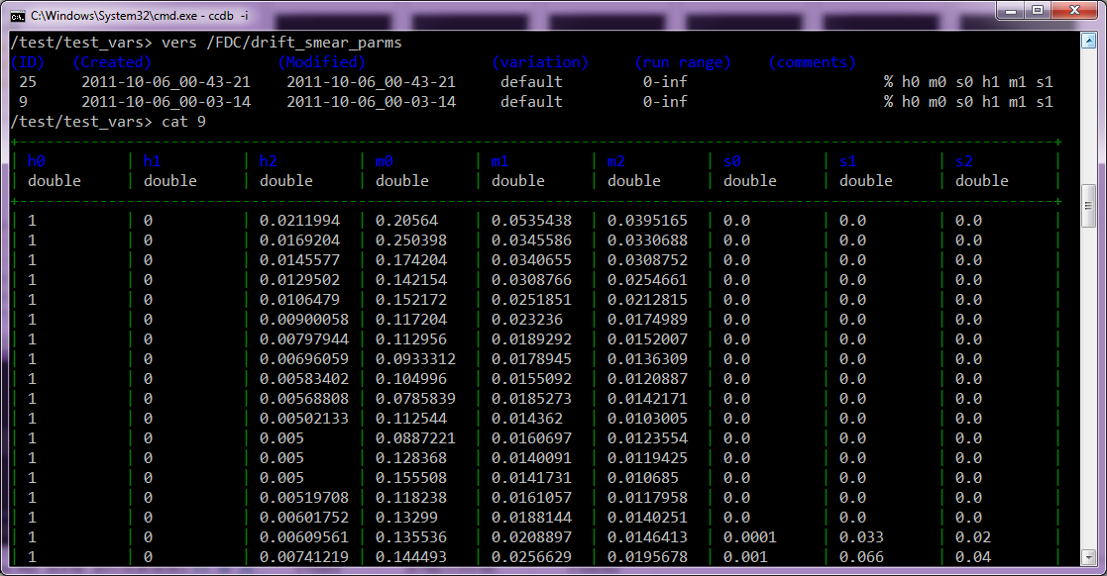
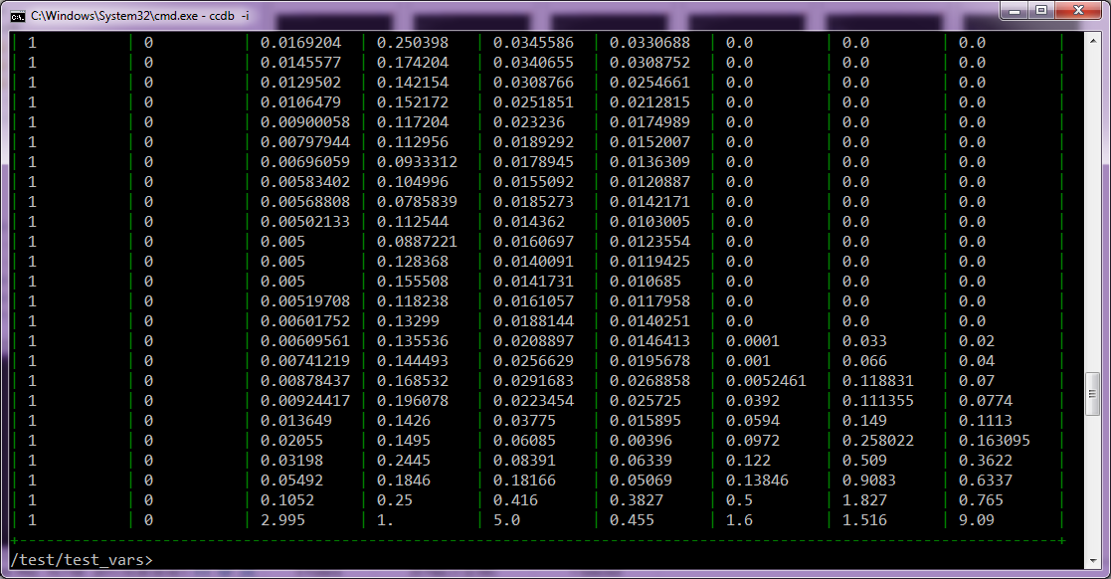
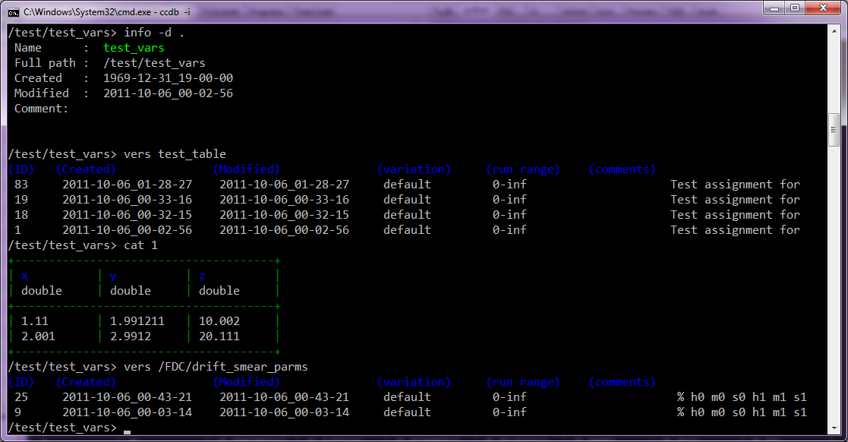
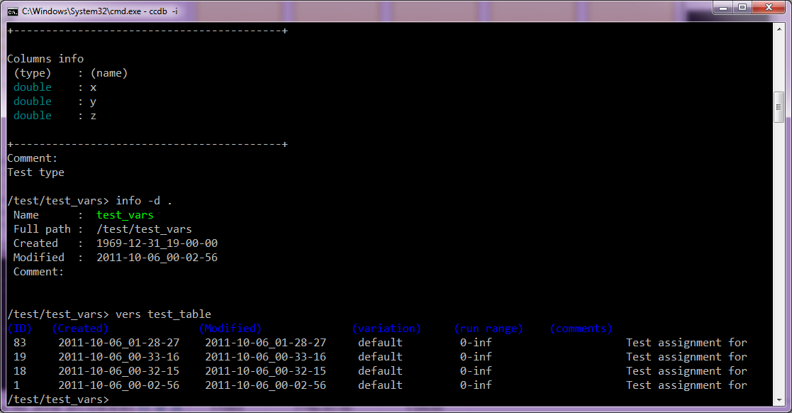
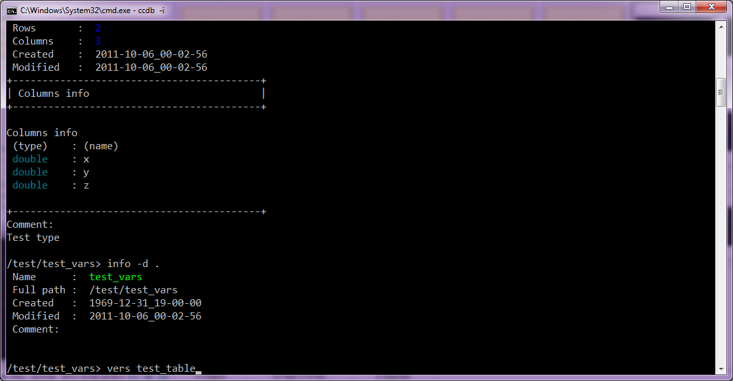
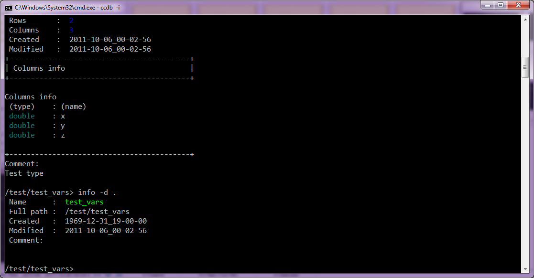
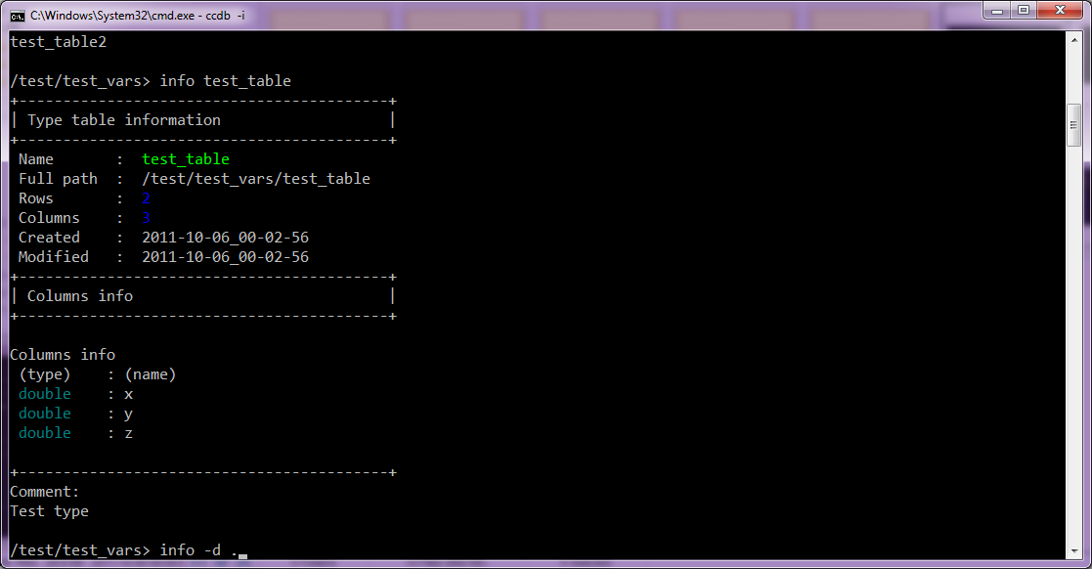
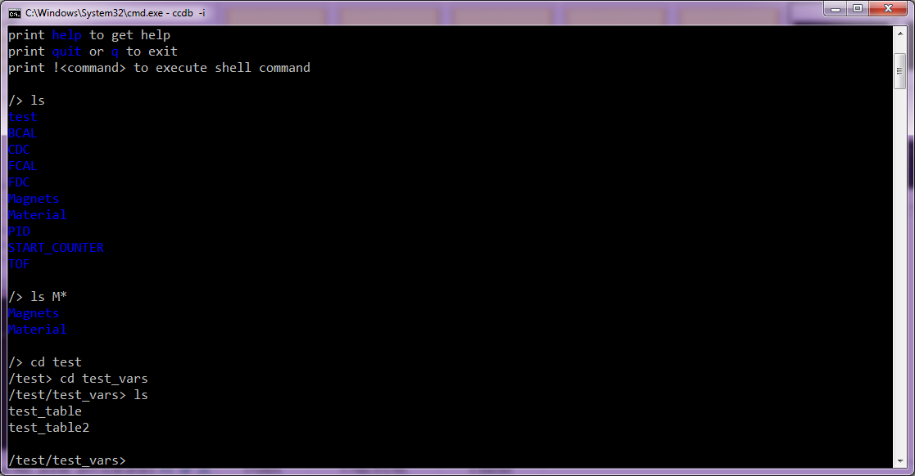
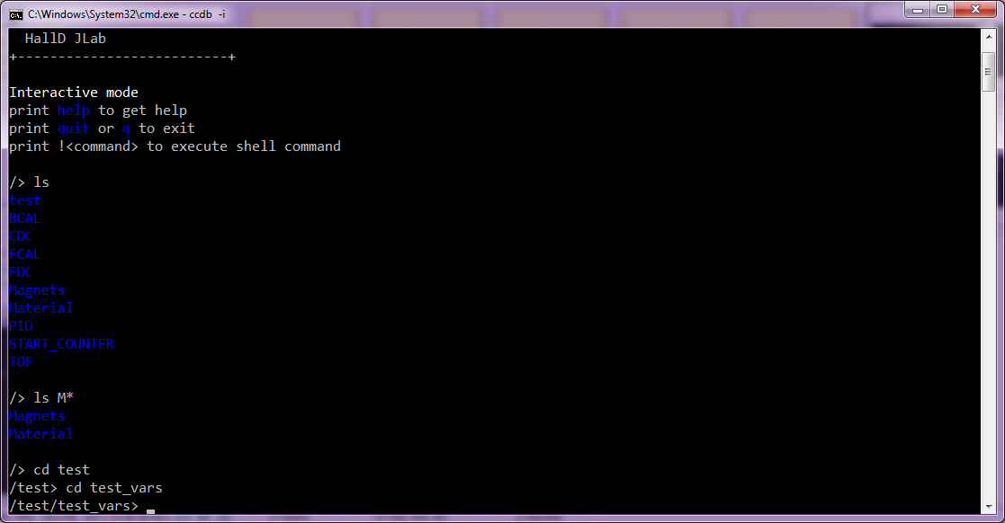
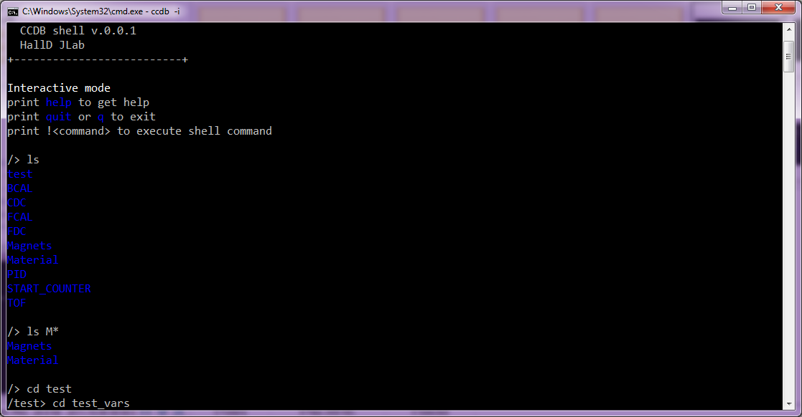
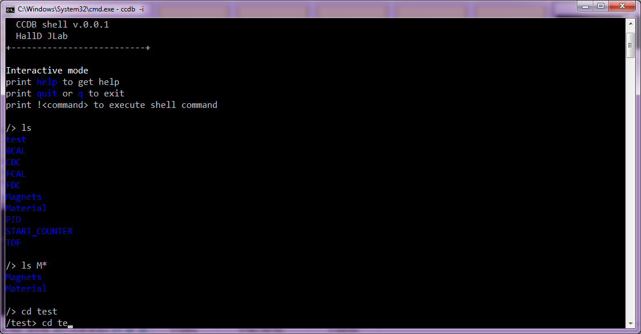
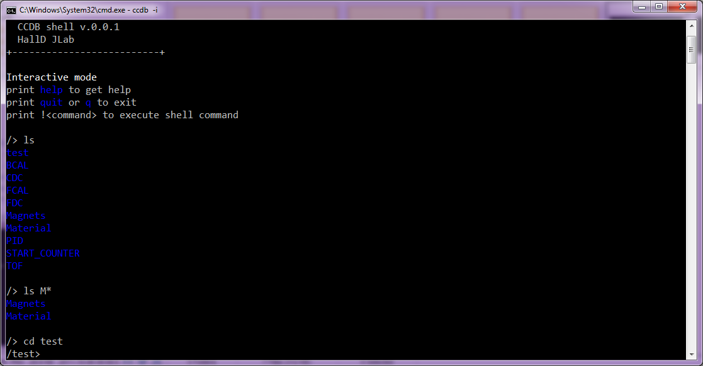
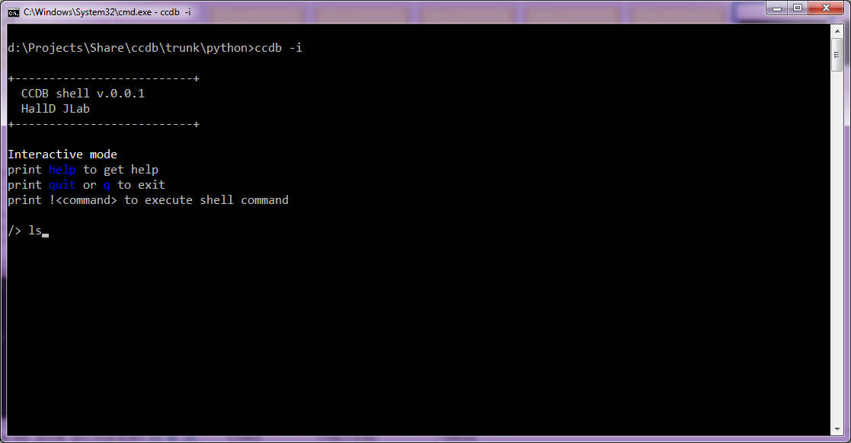

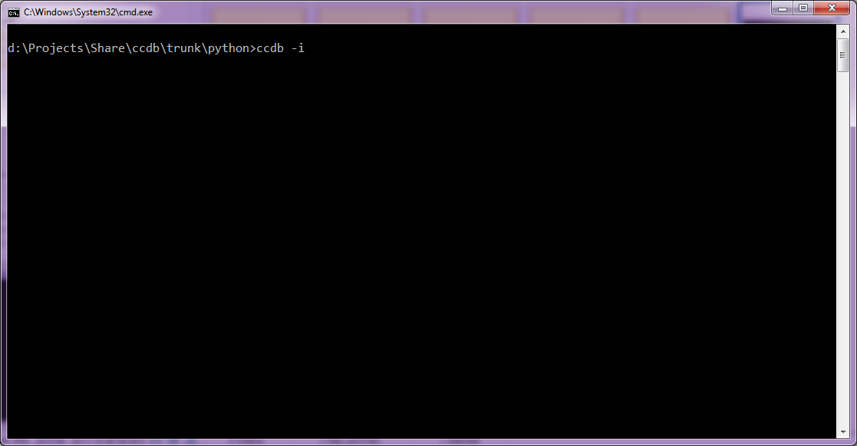
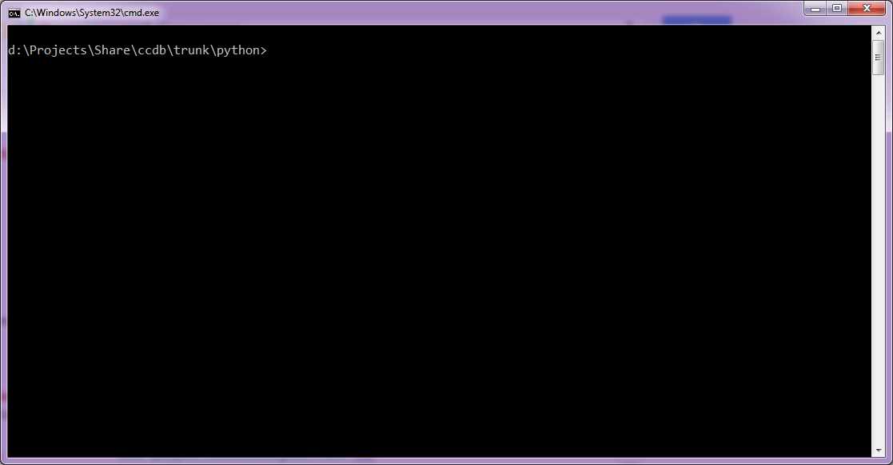
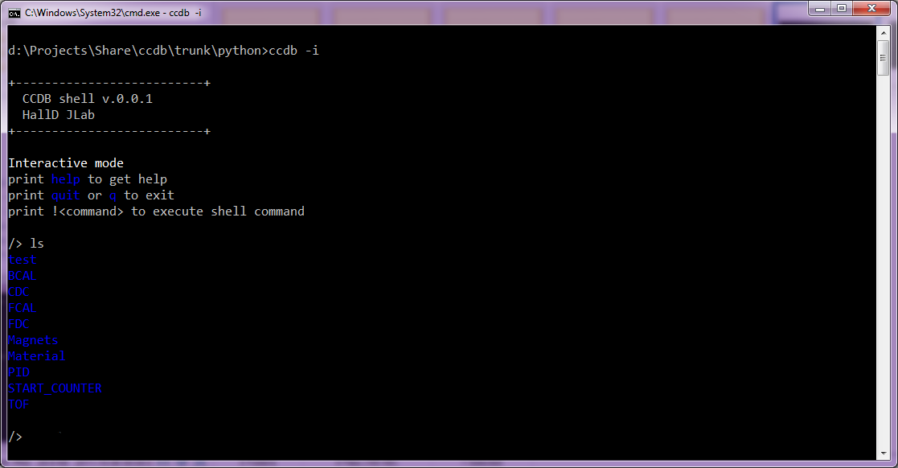

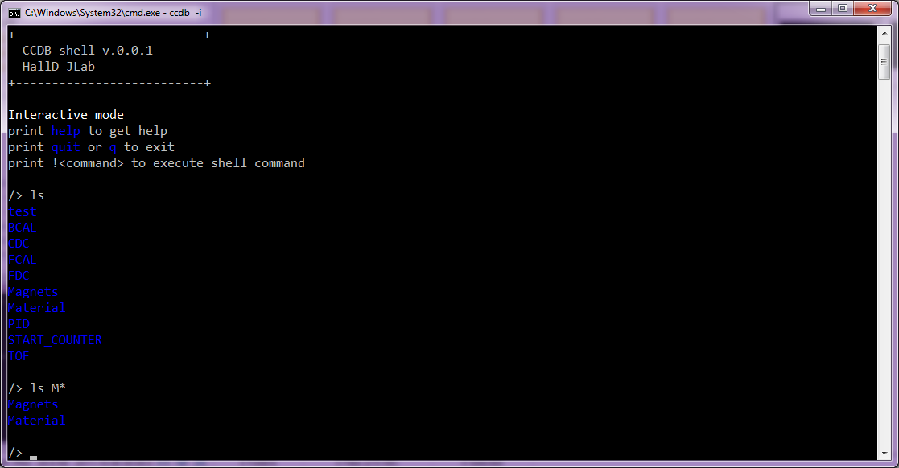

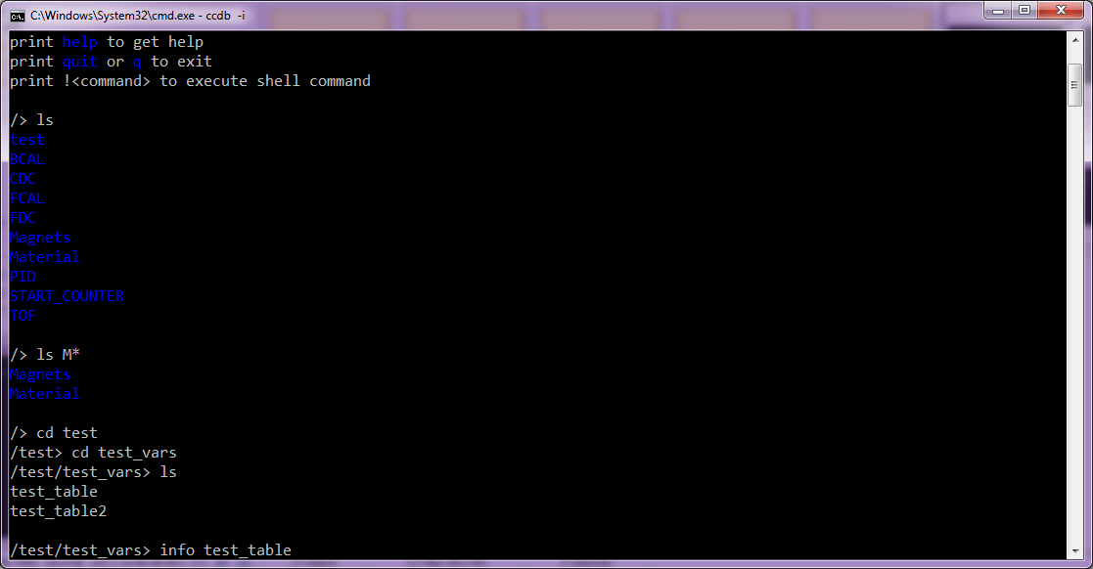
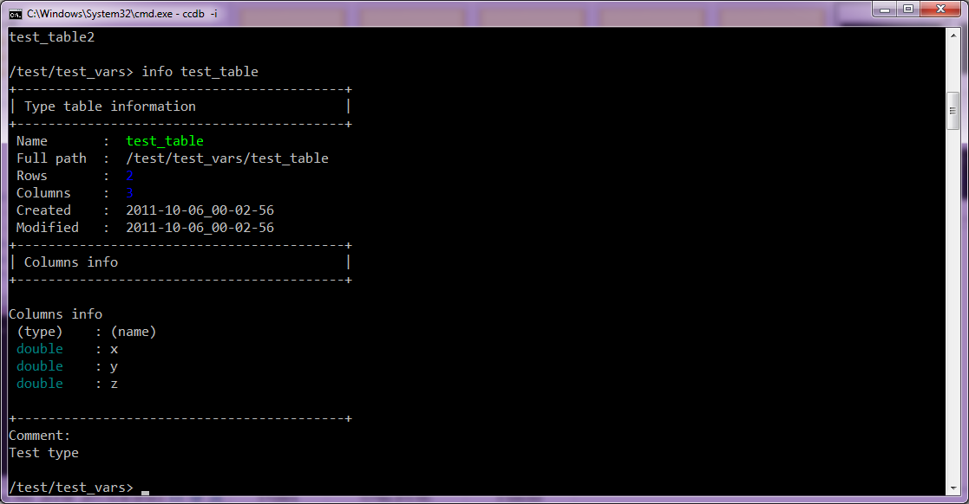
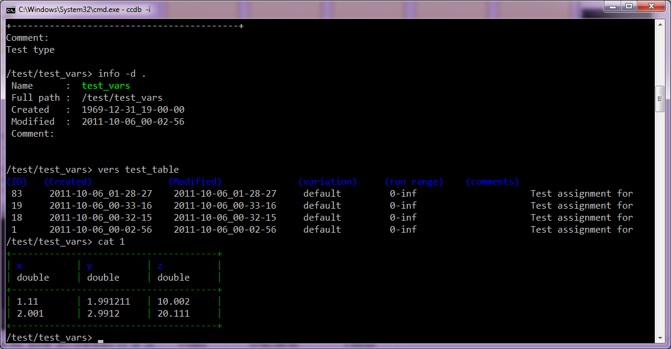
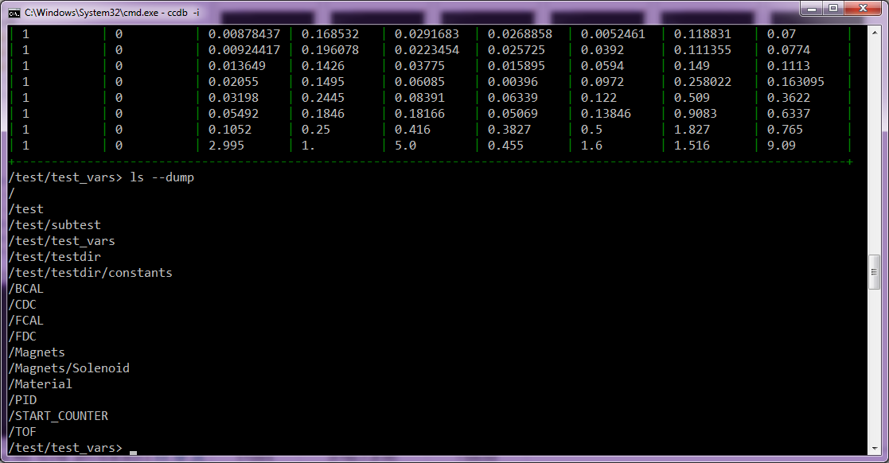
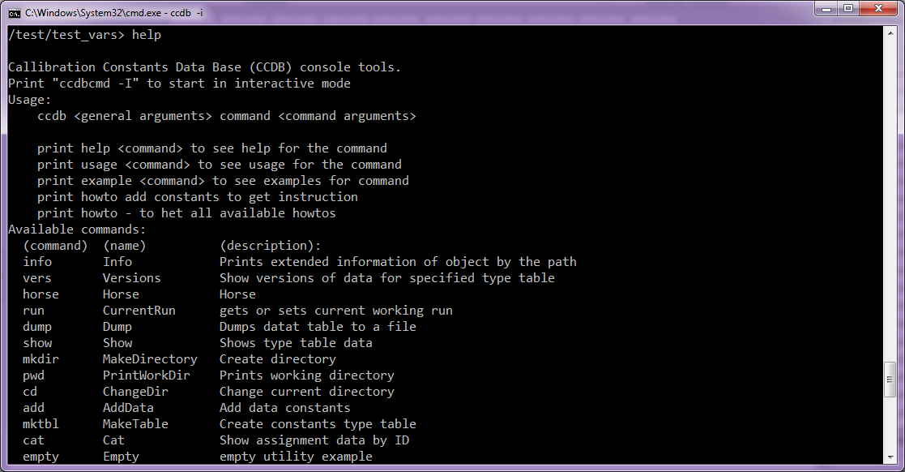
CCDB interactive shell

Slide 13
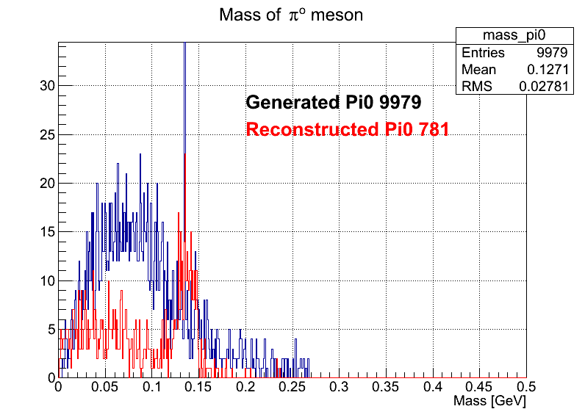
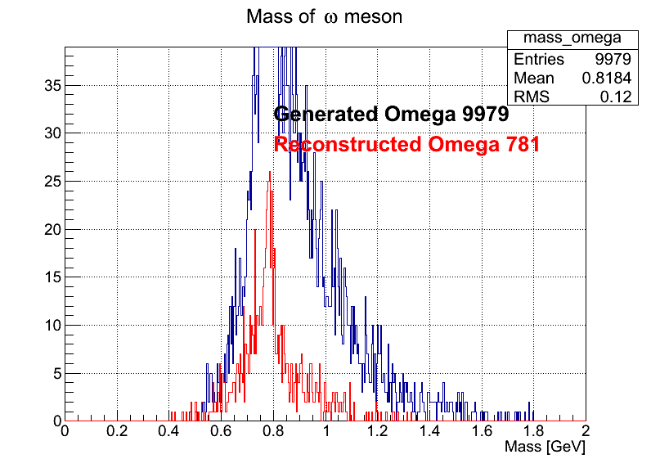
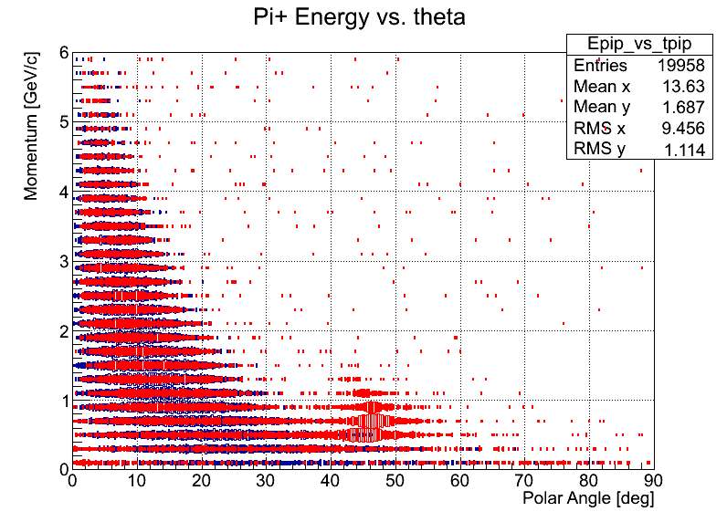
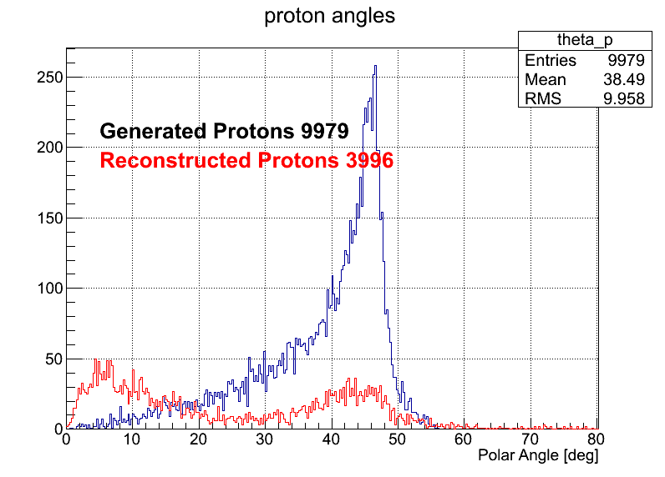
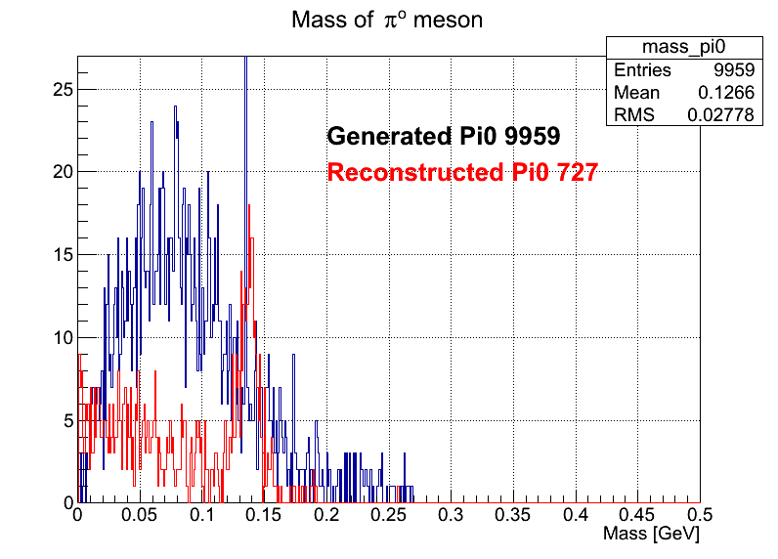
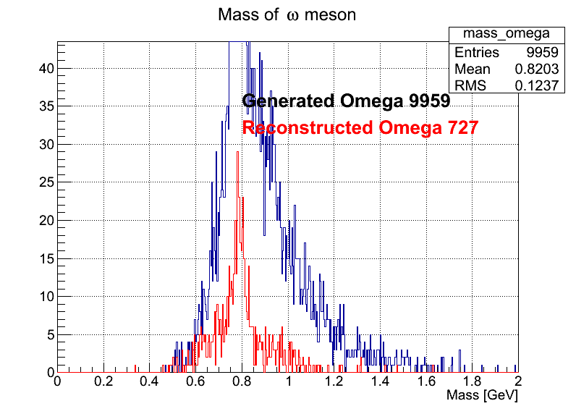
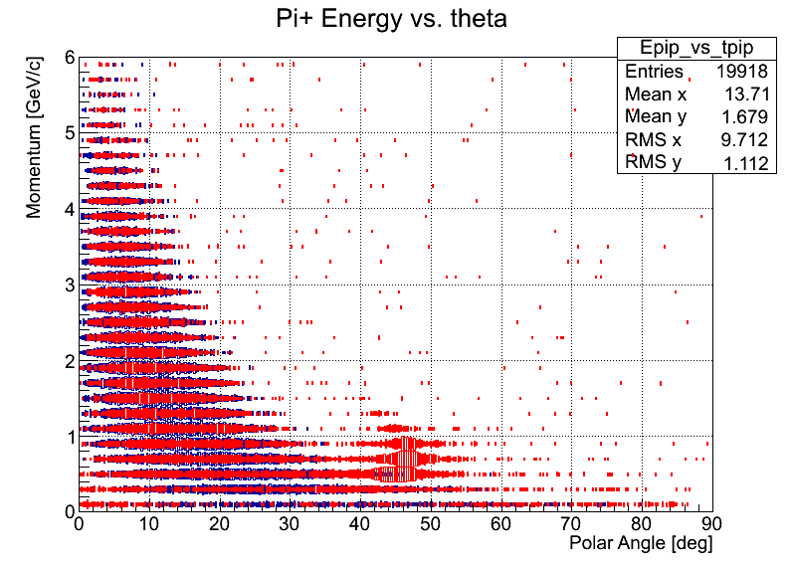
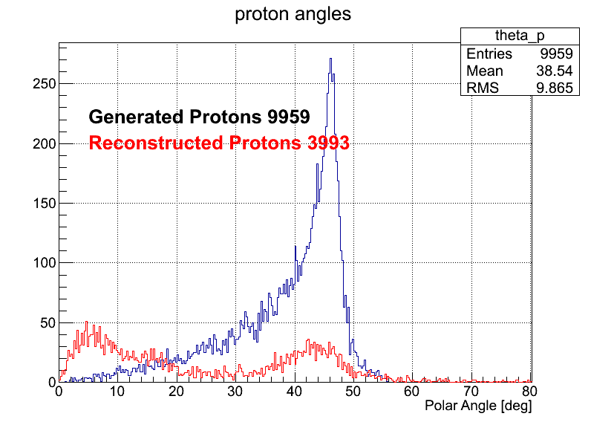
Automated tests
‘Make_b1pi’ scripts run for different calibration sources
Current files calibrations
CCDB MySQL calibrations

Slide 14
While testing (what about today?)
Have to build CCDB separately. MySQL dependencies switch: ccdb in halld soft bundle. Switch MySQL deps
Have to compile janaccdb plugin for jana switch: plugin is built by default
Have to specify plugin –PPLUGINS=…,janaccdb switch: janaccdb is set by default
Everybody uses constants files
Not all constants are really calibration constants

Slide 15
Install CCDB

Slide 16


CCDB Interfaces
C++ Users
JANA Users
Python Users
CCDB
WEB
> Command line tools _

Slide 17
C++ design levels
JANA API
Interfaces
C++ User API
Low level C++ API
Core
Data storage

Slide 18
User API in action
1
Create calibration object
calib = GetCalibration(“mysql://halld1”, 1000, “default”);
Connection
string
Run
Variation
2
Get constants
calib->GetCalib(constants,“/simple/constants”);
vector<vector<double>> constants;

Slide 19
Code example
Initialization.
//… Somewhere in “application” class
DCalibration *mCalibration = DCalibrationGenerator->GetCalibration(
“mysql://ccdb_user@halld1.jlab.org”, /*run number*/ 1000, /*variation*/“default”); //…
Getting the data.
DCallibration * calib = application->GetCalib(); /* returns mCalibration */
//getting double constants vector<double> constants; calib->GetCalib(constants, “/simple/constants”); calib->GetCalib(constants, “/simple/constants”, /*variation */ “john”); calib->GetCalib(constants, “/simple/constants”, /*variation */ “john”, /*time*/ time);
Multi-row and multi-type data.
//getting constants by rows and column names map<string, double> constants; //getting multi type constants vector<vector<double> > constants; calib->GetCalib(constants, “/simple/multi_rows_constants”);

Slide 20
C++ and JANA interface
Two main parts:
JCalibrationGenerator A generator class
Jcalibration class implementing the backend itself.
Retrieve calibration constants from CCDB (GetCalib())
Discovery of available constants (GetListOfNamepaths()) etc. Jcallibration * calib = jApp->GetCalib() vector<double> constants; calib->GetCalib(constants, “/simple/constants”); calib->GetCalib(constants, “/simple/constants::john”); calib->GetCalib(constants, “/simple/constants::john:2012”);

Slide 21
Multi Threading
C++ User API is designed to be multithread
Calibration object instances are thread safe.
Generator class manage distribution of ‘connections-by-threads’

Slide 22
Simple synchronization
App
Thread 1
Thread 2
Thread 3
Thread 4
Calibration object
Request 1
Request 2
Connection
Request 3
Request 4
Data Base

Slide 23
Simple synchronization 2
App
Thread 1
Thread 2
Thread 3
Thread 4
Calibration
object 1
Calibration
object 2
Calibration
object 3
Calibration
object 4
Connection
Connection
Connection
Connection
Data Base

Slide 24
Synchronization
App
Data Base

Slide 25
Getting threads
Calibration 1
Connection 1
Calibration 2
Thread
GetCalibration ( … )
Calibration Generator
Connection 2
Calibration 3
Connection 3
Calibration 5
Calibration 4
Connection 4
Calibration 5
Generator may hide complex logic for managing database connections per thread
Connection 5

Slide 26
Performance budget
Requirments:
1 to 10k values per a single table.
Access to a single table - less than 10 ms using a 1 Gigabit connection.
Retrieval of 10k values - less than 1 second.
Benchmarks:
PC - Core i5 2.5 GHz
Access to a single table – less than 1 ms
Retrieval of 10k values - less than 0.1 second
Real data:
Readout of all constants (much more than regular readout that is made on start)
Total constants read count – 126 421
Time – 0.7 s
Stick to 1 second to load calibration constants
Framework overhead ~ 10%

Slide 27
CCDB shell and command line tools
Aim: simplicity + better learning curve
Use POSIX like commands: ls, rm, mkdir, mv, … etc. commands
CCDB CLI
Interactive mode
Command line mode
ccdb -i
ccdb ls /test/test_vars
ls
cd test/test_vars
ccdb info /test/test_vars/test_table
info test_table
ccdb cat /test/test_vars/test_table
cat test_table
dump test_table
ccdb dump /test/test_vars/test_table

Slide 28
CCDB text files
#meta run rage: 100 - 200
#meta variation: default
# This is a simple table with 4 columns and
# 3 rows. Any users comments are here…
#& col1 col2 col3 col4
value value value value
value value value value
value value value value
Text files with tables.
One file – one table.
Comments and metadata optional
Using as separate storage
Files location related to namepaths of the tables
This means that if a table has a namepath: /simple/constants there is file constants in ($BASE_PATH)/simple/
All manipulations for import and export of such files

Slide 29
Database layout structure
Tags
Data
Type definition
/FDC/CathodeStrips/pedestals
Variation
name
Assignment (header)
Constants Type Table
name
N_rows
N_columns
Run range
many - 1
min
max
Constants
Event range
Directories
Columns
min
max
run
DATA BLOB
parentId
name
- name
- type

Slide 30
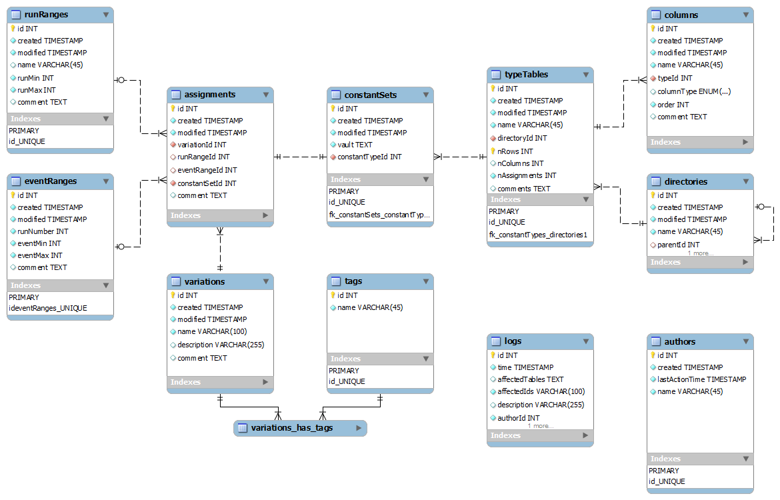
MySQL database layout

Slide 31
Searching over particular cell
Statement. We can do search through particular cell
Easy solution
Assumption: One knows which table he would like to search
We are capable of retrieving of 10 000 sets for about 1.5 s. Tables with less than 10 000 versions could be processed with current API
Universal solution.
Using indexing technique

Slide 32
Indexing technique
Data blob
Index table
row
cell
value
1
2
1
2
1
1
3
4
3
4
1
2
2
1
Index tables may be built afterwards
Only for particular cases
Only for particular tables
2
2

Slide 33
Overall package design
Interfaces
WEB
JANA Users
C++ Users
Python Users
> Command line tools _
Web engine
PHP
C++ CGI
JQuery
Calib. DB API
C++
SWIG
Python API (C++ API wrapping)
SQLite Provider
MySQL Provider
File Provider
Ruby
Java
.NET
+
20 more
languages
SQLite
MySQL Server
Local DB Files

Slide 34
SQLite
Zero-Configuration. SQLite does not need to be "installed" before it is used. There is no "setup" procedure.
Serverless
Single Database File
Stable Cross-Platform Database File
Compact
Faster then MySQL. Tests shows 2 – 20 times.
Similar SQL queries
Public domain

Slide 35
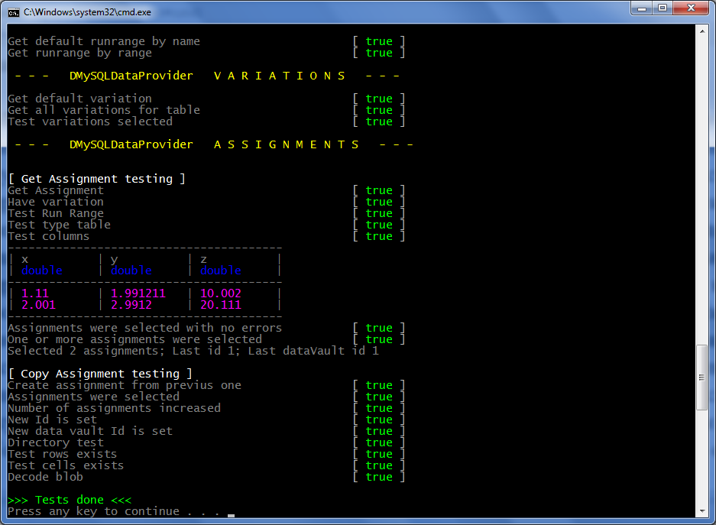
Unit testing

Slide 36
Command line tools implementation
Data flow
1. Interactive mode
2. Command line mode
/> ls --dump_tree
ccdbcmd <options> ls --dump_tree
ConsoleContext:
Logging
DB connection
Plugins system
Command parsing
Interactive loop
Interactive loop
Opt parser
ls --dump_tree
ColnsoleContext
Command parser
--dump_tree
Plugins (commands)
help
ls
pwd
mkdir
. . .
Python API

Slide 37
Web interface approach
Task
Have some framework to generate pages.
Connect this framework with C++ CCDB API
Solution
PHP for page generation.
CGI from C++ API for accessing data.
JQuery to glue both and make UI reach.

Slide 38
What is JQuery?
jQuery is a cross-browser JavaScript library designed to simplify the client-side scripting of HTML.
Released January 2006. Used by over 31% of the 10,000 most visited websites at the end of 2011.
Works on all todays browser. Moreover, makes JavaScript programming browser independent.
Makes AJAX – really easy. Enriches web User Interface.
AJAX - Asynchronous JavaScript and XML
Classic HTML – reload page on every user update.
AJAX – Possibility to reload only part of the page.

Slide 39

Web interface
How it works
USER
PHP generate pages.
JQuery asks the data from CGI.
CGI getting data by C++ API.
Web page
JQuery
C++ Cgi HTTP Context
PHP
Calib. DB API
C++
CCDB
My SQL Server
How compex is it?
$("#tree_place").treeview({url: “cgi-bin/ccdb.cgi?op=ajaxdirs “})

Slide 40
Dependencies summary
Concise overview
C++ API the only dependency is libmysql
Python wrapping is done by SWIG. No SWIG dependencies are needed for users.
Console tools requires python 2.7+.
Web interface consists of two parts PHP and C++ CGI.
Web pages are driven by JQuery
Technologies overview
C++, STL
C API for MySQL
Python
SWIG
PHP
JQuery

Slide 41
Calibration Database now
CCDB connects to JANA as a plugin
Converter for current calibrations is created
Existing constants are converted to CCDB
Tested with august tag of the reconstruction software
Several user already uses the package
Ready to a beta stage and Hall D usage

Slide 42


Conclusion
Calibrations Data Base (CCDB) Package provides interfaces to read and manage calibration constants for:
JANA Users, plain C++, Python, command line, web.
Versioning and branching for data available.
Core API is in C++.
Modular structure allows to extend package to use other storing sources. The only dependency for C++ is libmysql.
Managing is implemented for command line interface
Web interface is in progress
CCDB is at the Beta stage
Dmitry Romanov romanov@jlab.org

Slide 43
Old performance budget study
The values are grouped in sets. 1 to 10k values per a single set.
Access to a single number - less than 10 ms using a 1 Gigabit connection.
Retrieval of 10k values should - less than 1 second under similar conditions.
1 100 000 records with data blobs; 50 double doubles (8 digits) for each blob.
Queried randomly with 1100 requests.
Core 2 Duo 1800 GHz, 2 Gb – 0.23 sec average
Core i7 4 cores 2800 GHz, 8 Gb – 0.04 sec average
Stick to 1 second to load calibration constants
Data queries + network – 0.23 – 0.45 sec
Framework overhead ~ 4%
Conclusion: possible to keep in 1 second.

Slide 44
SWIG
.i
SWIG
ccdb_py.so
ccdb.py
CCDB API
C++
SWIG
Python API (C++ API wrapping)
CREATE Wrapping for any of languages:
Allegro, CL, C#, CFFI, CLISP, Chicken, Go, Guile, Java, Lua, Modula-3, Mzscheme, OCAML, Octave, Perl, PHP, Python, R, Ruby, Tcl, UFFI
SWIG - is an interface compiler that connects programs written in C and C++ with scripting languages
How to use SWIG?
Make SWIG interface files .h (it is headers without private members)
Run SWIG
Get C++ wrapping source files, compale it.
Get library
Get library in target language

