Slide 1

Calibration database
Dmitry Romanov
January 7, 2011

Slide 2


CCDB package overview
Interfaces for reading constants for JANA, plain C++, Python (and possibly other languages)
Web interface and command line tools to manage the data.
Full feature storage is DB (MySQL).
Local files storage with limited features
Tools to browse, import, export data
Simple for user
C++ Users
Python Users
> Command line tools _
WEB
JANA Users
CCDB
Package

Slide 3
Basic concepts
Column 1 | Column 2 | Column 3 | Column 4 | Column 5
value 11 | value 12 | value 13 | value 14 | value 15
value 21 | value 22 | value 23 | value 24 | value 25
value 31 | value 32 | value 33 | value 34 | value 35
Column 1 | Column 2 | Column 3 | Column 4 | Column 5
value 1 | value 2 | value 3 | value 4 | value 5
Column 1 | Column 2 | Column 3 | Column 4 | Column 5
double 11 | double 12 | double 13 | int 14 | double 15
double 21 | double 22 | double 23 | int 24 | double 25
double 31 | double 32 | double 33 | int 34 | double 35
Calibration constants as tables
Columns might have different types
Name paths. I.e. /FDC/pedestals
Data have versions and branches
“Data Update” by adding new version
No Delete

Slide 4
Database layout structure
Variation
/FDC/CathodeStrips/pedestals
name
Assignment
Constants Type Table
timestamp
run_range
variation
name
directory
N_rows
N_columns
Run range
min
max
many - 1
Constants
DATA BLOB
Directories
Columns
Event range
- name
- type
min
max
run
id
parentId
name

Slide 5
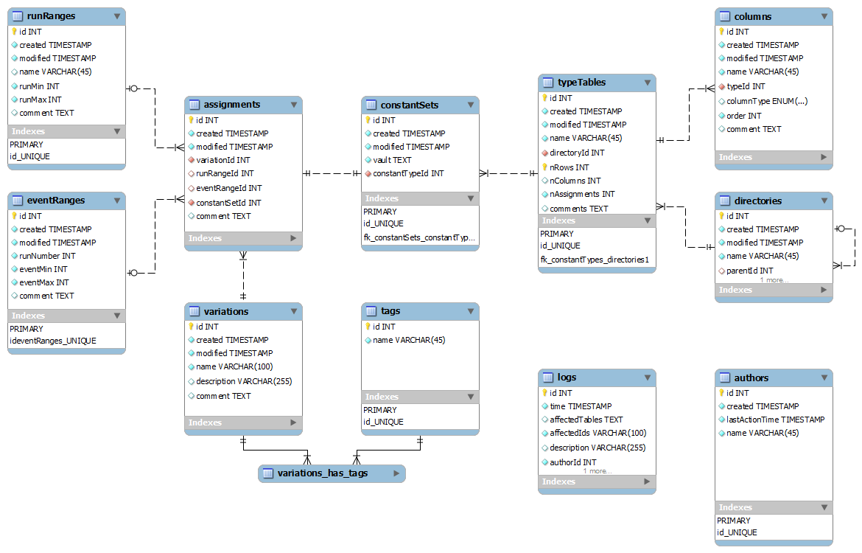
MySQL database layout

Slide 6
Deep into variations
/simple/constants
Variations provide branching
Users can create variations to work with their versions of constants
Main branch is called “default” variation
X | Y | Z
01/01/2011
1 | 1 | 1
02/03/2011
1.1 | 1.2 | 1.3
Variation: “john”
Time line
03/11/2011
04/12/2011
3 | 4 | 5
1.11 | 1.22 | 1.33
05/15/2011
3.5 | 4.5 | 5.5
06/01/2011
3.5 | 4.5 | 5.5
…
User enters: /simple/constants User gets: 1.1 ; 1.2 ; 1.3;
User enters: /simple/constants variation: jhon User gets: 3 ; 4 ; 5;
User enters: /simple/constants variation: john User gets: 3.5 ; 4.5 ; 5.5;
User enters: /simple/constants User gets: 1.11 ; 1.22 ; 1.33;
User enters: /simple/constants User gets: 3.5 ; 4.5 ; 5.5;

Slide 7
C++ design levels
JANA API
Interfaces
C++ User API
Low level API
Data

Slide 8
User API in action
1. calib = GetCalibration(“mysql://halld1”, 1000, “default”);

Slide 9
C++ design levels
JANA API
Interfaces
C++ User API
Low level API
Low level API
SQLite Provider
MySQL Provider
File Provider
SQLite DB
MySQL Server
Local DB Files
MySQL Server

Slide 10
Performance budget
The values are grouped in sets. 1 to 10k values per a single set.
Access to a single number - less than 10 ms using a 1 Gigabit connection.
Retrieval of 10k values should - less than 1 second under similar conditions.
1 100 000 records with data blobs; 50 double doubles (8 digits) for each blob.
Queried randomly with 1100 requests.
Core 2 Duo 1800 GHz, 2 Gb – 0.23 sec average
Core i7 4 cores 2800 GHz, 8 Gb – 0.04 sec average
Stick to 1 second to load calibration constants
Data queries + network – 0.23 – 0.45 sec
Framework overhead ~ 4%
Conclusion: possible to keep in 1 second.

Slide 11
Code example
Initialization.
//… Somewhere in “application” class
DCalibration *mCalibration = DCalibrationGenerator->GetCalibration(
“mysql://ccdb_user@halld1.jlab.org”, /*run number*/ 1000, /*variation*/“default”); //…
Getting the data.
DCallibration * calib = application->GetCalib(); /* returns mCalibration */
//getting double constants vector<double> constants; calib->GetCalib(constants, “/simple/constants”); calib->GetCalib(constants, “/simple/constants”, /*variation */ “john”); calib->GetCalib(constants, “/simple/constants”, /*variation */ “john”, /*time*/ time);
Multi-row and multi-type data.
//getting constants by rows and column names map<string, double> constants; //getting multi type constants vector<vector<double> > constants; calib->GetCalib(constants, “/simple/multi_rows_constants”);

Slide 12
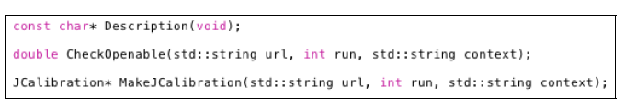
C++ and JANA interface
Two main parts:
1) JCalibrationGenerator A generator class (e.g. JCalibrationGeneratorMySQL)
2) Jcalibration class implementing the backend itself.
Retrieve calibration constants from CCDB (GetCalib())
Discovery of available constants (GetListOfNamepaths()) etc. Jcallibration * calib = jApp->GetCalib() vector<double> constants; calib->GetCalib(constants, “/simple/constants”); calib->GetCalib(constants, “/simple/constants”, /*variation */ “john”); calib->GetCalib(constants, “/simple/constants”, /*variation */ “john”, /*time*/ time);

Slide 13
Overall package design
Interfaces
WEB
JANA Users
C++ Users
Python Users
> Command line tools _
Web engine
PHP
C++ CGI
JQuery
Calib. DB API
C++
SWIG
Python API (C++ API wrapping)
ROOT FIle Provider
MySQL Provider
File Provider
Ruby
Java
.NET
+
20 more
languages
.root
MySQL Server
Local DB Files

Slide 14
SWIG
.i
SWIG
ccdb_py.so
ccdb.py
CCDB API
C++
SWIG
Python API (C++ API wrapping)
CREATE Wrapping for any of languages:
Allegro, CL, C#, CFFI, CLISP, Chicken, Go, Guile, Java, Lua, Modula-3, Mzscheme, OCAML, Octave, Perl, PHP, Python, R, Ruby, Tcl, UFFI
SWIG - is an interface compiler that connects programs written in C and C++ with scripting languages
How to use SWIG?
Make SWIG interface files .h (it is headers without private members)
Run SWIG
Get C++ wrapping source files, compale it.
Get library
Get library in target language

Slide 15
CCDB shell and command line tools
Aim: simplicity + better learning curve
If it have directories and names like POSIX file system, let it looks like POSIX file system. ls, rm, mkdir, mv, … etc. commands
Interactive mode
>> ls
adc/ dca/
>> cd adc
adc> > ls
../ adc _pedestals adc_scales
adc>> ls -a
adc _pedestals : 3 variations, 5 versions … <full info> adc_scales: 4 variations, 11 versions … <full info>
adc>>dump adc _pedestals --run 1200 --variation mc > /home/user/pedestals.txt
Command line mode
ccdb <connection> dump /adc/adcpedestals --run 1200 --variation mc > /home/user/pedestals.txt

Slide 16
Implementation
Core
Utils as plugins
1. Interactive mode
DConsoleContext
Context data
Streams
Utils by command
Commad parser
help
/> ls --all_tree
pwd
2. Command line mode
mkdir
ccdb <connection> ls --all_tree
--all_tree
ls
. . .
DConsoleContext – singleton model
All utils are derived from DConsoleUtilBase
Each utility has instance that calls RegisterConsoleUtil()
Each utility have to implement GetHelp() …. functions
Thus we get very flexable plugin like system
Python API (C++ API wrapping)

Slide 17
Web interface approach
Task
Have some framework to generate pages.
Connect this framework with C++ CCDB API
Solution
PHP for page generation.
CGI from C++ API for accessing data.
JQuery to glue both and make UI reach.

Slide 18
What is JQuery?
jQuery is a cross-browser JavaScript library designed to simplify the client-side scripting of HTML.
Released January 2006. Used by over 31% of the 10,000 most visited websites at the end of 2011.
Works on all todays browser. Moreover, makes JavaScript programming browser independent.
Makes AJAX – really easy. Enriches web User Interface.
AJAX - Asynchronous JavaScript and XML
Classic HTML – reload page on every user update.
AJAX – Possibility to reload only part of the page.

Slide 19

Web interface
How it works
USER
PHP generate pages.
JQuery asks the data from CGI.
CGI getting data by C++ API.
Web page
JQuery
C++ Cgi HTTP Context
PHP
Calib. DB API
C++
CCDB
My SQL Server
How compex is it?
$("#tree_place").treeview({url: “cgi-bin/ccdb.cgi?op=ajaxdirs “})

Slide 20
CCDB text files
#meta run rage: 100 - 200
#meta variation: default
# This is a simple table with 4 columns and
# 3 rows. Any users comments are here…
#& col1 col2 col3 col4
value value value value
value value value value
value value value value
Text files with tables.
One file – one table.
Comments and metadata optional
Using as separate storage
Files location related to namepaths of the tables
This means that if a table has a namepath: /simple/constants there is file constants in ($BASE_PATH)/simple/
All manipulations for import and export of such files

Slide 21
Multi threading
Multithreading mutexes only in JANA, C++, Python interfaces.
Multithreading by pthread
C++ Users
Python Users
> Command line tools _
WEB
JANA Users
CCDB
Package

Slide 22
Performance budget
The values are grouped in sets. 1 to 10k values per a single set.
Access to a single table - less than 10 ms using a 1 Gigabit connection.
Retrieval of 10k values should - less than 1 second under similar conditions.
1 100 000 records with data blobs; 50 double doubles (8 digits) for each blob.
Queried randomly with 1100 requests.
Core 2 Duo 1800 GHz, 2 Gb – 0.23 sec average
Core i7 4 cores 2800 GHz, 8 Gb – 0.04 sec average
Stick to 1 second to load calibration constants
Data queries + network – 0.23 – 0.45 sec
Framework overhead ~ 4%
Conclusion: possible to keep in 1 second.

Slide 23
Dependencies summary
Concise overview
C++ API the only dependency is libmysql
Python wrapping is done by SWIG. No SWIG dependencies are needed for users.
Console tools are made by python 2.6+. No additional dependencies.
Web interface consists of two parts PHP and C++ CGI.
Web pages are driven by JQuery
Technologies overview
C++, STL
C API for MySQL
Python
SWIG
PHP
JQuery

Slide 24


Conclusion
CCDB Package provides interfaces to read and manage calibration constants for:
JANA Users, plain C++, Python, command line, web.
Full featured storage is relational database (MySQL). Other storage mechanisms are possible.
Versioning and branching for data available.
Core API is in C++.
Modular structure allows to extend package to use other storing sources. The only dependency for C++ is libmysql.
Python wrapping is done by SWIG. That allow to have API for 19 other languages.
Dmitry Romanov romanov@jlab.org

