Slide 1

Calibration database
Dmitry Romanov
February 2, 2011

Slide 2


CCDB package overview
Versioning and branching
Full feature storage is DB (MySQL).
Interfaces JANA, plain C++, Python (and other)
Web interface and command line tools to manage the data.
Tools to browse, import, export data
Simple for user
C++ Users
Python Users
> Command line tools _
WEB
JANA Users
CCDB
Package

Slide 3
Basic concepts
Column 1 | Column 2 | Column 3 | Column 4 | Column 5
value 11 | value 12 | value 13 | value 14 | value 15
value 21 | value 22 | value 23 | value 24 | value 25
value 31 | value 32 | value 33 | value 34 | value 35
Column 1 | Column 2 | Column 3 | Column 4 | Column 5
value 1 | value 2 | value 3 | value 4 | value 5
Column 1 | Column 2 | Column 3 | Column 4 | Column 5
double 11 | double 12 | double 13 | int 14 | double 15
double 21 | double 22 | double 23 | int 24 | double 25
double 31 | double 32 | double 33 | int 34 | double 35
Calibration constants as tables
Columns might have different types
Name paths. I.e. /FDC/pedestals
Data have versions and branches
“Data Update” by adding new version
No Delete

Slide 4
Deep into variations
/simple/constants
Variations provide branching
Users can create variations to work with their versions of constants
Main branch is called “default” variation
X | Y | Z
01/01/2011
1 | 1 | 1
02/03/2011
1.1 | 1.2 | 1.3
Variation: “john”
Time line
03/11/2011
04/12/2011
3 | 4 | 5
1.11 | 1.22 | 1.33
05/15/2011
3.5 | 4.5 | 5.5
06/01/2011
3.5 | 4.5 | 5.5
…
User enters: /simple/constants User gets: 1.1 ; 1.2 ; 1.3;
User enters: /simple/constants variation: jhon User gets: 3 ; 4 ; 5;
User enters: /simple/constants variation: john User gets: 3.5 ; 4.5 ; 5.5;
User enters: /simple/constants User gets: 1.11 ; 1.22 ; 1.33;
User enters: /simple/constants User gets: 3.5 ; 4.5 ; 5.5;

Slide 5
Database layout structure
Variation
/FDC/CathodeStrips/pedestals
name
Assignment
Constants Type Table
timestamp
run_range
variation
name
directory
N_rows
N_columns
Run range
min
max
many - 1
Constants
DATA BLOB
Directories
Columns
Event range
- name
- type
min
max
run
id
parentId
name

Slide 6
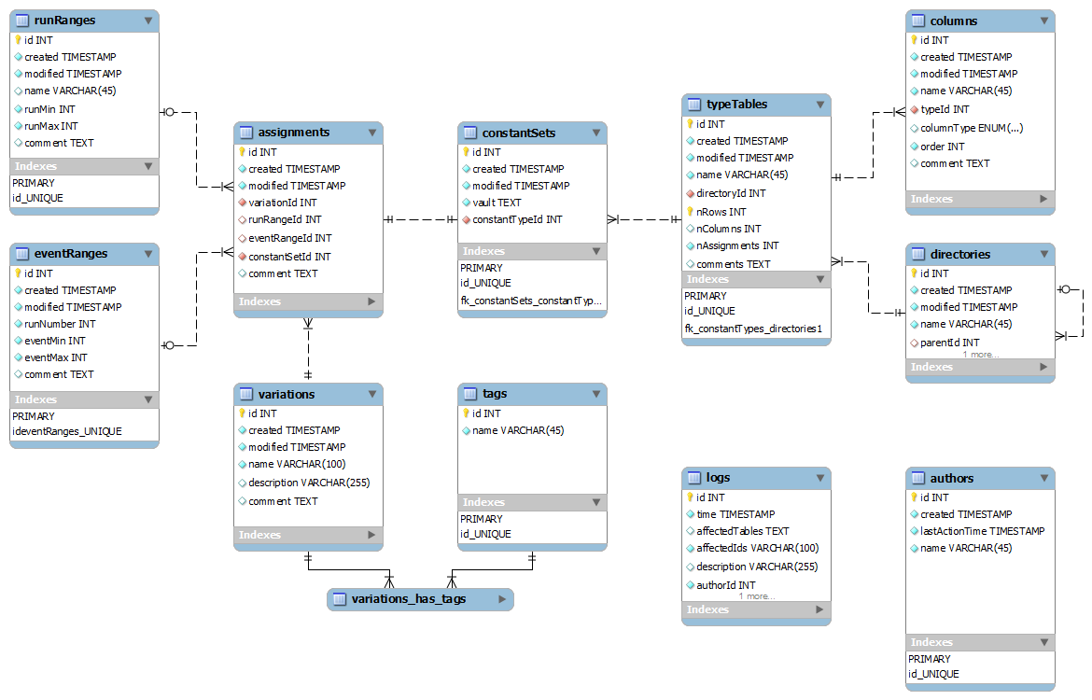
MySQL database layout

Slide 7
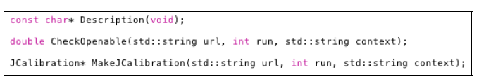
C++ and JANA interface
Two main parts:
1) JCalibrationGenerator A generator class (e.g. JCalibrationGeneratorMySQL)
2) Jcalibration class implementing the backend itself.
Retrieve calibration constants from CCDB (GetCalib())
Discovery of available constants (GetListOfNamepaths()) etc. Jcallibration * calib = jApp->GetCalib() vector<double> constants; calib->GetCalib(constants, “/simple/constants”); calib->GetCalib(constants, “/simple/constants”, /*variation */ “john”); calib->GetCalib(constants, “/simple/constants”, /*variation */ “john”, /*time*/ time);

Slide 8
Code example
Initialization.
//… Somewhere in “application” class
DCalibration *mCalibration = DCalibrationGenerator->GetCalibration(
“mysql://ccdb_user@halld1.jlab.org”, /*run number*/ 1000, /*variation*/“default”); //…
Getting the data.
DCallibration * calib = application->GetCalib(); /* returns mCalibration */
//getting double constants vector<double> constants; calib->GetCalib(constants, “/simple/constants”); calib->GetCalib(constants, “/simple/constants”, /*variation */ “john”); calib->GetCalib(constants, “/simple/constants”, /*variation */ “john”, /*time*/ time);
Multi-row and multi-type data.
//getting constants by rows and column names map<string, double> constants; //getting multi type constants vector<vector<double> > constants; calib->GetCalib(constants, “/simple/multi_rows_constants”);

Slide 9
Overall package design
Interfaces
WEB
JANA Users
C++ Users
Python Users
> Command line tools _
Web engine
PHP
C++ CGI
JQuery
Calib. DB API
C++
SWIG
Python API (C++ API wrapping)
SQLite Provider
MySQL Provider
File Provider
Ruby
Java
.NET
+
20 more
languages
SQLite
MySQL Server
Local DB Files

Slide 10
SWIG
.i
SWIG
ccdb_py.so
ccdb.py
CCDB API
C++
SWIG
Python API (C++ API wrapping)
CREATE Wrapping for any of languages:
Allegro, CL, C#, CFFI, CLISP, Chicken, Go, Guile, Java, Lua, Modula-3, Mzscheme, OCAML, Octave, Perl, PHP, Python, R, Ruby, Tcl, UFFI
SWIG - is an interface compiler that connects programs written in C and C++ with scripting languages
How to use SWIG?
Make SWIG interface files .h (it is headers without private members)
Run SWIG
Get C++ wrapping source files, compale it.
Get library
Get library in target language

Slide 11
CCDB shell and command line tools
Aim: simplicity + better learning curve
Use POSIX like commands: ls, rm, mkdir, mv, … etc. commands
Interactive mode
>> ls
adc/ dca/
>> cd adc
adc> > ls
../ adc _pedestals adc_scales
adc>> ls -l
adc _pedestals : 3 variations, 5 versions … <full info> adc_scales: 4 variations, 11 versions … <full info>
adc>>dump adc _pedestals --run 1200 --variation mc > /home/user/pedestals.txt
Command line mode
ccdbcmd dump /adc/adcpedestals --run=1200 --variation=mc > /home/user/pedestals.txt

Slide 12
Command line tools implementation
Data flow
1. Interactive mode
2. Command line mode
/> ls --dump_tree
ccdbcmd <options> ls --dump_tree
ConsoleContext:
Logging
DB connection
Plugins system
Command parsing
Interactive loop
Interactive loop
Opt parser
ls --dump_tree
ColnsoleContext
Command parser
--dump_tree
Plugins (commands)
help
ls
pwd
mkdir
. . .
Python API

Slide 13
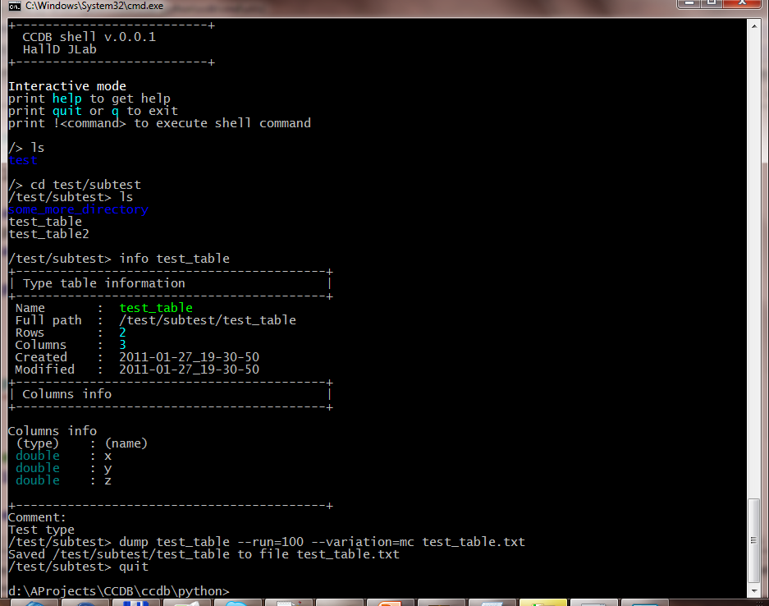
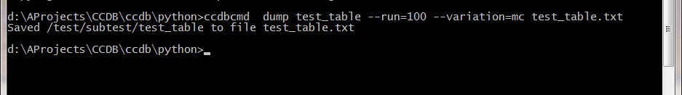
CCDBCMD Live example
Interactive mode
…
Command line mode

Slide 14
Web interface approach
Task
Have some framework to generate pages.
Connect this framework with C++ CCDB API
Solution
PHP for page generation.
CGI from C++ API for accessing data.
JQuery to glue both and make UI reach.

Slide 15
What is JQuery?
jQuery is a cross-browser JavaScript library designed to simplify the client-side scripting of HTML.
Released January 2006. Used by over 31% of the 10,000 most visited websites at the end of 2011.
Works on all todays browser. Moreover, makes JavaScript programming browser independent.
Makes AJAX – really easy. Enriches web User Interface.
AJAX - Asynchronous JavaScript and XML
Classic HTML – reload page on every user update.
AJAX – Possibility to reload only part of the page.

Slide 16

Web interface
How it works
USER
PHP generate pages.
JQuery asks the data from CGI.
CGI getting data by C++ API.
Web page
JQuery
C++ Cgi HTTP Context
PHP
Calib. DB API
C++
CCDB
My SQL Server
How compex is it?
$("#tree_place").treeview({url: “cgi-bin/ccdb.cgi?op=ajaxdirs “})

Slide 17
CCDB text files
#meta run rage: 100 - 200
#meta variation: default
# This is a simple table with 4 columns and
# 3 rows. Any users comments are here…
#& col1 col2 col3 col4
value value value value
value value value value
value value value value
Text files with tables.
One file – one table.
Comments and metadata optional
Using as separate storage
Files location related to namepaths of the tables
This means that if a table has a namepath: /simple/constants there is file constants in ($BASE_PATH)/simple/
All manipulations for import and export of such files

Slide 18
Performance budget
The values are grouped in sets. 1 to 10k values per a single set.
Access to a single number - less than 10 ms using a 1 Gigabit connection.
Retrieval of 10k values should - less than 1 second under similar conditions.
1 100 000 records with data blobs; 50 double doubles (8 digits) for each blob.
Queried randomly with 1100 requests.
Core 2 Duo 1800 GHz, 2 Gb – 0.23 sec average
Core i7 4 cores 2800 GHz, 8 Gb – 0.04 sec average
Stick to 1 second to load calibration constants
Data queries + network – 0.23 – 0.45 sec
Framework overhead ~ 4%
Conclusion: possible to keep in 1 second.

Slide 19
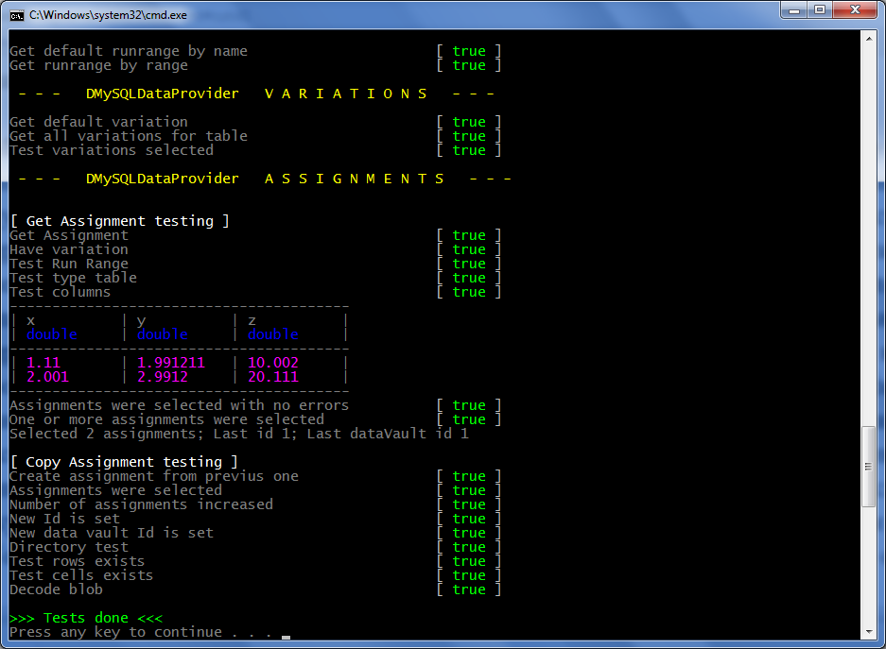
Unit testing

Slide 20
Multi Threading
C++ User API is designed
CCDB is thread safe.

Slide 21
Simple synchronization
App
Thread 1
Thread 2
Thread 3
Thread 4
Calibration object
Request 1
Request 2
Connection
Request 3
Request 4
Data Base

Slide 22
Simple synchronization 2
App
Thread 1
Thread 2
Thread 3
Thread 4
Calibration
object 1
Calibration
object 2
Calibration
object 3
Calibration
object 4
Connection
Connection
Connection
Connection
Data Base

Slide 23
Synchronization
App
Data Base

Slide 24
Getting threads
Calibration 1
Connection 1
Calibration 2
Thread
GetCalibration ( … )
Calibration Generator
Connection 2
Calibration 3
Connection 3
Calibration 4
Connection 4
Calibration 5
Connection 5

Slide 25
Performance

Slide 26
Dependencies summary
Concise overview
C++ API the only dependency is libmysql
Python wrapping is done by SWIG. No SWIG dependencies are needed for users.
Console tools are made by python 2.6+. No additional dependencies.
Web interface consists of two parts PHP and C++ CGI.
Web pages are driven by JQuery
Technologies overview
C++, STL
C API for MySQL
Python
SWIG
PHP
JQuery

Slide 27


Conclusion
CCDB Package provides interfaces to read and manage calibration constants for:
JANA Users, plain C++, Python, command line, web.
Full featured storage is relational database (MySQL). Other storage mechanisms are possible.
Versioning and branching for data available.
Core API is in C++.
Modular structure allows to extend package to use other storing sources. The only dependency for C++ is libmysql.
Python wrapping is done by SWIG. That allow to have API for 19 other languages.
Dmitry Romanov romanov@jlab.org

