Slide 1

Calibration database Profile guided optimization
Dmitry Romanov
February 2, 2011

Slide 2
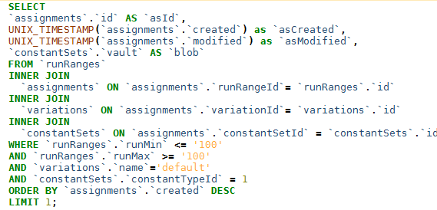
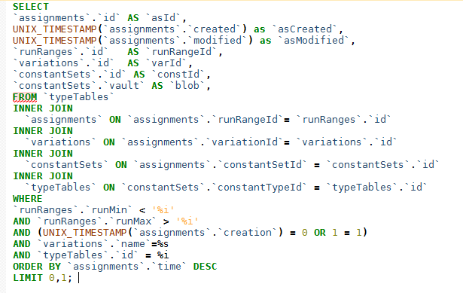
What to optimize
1000 queries ~ 4 sec on my laptop
GetDirectory(path) – prefetched and optimized
GetTypeTable(path)
GetData(… params …)
GetAssignment(… params …)

Slide 3
Optimization ideas list
Create object factory to “clear()” instead of “new”
Use memory allocated cache, to store and manipulate intermediate arrays
Do all in one query to minimize network load
Prefetch variation names to simplify querries
Cache parts of results trying to minimize mysql usage
Use prepared statements
… about 10 more ideas

Slide 4
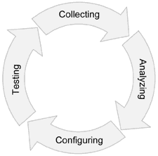
Profile guided optimization

Slide 5



Profile types
Instrumentation
Sampling
1) Timer START
Run
Gather sample statistics
2.
3) Timer STOP

Slide 6
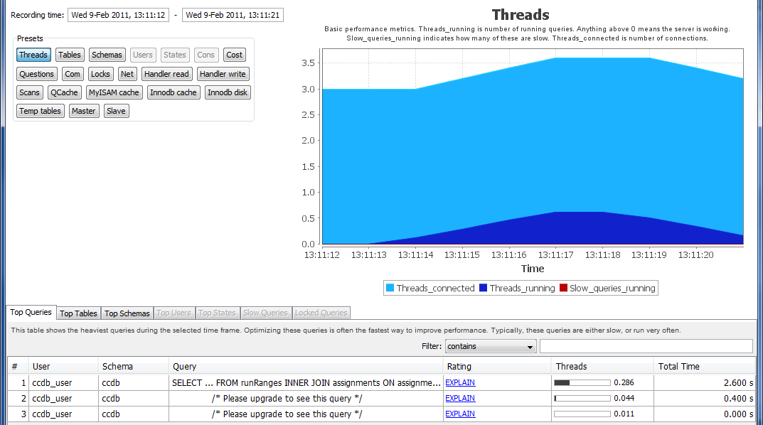
First profiling
C++ sampling -> 84% at libmysql
Jet profiler. MySQL:

Slide 7
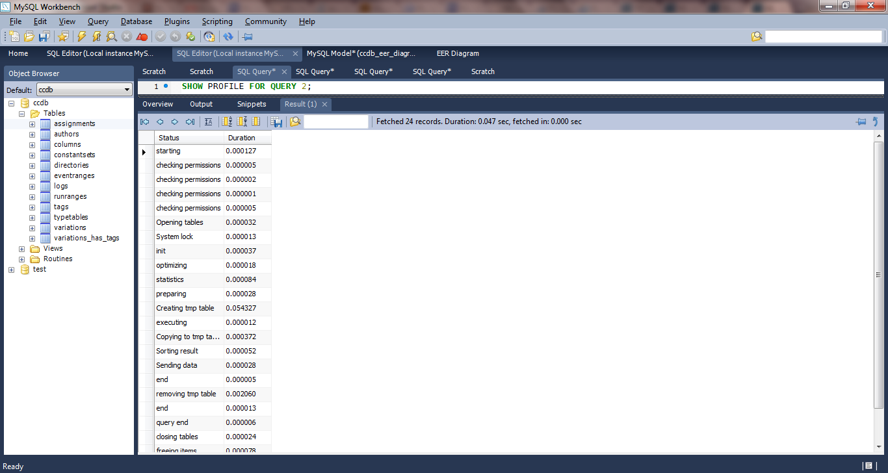
Query profiling

Slide 8
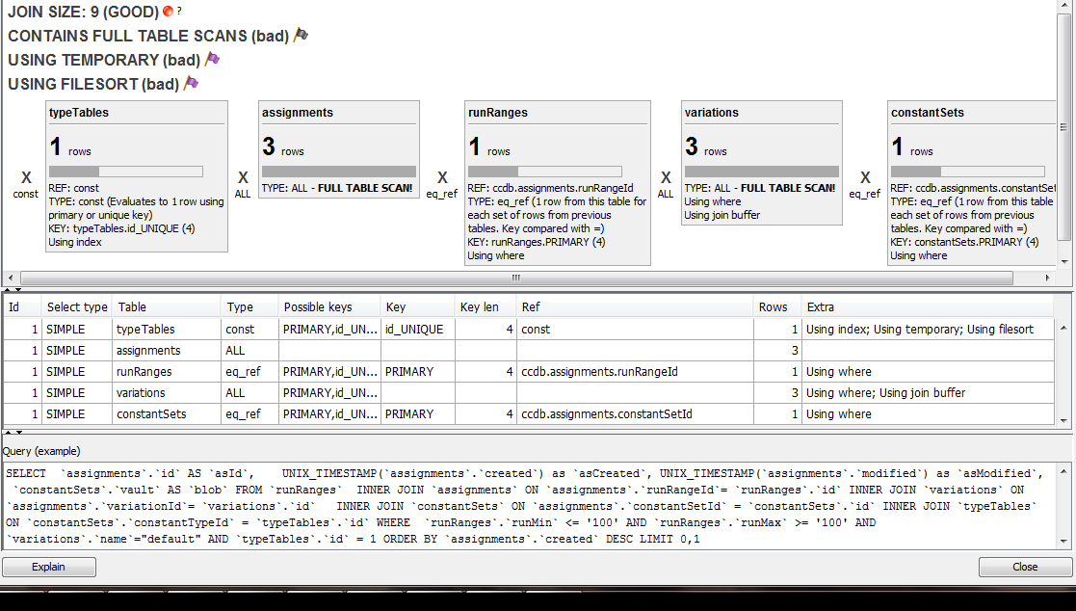
Query explain

Slide 9
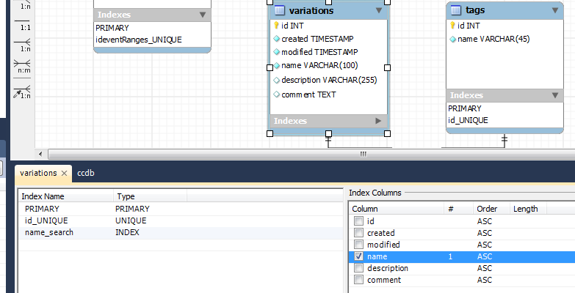
Fixing…

Slide 10
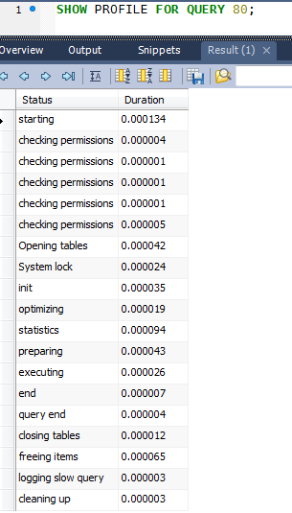
Profiling
C++ result -> 0.9 sec
4 sec -> 0.9 sec
Without ANY functionality change
With method that initially was not on optimization list

Slide 11
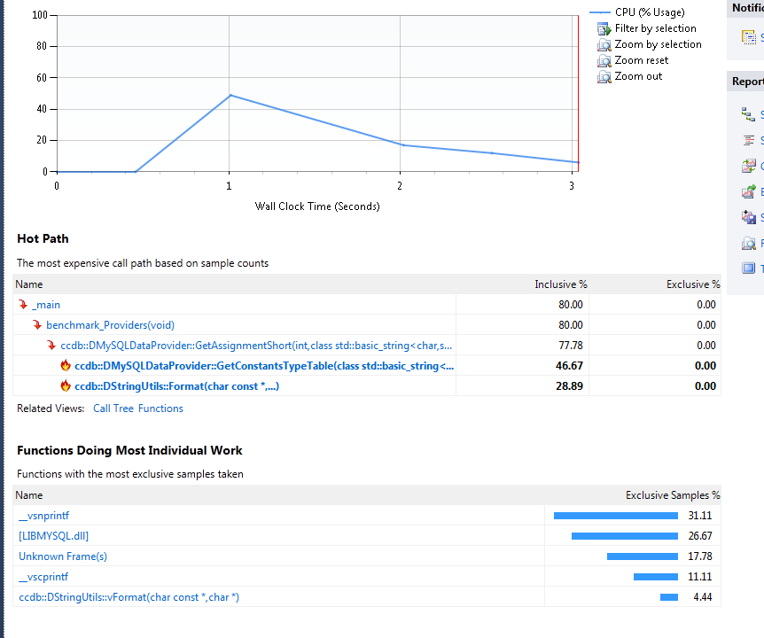
C++ profiling

Slide 12
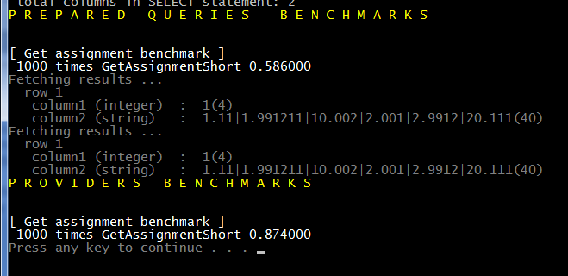
Fixing by using prestored queries

Slide 13
Conclusion
4 sec -> 0.6 sec with only 2 optimization.
1 of this 2 optimizations was not in “optimization ideas list”
Initial optimization list consist of ~15 items.

