Slide 1
Topic
Message-Location
Envelope
Shared-Memory Key
xMsgMeta
Version
Description
Author
Status
Severity-ID
Sender
Sender-State
Communication-ID
Composition
Execution-Time
Action
Control
Data-Type
Data-Description
Reply-To
Byte-Order
xMsgData-Object
Byte-Array
Topic
Message-Location
Envelope
Shared-Memory Key
xMsgMeta
Version
Description
Author
Status
Severity-ID
Sender
Sender-State
Communication-ID
Composition
Execution-Time
Action
Control
Data-Type
Data-Description
Reply-To
Byte-Order
xMsgData-Object
Byte-Array
Exception Reporting
Service Bus
Engine
Service Bus
Service
Operational Info Reporting

Slide 2
S2
S1
S1
S3
S3
S2
Example 1
S1+S2,S3
Example 2
S1,S2+S3

Slide 3
S1
S3
S1
S2
S3
S4
S2
S5
S6
S1,S2+&S3
S1+S2+S3+S4;S3+S5+S6

Slide 4
Orchestrator and/or Monitor
Registrar
Publishers
Database
Req/Rep
tcp:8888
Subscribers
Database
FE
Registrar
Publishers
Database
Req/Rep
tcp:8888
Orchestrator
Subscribers
Database
CLARA node proxy
Pub
Tcp:7771
Service
Service
Service
tcp:7772
sub
DPE

Slide 5
Registrar
Publishers
Database
Req/Rep
tcp:8888
Subscribers
Database
Front-End
Registrar
Publishers
Database
Req/Rep
tcp:8888
Subscribers
Database
DPE

Slide 6
Out-1
pointer
Out-1
message
input
Engine Execution Thread
Out-n
Out-n
Service
0mq available socket connections to a specific DPE of the output link
0mq busy/in use socket connections for an output link

Slide 7
Service Engine Object
Engine Reference
Thread
Object Pool
Thread Pool
Service

Slide 8
F1
F2
&EB
R
F3
F4
F1,F2,F3,F4+&EB+R+F1,F2,F3,F4

Slide 9
Topic
“envelope”
xMsgMeta
“sender_comID”
xMsgData
byteArray

Slide 10
Service Object map
Service Engine Object
Proxy
Engine Execute Method
Container
Key = service name
Deploy Service
Callback
Thread
Create Container
Callback
Shared Memory
Network Data
DPE
Engine Execute Method
Registrar
Thread Pool
publishers
subscribers
Service Request
Callback
Service Engine in a Thread
Data from the shared memory
Service
De-serialized data
Serialized data to a service
running in a different process
Register service
Data to the shared memory

Slide 11
DPE
Names-DB
Shared Memory
Publishers-DB
Subscribers-DB
Registration Service

Slide 12
S5
S1
S2
S3
S4
S6

Slide 13
Registrar
Publishers
Database
Req/Rep
tcp:8881
Subscribers
Database
CLARA proxy
Pub
Tcp:7771
Service
Service
Service
tcp:7772
sub
DPE

Slide 14
Orchestration Layer
Local Registration
Local Registration
DPE
DPE
SC
SC
SC
SC
S
S
FE
S
S
S
S
Registration
Proxy/gateway
security
Local Registration
Local Registration
DPE
DPE
SC
SC
SC
SC
S
S
Service Layer
S
S
S
S
Service Bus

Slide 15
DPE
EC
HT
TOF
TT
EB
R
W
EC
HT
TOF
TT
EB
SS
Local File System
Shared File System
Computing Node 1
OR
Computing Node N

Slide 16
R3.node001:worker
CLARA DPE
NAIADS compute(r4.8xlarge)
32vCore,244GB RAM
640GB local disk/scratch
ASDC
Clarreo_B
/data3_3500
Data Staging
AWS API
AWS API
Data Staging
R3.node002:worker
CLARA DPE
NAIADS compute(r4.8xlarge)
32vCore,244GB RAM
640GB local disk/scratch
5TB S3
SCIAMACHY
stage files
9 years
AWS API call to
stage data into SSD
AWS API
Data Archive
R3.node016:worker
CLARA DPE
NAIADS compute(r4.8xlarge)
32vCore,244GB RAM
640GB local disk/scratch
Glecier Archive

Slide 17
Data processing application composition (task service)
S1
Java
S2
Java
S3
Java
S4
Java
S5
Java
S6
C++
S7
C++
Node-1
Node-2
Service Bus Service Bus
S1
Java
S2
Java
S3
Java
S4
Java
S5
Java
S6
C++
S7
C++
Shared Memory
Shared Memory
Shared Memory
DPE-1
DPE-2
DPE-3

Slide 18
NAIADS Parallel Event Building Application
Single service with composite engine
Next
Close files
Orbit
File
Splitter
EB Filter
Search &
Add
Search &
Convolve
Clouds
Search &
Convolve
Aerosols
Search &
Interpolate
Convolve
File
File
File
File
File
Single service with composite engine
Done with the orbit
File names
Staging
Service
File open
N next
IO optimized EB Node/DPE 1
In Memory
Event Storage
Queue
Event
Source
EB
Orchestrator
Shared
File System
Network Optimized. Single core Node/DPE
IO optimized EB Node/DPE N

Slide 19
NAIADS Parallel Event Processing Application
Close files
Stats
Writer
File
Close files
Watts
Clean
Resample
PR
Filter
Joiner
N-Tuple
Writer
File
Single service with composite engine
Done
Joiner
Writer
Next
File
Done with the orbit
Staging
Service
In Memory
Event Storage
Queue
Event
Source
IO optimized Processing Node/DPE 1
Network Optimized. Single core Node/DPE
Event Processing
Orchestrator
Stage and delete files
Shared
File System
N next
IO optimized Processing Node/DPE N

Slide 20
Digital Data Demography

Slide 21
Data Growth

Slide 22
Scientific Data Expansion

Slide 23
The Rise of IoT

Slide 25
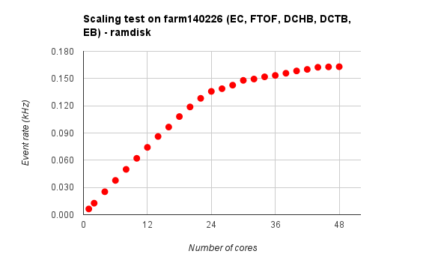
Scaling Within a Single Node Intel Haswell 24/48 core system

Slide 26
Scaling Within Multiple Node Intel Haswell 24/48 core system

