Slide 1
HIPO4 + CLAS12TOOL + ROOT
17/06/19

Slide 2
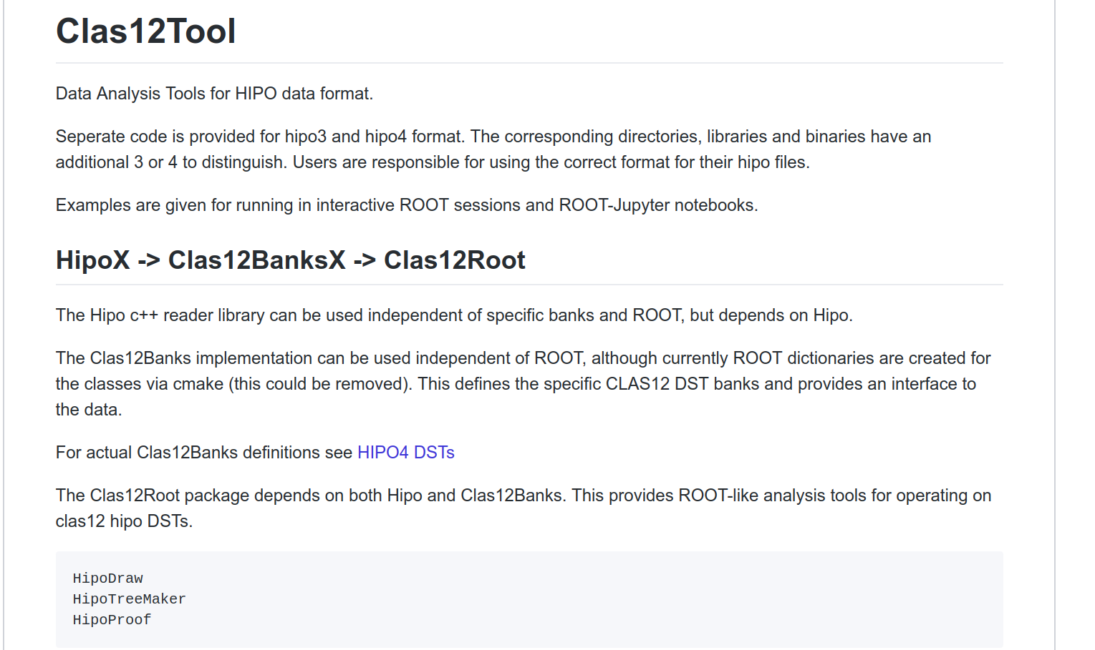

Slide 3
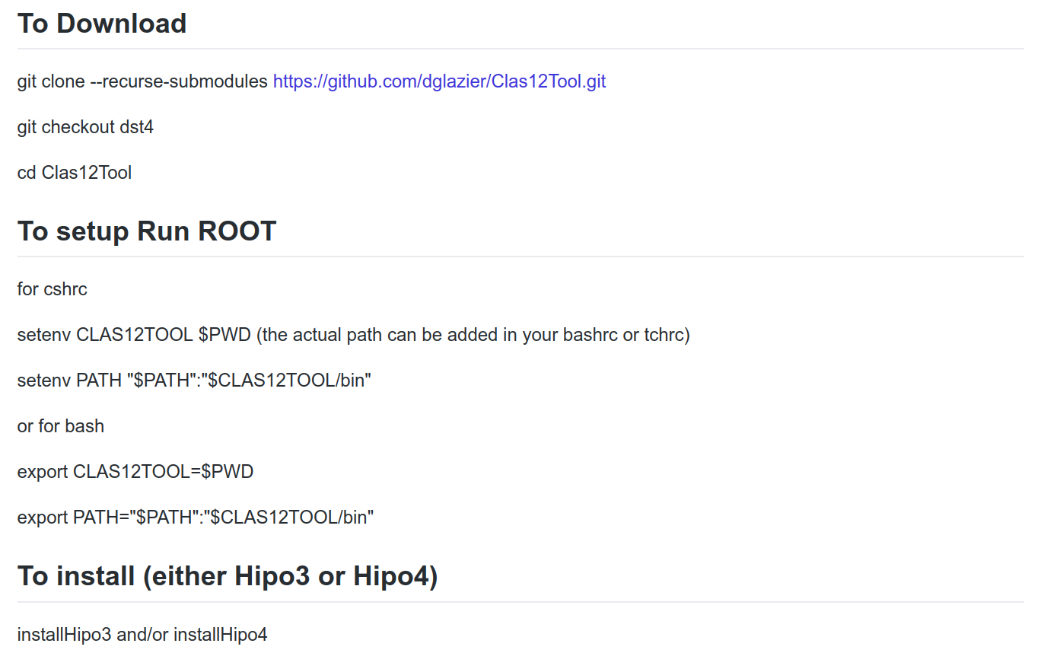
**TEMPORARY** will move to master

Slide 4
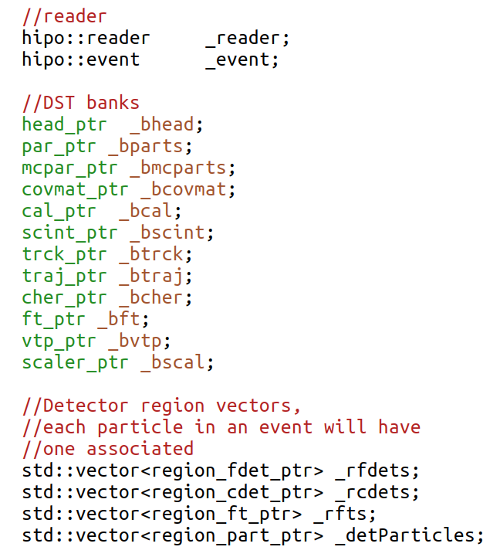
New clas12reader class
region_particles
= particle +
associated detector info
Seperate class for regions:
FT, FD, CD

Slide 5
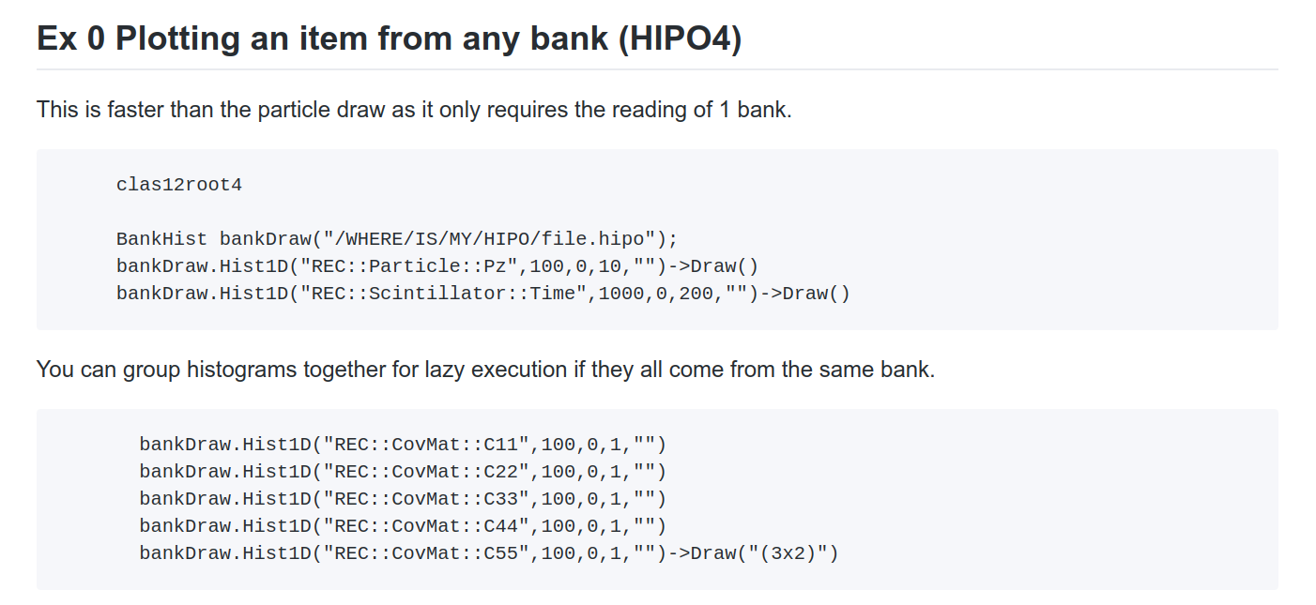

Slide 6
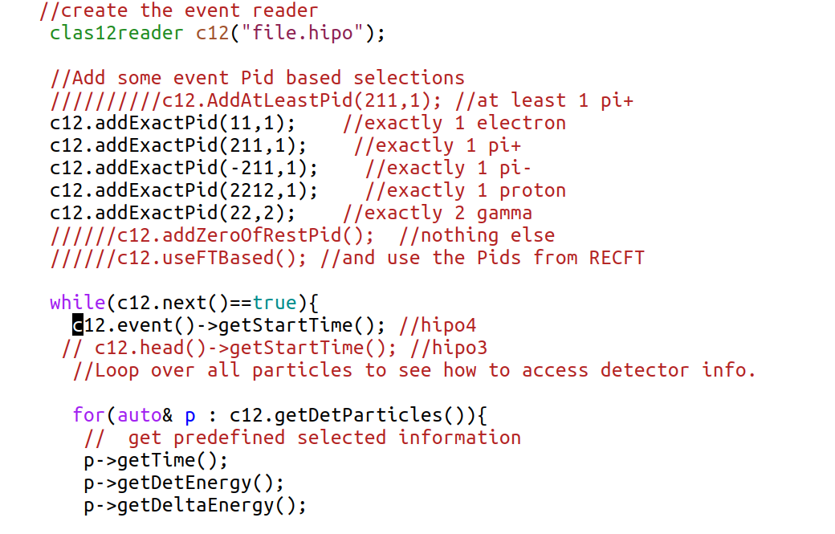
Creating your own analysis loop : clas12root4
i.e. for FD track you get time
from FTOF1B,FTOF1A,FTOF2,PCAL
In order of precedence

Slide 7
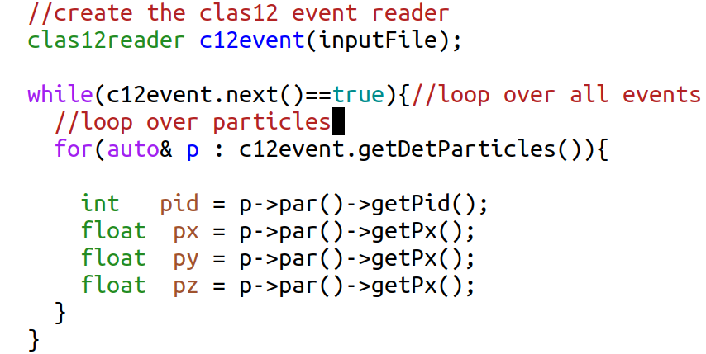

Slide 8
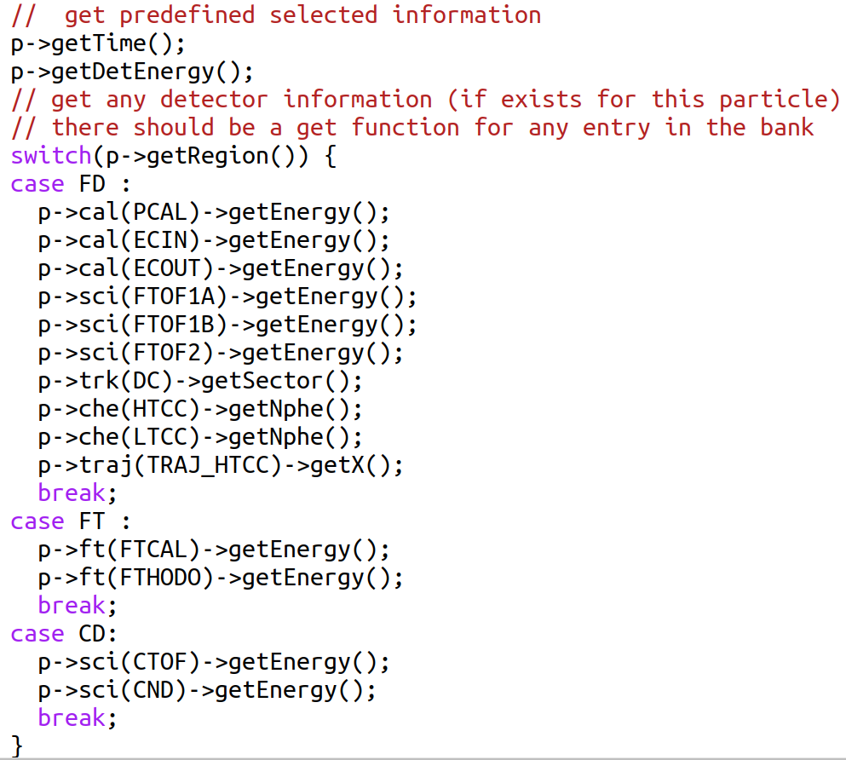
Only need to loop over
Particle!

Slide 9
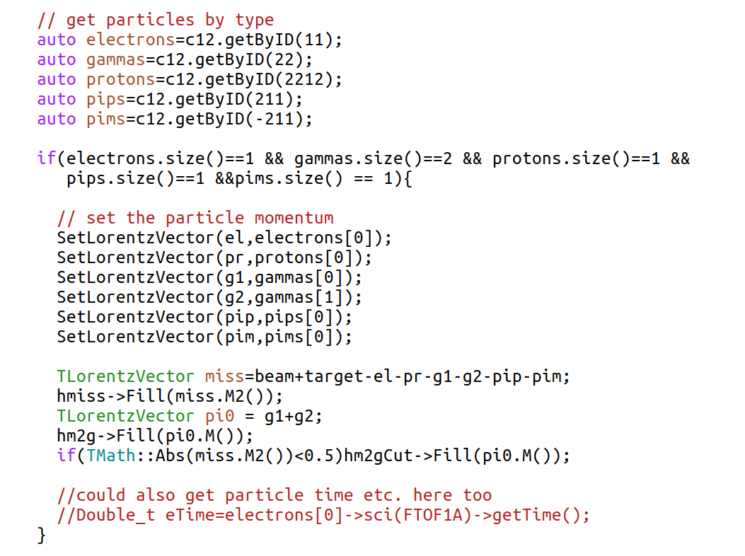
Or analyse particular final states

Slide 10
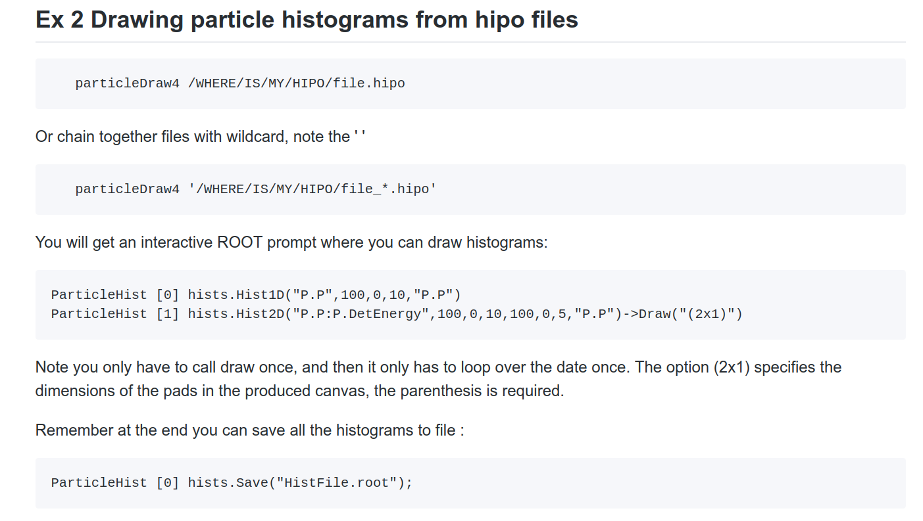

Slide 11
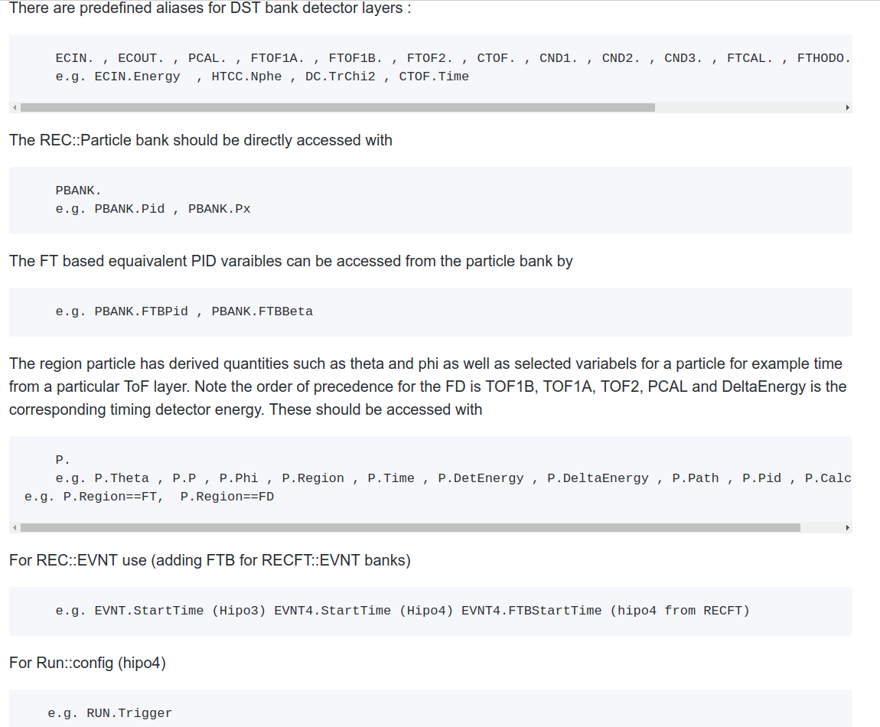

Slide 12
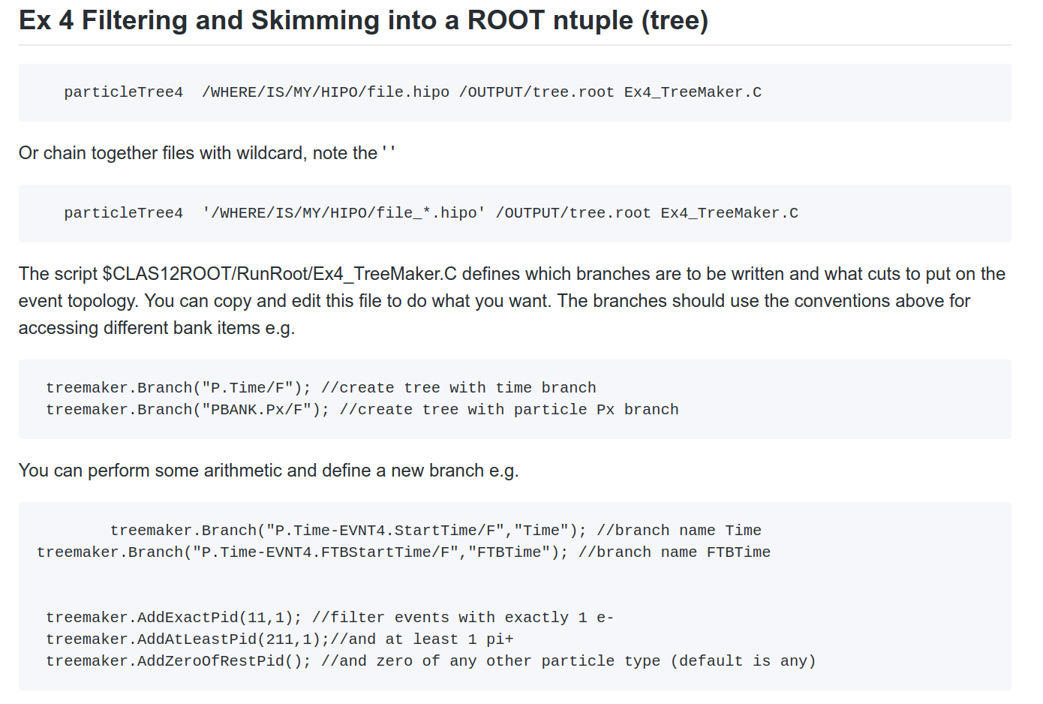

Slide 13
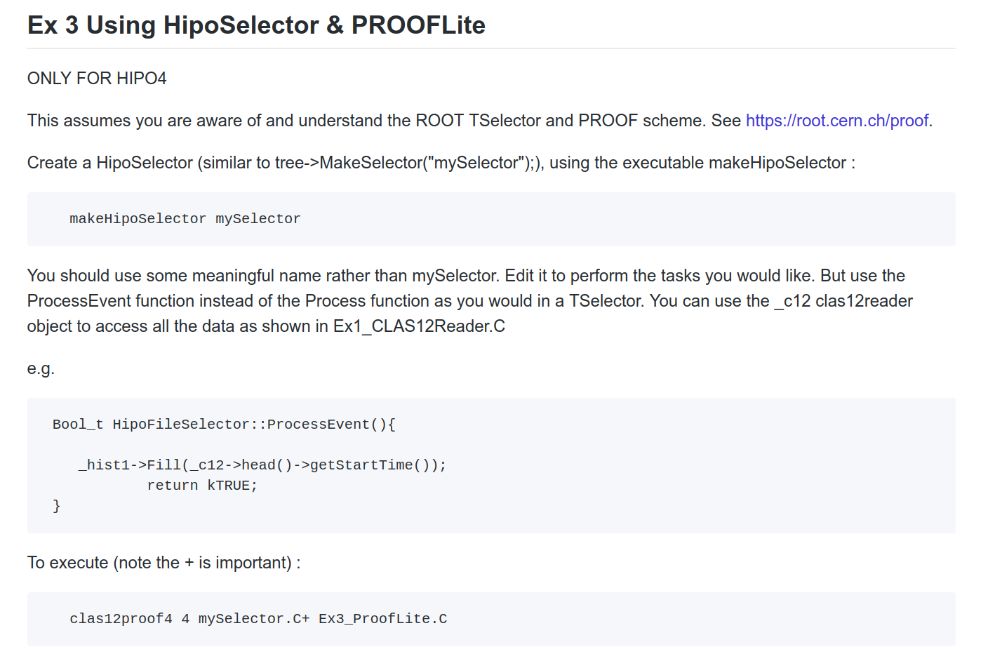

Slide 14
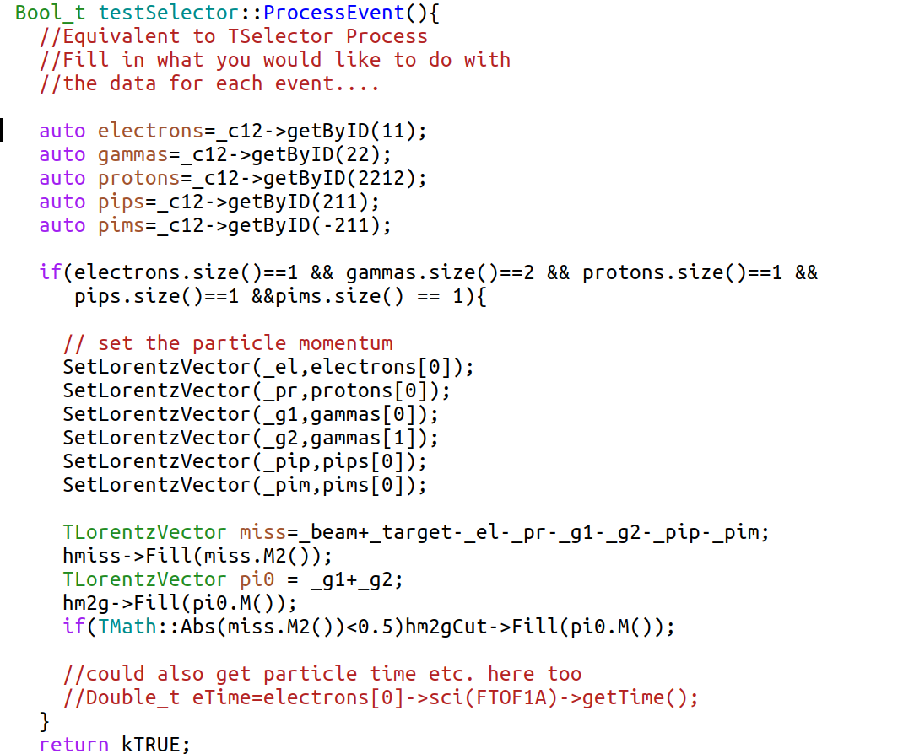

Slide 15
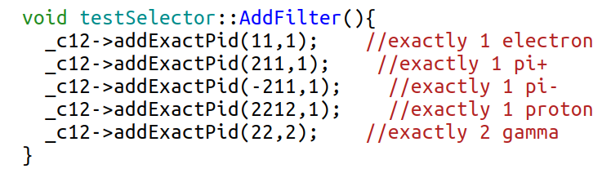
Add event selections to HipoSelector

