Slide 1


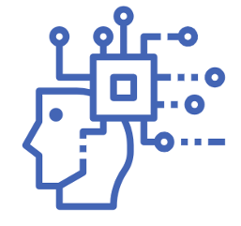

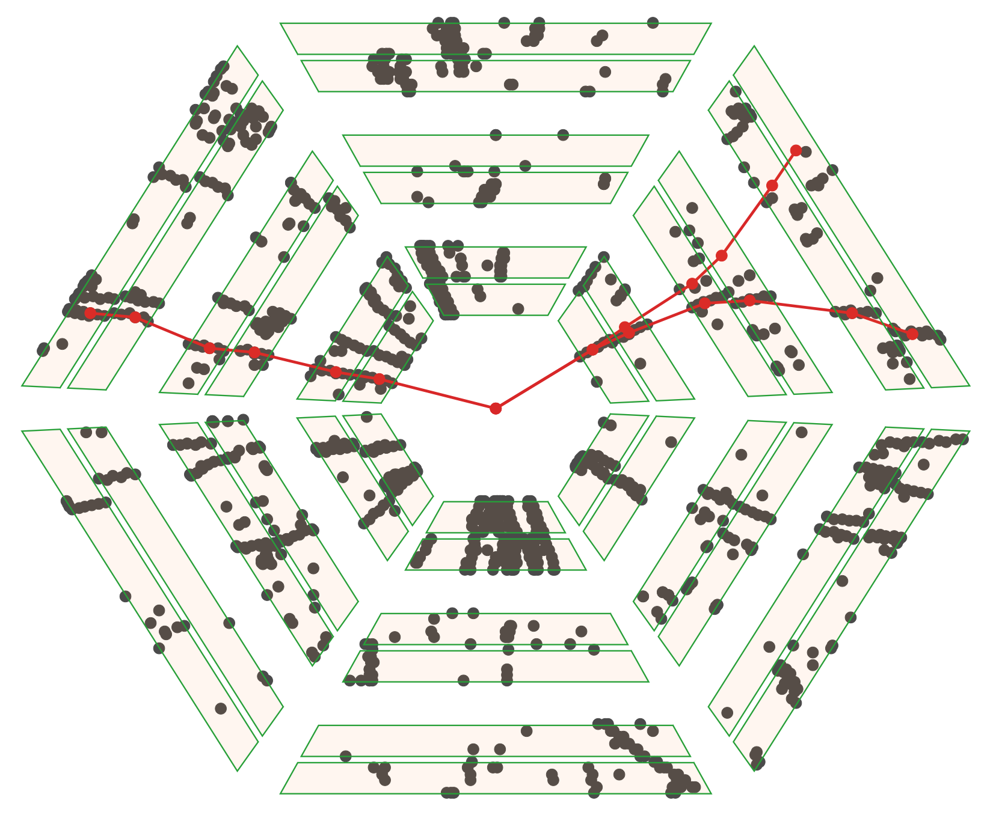
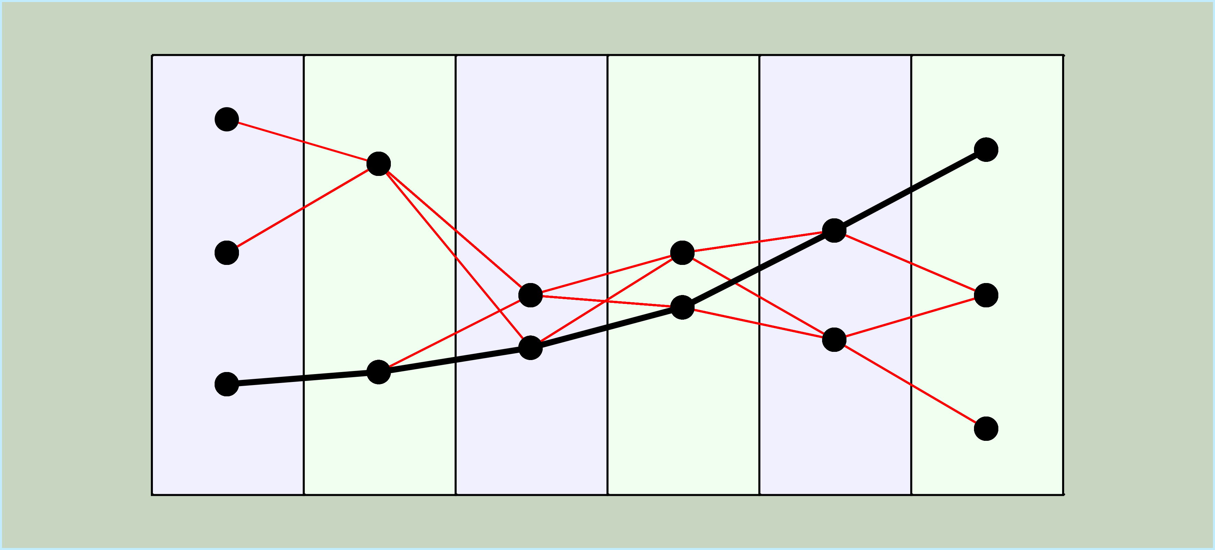
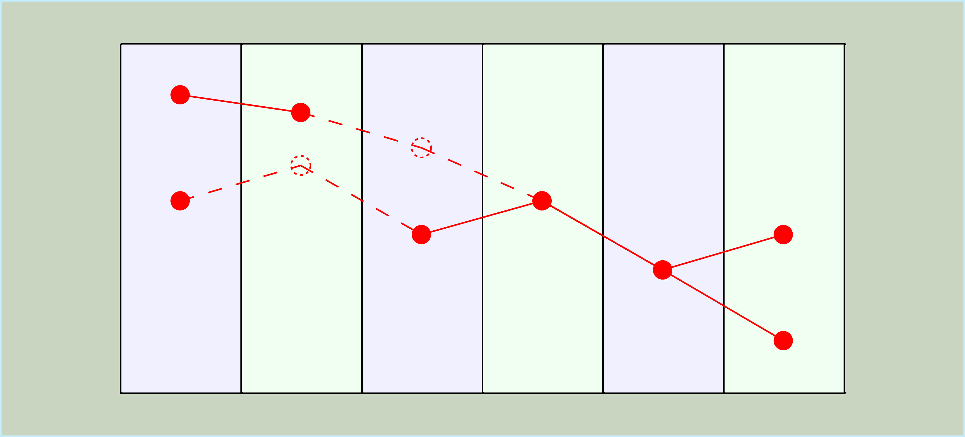
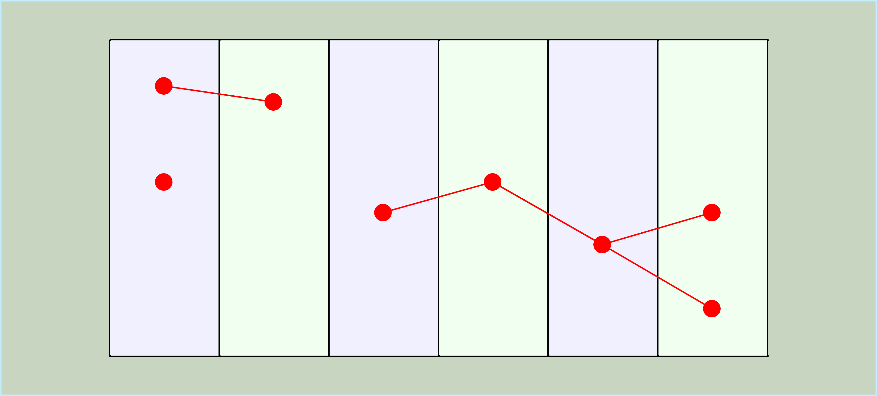
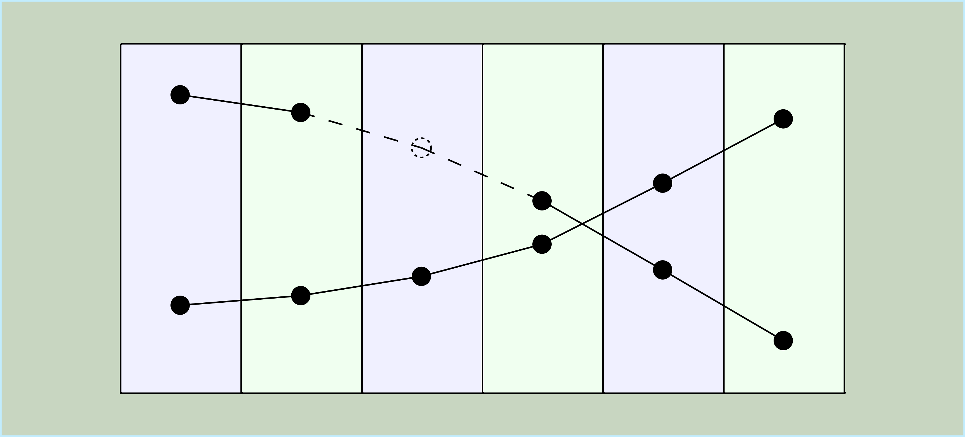
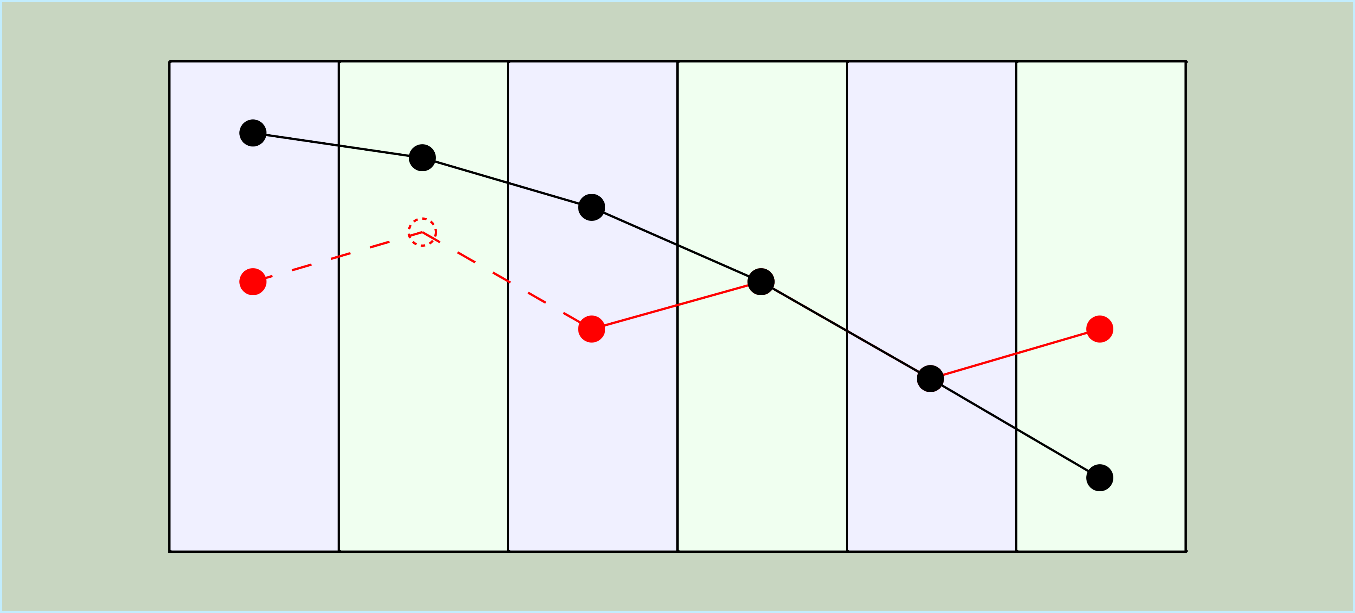
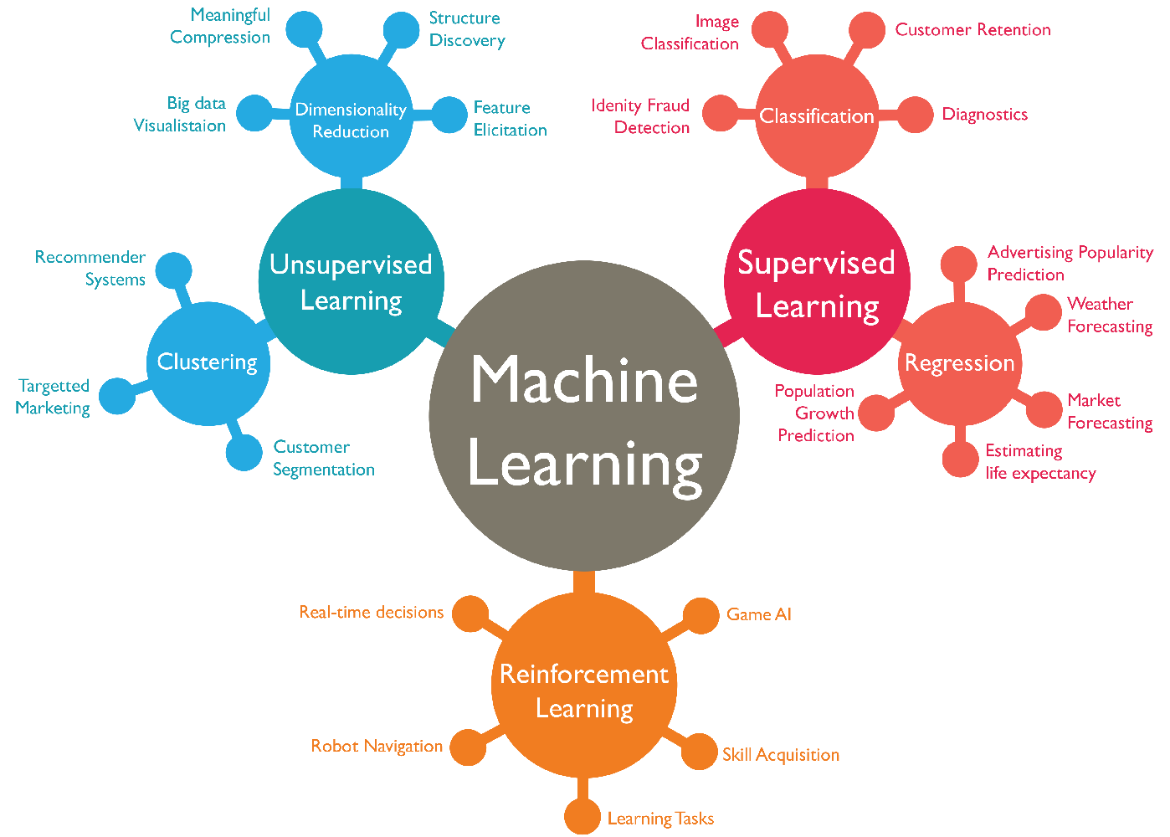
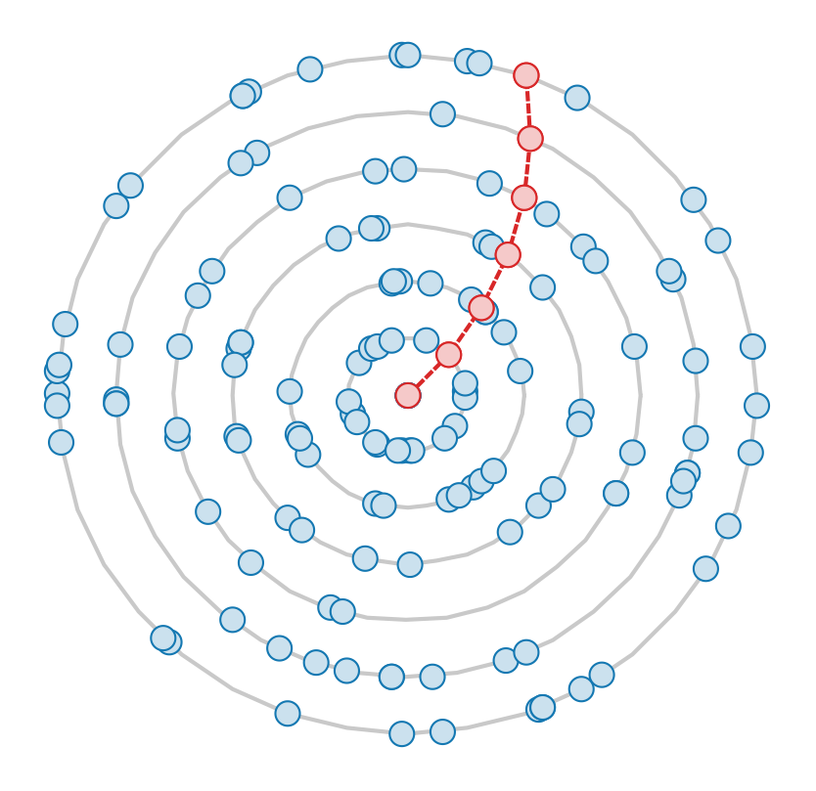
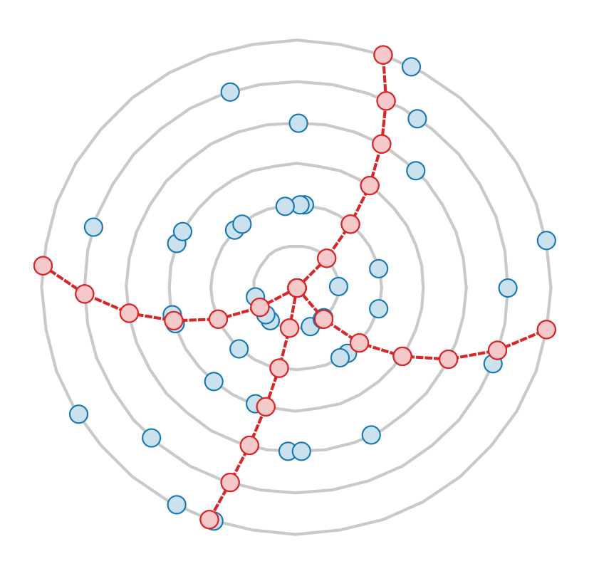
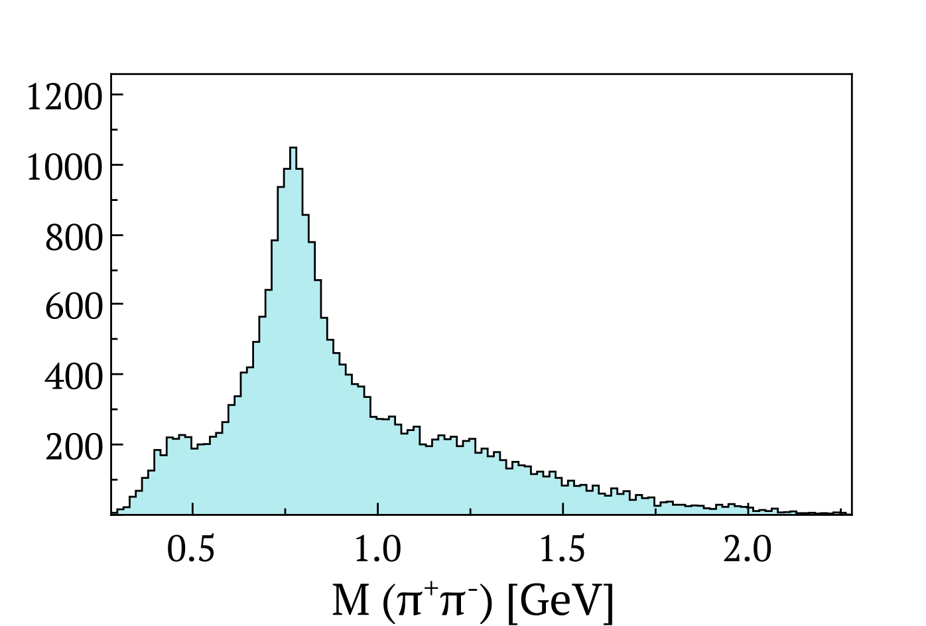
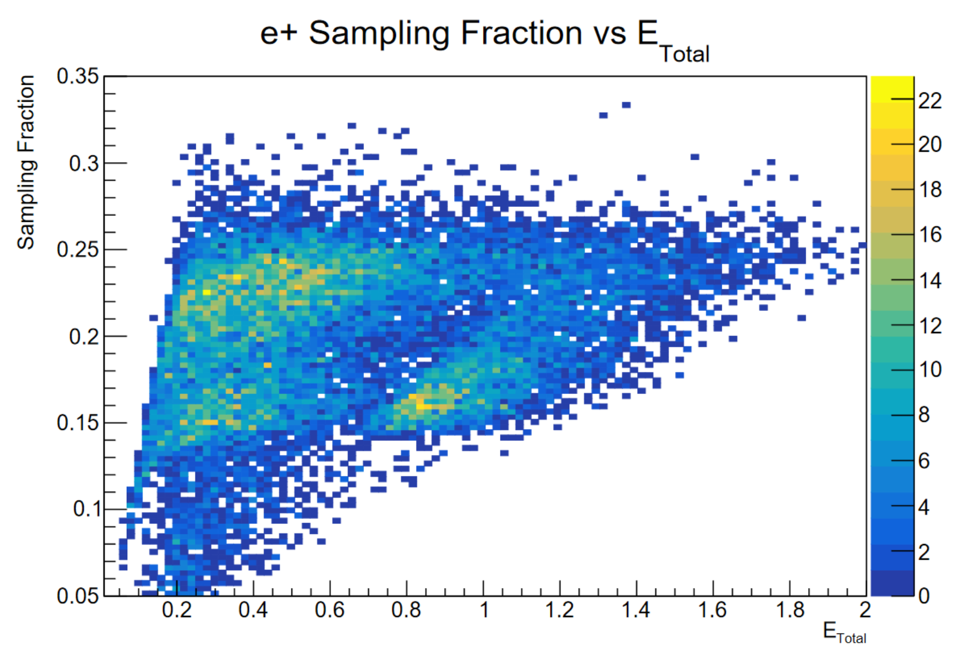
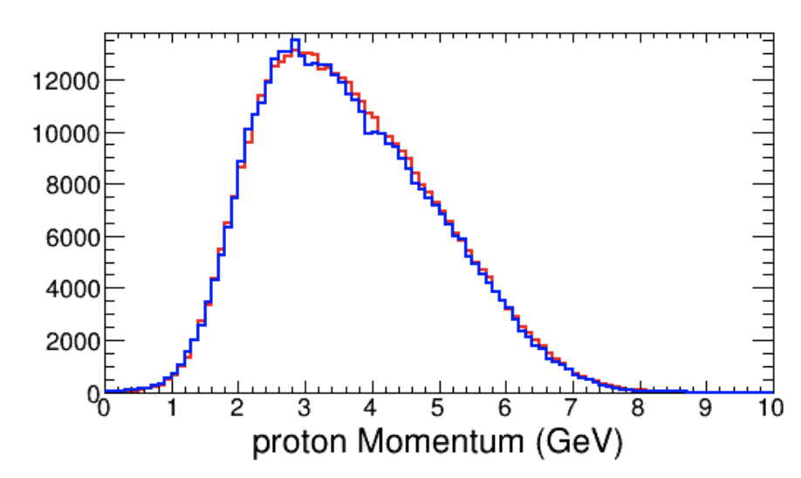

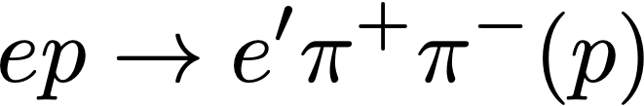
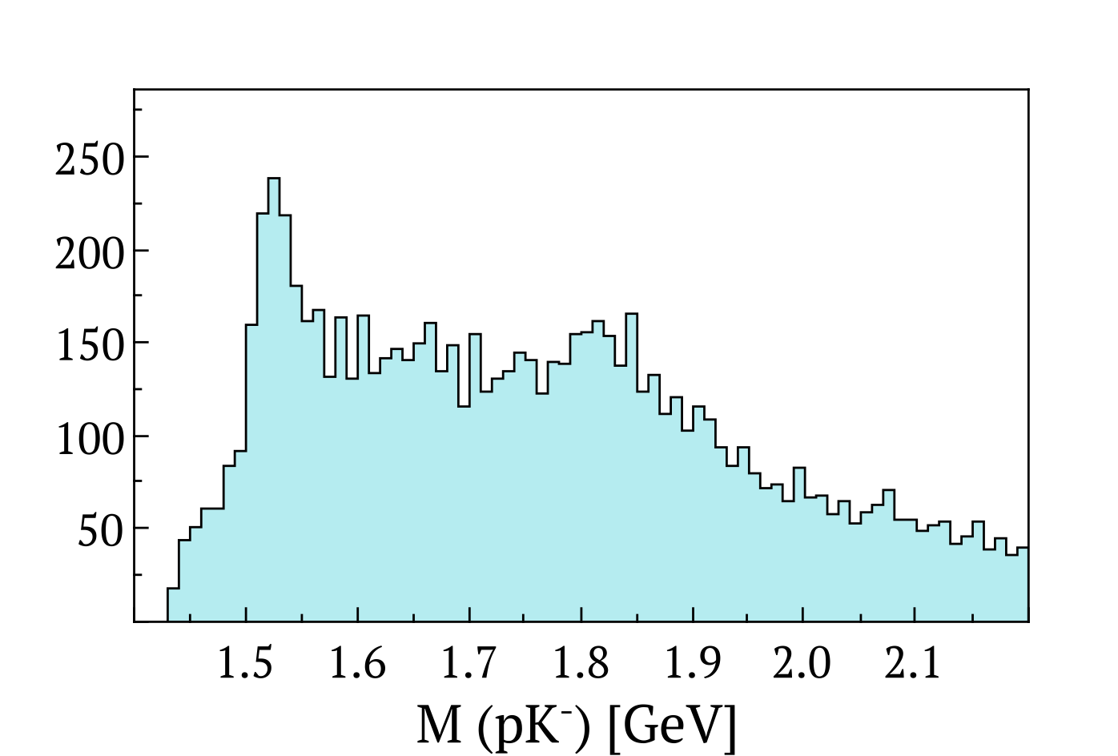
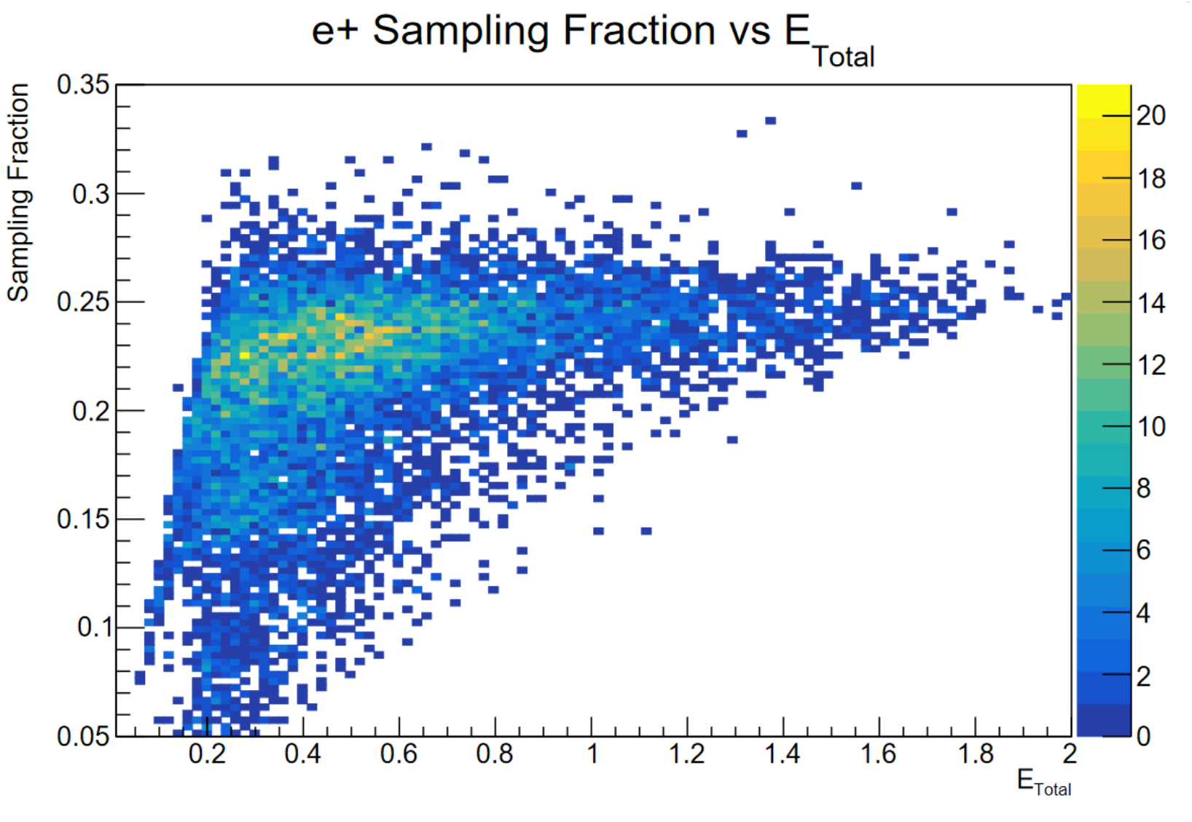
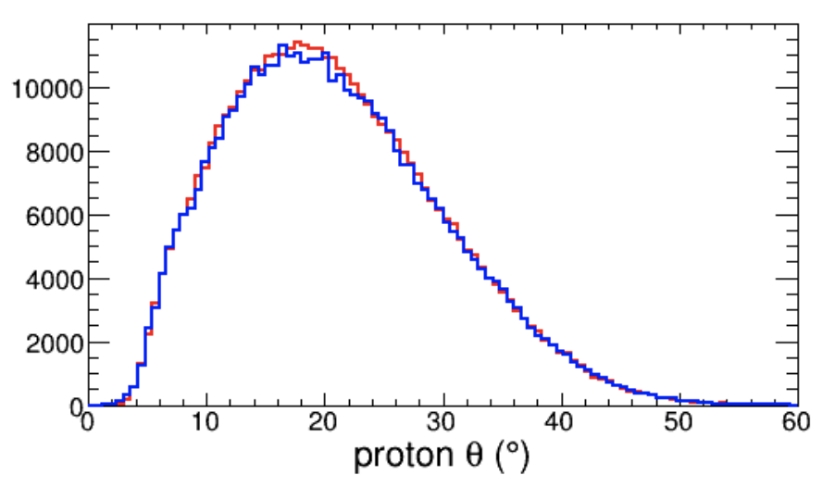

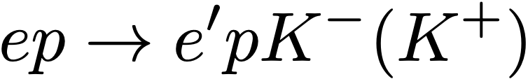
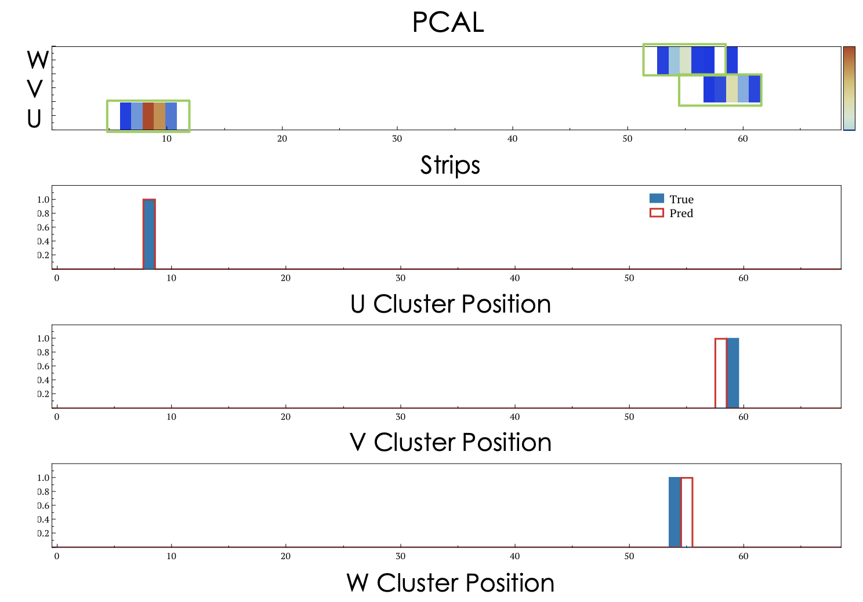
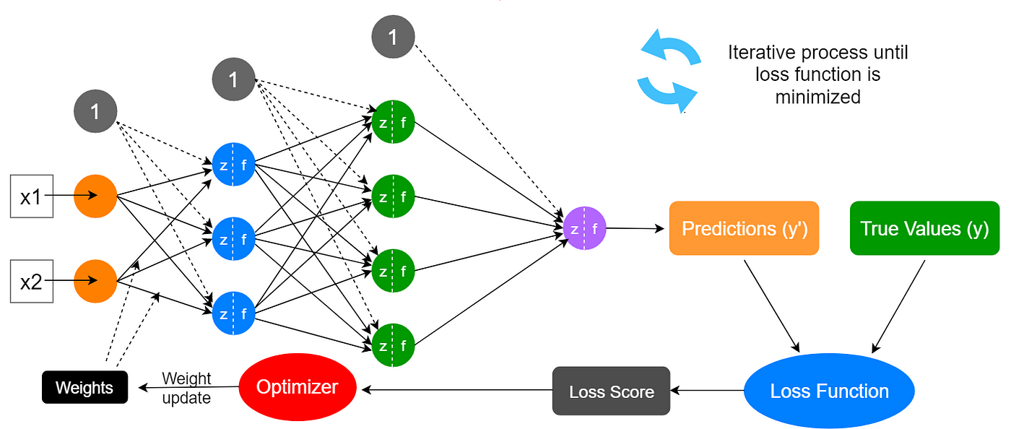
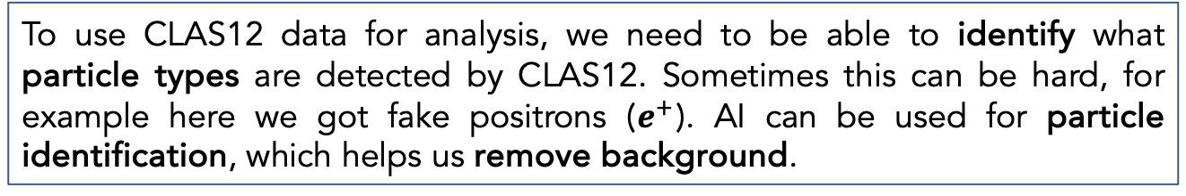
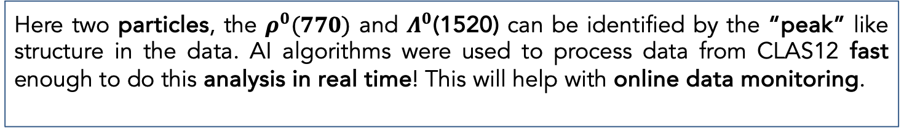
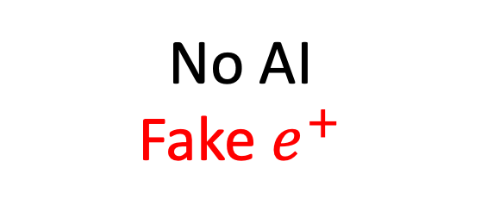
Artificial Intelligence (AI)
Thomas Jefferson National Accelerator Facility
What is it?
AI In Tracking
From helping doctors diagnose diseases to generating cool images, Artificial Intelligence (AI) has been used for many applications in industry and science, even at CLAS12! So, what is AI?
AI, in its broadest sense, is intelligence exhibited by machines. It aims to have computers perform tasks that typically require human intelligence, like recognizing cats and dogs in pictures. It does so by combining large amounts of data with fast, iterative algorithms, allowing the computers to learn automatically from patterns or features in the data.
At CLAS12 we mostly use Machine Learning (ML), a subset of AI where computers learn to make predictions from data, without being explicitly programmed. It's like teaching a computer to recognize patterns by showing it examples, rather than giving it rules to follow.
When a particle goes through CLAS12 it creates an electrical signal in several detector components. We call these signals hits. As a particle goes through several detector components it will leave several hits in CLAS12. These hits form a track, and we call the process of associating the hits together tracking.
It turns out AI is very helpful at tracking, let’s see how!
The Drift Chambers are used to determine:
The location of the nuclear collision generating the particles
The angle and direction of the particles
The momentum of the particles
For this we need to combine hits to create tracks.
First AI tells us what hits belong to a track.
Then we look at remaining hits.
AI then suggests what hits are missing.
AI then tells us what hits belong to a 2nd track.
And now we’ve found two tracks!
PIONS
No AI
AI and denoising
PROTONS
In the drift chambers we get some “background hits”, which we also call noise. Noise can be due to real particles that are not associated with the beam-target interaction or electrical noise. Noise can make it harder to find tracks, but AI can help us remove noise. We call this process denoising. Can you spot the tracks before denoising?
Data Analysis with AI
Did you know?
True Simulation
AI Simulation
Machine Learning got its name in 1959, referring to how an algorithm changes itself to learn to do a task.
Neural Networks were inspired by the structure of neurons in animal brains.
The first working AI programs were written in 1951. They could play checkers and chess. 46 years later, in 1997, AI beat a chess master for the first time!
Would you let AI drive your car? Image recognition with AI has a wide range of applications, from medical diagnosis to self driving cars. It can even do better than humans in some specific tasks!
AI is not just used at CLAS12 but also in many areas of research. In fact, AI is even being used in space exploration to analyse data from space missions and make decisions about how to proceed.
No AI
Fake $e^{+}$
With AI
Here two particles, the $ρ^{0}(770)$ and $Λ^{0}$(1520) can be identified by the “peak” like structure in the data. AI algorithms were used to process data from CLAS12 fast enough to do this analysis in real time! This will help with online data monitoring.
To use CLAS12 data for analysis, we need to be able to identify what particle types are detected by CLAS12. Sometimes this can be hard, for example here we got fake positrons ($e^{+}$). AI can be used for particle identification, which helps us remove background.
Simulating particle detectors like CLAS12 can be slow and computationally intensive. AI can reproduce the standard simulation to the percent level but 10000 faster!
Neural Networks
Neural Networks are one of the most common AI algorithm. Let’s try to understand how they work!
Nodes are arranged in layers. They take in a number from each node in the previous layer. Next, they pass it to the neurons in the next layer after multiplying that number by a weight.
Neural Networks are trained by comparing their predictions to a correct answer. Just like you, neural networks learn by making mistakes!
During the training process, the neural network makes a prediction, then updates itself based on how accurate the prediction was. This process is repeated until the network stops getting better.
x1 and x2 are the numbers that we give to the neural network. This could be the position of the hits in the drift chamber.
The network predicts numbers. For example, in denoising, a hit is noise (0) or not (1). The true values are the correct answers, these need to be written out by a human intelligence.
Given a track in the drift chamber, AI can find where a particle hits other detectors. The image above shows the AI prediction and truth for the pre-shower calorimeter (PCAL).
Look at the detector and other posters. Do you think you could do the same?
Contributing Institutions
Weights connect a node to each nodes in the subsequent layer. These weights allow a network to make a prediction. By changing its own weights, the network is able to learn.
To decide how accurate a prediction is, the network uses a loss function. This can be as simple as taking the average squared difference between the prediction and the true value.
The network then uses its optimizer and the loss score to decide how to change its own weights.
Once the network is finished training, we can use it’s predictions without knowing the true values!
Jefferson Lab, Newport News, VA, USA
University of Glasgow, Glasgow, UK
Old Dominion University, Norfolk, VA, USA

