Slide 1


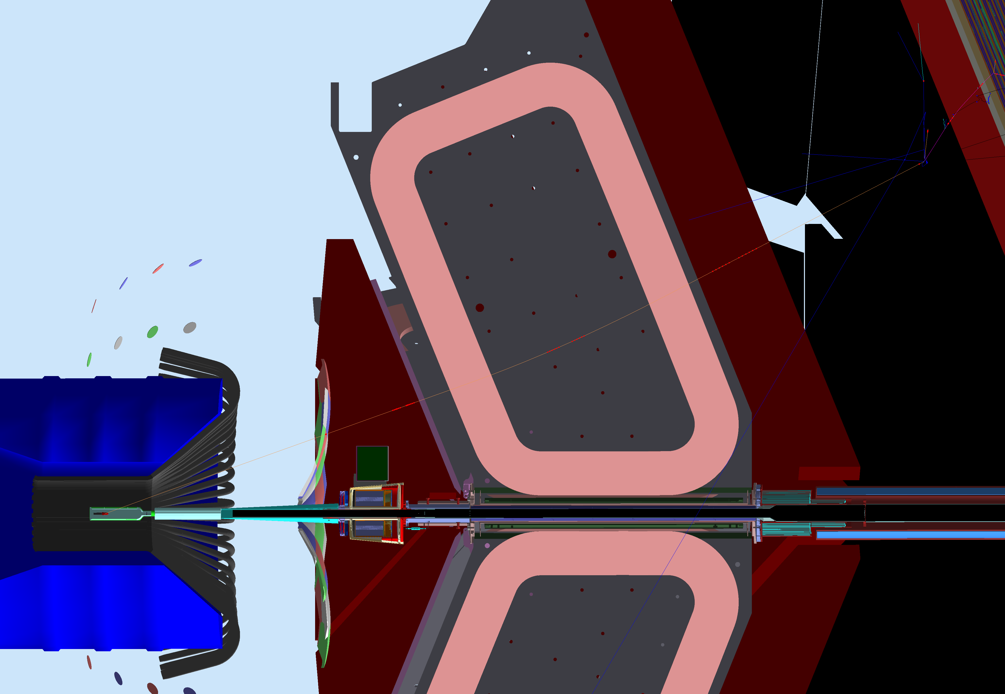
Detecting Momentum in the CLAS12 Torus
Thomas Jefferson National Accelerator Facility
The magnets steer the particles.

