Slide 1
OAuth2 Intro

Slide 2
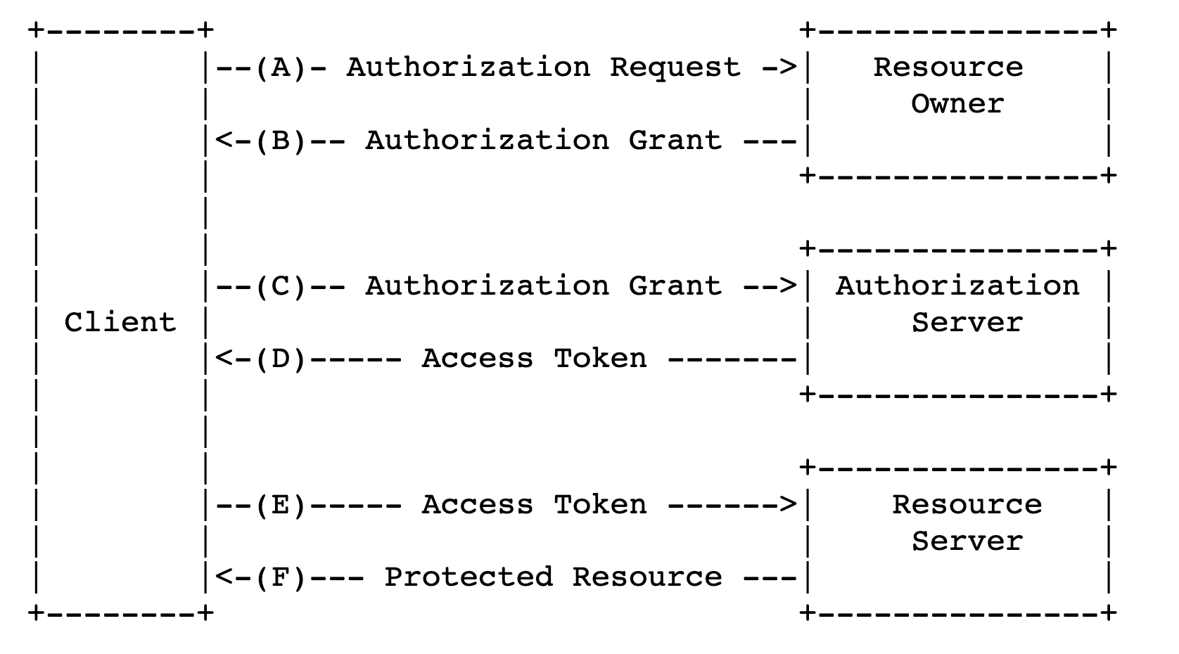

Slide 3
Users
Third-Party Applications
File System,
Computing Nodes

Slide 4
Users
Third-Party Applications:
Confidential
Server app
Public
Browser app
Native app
(*must first be registered)
File System,
Computing Nodes

Slide 5
Users:
Lab account?
or Phone number?
Third-Party Applications
File System,
Computing Nodes

Slide 6
Authorization Process

Slide 7
Authorization Grant
Authorization Code
Authorization Server as intermediary
Owner Privacy
Grant Visibility
-> PKCE
Implicit
Directly Access Token
Verified via redirection URI
Exposed to more apps
Efficiency > , Security <
-> legacy
Resource Owner Password Credentials
Only for First-Party Apps
user + pwd
exchange for long-live token
Client Credentials
Get client’s own information
etc.
Authorization Process

Slide 8
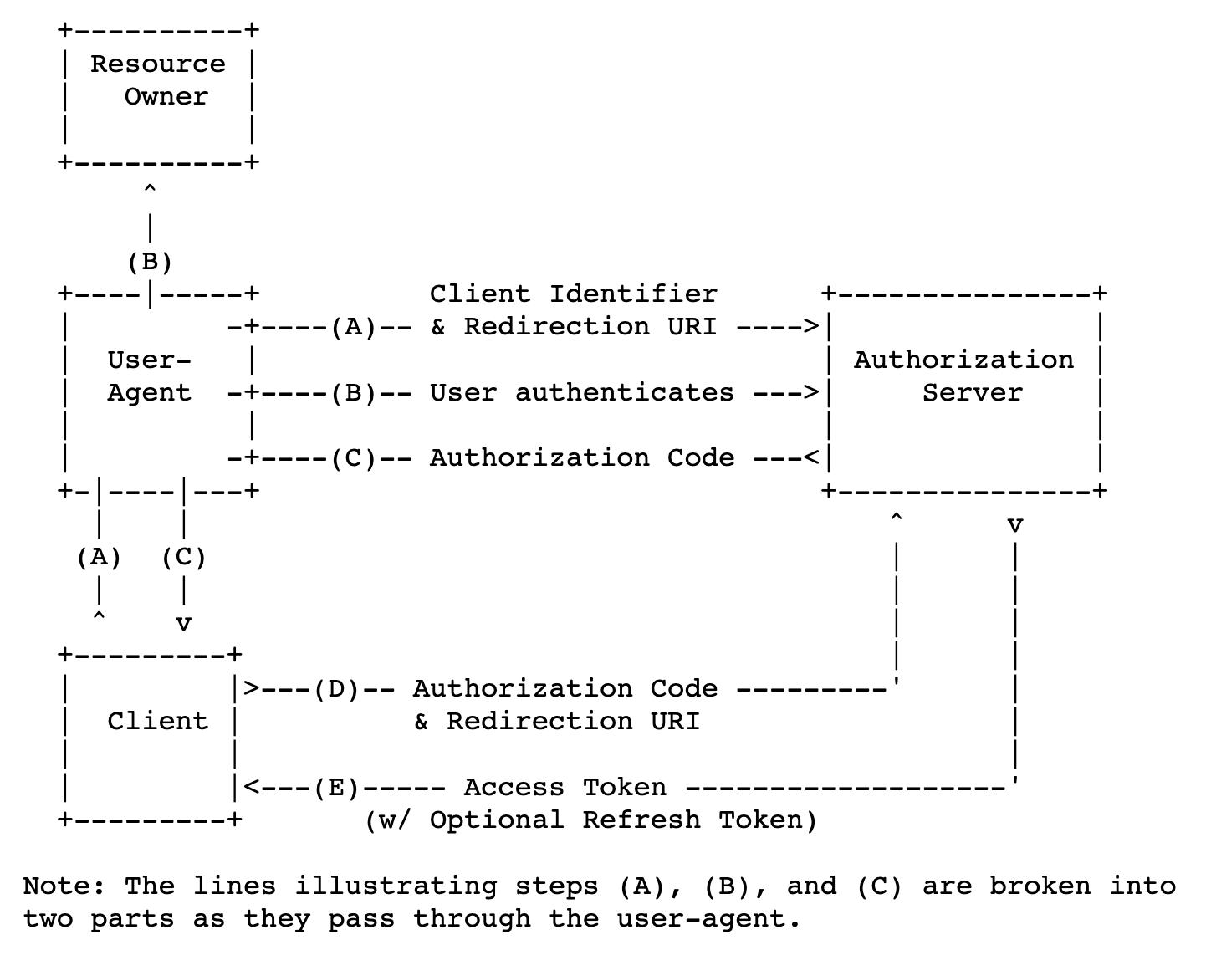
Authorization Grant
Authorization Code
Authorization Server as intermediary
Owner Privacy
Grant Visibility
-> PKCE
Implicit
Directly Access Token
Verified via redirection URI
Exposed to more apps
Efficiency > , Security <
-> legacy
Resource Owner Password Credentials
Only for First-Party Apps
user + pwd
exchange for long-live token
Client Credentials
Get client’s own information
etc.
Authorization Process

Slide 9
Authorization Grant
Authorization Code
Authorization Server as intermediary
Owner Privacy
Grant Visibility
-> PKCE
Implicit
Directly Access Token
Verified via redirection URI
Exposed to more apps
Efficiency > , Security <
-> legacy
Resource Owner Password Credentials
Only for First-Party Apps
user + pwd
exchange for long-live token
Client Credentials
Get client’s own information
etc.
Authorization Process

Slide 10
Authorization Grant
Authorization Code
Authorization Server as intermediary
Owner Privacy
Grant Visibility
-> PKCE
Implicit
Directly Access Token
Verified via redirection URI
Exposed to more apps
Efficiency > , Security <
-> legacy
Resource Owner Password Credentials
Only for First-Party Apps
user + pwd
exchange for long-live token
Client Credentials
Get client’s own information
etc.
Authorization Process

Slide 11
Authorization Grant
Authorization Code
Authorization Server as intermediary
Owner Privacy
Grant Visibility
-> PKCE
Implicit
Directly Access Token
Verified via redirection URI
Exposed to more apps
Efficiency > , Security <
-> legacy
Resource Owner Password Credentials
Only for First-Party Apps
user + pwd
exchange for long-live token
Client Credentials
Get client’s own information
etc.
Authorization Process

Slide 12
Authorization Grant
Authorization Code
Authorization Server as intermediary
Owner Privacy
Grant Visibility
-> PKCE
Implicit
Directly Access Token
Verified via redirection URI
Exposed to more apps
Efficiency > , Security <
-> legacy
Resource Owner Password Credentials
Only for First-Party Apps
user + pwd
exchange for long-live token
Client Credentials
Get client’s own information
etc.
Authorization Process

Slide 13
Usage of OAuth2
Create and
Register App

Slide 14
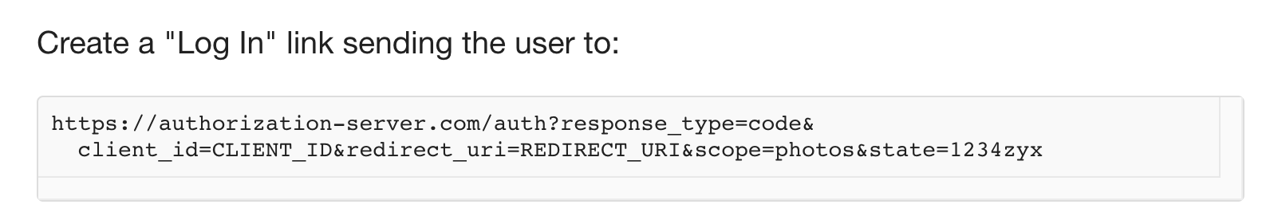
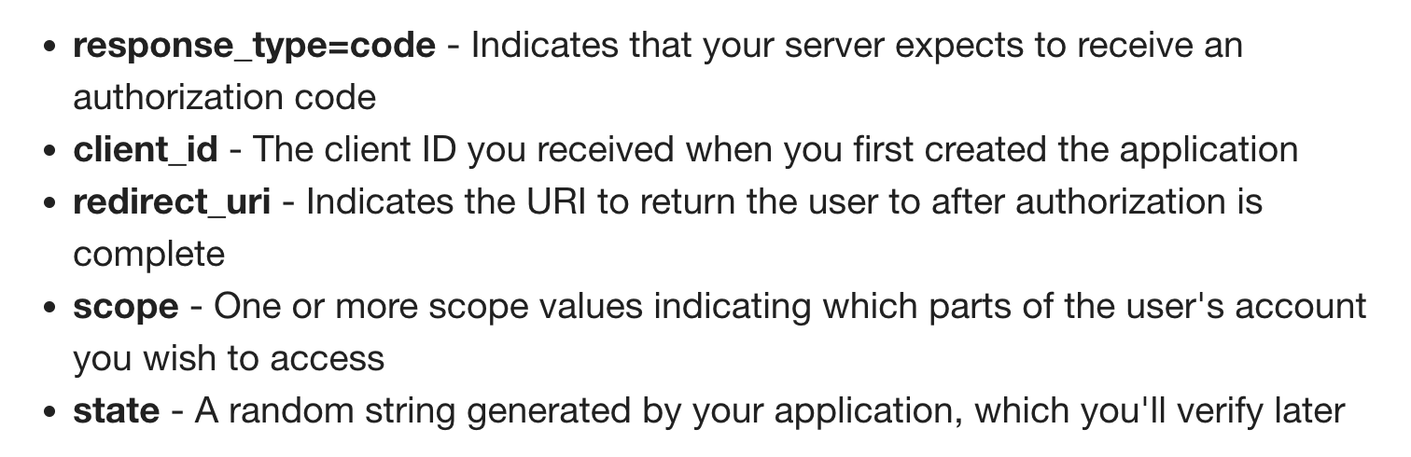
Usage of OAuth2
Create and
Register App

Slide 15
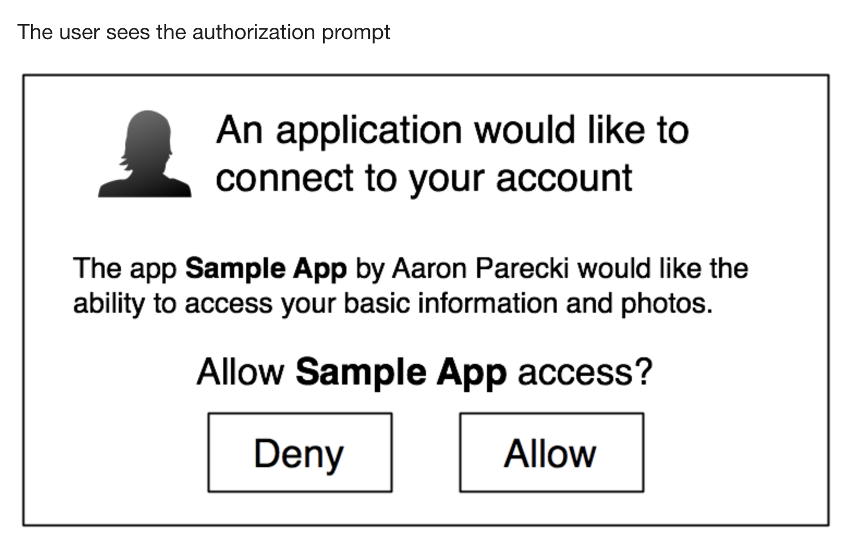
Usage of OAuth2
Create and
Register App

Slide 16
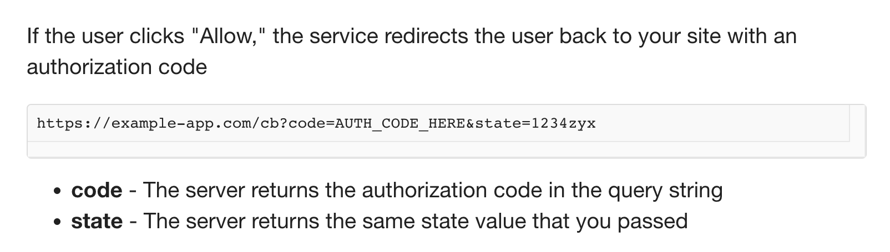
Usage of OAuth2
Create and
Register App

Slide 17
Requirements of OAuth2
Protocol Endpoints
Authorization server
authorization endpoint
token endpoint
Client
redirection endpoint
And ?

Slide 18
https://www.rfc-editor.org/rfc/rfc6749#section-1.5
https://aaronparecki.com/oauth-2-simplified/#client-credentials
https://developers.google.com/identity/protocols/oauth2/javascript-implicit-flow#oauth-2.0-endpoints

