Slide 1
Available Data

Slide 2
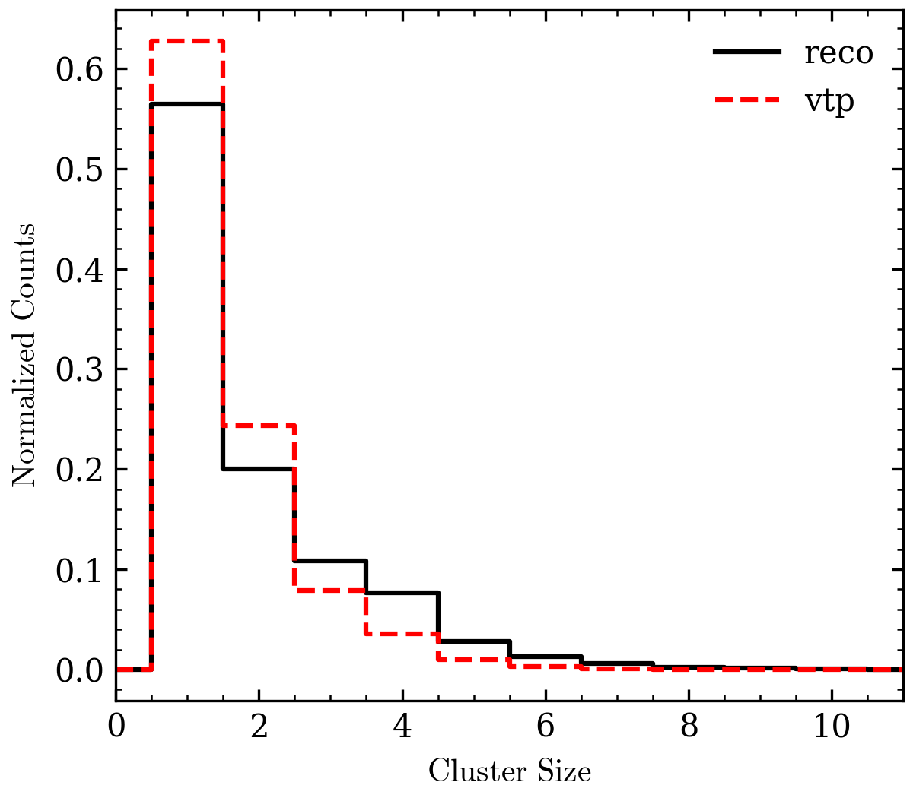
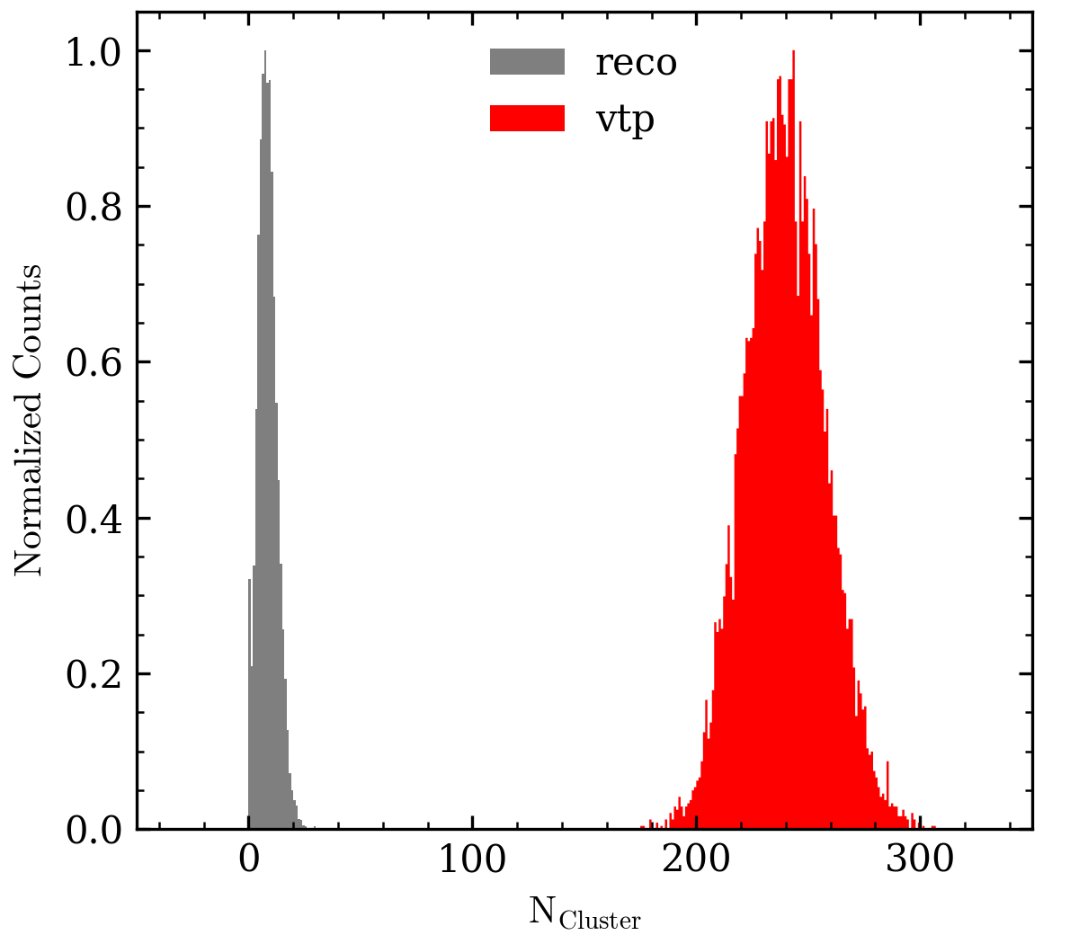
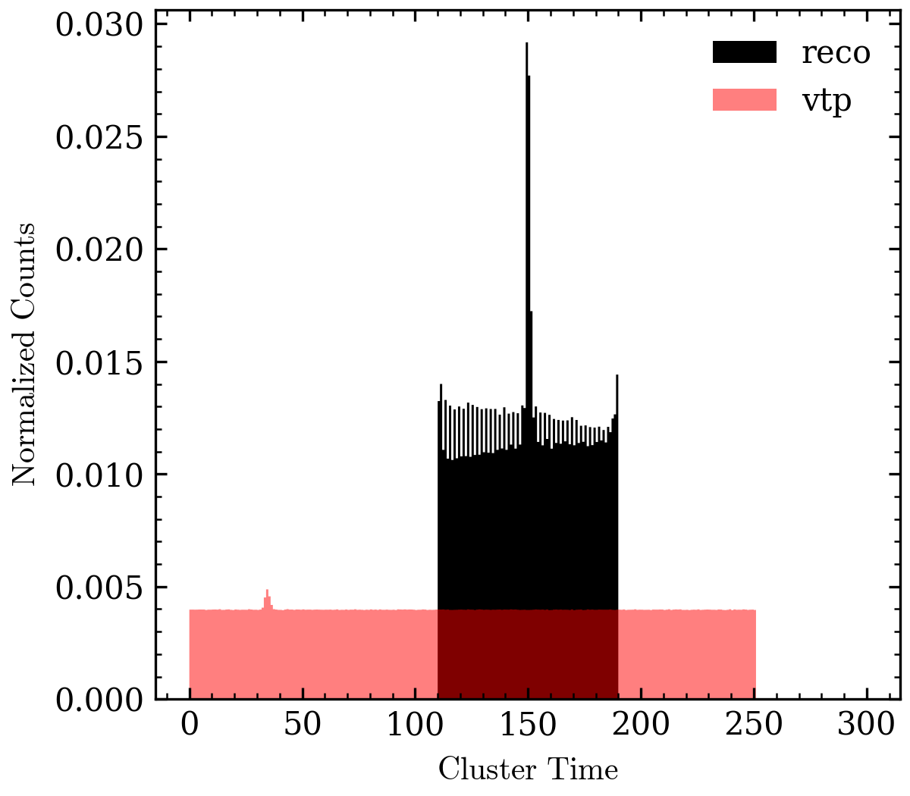
RUN 4454, Seg 0
Hcana reconstructed cluster quantities → NPS.Cal.*
Reconstructed kinematics → NPS.kin.Secondary.*
Cluster info taken from vtp trigger → NPS.Cal.vtp*
Cluster size
# of clusters
Cluster time

Slide 3
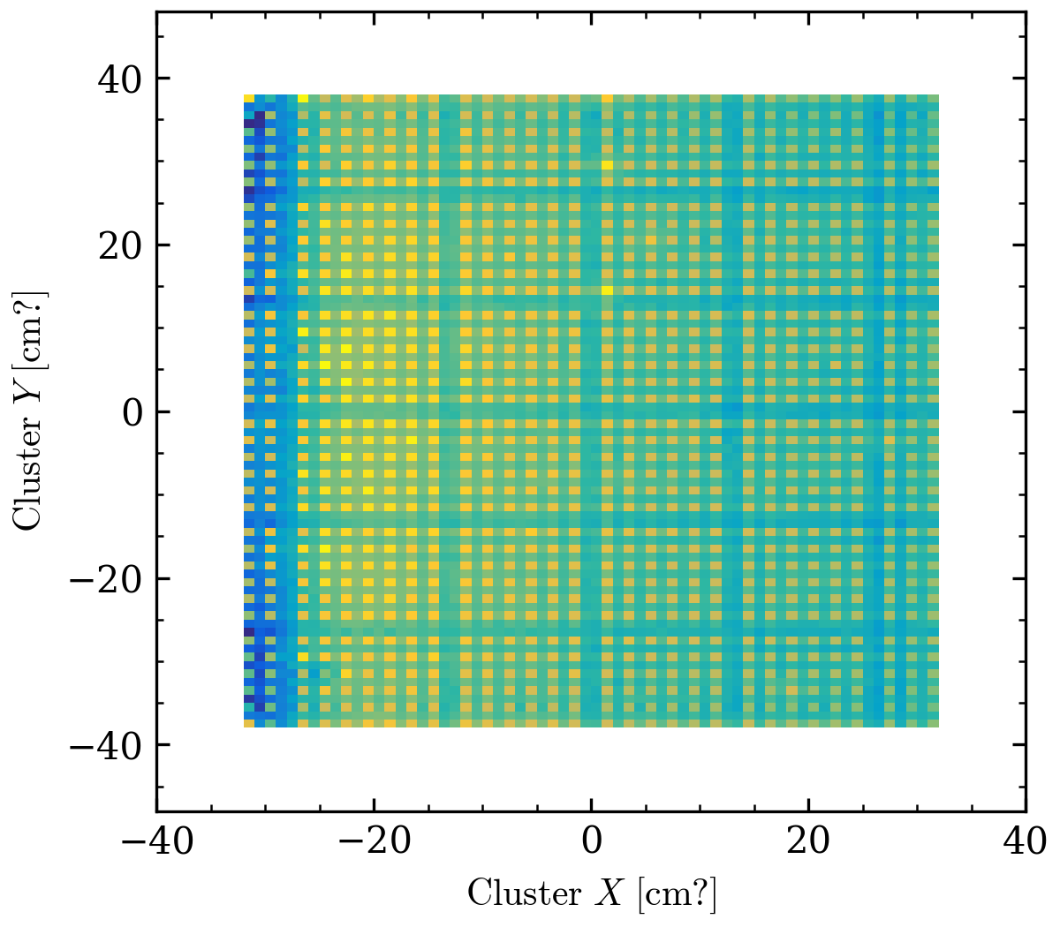
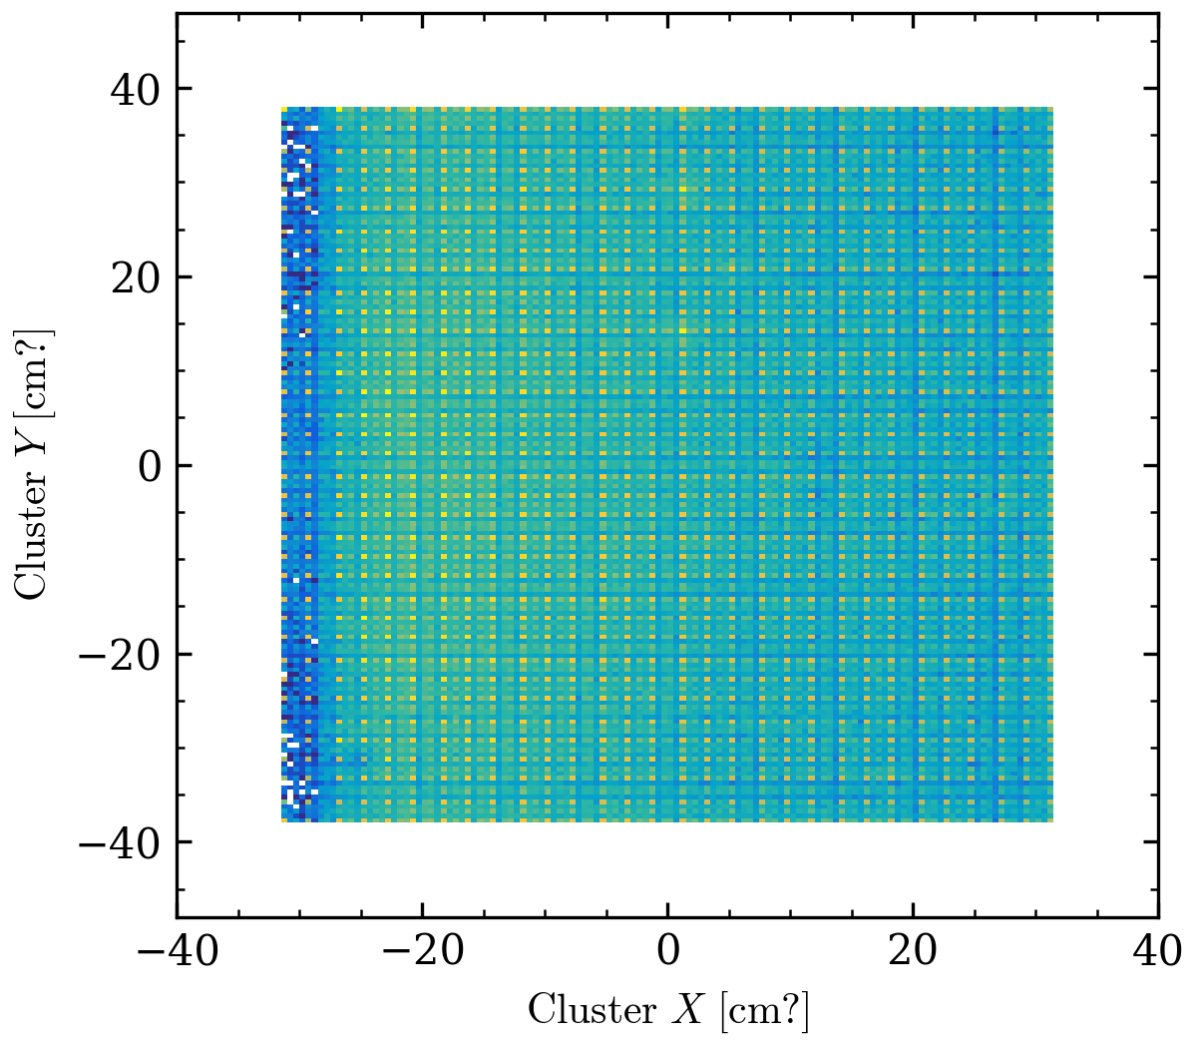
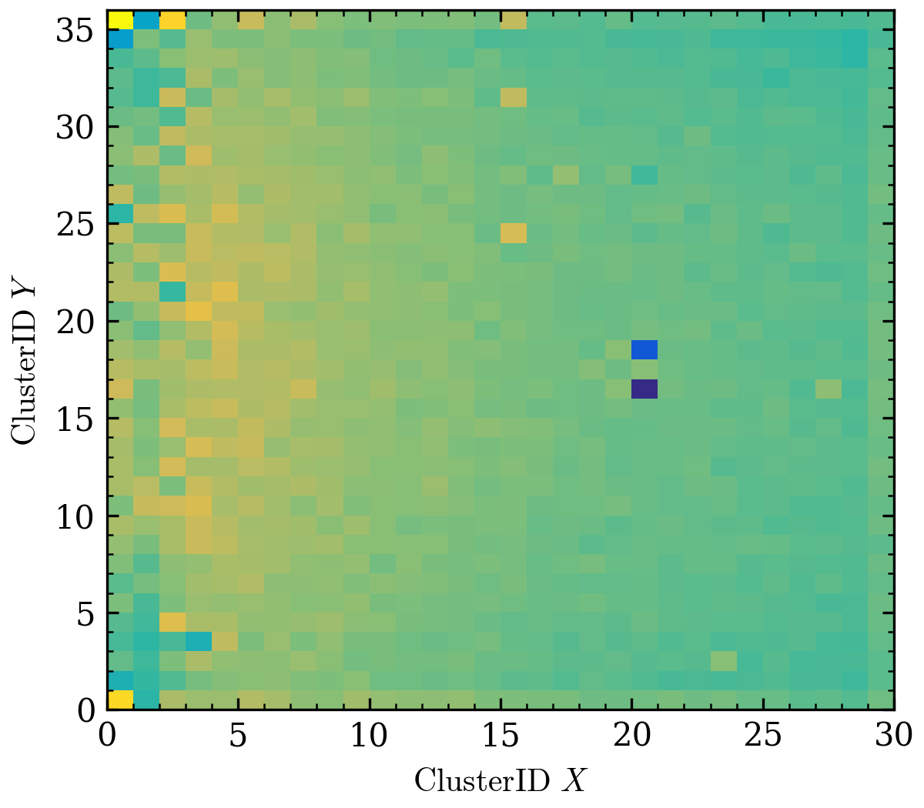
Cluster XY pattern from hcana and vtp
calibrated
vtp
Assume vtp data is all we see,
Ever moved the nps during the experiment ?
ML model do not know the calibration and treat the XY hit the same way

Slide 4
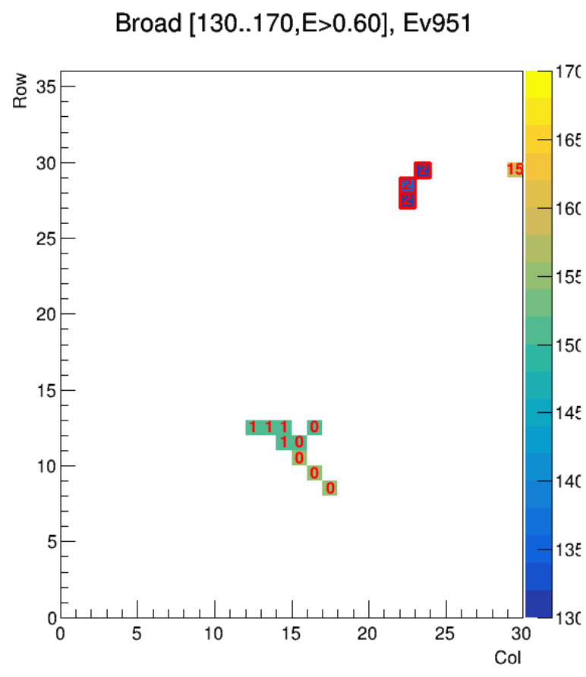
Timing info from Josh
Cuts
Hms triggered
Cluster E > 0.6 GeV
Cluster time within some window
For each pixel:
NPS.cal.fly.block_clusterID (number in the plot) NPS.cal.fly.goodAdcTdcDiffTime (color)

Slide 5
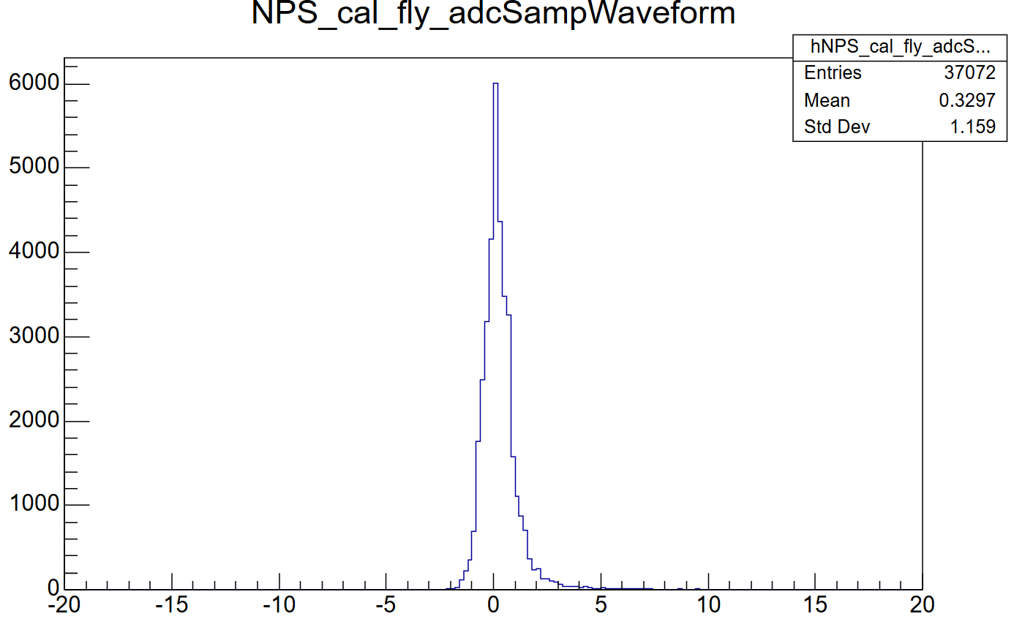
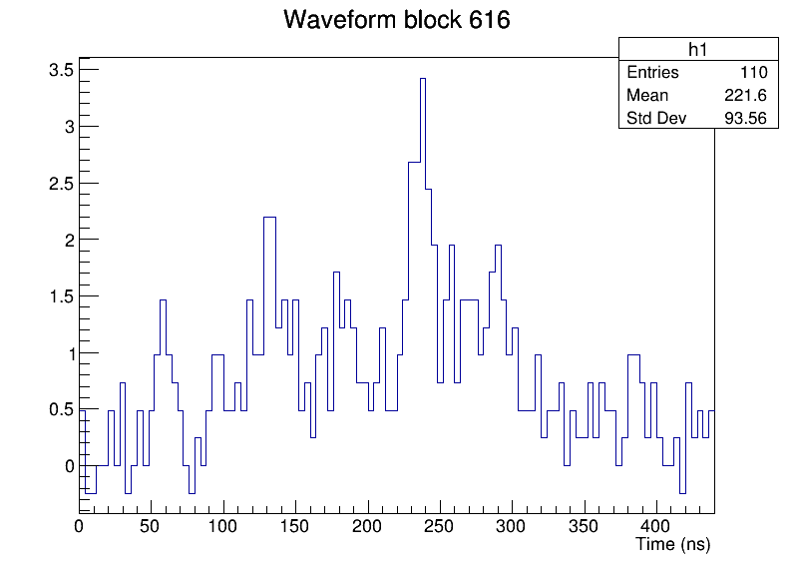
Waveform data from replay
Flatten vector of waveforms
Only active blocks are stored
Length of waveform = 110 (each 4ns)
1 waveform can have multiple pulses/hits
2 element used to store block id and length
Total length = nblocks * (110 + 2)

Slide 6
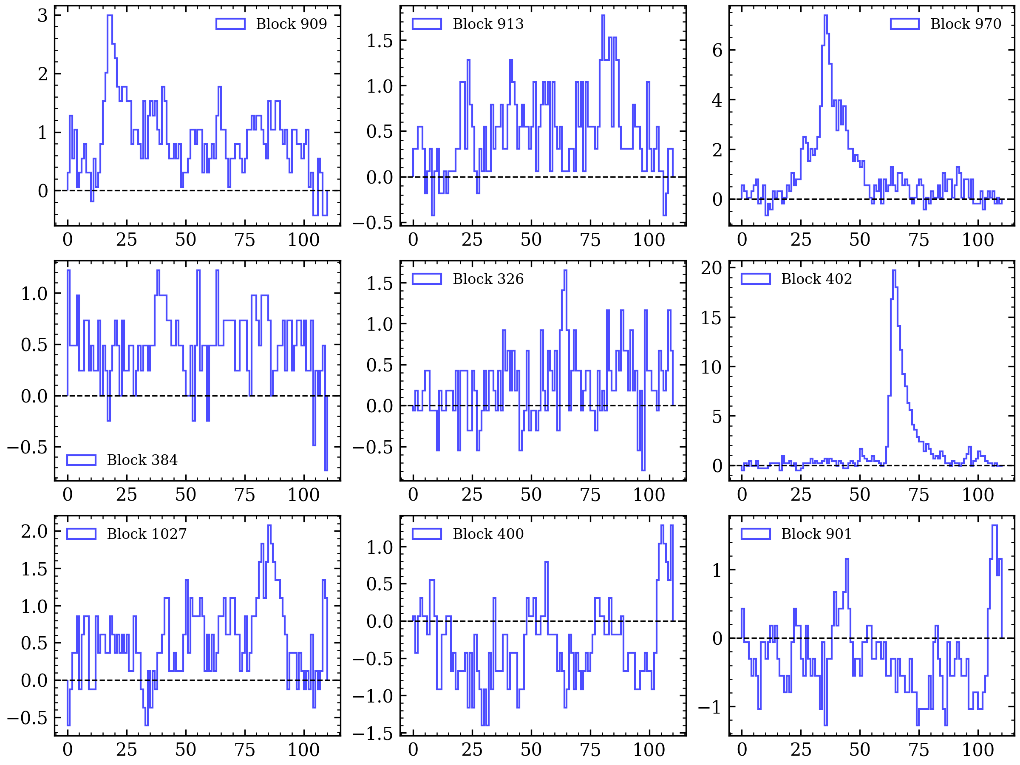
Waveform data from replay

Slide 7
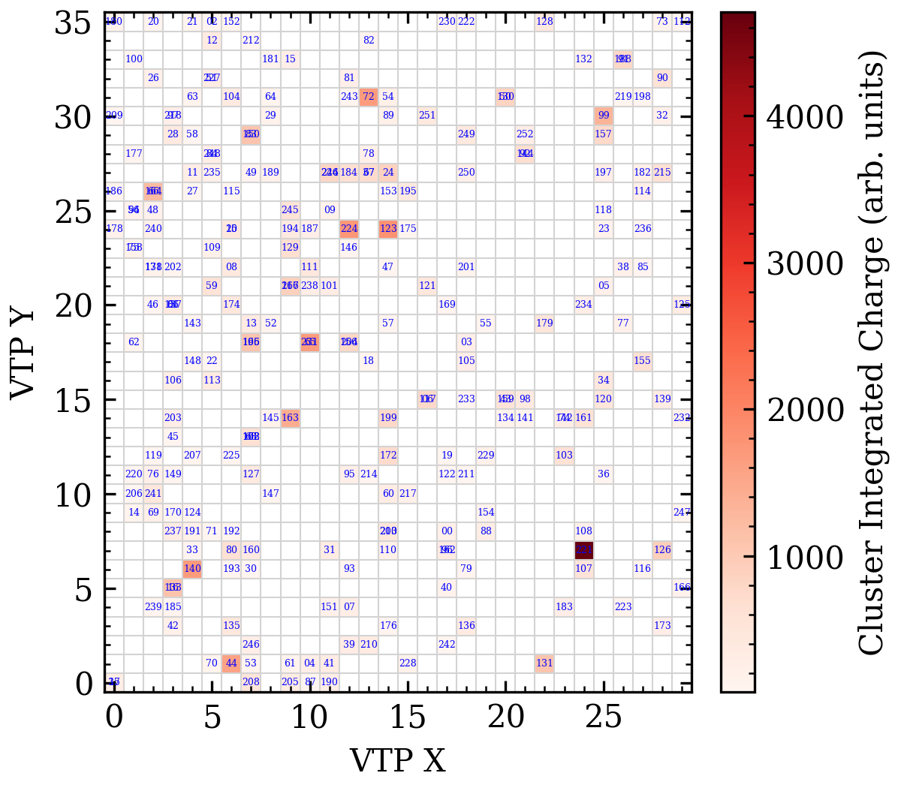
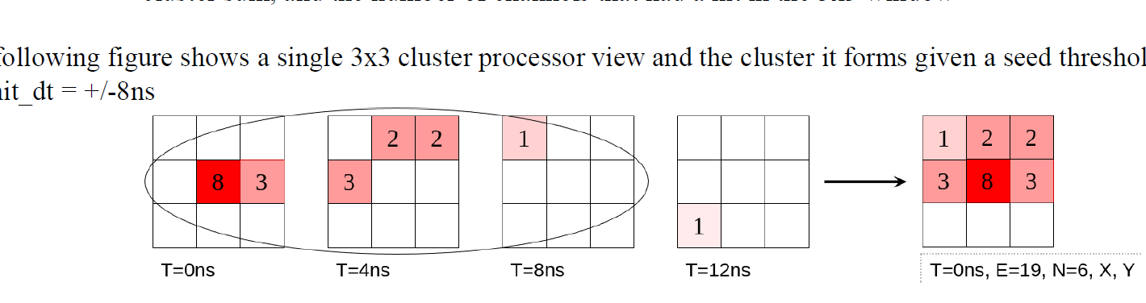
VTP
Use 3x3 grid to determine trigger
center position of vtp cluster
(color represent total energy within the grid)

Slide 8
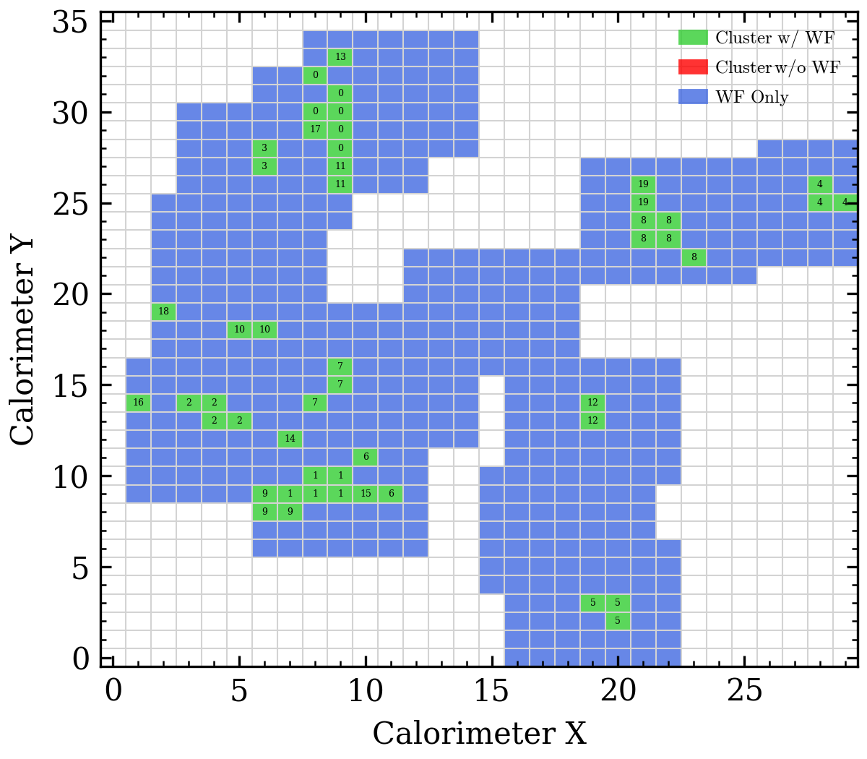
Blocks with waveform and cluster found by hcana

Slide 9
Frame construction

Slide 10

How to pack data to a frame
Structure of a frame in SRO
2$μs$
waveforms
Gap between 2 events
waveforms
110 time buckets = 440ns
? ns
440ns
A time gap between events determined by the TI module which measures the start time of the events
Branch : g.evtime
If coda version > 3, TI time is already decoded in THaEvData,
Else it is set from THcHelicityReader ?
Estimated as pedestals in the previous event

Slide 11
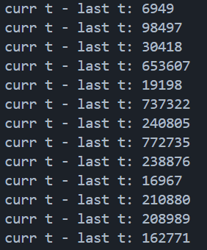

How to pack data to a frame
2$μs$
waveforms
Gap between 2 events
waveforms
110 time buckets = 440ns
? ns
440ns
A time gap between events determined by the TI module which measures the start time of the events
Branch : g.evtime (unit = ns ???)
Large gap so one frame is just one event + some pedestal ?

Slide 12
Model

Slide 13
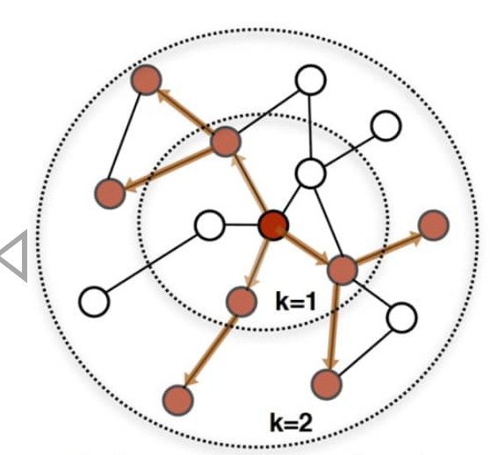
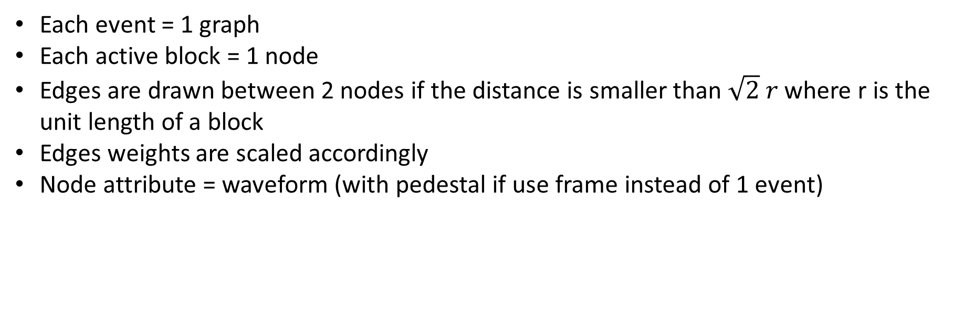
Graphical Neural Network (No result yet)
Each event = 1 graph
Each active block = 1 node
Edges are drawn between 2 nodes if the distance is smaller than $\sqrt{2} r$ where r is the unit length of a block
Edges weights are scaled accordingly
Node attribute = waveform (with pedestal if use frame instead of 1 event)

Slide 14
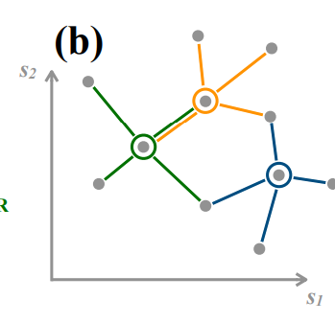
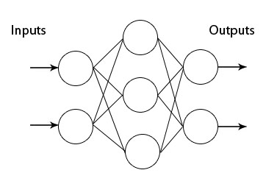
Model
Should be modified later
smaller goal
ignore true timing, energy
only classify the members of each clusters
Garnet/Gravnet
Nx
Edge construction in latent space
Pos embedding to keep the temporal info
Another kNN edges
Input tensors
(imagine no edge here)
Takes the neighbour and compute new features
Compare with truth edges → bce loss

Slide 15
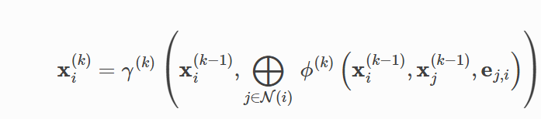
Message Passing
Graph operation which only takes the features from connected nodes
Generalize convolution
Permutation invariant function (sum , mean)
Since we are dealing with a time series, replace it with lstm, attention ?

