Slide 1
SoLID pi/e ratio and rejection
Zhiwen Zhao
2021/01/29

Slide 2
method
Code and log in https://github.com/JeffersonLab/solid_gemc/tree/master/analysis/pid
pi/e ratio after pi rejection is obtained from
pi and e inclusive generator
pi inclusive generator, latest “evgen_bggen”
e inclusive generator, latest “evgen_inclusive_e” (eAll) without radiation correction
(under work) SoLID detector simulation (at least EC+LGC) for e detection and pi rejection
Online performance: trigger rate study shows general pi rejection factor 1e-2 for EC (6+1module) and additional 6e-3 for LGC (2 pe in each of 2 PMT, P<4GeV), total ~6e-5
Offline performance: 5e-3 for EC? Additional 1e-3 for LGC? total 1e-5 or 1e-6?
(for now) use conservative simple factors to estimate offline performance
e detection factor 100%
pi rejection factor
1e-4 (FA P<4GeV) and 5e-3 (FA P>4GeV) and 5e-3 (LA), for SIDIS_He3 and JPsi_LH2
1e-5 (FA P<4GeV) and 5e-3 (FA P>4GeV), for PVDIS_LD2
pi/e ratio after pi rejection can be controlled below 1%
Except for JPsi_LH2, P<3GeV at LA, but invariant mass and kinematic fitting can help
the pion generator would take too much time to generate events at high P and large theta

Slide 3
SIDIS_He3

Slide 4
JPsi_LH2

Slide 5
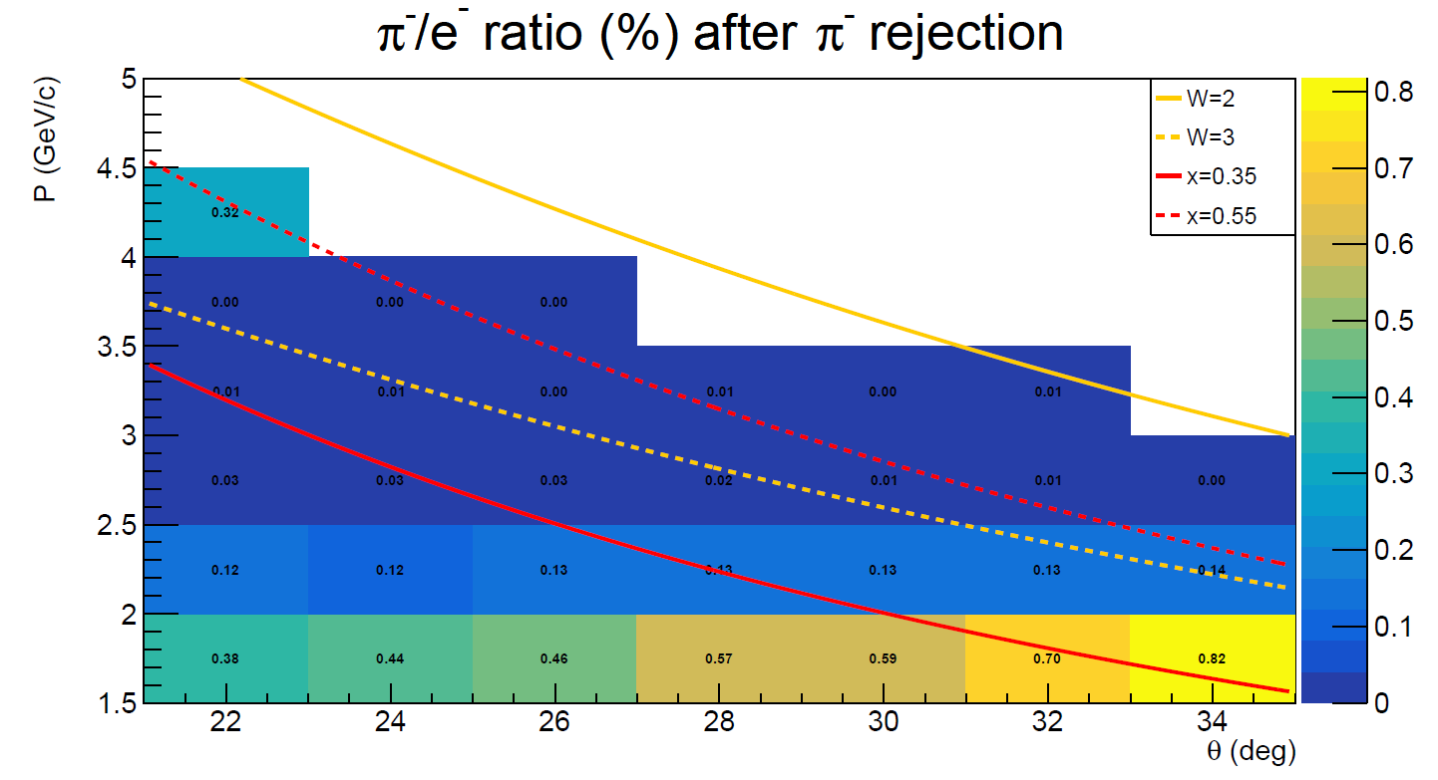
PVDIS_LD2

Slide 6
backup

Slide 7
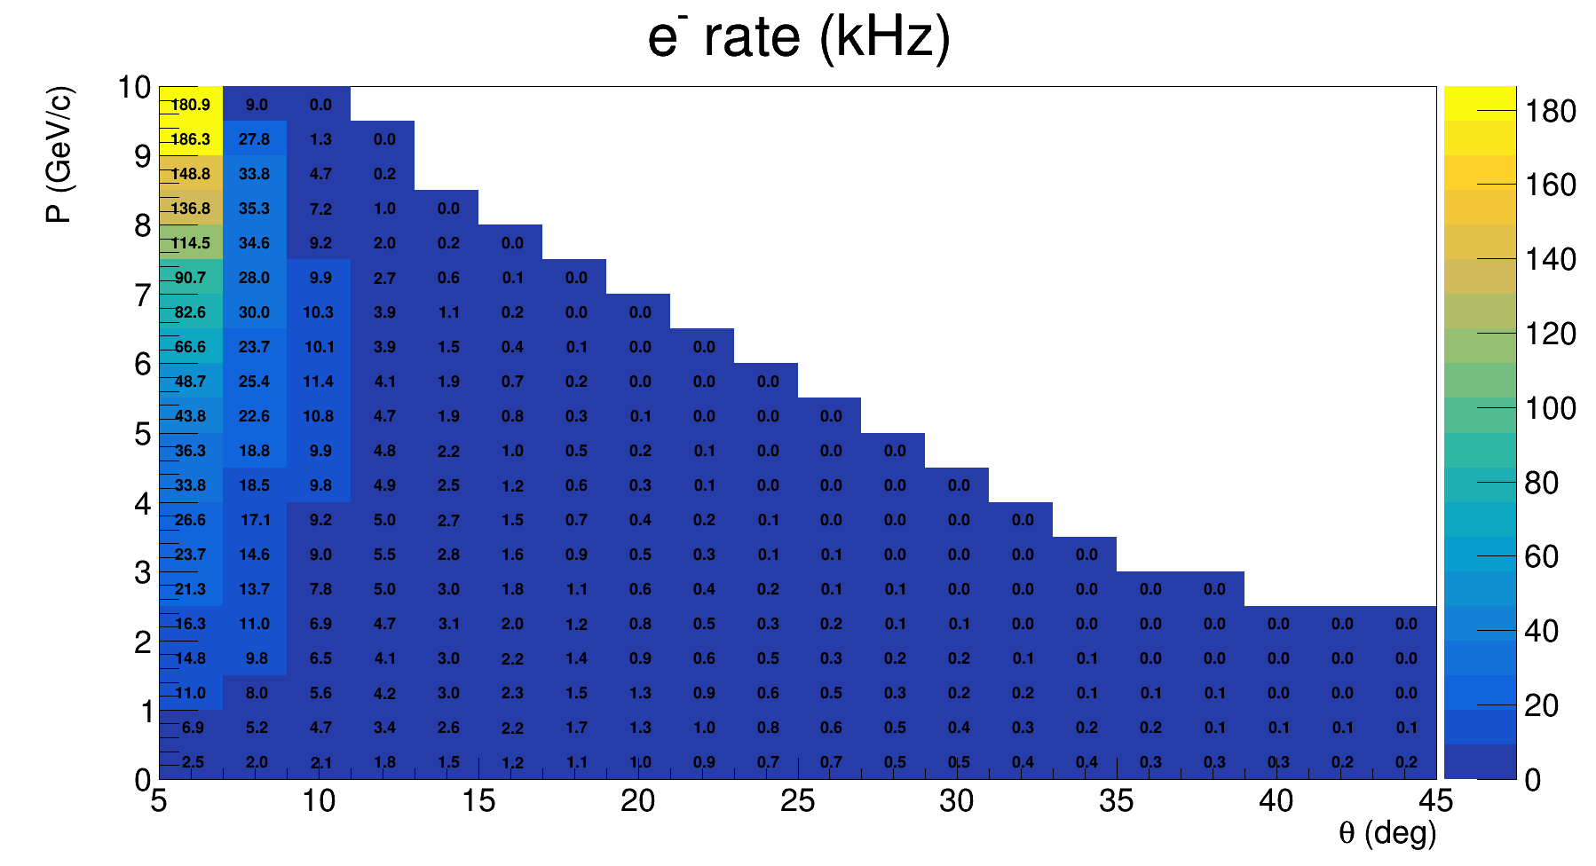
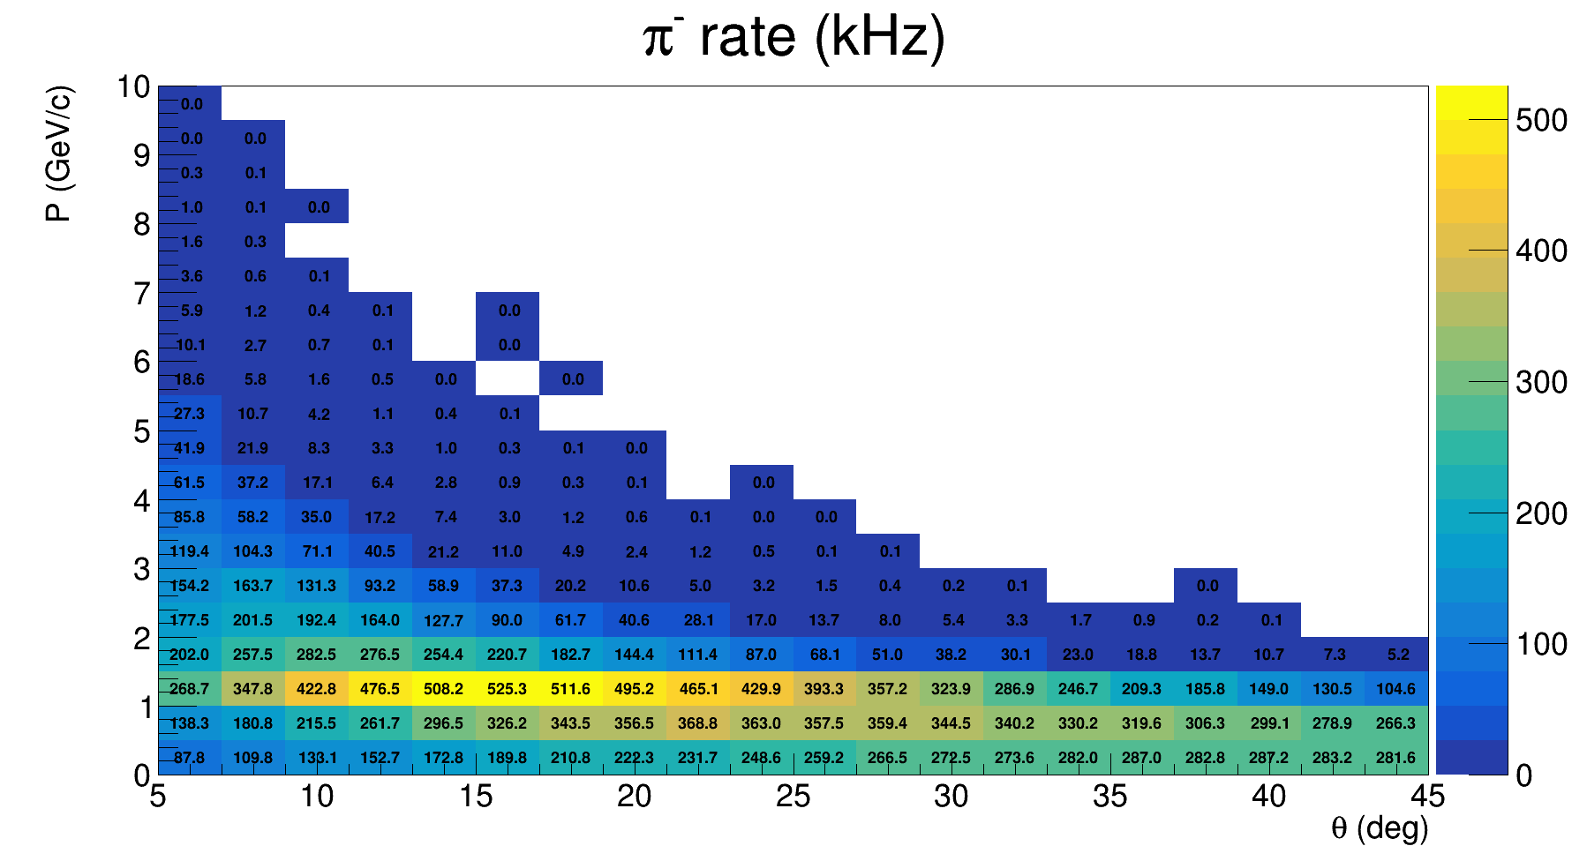
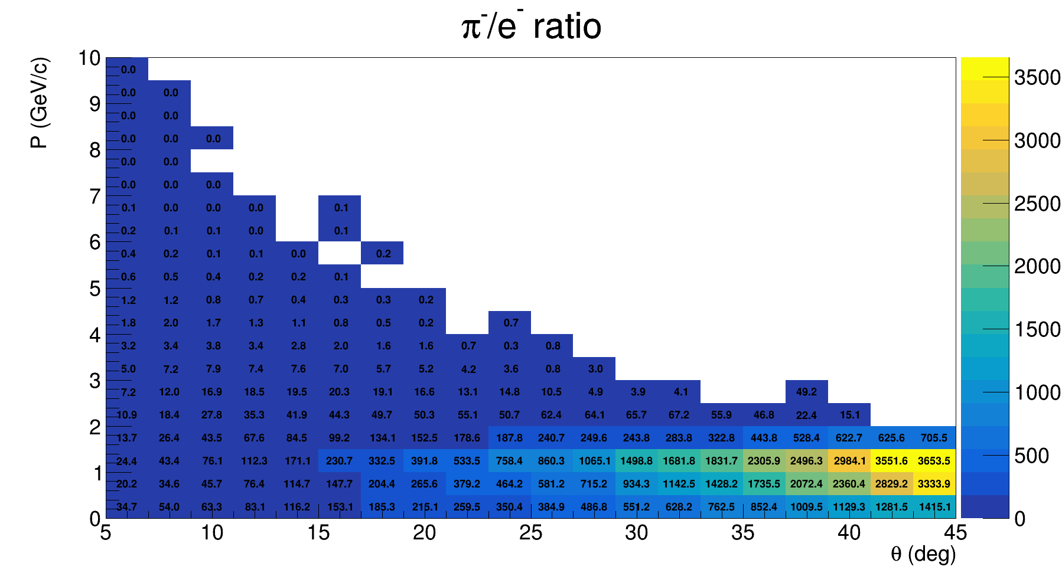
SIDIS_He3

Slide 8
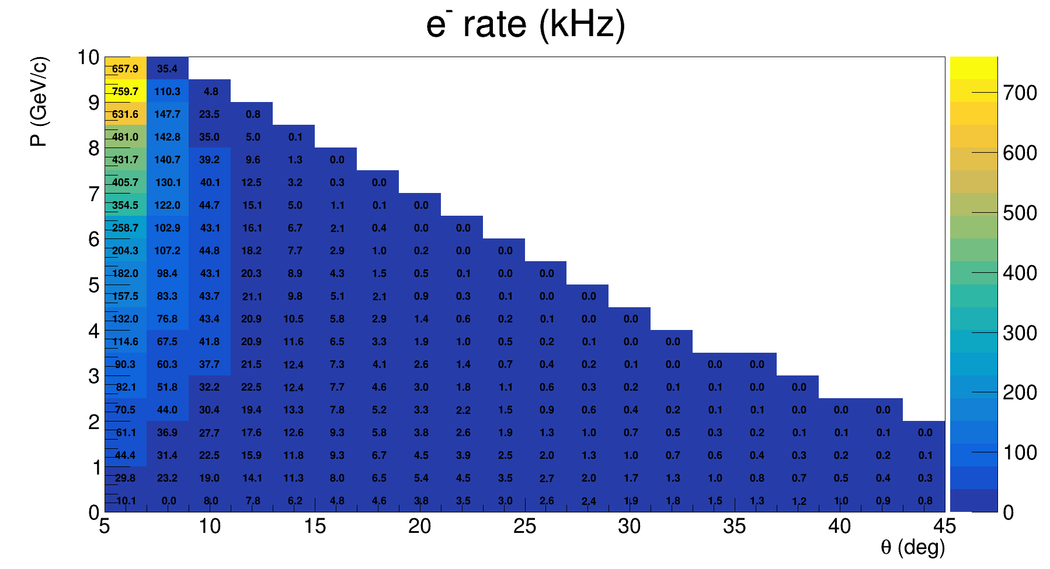
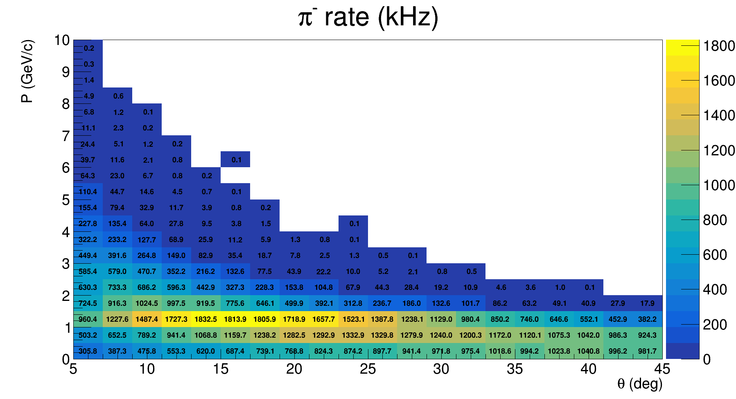
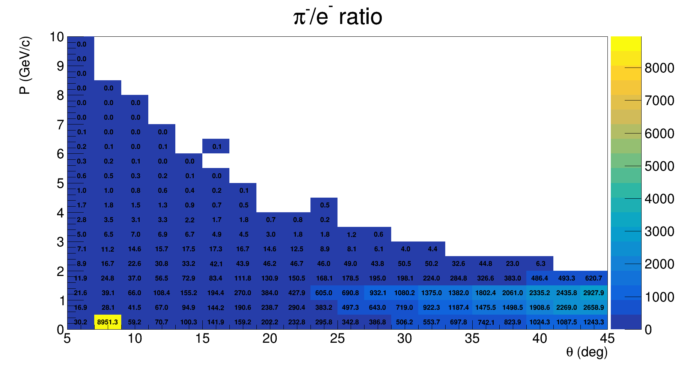
JPsi_LH2

Slide 9
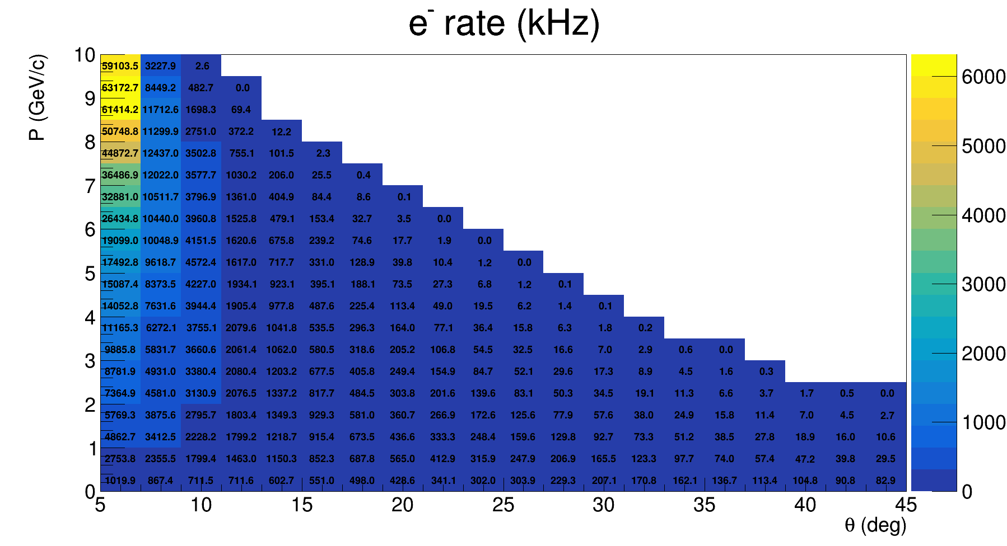
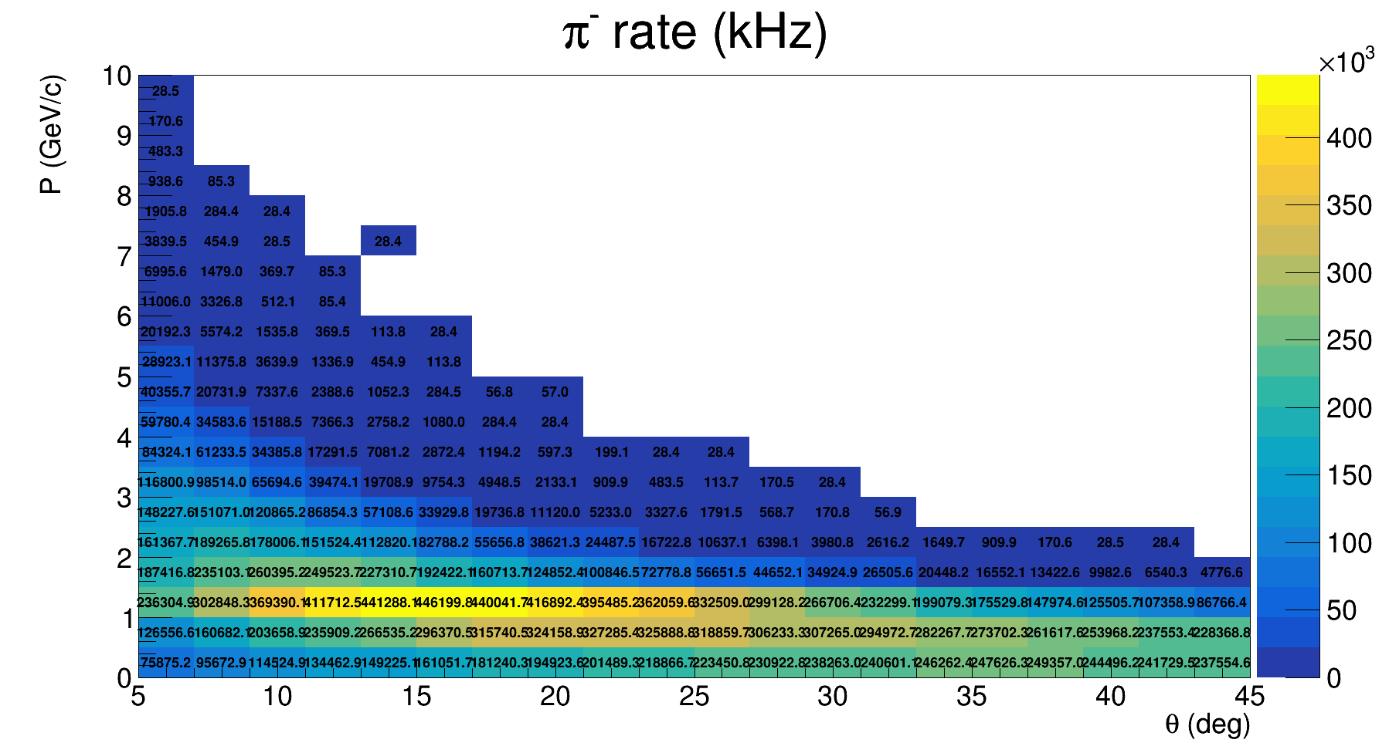
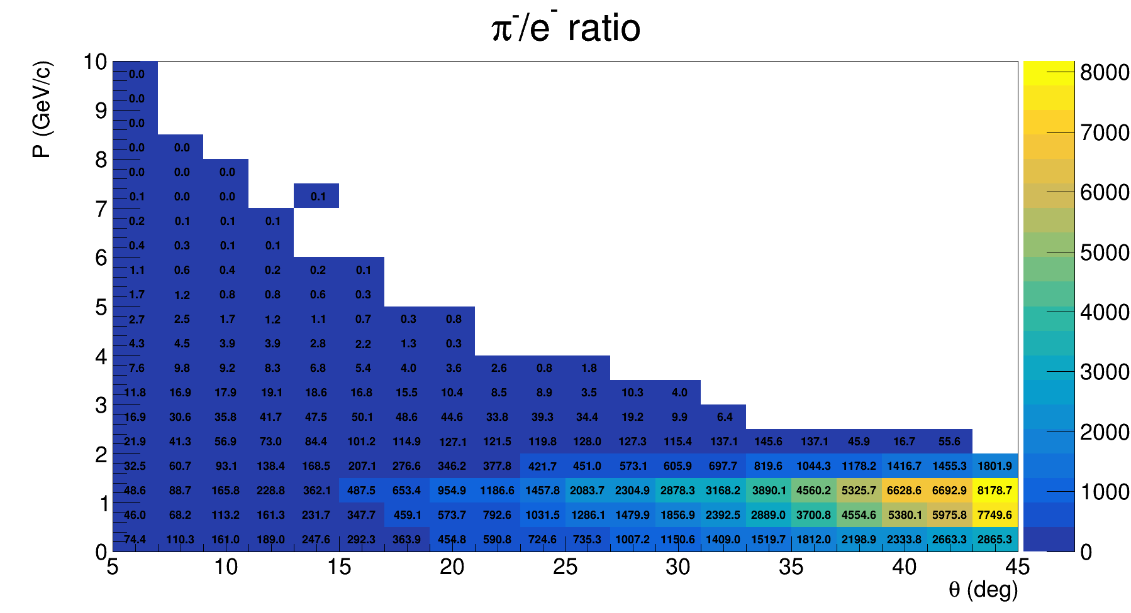
PVDIS_LD2

