Slide 1
SoLID pi/e ratio and rejection
Zhiwen Zhao
2021/04/07
2021/03/11
2021/01/29

Slide 2
method
Code and log in https://github.com/JeffersonLab/solid_gemc/tree/master/analysis/pid
pi/e ratio after pi rejection is obtained from
pi and e inclusive generator
pi inclusive generator, latest “evgen_bggen”
e inclusive generator, latest “evgen_inclusive_e” (eAll) without radiation correction
(under work) SoLID detector simulation (at least EC+LGC) for e detection and pi rejection
Online performance: trigger rate study shows general pi rejection factor 1e-2 for EC (6+1module) and additional 6e-3 for LGC (2 pe in each of 2 PMT, P<4GeV), total ~6e-5?
Offline performance: 5e-3 for EC? Additional 1e-3 for LGC? total 1e-5 or 1e-6?
(for now) use conservative simple factors to estimate offline performance
e detection factor 100%
pi rejection factor
1e-4 (FA P<4GeV EC+LGC) and 5e-3 (FA P>4GeV EC) and 5e-3 (LA EC), for SIDIS_He3 and JPsi_LH2
1e-4 (FA P<4GeV EC+LGC) and 5e-3 (FA P>4GeV EC), for PVDIS_LD2
Proton rejection factor
1e-4 (FA), for PVDIS_LD2
pi/e ratio after pi rejection can be controlled below 1%
Except for JPsi_LH2, P<3GeV at LA, but invariant mass and kinematic fitting can help
LGC using N2 instead of CO2, could have rejection much higher than 4GeV?
the pion generator would take too much time to generate events at high P and large theta

Slide 3
SIDIS_He3

Slide 4
JPsi_LH2

Slide 5
PVDIS_LD2

Slide 6
PVDIS_LD2

Slide 7
PVDIS_LD2

Slide 8
PVDIS_LD2

Slide 9
PVDIS_LD2

Slide 10
PVDIS_LD2

Slide 11
PVDIS_LD2

Slide 12
backup

Slide 13
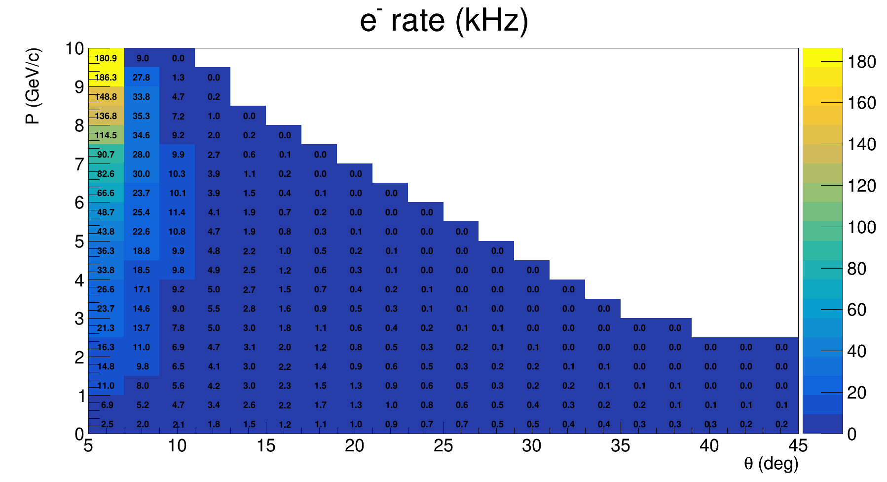
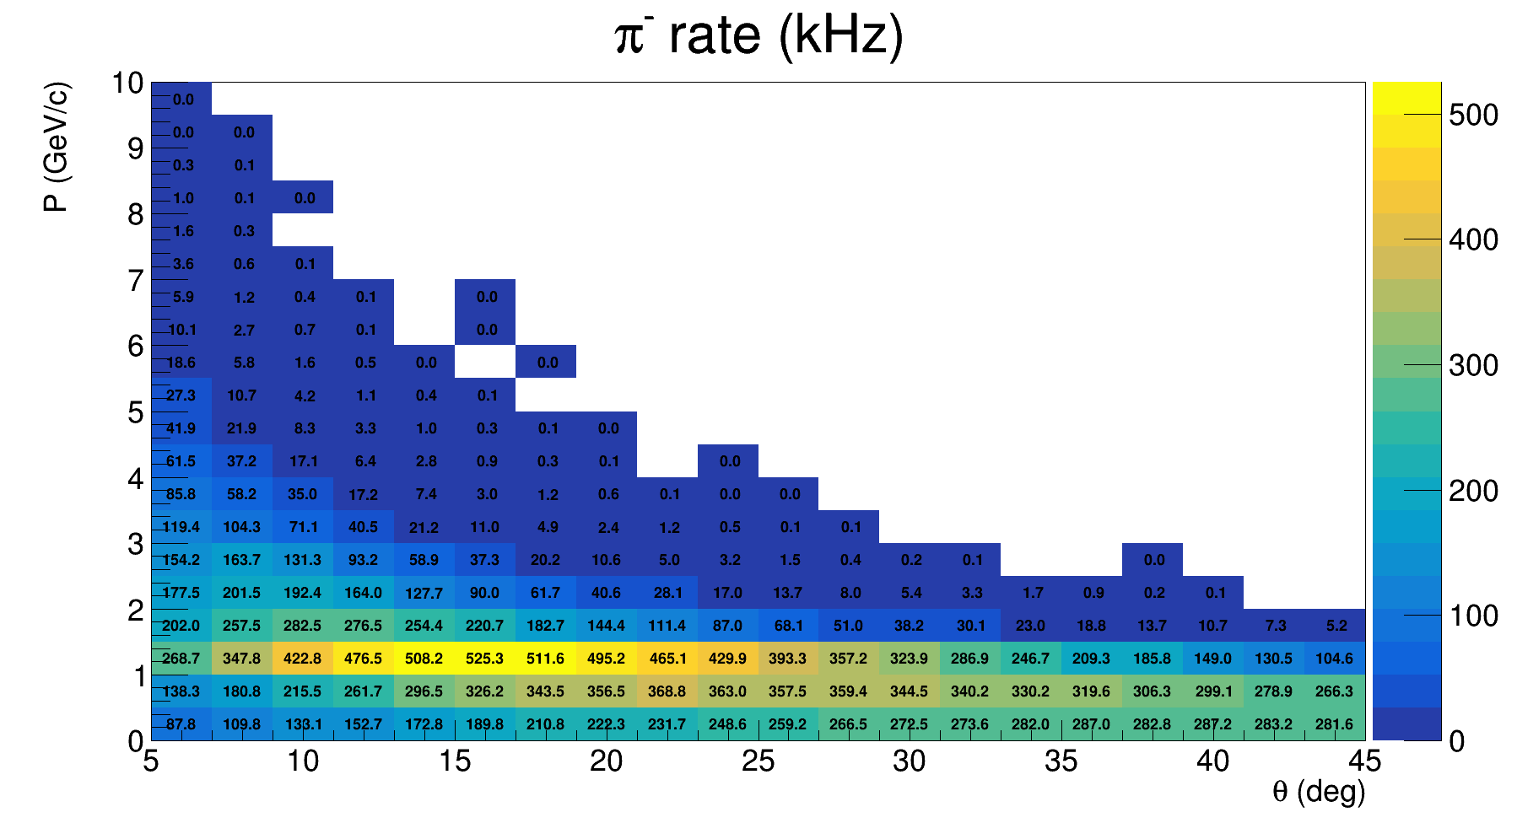
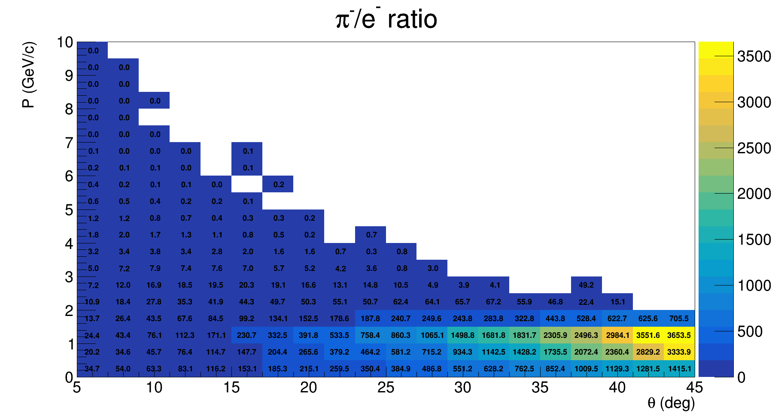
SIDIS_He3

Slide 14
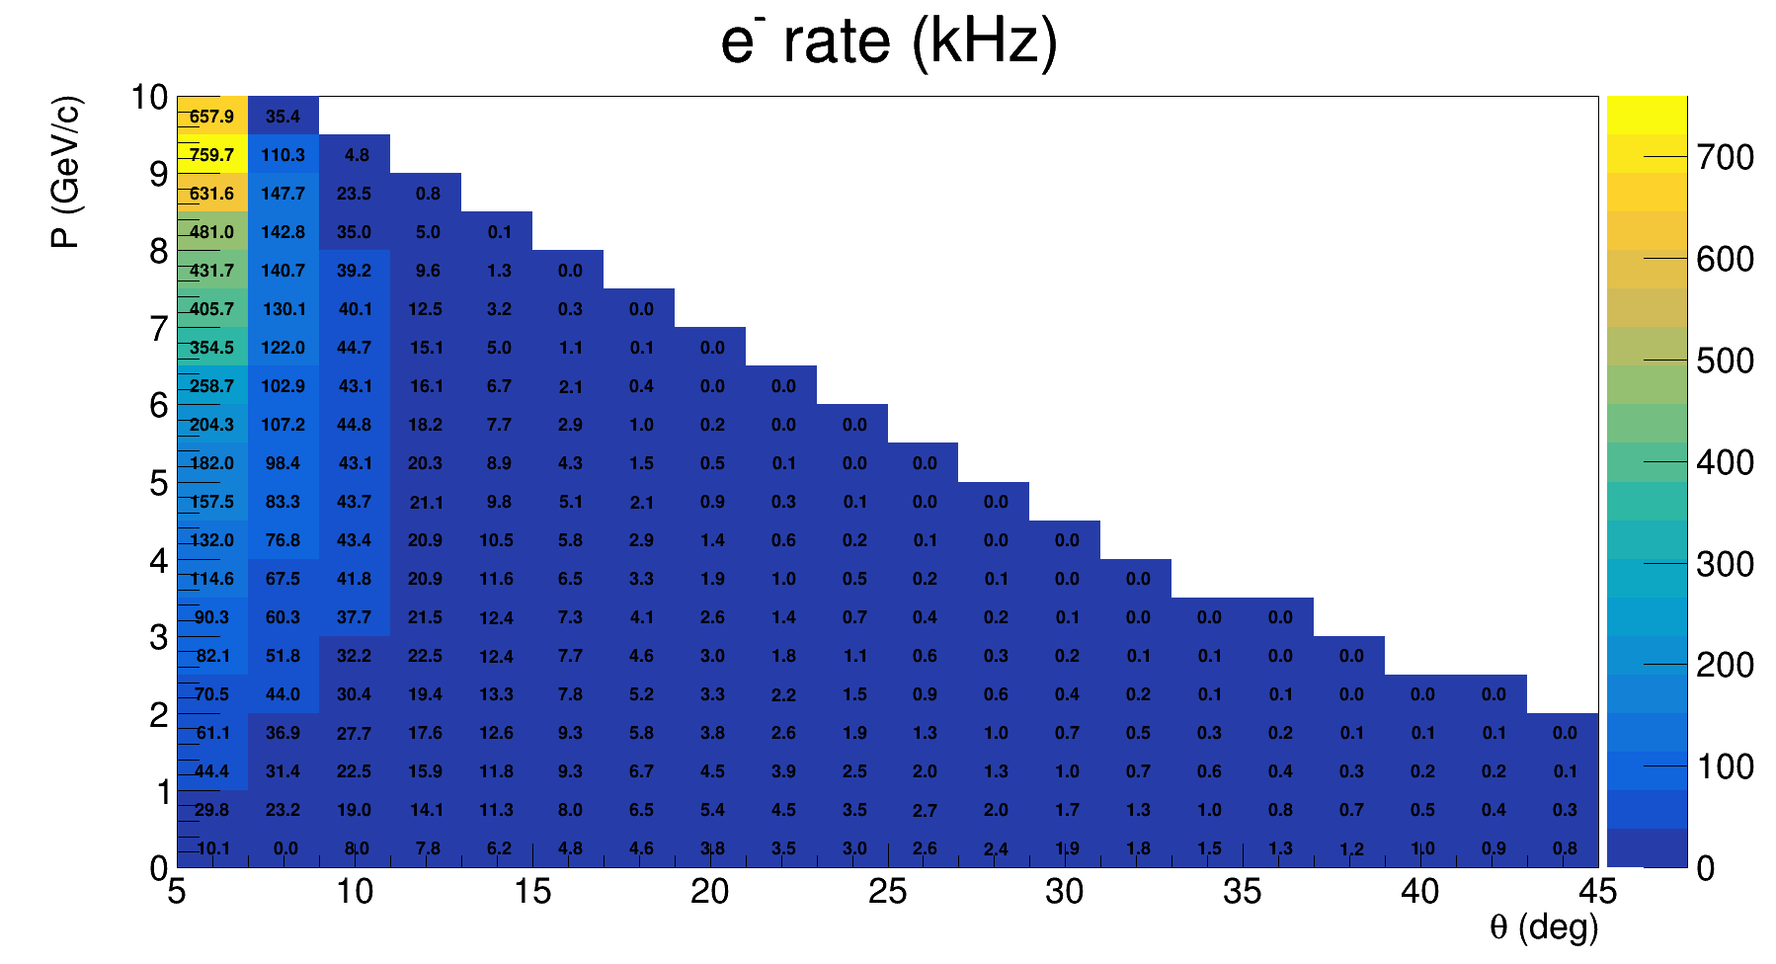
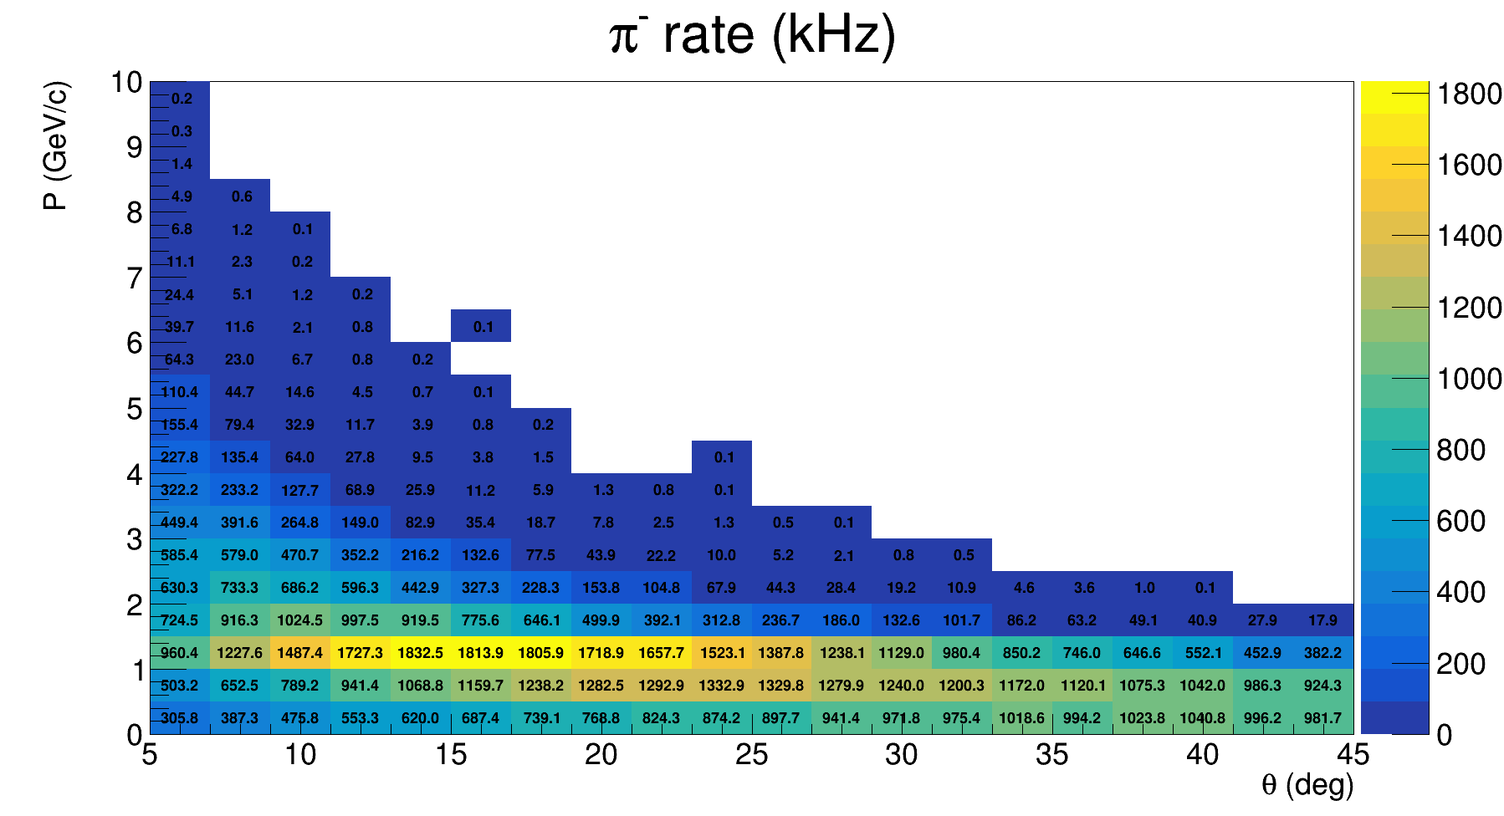
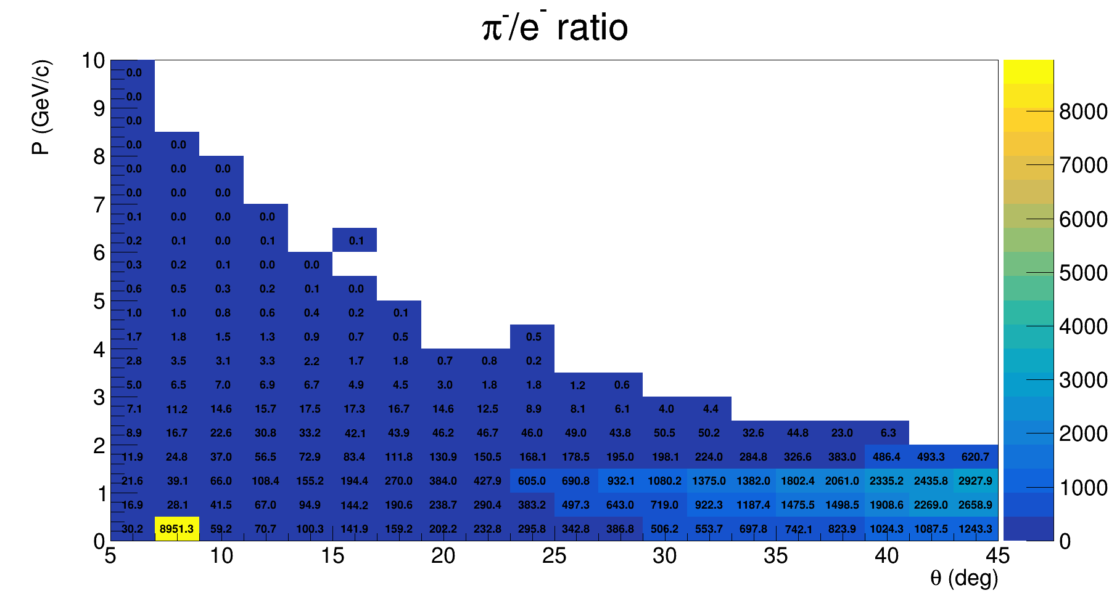
JPsi_LH2

Slide 15
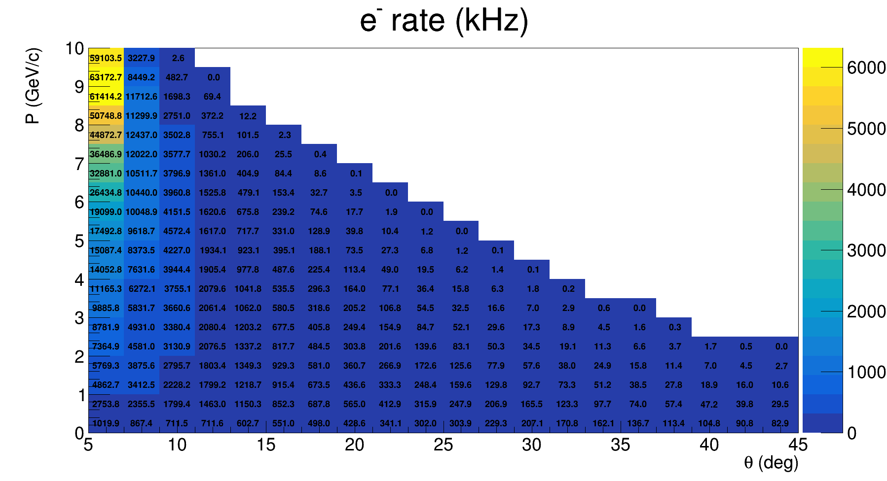
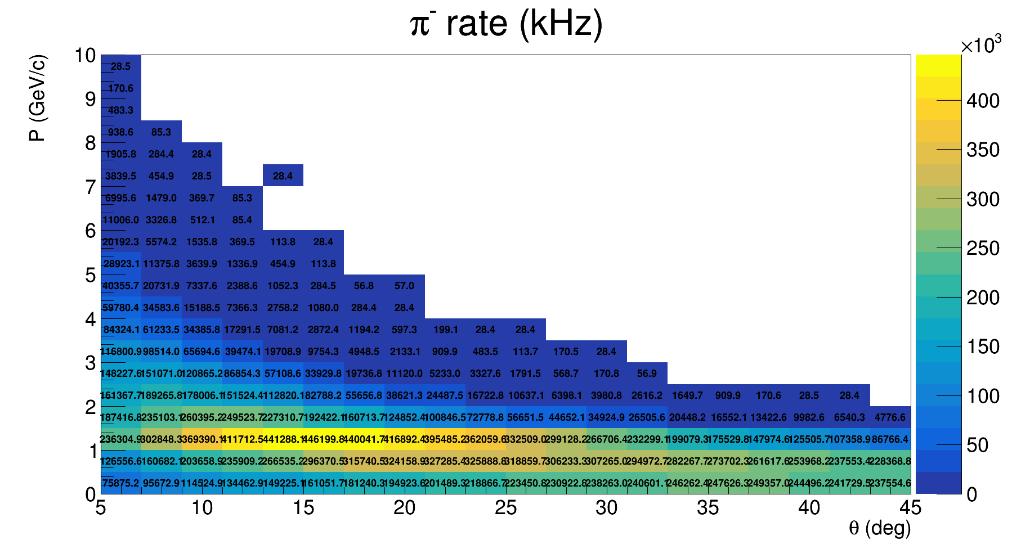
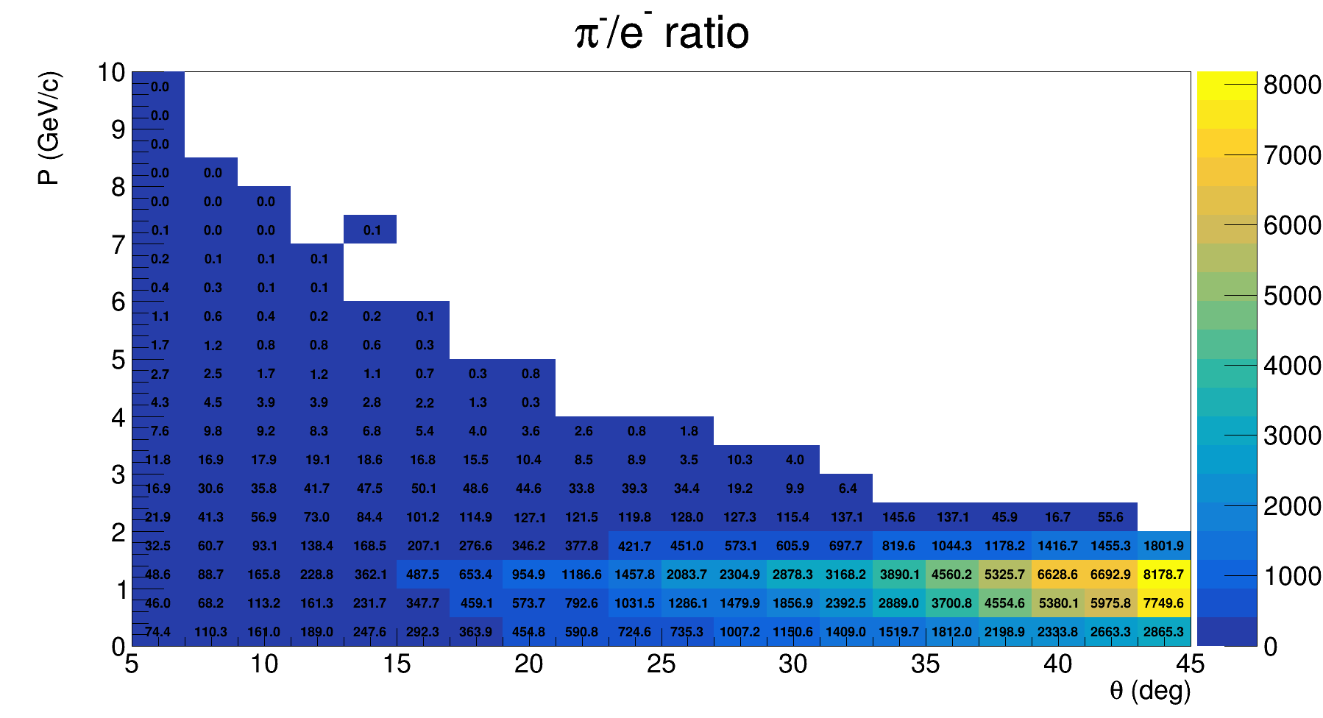
PVDIS_LD2

Slide 16
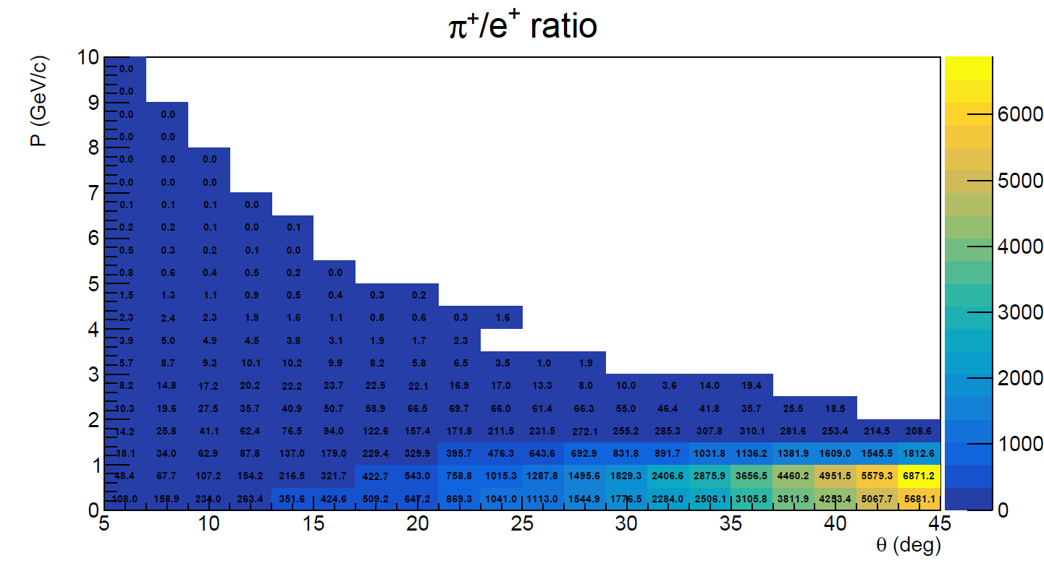
PVDIS_LD2

