Slide 1
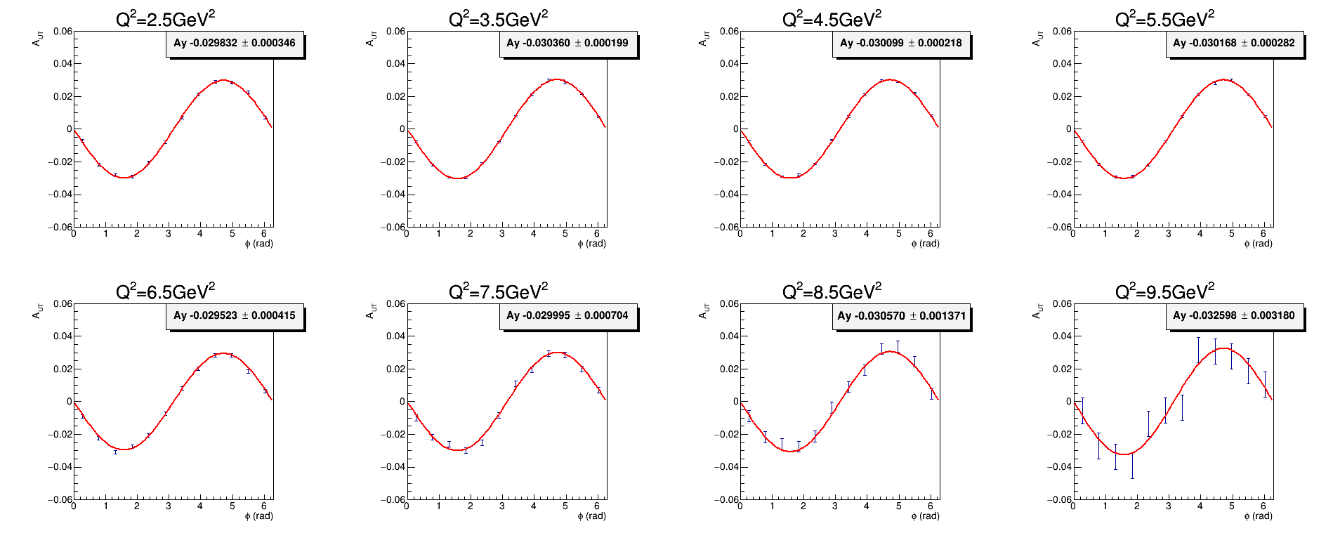
A_{UT} projection of SoLID He3 large angle detector (LD)
A_{UT} = A_{y} * sin(ϕ_{s}) with Ay=-0.03 and stat error

Slide 2
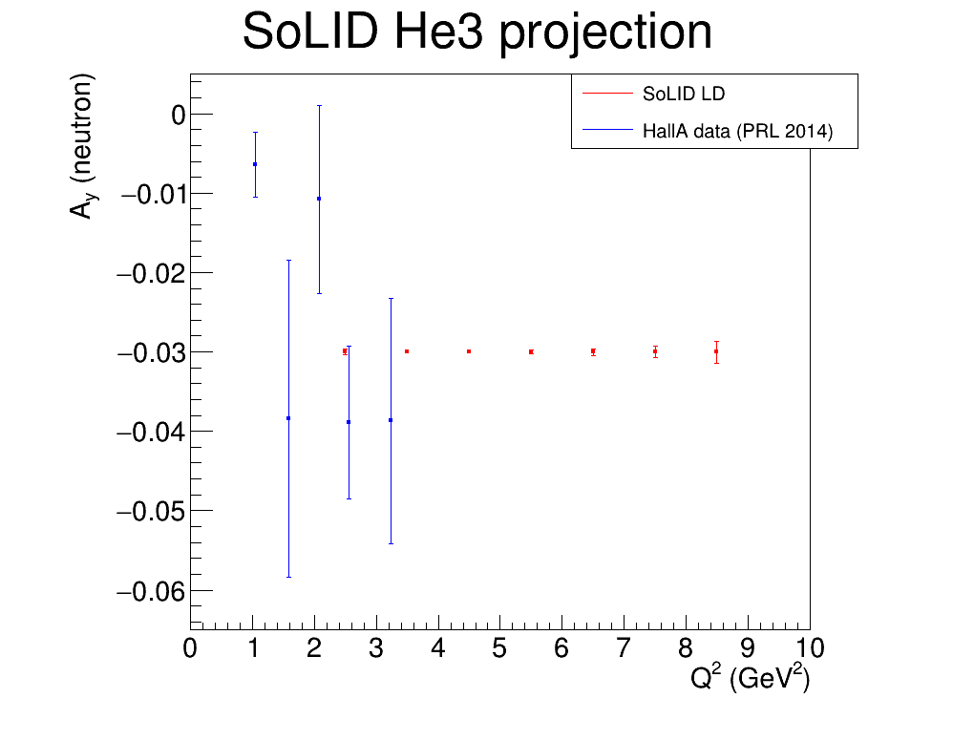
A_{y} projection of SoLID He3 large angle detector (LD)
SoLID He3 running condition
15uA e- beam (48 days at 11GeV and 21 days at 8.8GeV)
40cm 10amg He3 target with window collimator
Hall A data from Phys. Rev. Lett. 113, 022502 (2014) are at individual Q2 and x bins, while SoLID LD projection are integral over all x bins
The comparison shows stat error only. Hall A data has sys error similar to stat error and SoLID LD sys error is about 7%

