Slide 1

Kansas Degree Programs Which have the best value?
By Jeff Williams

Slide 2
Purpose
3 questions I attempted to answer with this dataset
I. Which degree programs in Kansas have the highest return on investment, considering median wage and job placement rate?
II. How do the median wages and placement rates of each university compare?
III. Does university choice matter when it comes to salary for similar degrees?

Slide 3
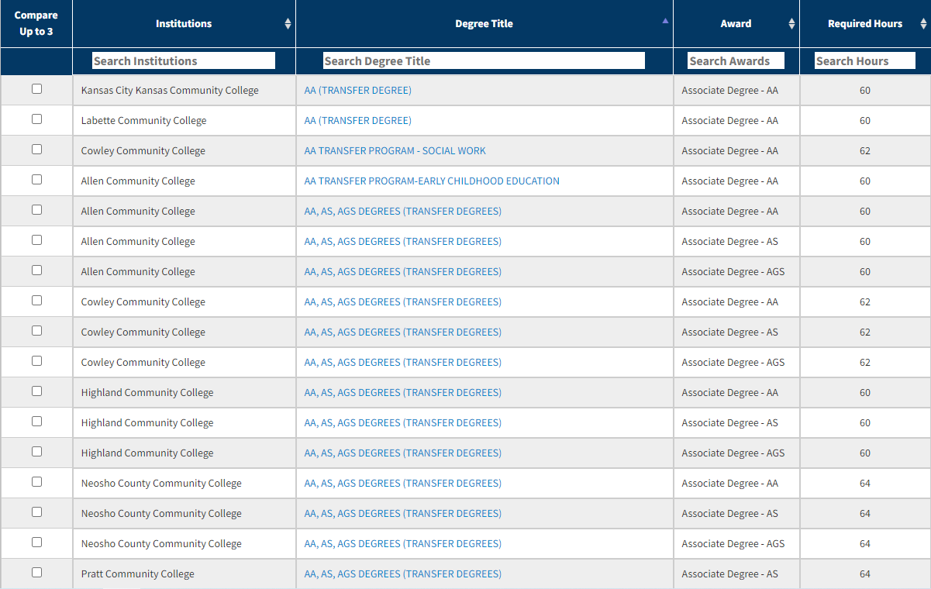
Data Sources https://ksdegreestats.org/program_search.jsp
This table from the KS Board of Regents site has details and data about over one thousand degree programs from KS Higher Ed. Institutions.
I scraped this table for a list of links that I would use to collect data from each individual degree.

Slide 4
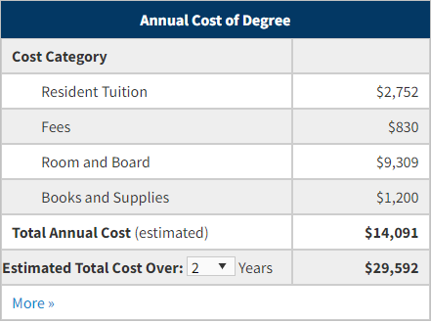
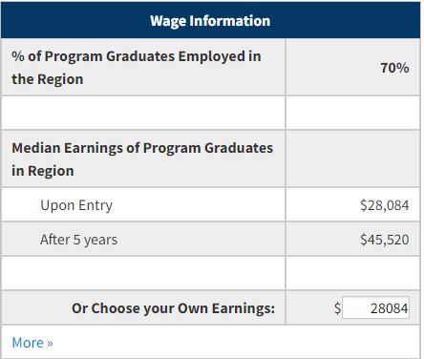
Data Collected for Each Degree
Degree Title
Institution
Required Hours
Annual Tuition Cost
Annual Fees
Placement Percentage
Median Wage after graduation
Median Wage after 5 years

Slide 5
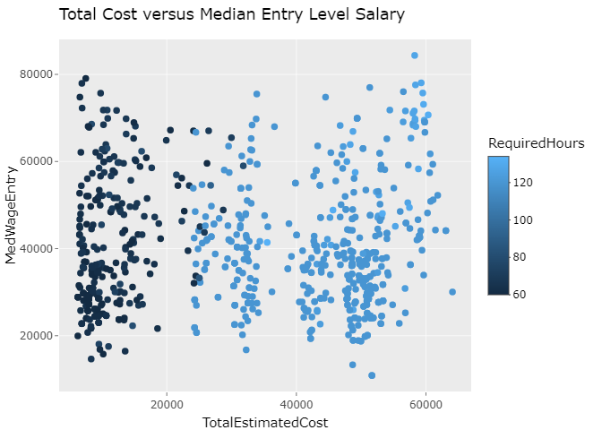
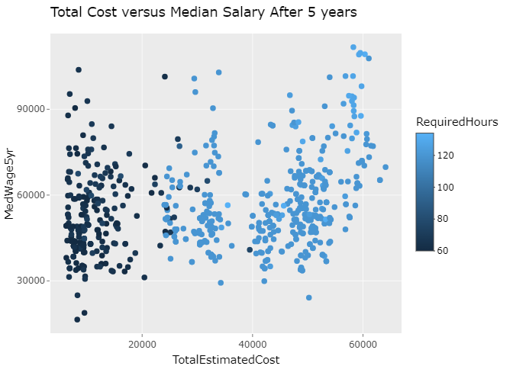
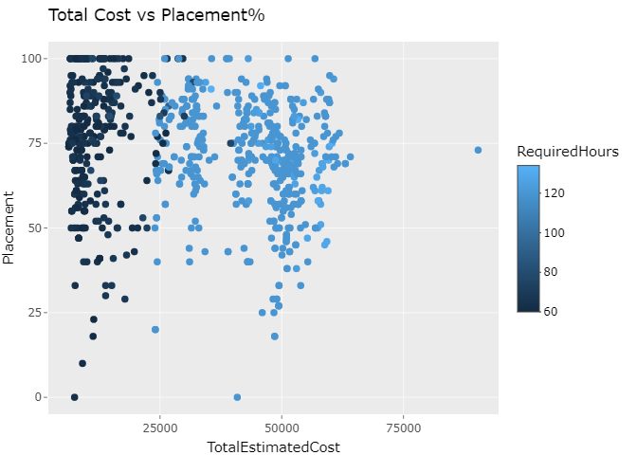
Q1: Which degree programs in Kansas have the highest return on investment, considering median wage and job placement rate?
We can see that entry level wages for associates and bachelors degree holders are comparable, however, bachelors have higher wages after 5 years.
Also, associate degree holders have an advantage when it comes to placement rate.

Slide 6
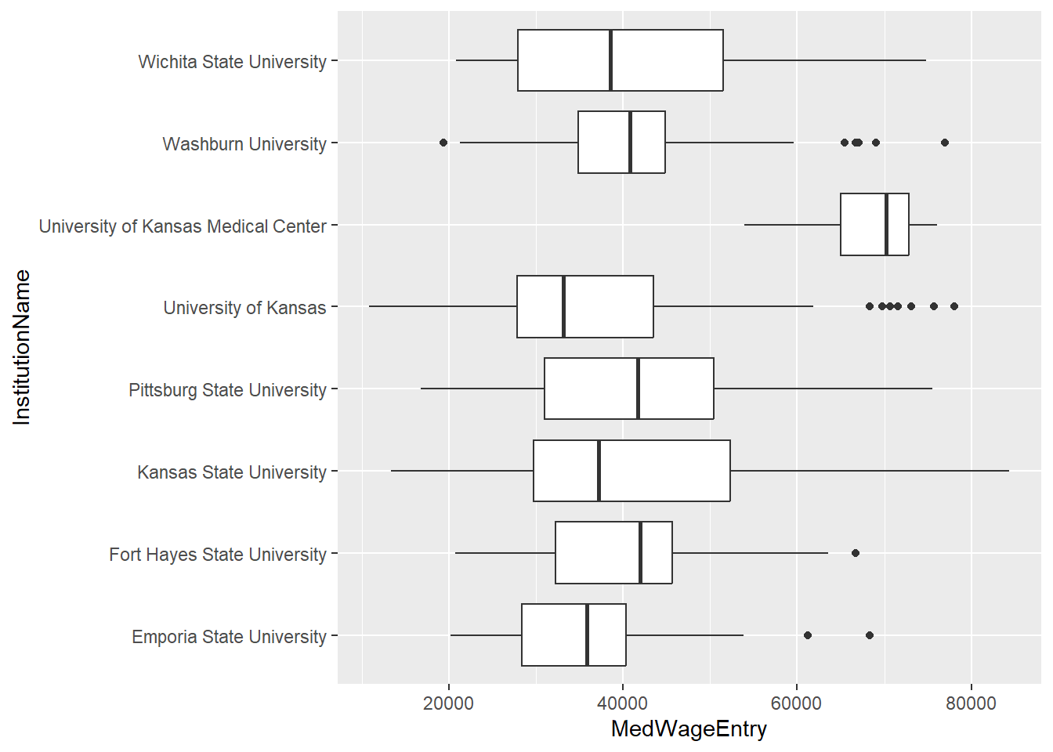
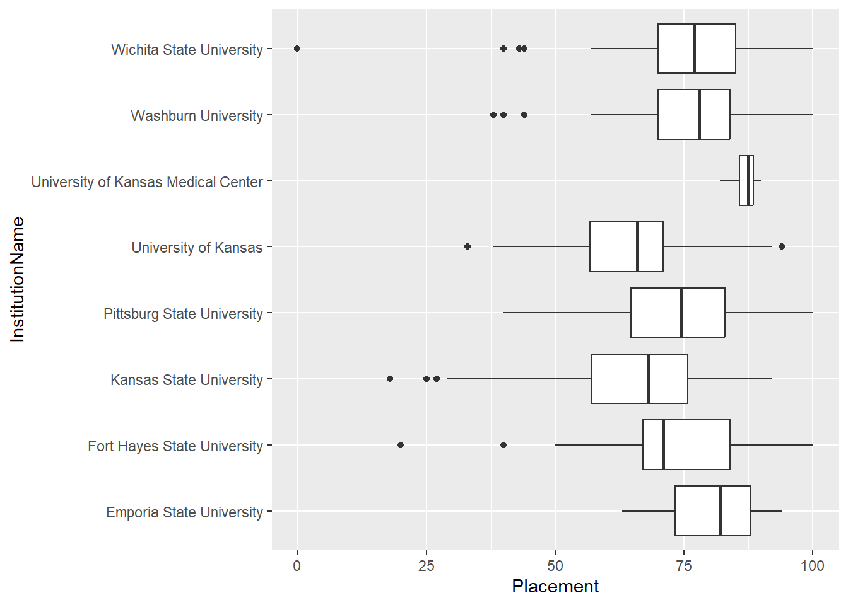
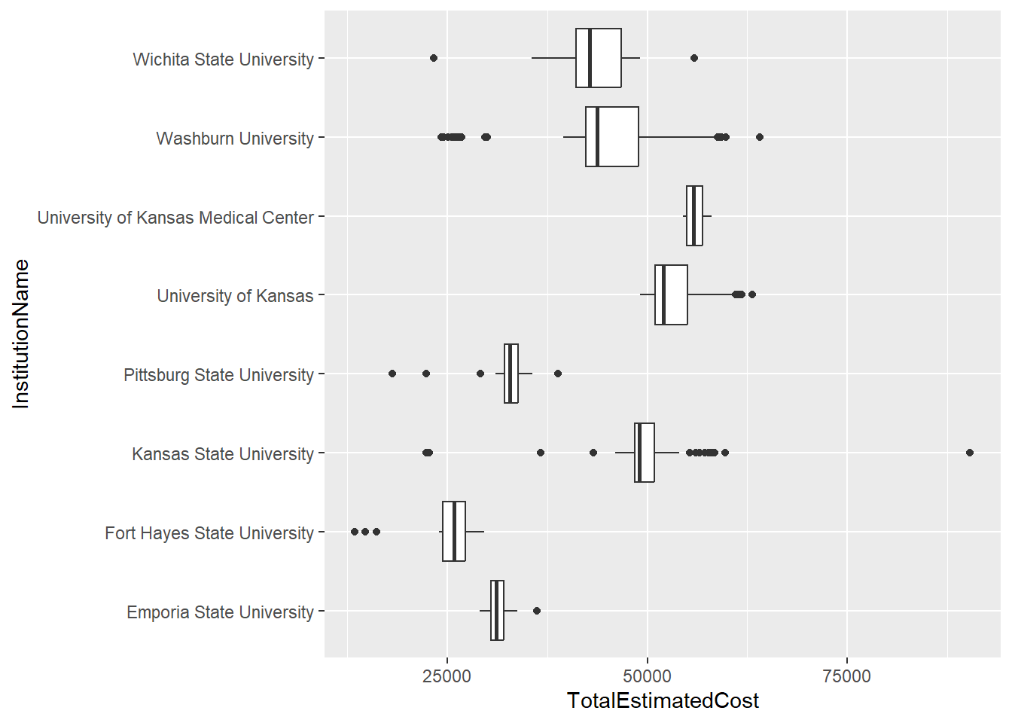
Q2: How do the median wages and placement rates of each university compare?
From the first boxplot, we can see that ranges for median wages of each university are quite similar, though some have a higher median. Surprisingly, Pittsburg, Fort Hayes, and Washburn have the highest median entry level wage, even though they are cheaper than the larger state universities.

Slide 7
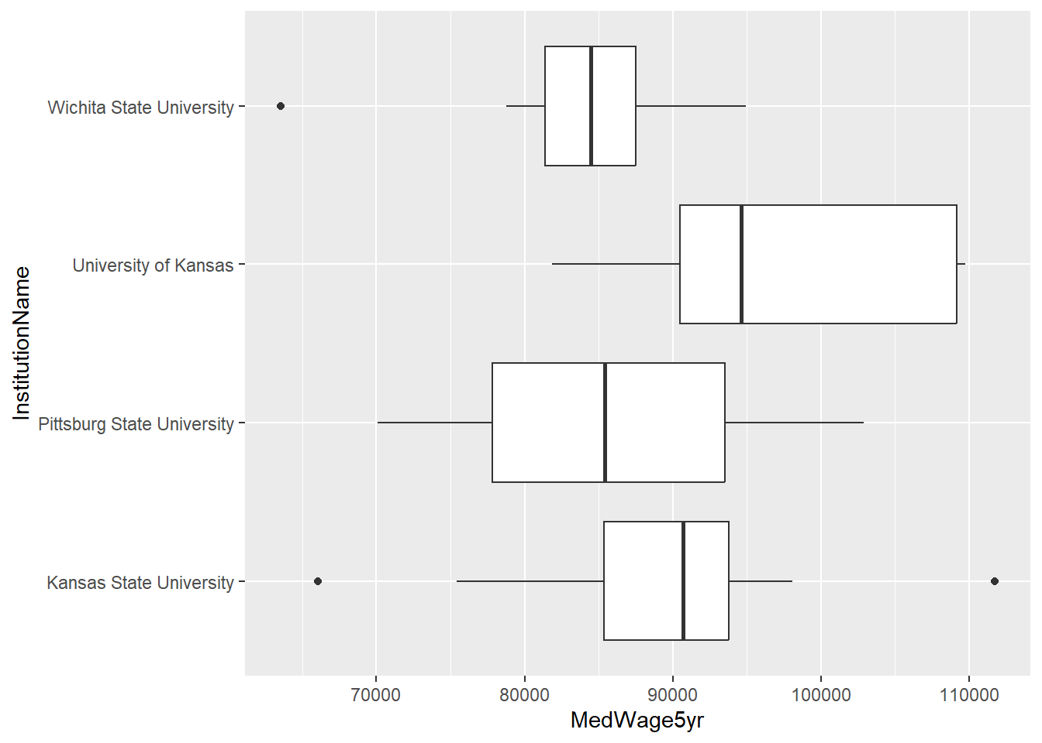
Q3: Does university choice matter when it comes to salary for similar degrees?
This chart shows us something interesting. Within the engineering field, the larger university graduates seem to have an advantage in long term salary. This contrasts with the previous plots, which gives a different outcome when considering all program types.

Slide 8
Concerns
This data set is susceptible to outliers, considering that the site did not provide sample sizes that the median wage were based on.
It would be hard to prove the veracity of the data set, considering the data is probably all self-reported.

