Slide 1

Department of Computer Science and Engineering
(Cyber Security)
PROJECT TITLE:
JARVIS: AI-ORCHESTRATED KALI LINUX
CYBERSECURITY PLATFORM
NAME: JEFFERY ANTONY J
REG NO: 241901041

Slide 2
ABSTRACT
AI-orchestrated Kali Linux operations
Security tools need command syntax and manual output chaining. Letting an AI model run raw shell commands risks injection and unsafe changes.
JARVIS keeps AI planning separate from backend validation and execution, using structured function calling.
Approved actions run on a Kali Linux VM through SSH/SFTP, or in a simulation mode for testing.
JARVIS adds a tool registry, dual permission gates, upload checks and a history of process reports.

Slide 3
PROBLEM STATEMENT / OBJECTIVE
Problem statement: Complex command syntax slows operators, separate tools need manual chaining, and unrestricted LLM-generated shell commands can cause injection or false claims of success.
Objectives:
Turn chat requests into structured operations through AI function calling.
Keep validation and execution in the backend, apart from the AI model.
Keep a dynamic registry with tool visibility and execution permission.
Run approved operations on Kali over SSH/SFTP, or in simulation mode.
Accept PCAPs, logs and archives and keep investigation history.

Slide 4
TOOLS, TECHNOLOGIES AND IMPLEMENTATION
Frontend: React 19, Vite
Backend: FastAPI, Pydantic, SQLAlchemy
AI: NVIDIA NIM, LLaMA 3.1 Nemotron 70B Instruct (function calling)
Database: SQLite (tool registry, uploads, process records)
Execution: Paramiko SSH/SFTP to a Kali Linux VM
Testing: six security test cases, all reported as PASS

Slide 5
TOOLS, TECHNOLOGIES AND IMPLEMENTATION
Implementation
The React interface sends JSON requests to FastAPI; the backend resolves the session and loads the tools enabled for the AI.
The AI returns a structured function call, never raw shell authority.
Gate 1: tool is enabled and in the registry. Gate 2: execution_allowed is true. Inputs are parsed with shlex and shell metacharacters are blocked.
Uploads are checked for type and size (50 MB), hashed with SHA-256 and sent by SFTP to an isolated per-session path on Kali.
stdout, stderr and exit status are captured, stored and summarised for the operator.

Slide 6
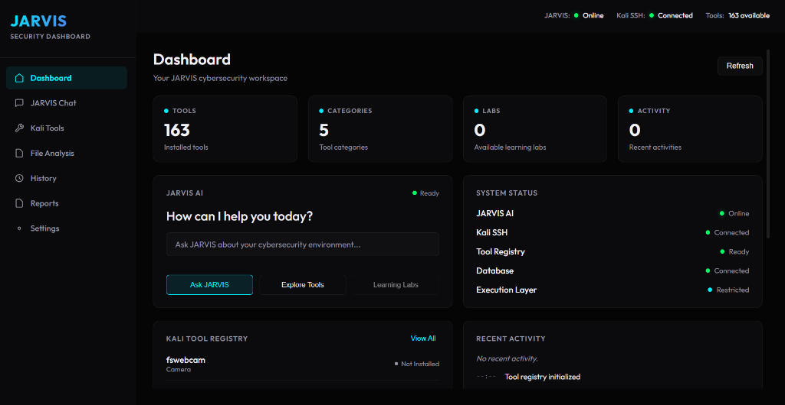
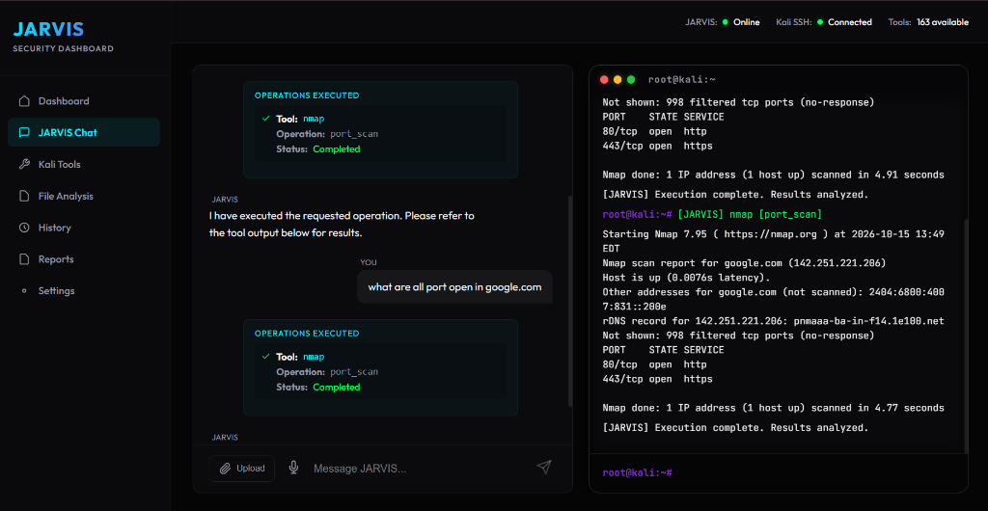
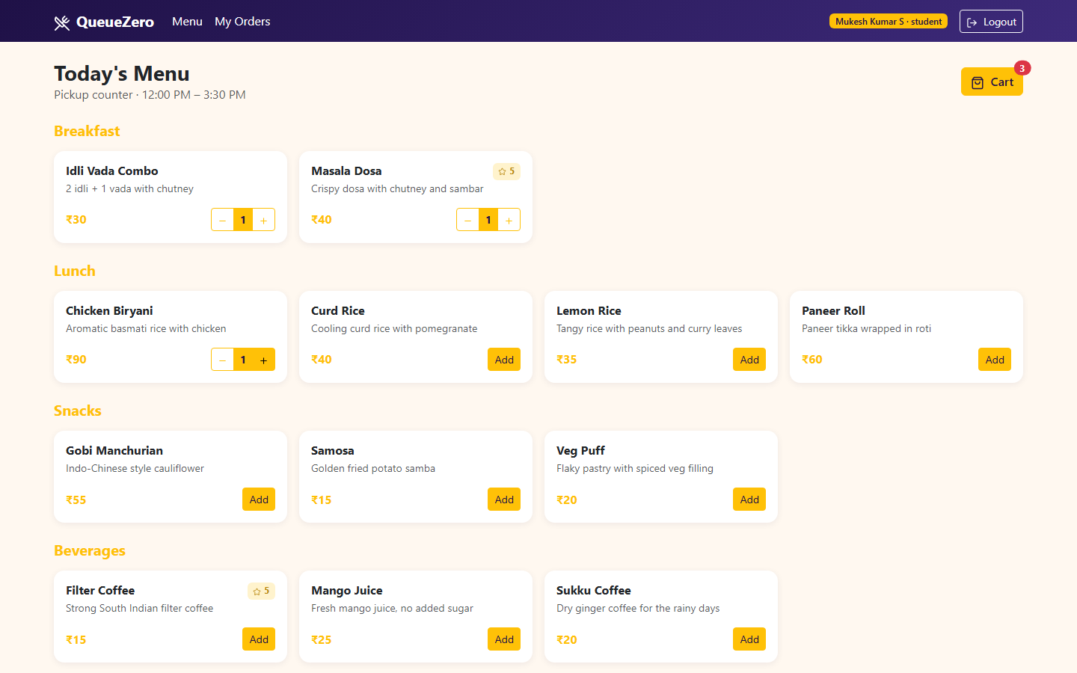
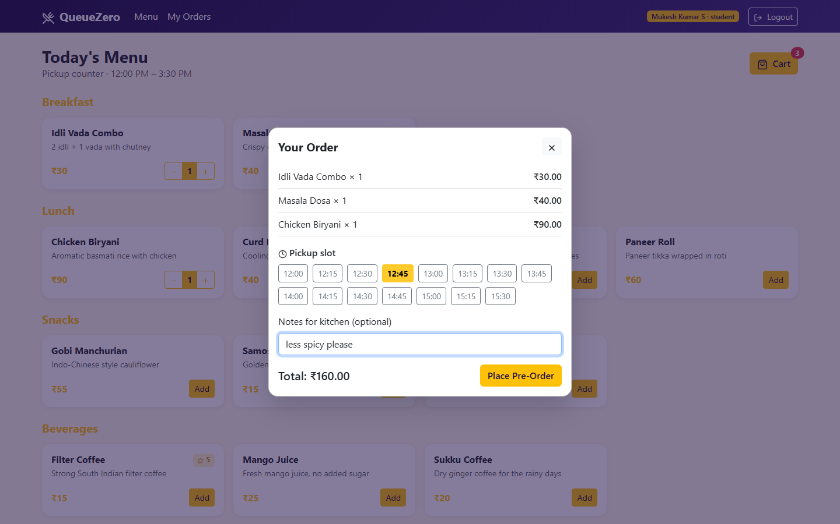
IMPLEMENTATION SNAPSHOTS - DASHBOARD
Dashboard: tools, status, AI assistant
JARVIS Chat with Nmap and terminal output

Slide 7
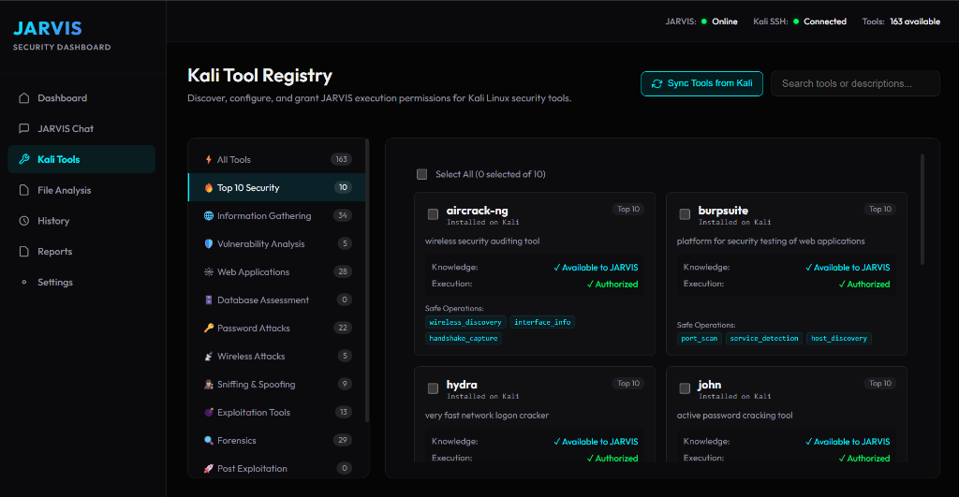
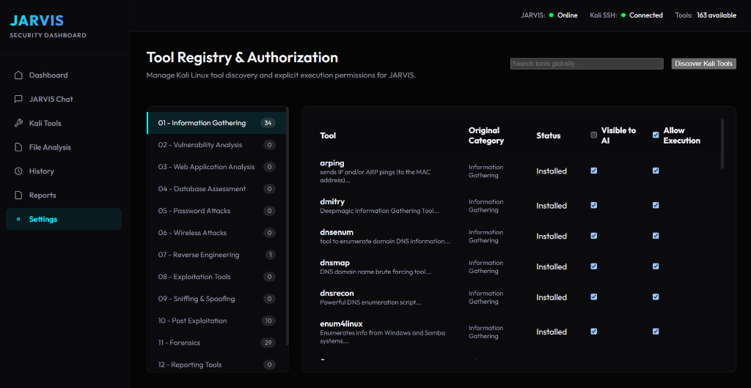
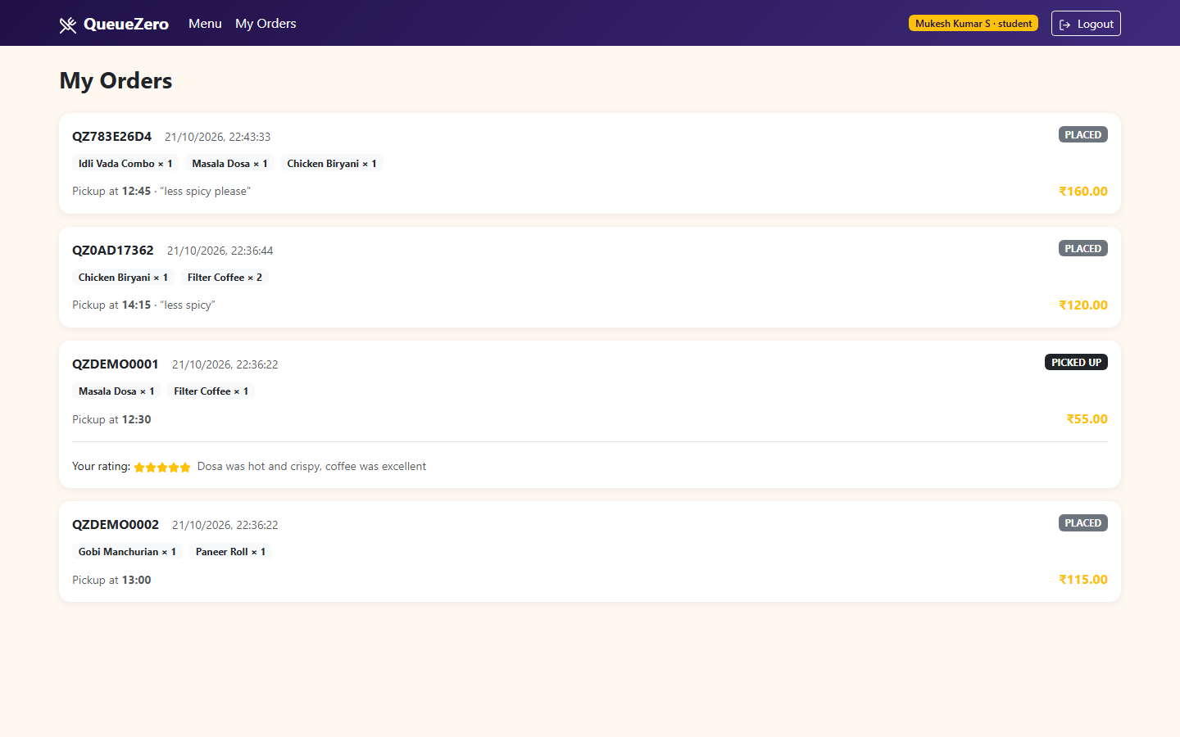
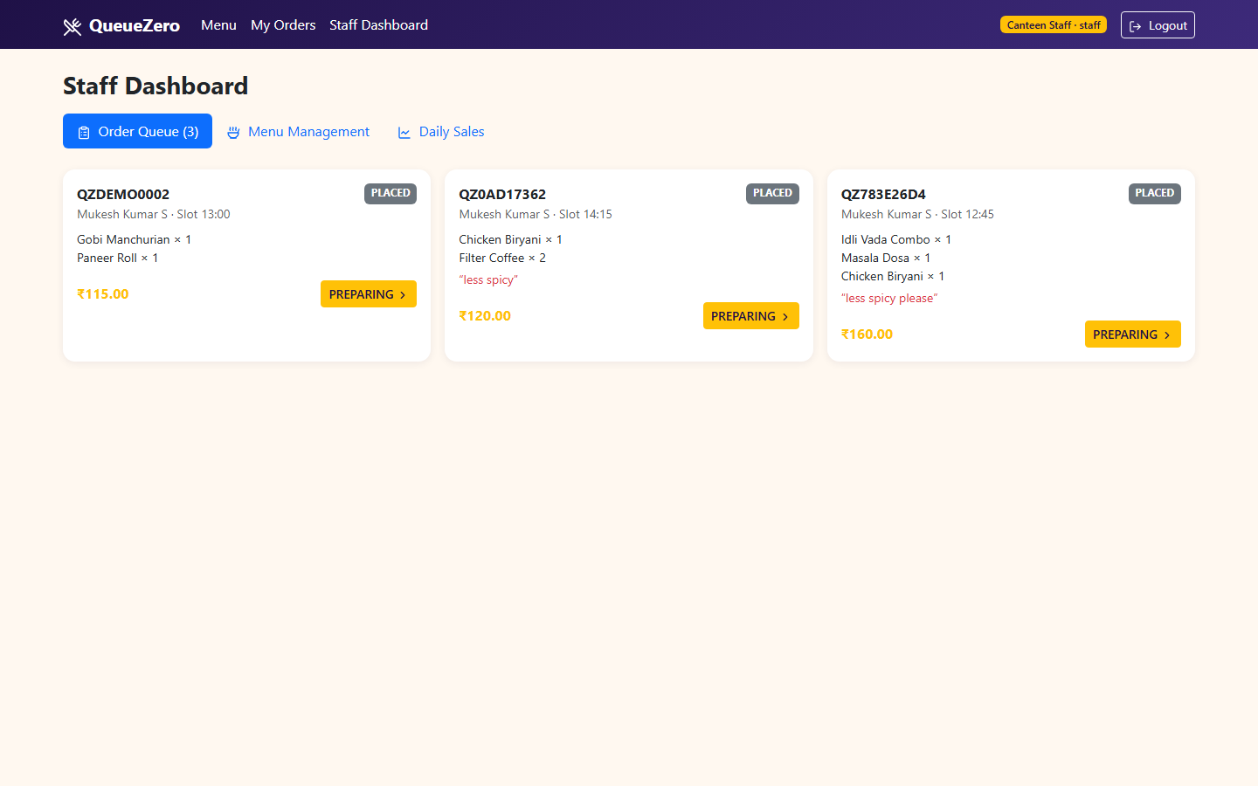
IMPLEMENTATION SNAPSHOTS - TOOL REGISTRY
Kali Tool Registry and permissions
Tool visibility and execution settings

Slide 8
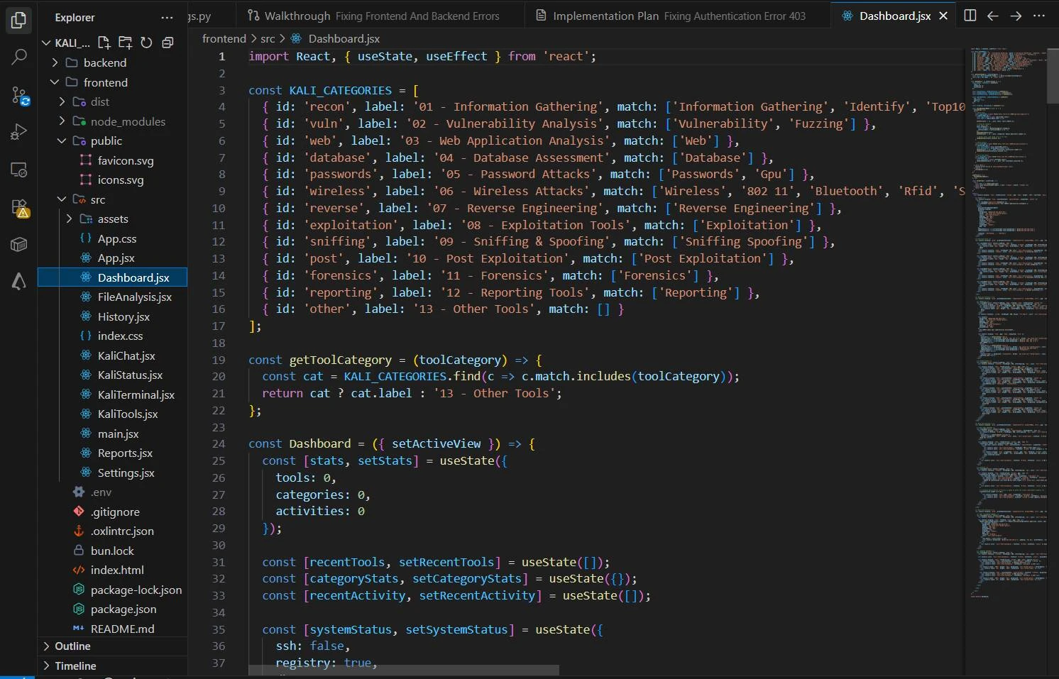
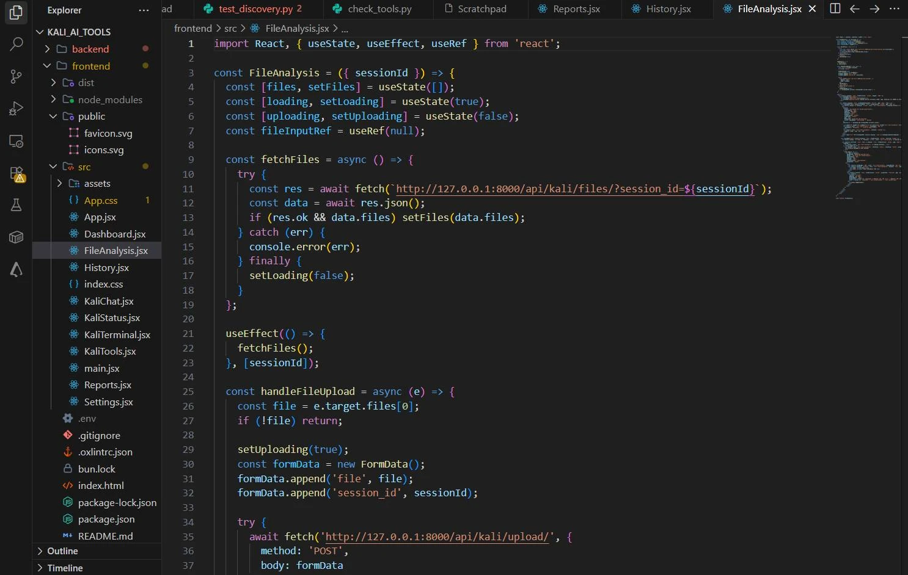
SOURCE CODE - FRONTEND
Dashboard.jsx: tool categories and dashboard state
FileAnalysis.jsx: file list and upload to the API

Slide 9
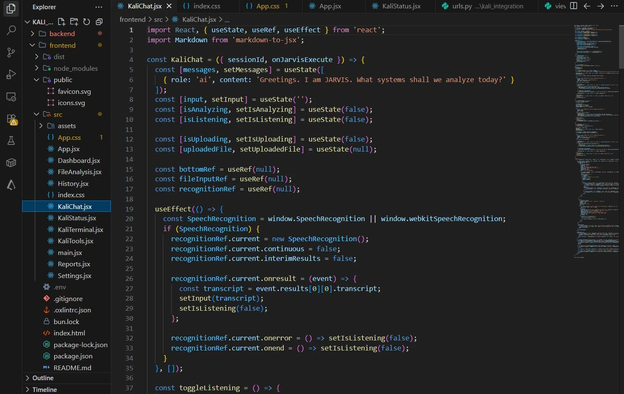
SOURCE CODE - CHAT
KaliChat.jsx: chat state, upload and voice input

Slide 10
PROJECT OUTCOME
Developed JARVIS, a web platform that links a React interface, a FastAPI backend, an NVIDIA NIM model and a Kali Linux VM.
Added a dynamic tool registry (163 tools shown), chat and voice input, a terminal, file analysis, history and reports.
Used dual permission gates, command sanitising, upload validation and isolated remote paths.
The project report lists six security test cases as PASS (unregistered tool, injection, disabled execution, bad upload).
Outcome: A development and simulation platform that shows safe, structured AI-assisted tool orchestration.

Slide 11
FUTURE WORKS
Add WebSocket streaming for line-by-line progress on long scans.
Evaluate local models (vLLM or Ollama) for offline or restricted networks.
Explore multi-agent testing with explicit permissions.
Generate compliance reports against OWASP and NIST SP 800-115.
Harden operations: secret rotation, SSH host-key checks, log retention, concurrency.
Test beyond the host-only VM setup before any wider deployment.

Slide 12
CONCLUSION
JARVIS connects a React interface, a FastAPI backend, an NVIDIA NIM model and a Kali Linux target in one controlled workflow.
Its main idea is to keep AI planning separate from deterministic validation and execution, using a registry, dual gates, input checks and process records.
Overall, JARVIS shows how natural-language security operations can be made observable and safer, within a development and simulation environment.

