Slide 1
WickrIO
Development overview

Slide 2
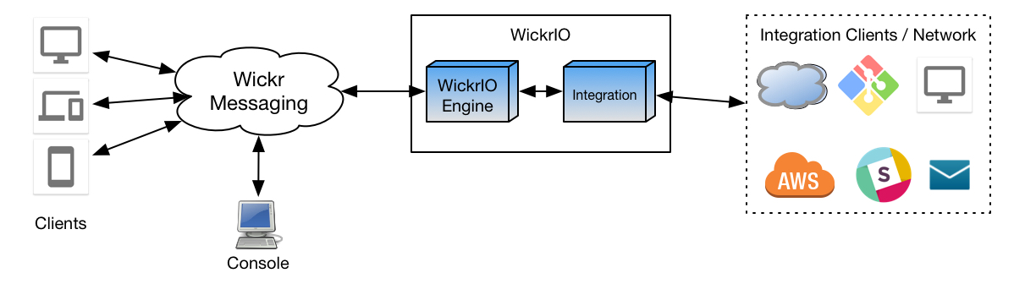
WickrIO Architecture

Slide 3
WickrIO Client Integrations
WickrIO distribution comes with the following integrations:
Hello_world_bot / Welcome_bot
File_bot
Hubot
Web_interface

Slide 4
WickrIO Client Node.js Addon API
Supported APIs
Get and Clear Statistics
Get list of rooms
Get, Add, Modify, leave and Delete Rooms
Get list of group convos
Get, Add, Delete group convos
Get received messages
Send messages (1to1, secure room and group convos)
Async message reception
Similar to the HTTP REST APIs

Slide 5
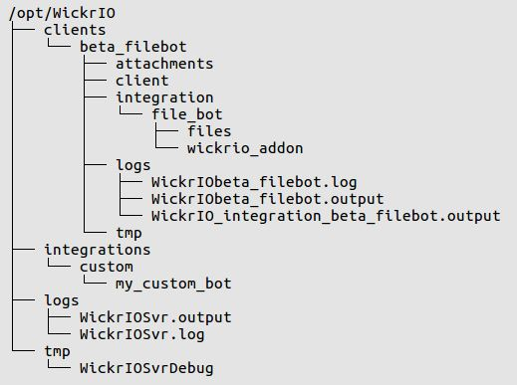
WickrIO Working Directory

