Slide 1
WickrIO
Development overview

Slide 2
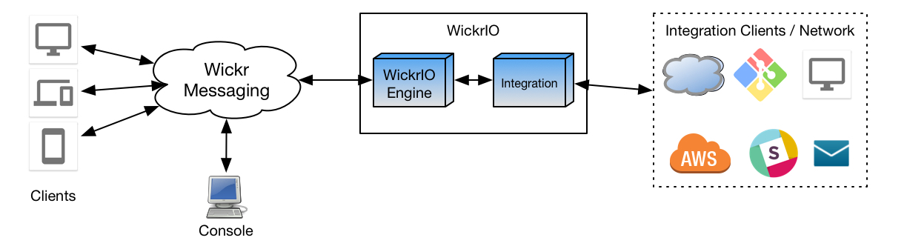
WickrIO Architecture

Slide 3
WickrIO Client Node.js Addon API
Supports HTTP REST API
Implementing direct Javascript API support
MotherBot Wickr API can support interface to WickrIO API
WickrIO Client(s) support following API types:
Send messages and files
Get, clear statistics
Create, get, modify and delete secure rooms
Create, get, leave and delete group conversations

Slide 4
WickrIO Client Node.js Addon API
Supports HTTP REST API
Get and Clear Statistics
Get list of rooms
Get, Add, Modify, leave and Delete Rooms
Get list of group convos
Get, Add, Delete group convos
Get received messages
Send messages (1to1, secure room and group convos)
Async message reception

Slide 5
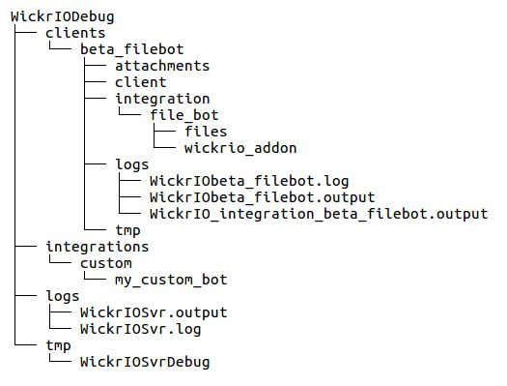
WickrIO Working Directory

Slide 6
WickrIO Security Review
Client configuration on local machine
RISK: local system database is non encrypted
HTTPS supported
HTTP/HTTPS Authentication supported
Basic authentication: username/password
“wickr-token”: encoded token
RISK: currently values stores in un-encrypted database on WickrIO system
Password security
Stored opentext until initial login of client

