Slide 1
Charity Foundation Platform Database
By: Group 6
Jiaoli Yang
Shiqi Yu
Jiangnan Xia
Haojie Zhang
Hanzhang Wang

Slide 2
Content:
01
Background
02
Final ERD
03
Views
04
Reports

Slide 3
P
1
art
Background

Slide 4

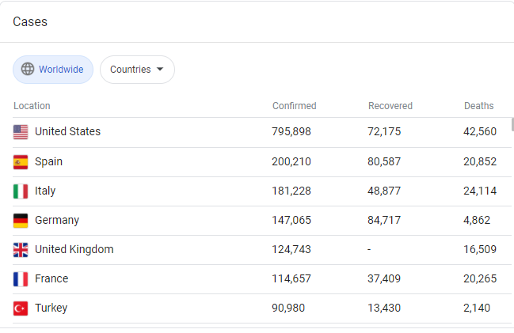
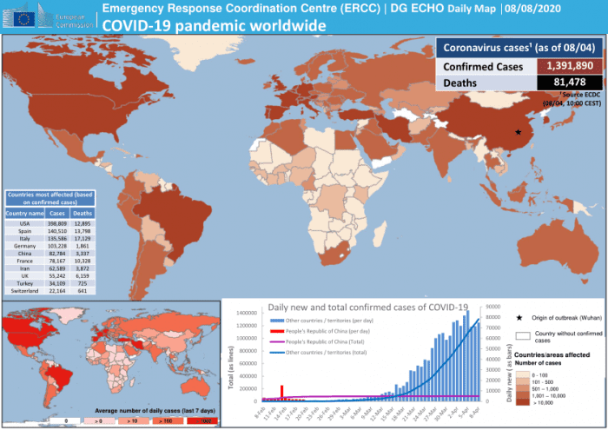
Background
The whole earth is now suffered by COVID-19.

Slide 5
Background
So we developed the:
Charity Foundation Platform Database

Slide 6


Background
Solve doctors' needs quickly and save their time
Collect evaluations and make progress

Slide 7
P
2
art
ERD

Slide 8
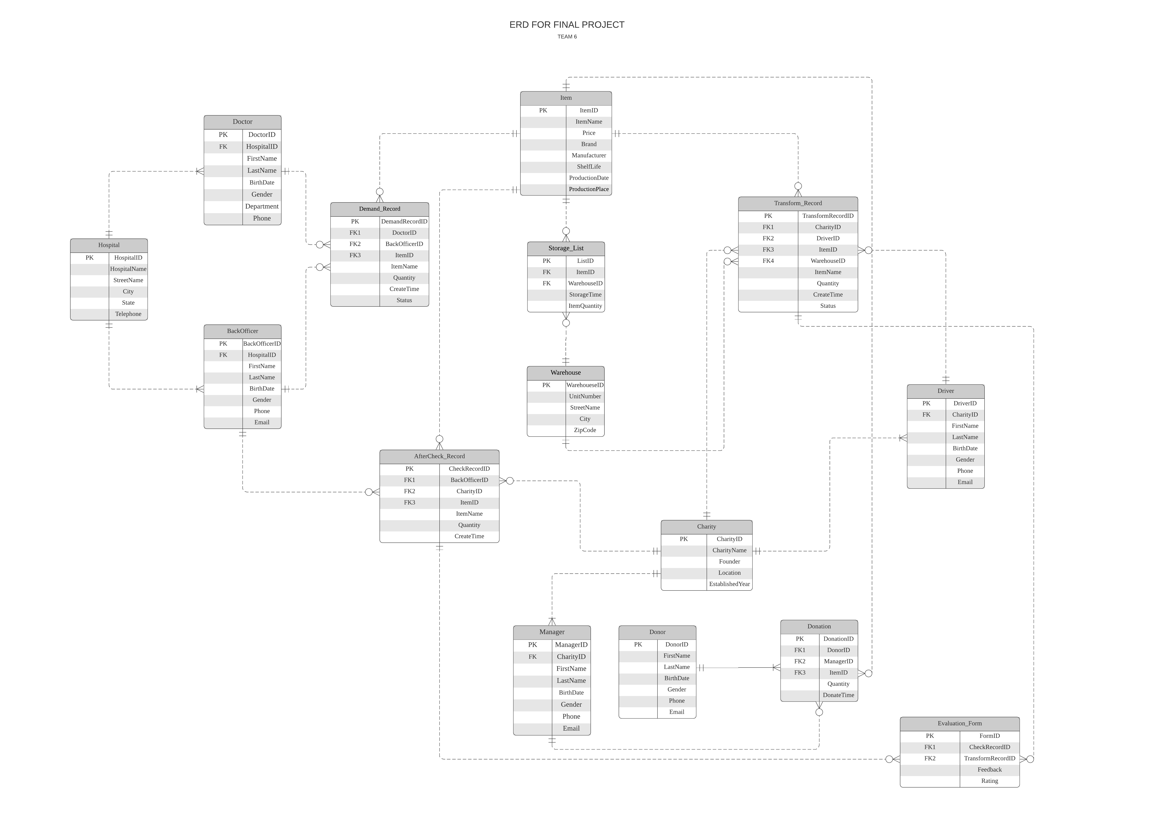

Slide 9
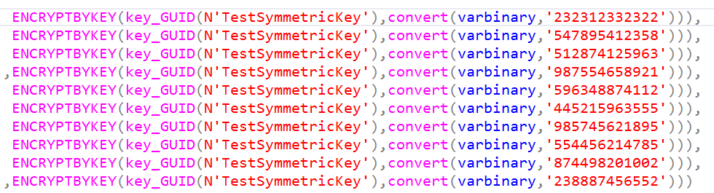
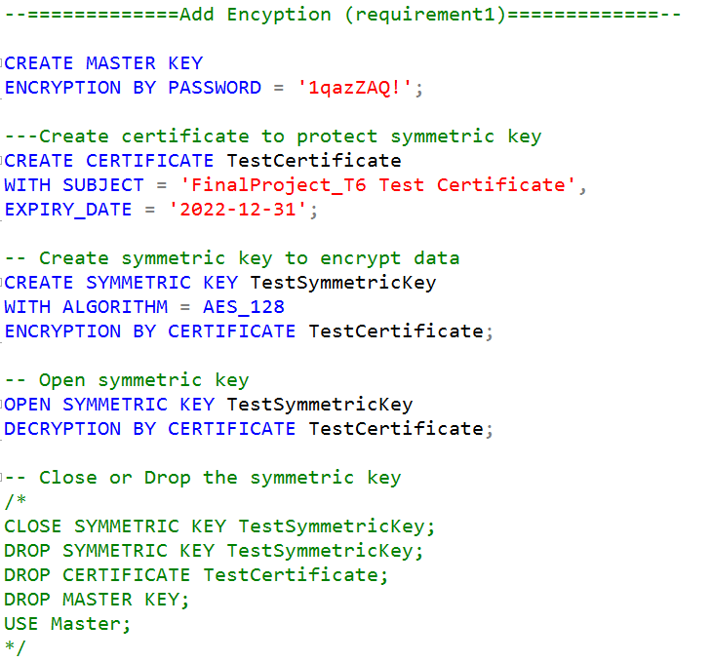
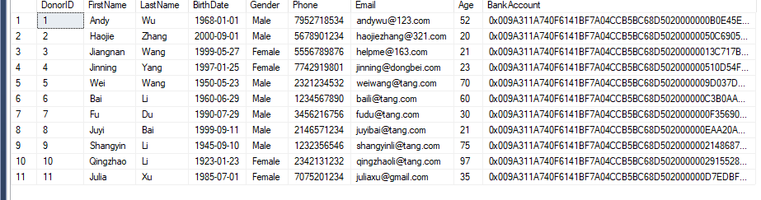
Add Encyption

Slide 10
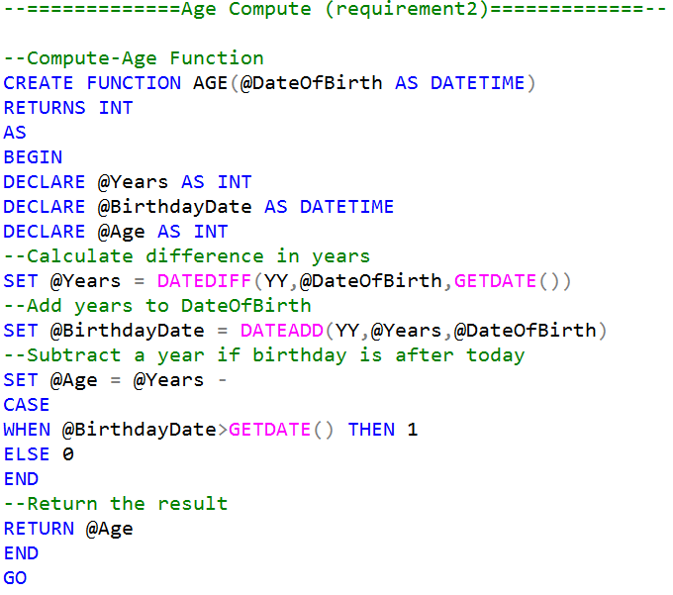
Compute Age

Slide 11
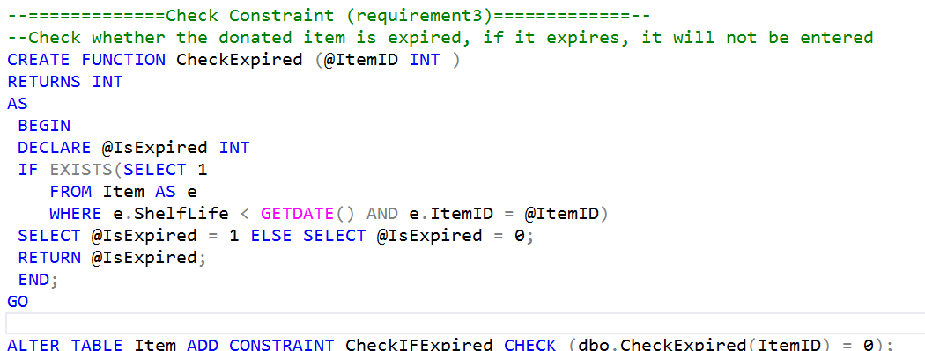
Check Constraint

Slide 12
P
3
art
Views

Slide 13
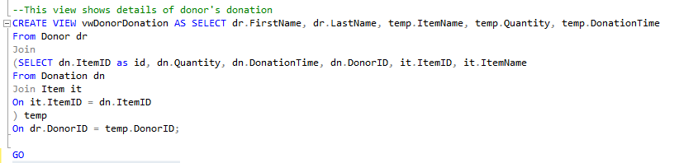
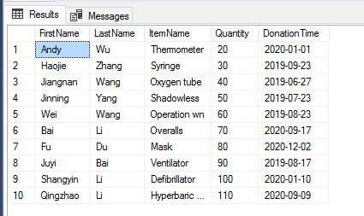
View1
View1 is to show details of donor's donation

Slide 14
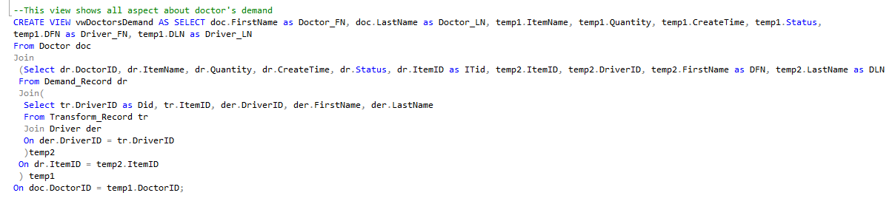
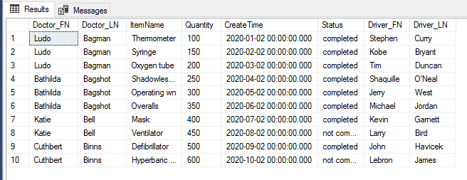
View2
View2 is to show all aspects about doctor's demand

Slide 15
P
4
art
Reports

Slide 16
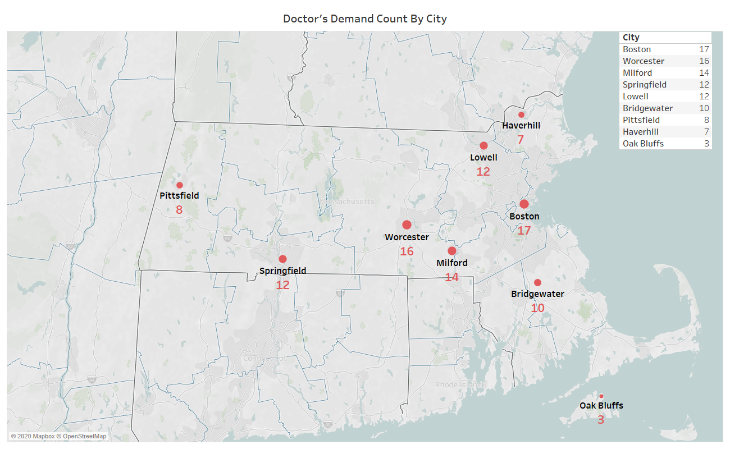
Key screenshot
This figure shows top 10 demand for doctors in MA.
Notes:
This figure shows the top 10 demand for doctors in MA. We can notice there is 17 demand from doctors in Boston, which means those hospitals might face the situation of medical devices shortage.
This geographical figure can help the charity to select suitable warehouse location in order to reduce the medical device's transportation time.

Slide 17
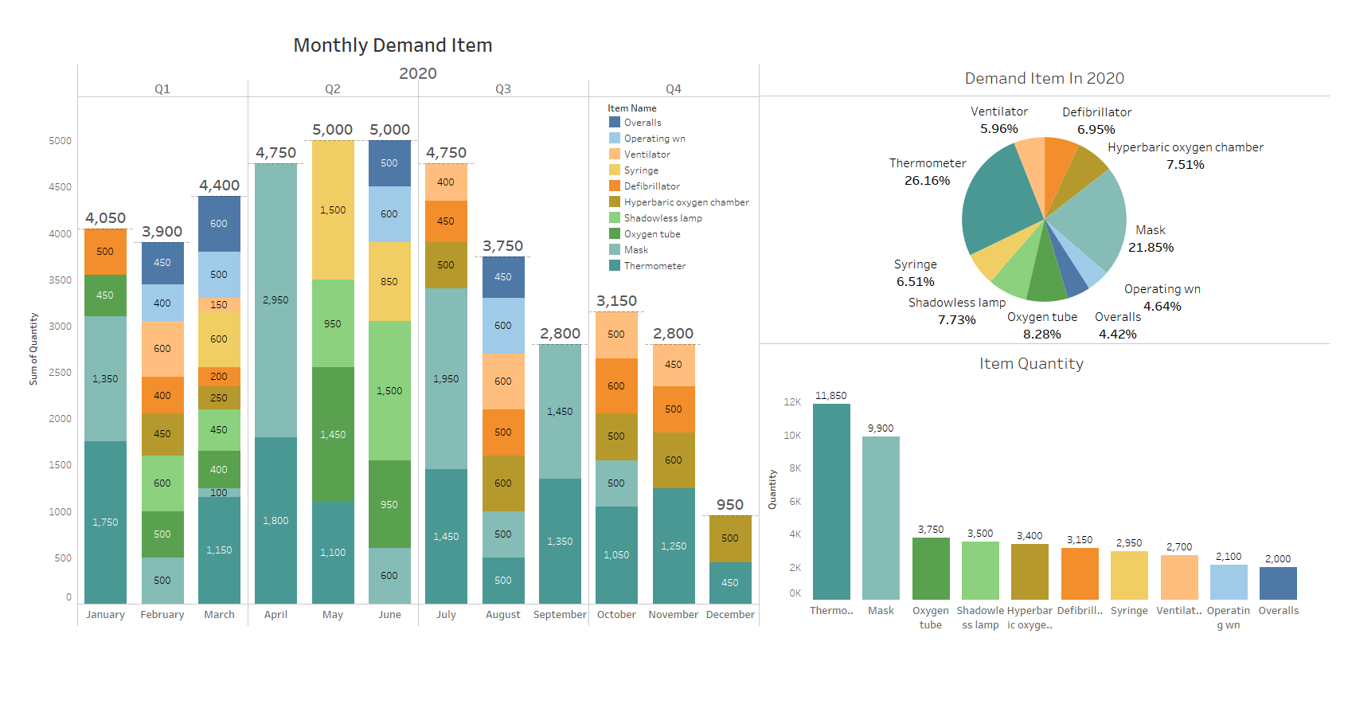
Key screenshot
This figure shows montly demand details.

Slide 18
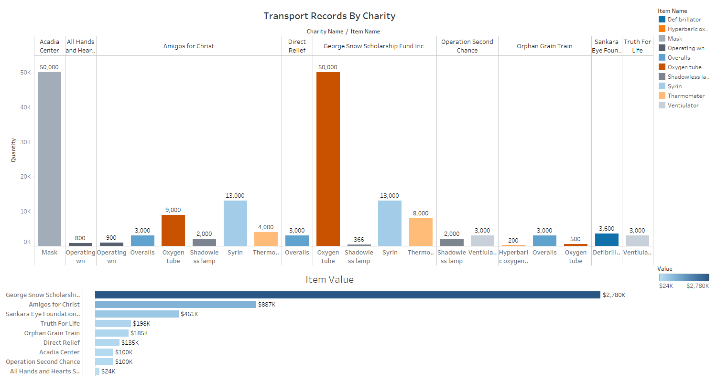
Key screenshot
This figure shows chartiy's transport records.

Slide 19
Thank You
Group 6

