Slide 1
线性方程组的迭代法
迭代法的一般形式
Richardson迭代
Jacobi迭代
Gauss-Seidel迭代
连续过松弛(SOR)迭代
迭代法的收敛性

Slide 2

线性方程组的迭代法
引例：求解方程组$\left\{\begin{aligned}3u+v=5 \\ u+2v=5\end{aligned}\right.$
迭代1: $\left\{\begin{aligned}u_{k+1}=\frac{5−v_{k}}{3} \\ v_{k+1}=\frac{5−u_{k}}{2}\end{aligned}\right.$
迭代2: $\left\{\begin{aligned}u_{k+1}=5−2v_{k} \\ v_{k+1}=5−3u_{k}\end{aligned}\right.$
需要回答的问题：
为什么需要迭代法？
如何设计通用的迭代法？
迭代的收敛性？

Slide 3
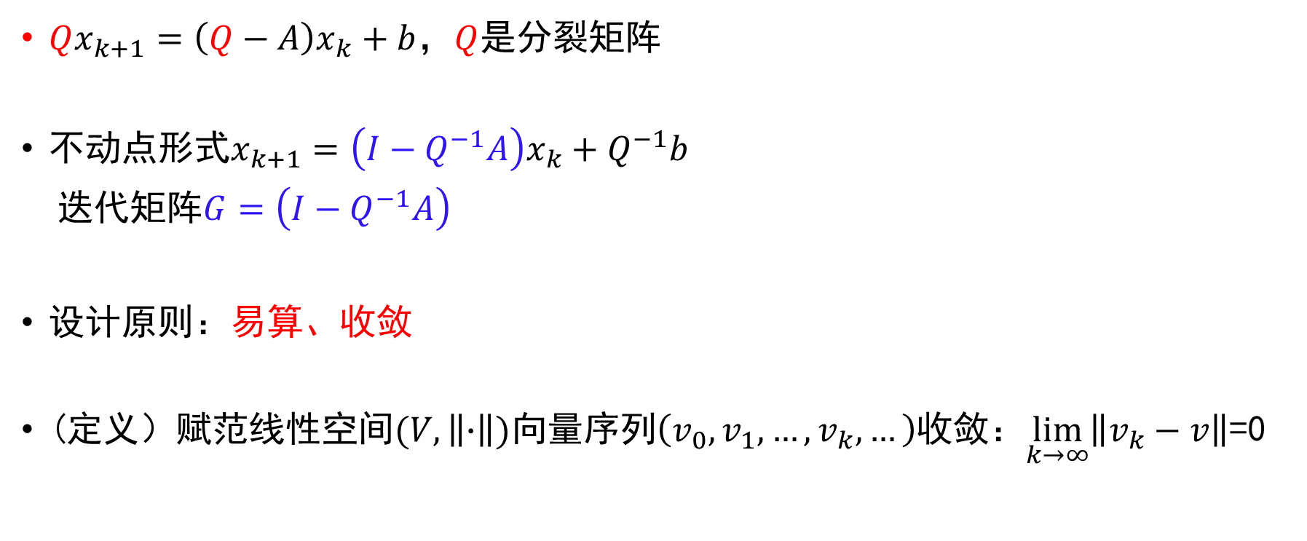
迭代法的一般形式
$Qx_{k+1}=\left(Q−A\right)x_{k}+b$，$Q$是分裂矩阵
不动点形式$x_{k+1}=\left(I−Q^{−1}A\right)x_{k}+Q^{−1}b$
迭代矩阵$G=\left(I−Q^{−1}A\right)$
设计原则：易算、收敛
(定义）赋范线性空间$(V,\left\|∙\right\|)$向量序列$\left(v_{0},v_{1},…,v_{k},…\right)$收敛：$\lim_{k→∞}\left\|v_{k}−v\right\|$=0

Slide 4

Richardson迭代
$Qx_{k+1}=\left(Q−A\right)x_{k}+b$, $Q=I,G=I−A$
例：$\left\{\begin{aligned}3u+v=5 \\ u+2v=5\end{aligned}\right.$
系数矩阵$A=\left[\begin{matrix}3 & 1 \\ 1 & 2\end{matrix}\right]$
Richardson迭代：$\left[\begin{aligned}u_{k+1} \\ v_{k+1}\end{aligned}\right]=\left[\begin{matrix}−2 & −1 \\ −1 & −1\end{matrix}\right]\left[\begin{aligned}u_{k} \\ v_{k}\end{aligned}\right]+\left[\begin{aligned}5 \\ 5\end{aligned}\right]$

Slide 5
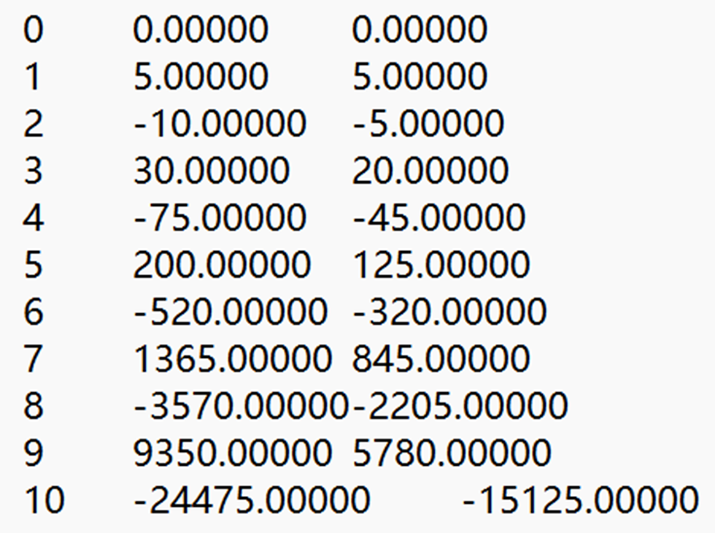




Richardson迭代
$$k$$
$$u$$
$$v$$
迭代过程：$x_{0}={\left[0,0\right]}^{T}$
$$\left[\begin{aligned}u_{1} \\ v_{1}\end{aligned}\right]=\left[\begin{matrix}−2 & −1 \\ −1 & −1\end{matrix}\right]\left[\begin{aligned}0 \\ 0\end{aligned}\right]+\left[\begin{aligned}5 \\ 5\end{aligned}\right]=\left[\begin{aligned}5 \\ 5\end{aligned}\right]$$
$$\left[\begin{aligned}u_{2} \\ v_{2}\end{aligned}\right]=\left[\begin{matrix}−2 & −1 \\ −1 & −1\end{matrix}\right]\left[\begin{aligned}5 \\ 5\end{aligned}\right]+\left[\begin{aligned}5 \\ 5\end{aligned}\right]=\left[\begin{aligned}−10 \\ −5\end{aligned}\right]$$
$$\left[\begin{aligned}u_{3} \\ v_{3}\end{aligned}\right]=\left[\begin{matrix}−2 & −1 \\ −1 & −1\end{matrix}\right]\left[\begin{aligned}−10 \\ −5\end{aligned}\right]+\left[\begin{aligned}5 \\ 5\end{aligned}\right]=\left[\begin{aligned}30 \\ 20\end{aligned}\right]$$

Slide 6

Jacobi迭代
$Qx_{k+1}=\left(Q−A\right)x_{k}+b, Q=D, G=−D^{−1}\left(L+U\right)$
$$D=\left[\begin{matrix}a_{11} & 0 & … & 0 \\ 0 & a_{22} & ⋱ & 0 \\ ⋮ & ⋱ & ⋱ & ⋮ \\ 0 & 0 & … & a_{nn}\end{matrix}\right]$$
$$L=\left[\begin{matrix}0 & 0 & … & 0 \\ a_{21} & 0 & ⋱ & 0 \\ ⋮ & ⋱ & ⋱ & ⋮ \\ a_{n1} & a_{n2} & … & 0\end{matrix}\right], U=\left[\begin{matrix}0 & a_{12} & … & a_{1n} \\ 0 & 0 & ⋱ & a_{2n} \\ ⋮ & ⋱ & ⋱ & ⋮ \\ 0 & 0 & … & 0\end{matrix}\right]$$

Slide 7

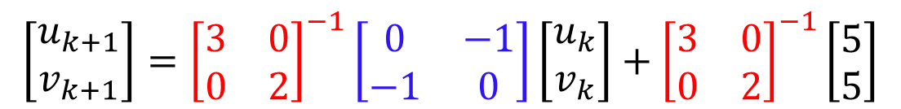
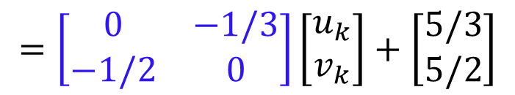




Jacobi迭代
例：$\left\{\begin{aligned}3u+v=5 \\ u+2v=5\end{aligned}\right.$
系数矩阵$A=\left[\begin{matrix}3 & 1 \\ 1 & 2\end{matrix}\right]$
Jacobi迭代： $Qx_{k+1}=\left(Q−A\right)x_{k}+b, Q=D$
$$\left[\begin{aligned}u_{k+1} \\ v_{k+1}\end{aligned}\right]={\left[\begin{matrix}3 & 0 \\ 0 & 2\end{matrix}\right]}^{−1}\left[\begin{matrix}0 & −1 \\ −1 & 0\end{matrix}\right]\left[\begin{aligned}u_{k} \\ v_{k}\end{aligned}\right]+{\left[\begin{matrix}3 & 0 \\ 0 & 2\end{matrix}\right]}^{−1}\left[\begin{aligned}5 \\ 5\end{aligned}\right]$$
$$=\left[\begin{matrix}0 & −1/3 \\ −1/2 & 0\end{matrix}\right]\left[\begin{aligned}u_{k} \\ v_{k}\end{aligned}\right]+\left[\begin{aligned}5/3 \\ 5/2\end{aligned}\right]$$
$$D^{−1}$$
$$D−A$$
$$D^{−1}$$
$$=\left[\begin{aligned}(5−v_{k})/3 \\ (5−u_{k})/2\end{aligned}\right]$$

Slide 8
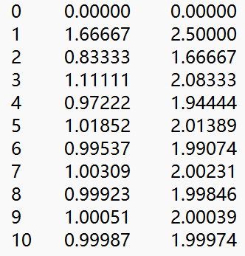




Jacobi迭代
$$k$$
$$u$$
$$v$$
迭代过程：$x_{0}={\left[0,0\right]}^{T}$
$$\left[\begin{aligned}u_{1} \\ v_{1}\end{aligned}\right]=\left[\begin{aligned}(5−v_{0})/3 \\ (5−u_{0})/2\end{aligned}\right]=\left[\begin{aligned}5/3 \\ 5/2\end{aligned}\right]$$
$$\left[\begin{aligned}u_{2} \\ v_{2}\end{aligned}\right]=\left[\begin{aligned}(5−v_{1})/3 \\ (5−u_{1})/2\end{aligned}\right]=\left[\begin{aligned}5/6 \\ 5/3\end{aligned}\right]$$
$$\left[\begin{aligned}u_{3} \\ v_{3}\end{aligned}\right]=\left[\begin{aligned}(5−v_{2})/3 \\ (5−u_{2})/2\end{aligned}\right]=\left[\begin{aligned}10/9 \\ 25/12\end{aligned}\right]$$

Slide 9




Jacobi迭代
Jacobi迭代与Richardson迭代的关系
Richardson
Jacobi
$$x_{k+1}=\left(I−A\right)x_{k}+b$$
$$Ax=b$$
$$x_{k+1}=\left(I−D^{−1}A\right)x_{k}+D^{−1}b$$
Richardson
$$D^{−1}Ax=D^{−1}b$$

Slide 10

Gauss-Seidel迭代
$Qx_{k+1}=\left(Q−A\right)x_{k}+b, Q=D+L, G=−{\left(L+D\right)}^{−1}U$
$$D=\left[\begin{matrix}a_{11} & 0 & … & 0 \\ 0 & a_{22} & ⋱ & 0 \\ ⋮ & ⋱ & ⋱ & ⋮ \\ 0 & 0 & … & a_{nn}\end{matrix}\right]$$
$$L=\left[\begin{matrix}0 & 0 & … & 0 \\ a_{21} & 0 & ⋱ & 0 \\ ⋮ & ⋱ & ⋱ & ⋮ \\ a_{n1} & a_{n2} & … & 0\end{matrix}\right], U=\left[\begin{matrix}0 & a_{12} & … & a_{1n} \\ 0 & 0 & ⋱ & a_{2n} \\ ⋮ & ⋱ & ⋱ & ⋮ \\ 0 & 0 & … & 0\end{matrix}\right]$$

Slide 11
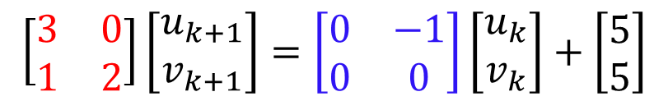




Gauss-Seidel迭代
例：$\left\{\begin{aligned}3u+v=5 \\ u+2v=5\end{aligned}\right.$
系数矩阵$A=\left[\begin{matrix}3 & 1 \\ 1 & 2\end{matrix}\right]$
Gauss-Seidel迭代： $Qx_{k+1}=\left(Q−A\right)x_{k}+b, Q=L+D$
$$⟹\left[\begin{aligned}u_{k+1} \\ v_{k+1}\end{aligned}\right]=\left[\begin{aligned}\frac{5−v_{k}}{3} \\ \frac{5−u_{k+1}}{2}\end{aligned}\right]$$
$$\left[\begin{matrix}3 & 0 \\ 1 & 2\end{matrix}\right]\left[\begin{aligned}u_{k+1} \\ v_{k+1}\end{aligned}\right]=\left[\begin{matrix}0 & −1 \\ 0 & 0\end{matrix}\right]\left[\begin{aligned}u_{k} \\ v_{k}\end{aligned}\right]+\left[\begin{aligned}5 \\ 5\end{aligned}\right]$$
$$L+D$$
$$−U$$

Slide 12
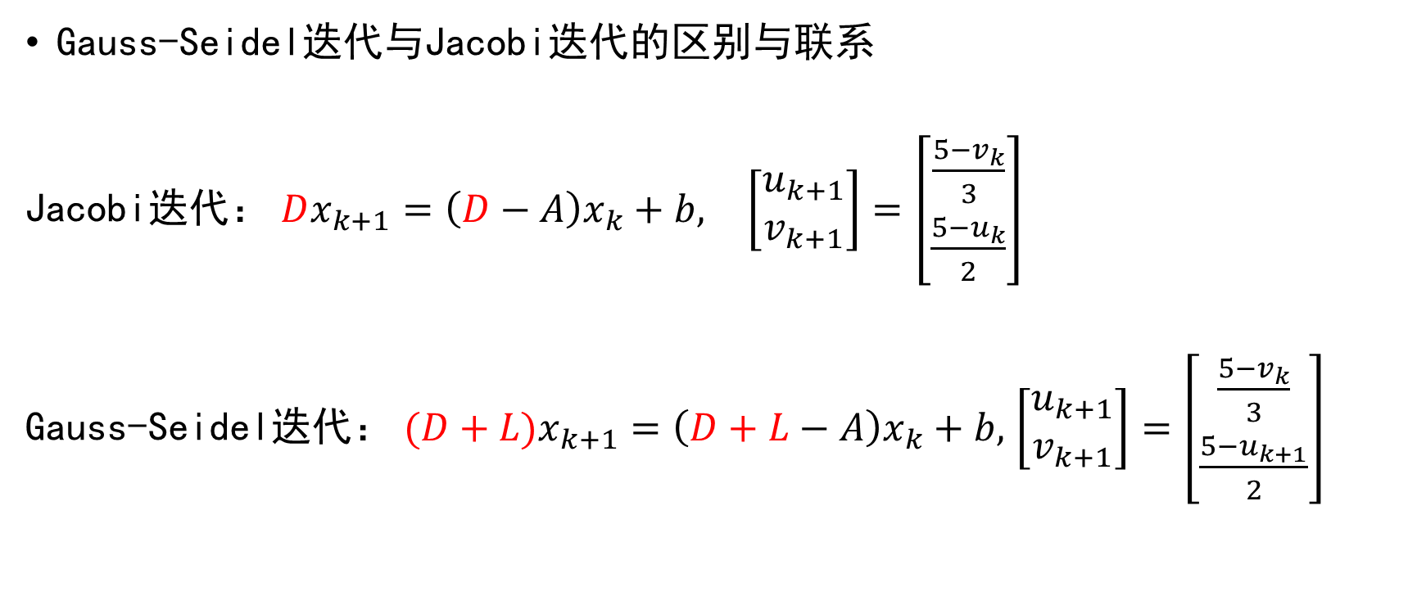
Gauss-Seidel迭代
Gauss-Seidel迭代与Jacobi迭代的区别与联系
Jacobi迭代： $Dx_{k+1}=\left(D−A\right)x_{k}+b,$ $\left[\begin{aligned}u_{k+1} \\ v_{k+1}\end{aligned}\right]=\left[\begin{aligned}\frac{5−v_{k}}{3} \\ \frac{5−u_{k}}{2}\end{aligned}\right]$
Gauss-Seidel迭代： $(D+L)x_{k+1}=\left(D+L−A\right)x_{k}+b,$ $\left[\begin{aligned}u_{k+1} \\ v_{k+1}\end{aligned}\right]=\left[\begin{aligned}\frac{5−v_{k}}{3} \\ \frac{5−u_{k+1}}{2}\end{aligned}\right]$

Slide 13
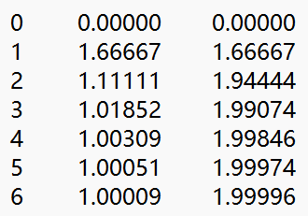




Gauss-Seidel迭代
$$k$$
$$u$$
$$v$$
迭代过程：$x_{0}={\left[0,0\right]}^{T}$
$$\left[\begin{aligned}u_{1} \\ v_{1}\end{aligned}\right]=\left[\begin{aligned}\frac{5−v_{0}}{3} \\ \frac{5−u_{1}}{2}\end{aligned}\right]=\left[\begin{aligned}\frac{5}{3} \\ \frac{5}{3}\end{aligned}\right]$$
$$\left[\begin{aligned}u_{2} \\ v_{2}\end{aligned}\right]=\left[\begin{aligned}\frac{5−v_{1}}{3} \\ \frac{5−u_{2}}{2}\end{aligned}\right]=\left[\begin{aligned}\frac{10}{9} \\ \frac{35}{18}\end{aligned}\right]$$
Gauss-Seidel迭代通常收敛比Jacobi迭代快
Jacobi迭代更适合并行计算

Slide 14
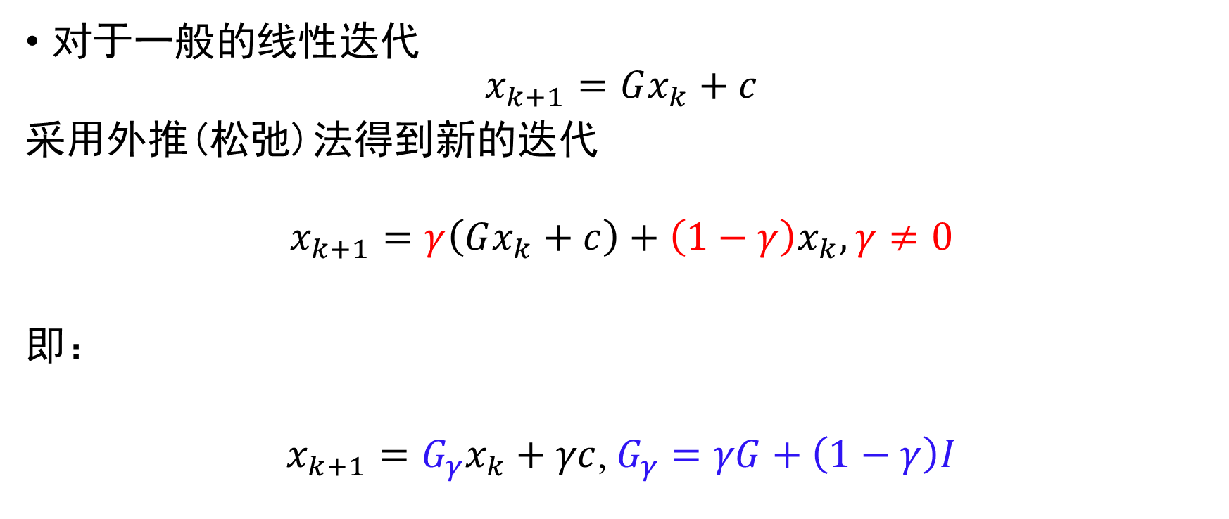
连续超松弛（SOR）迭代
对于一般的线性迭代
$$x_{k+1}=Gx_{k}+c$$
采用外推(松弛)法得到新的迭代
$$x_{k+1}=γ\left(Gx_{k}+c\right)+\left(1−γ\right)x_{k}, γ≠0$$
即：
$x_{k+1}=G_{γ}x_{k}+γc$, $G_{γ}=γG+\left(1−γ\right)I$

Slide 15
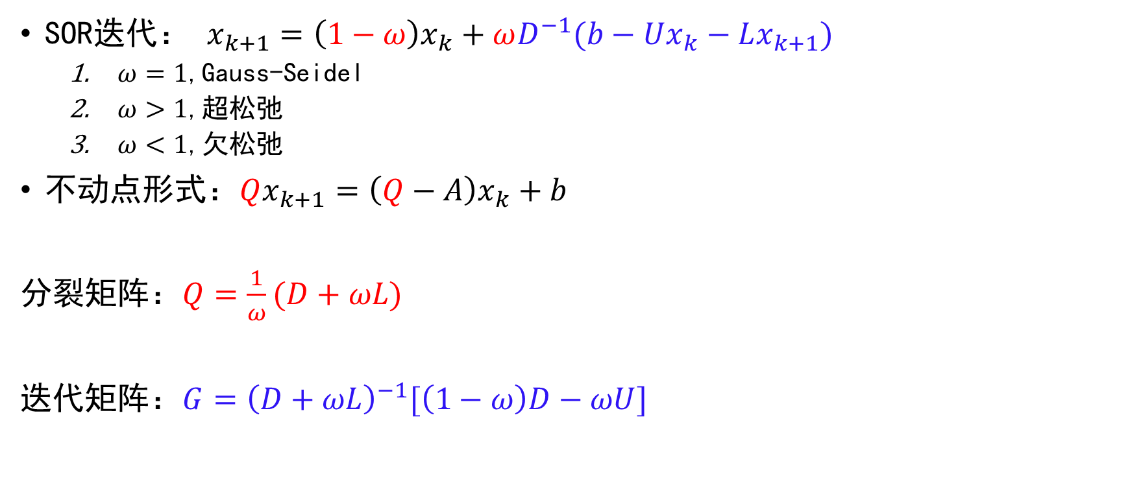
连续超松弛（SOR）迭代
Gauss-Seidel
SOR迭代： $x_{k+1}=\left(1−ω\right)x_{k}+ωD^{−1}(b−Ux_{k}−Lx_{k+1})$
$ω=1$,Gauss-Seidel
$ω>1$,超松弛
$ω<1$,欠松弛
不动点形式：$Qx_{k+1}=\left(Q−A\right)x_{k}+b$
分裂矩阵：$Q=\frac{1}{ω}(D+ωL)$
迭代矩阵：$G={\left(D+ωL\right)}^{−1}[\left(1−ω\right)D−ωU]$

Slide 16
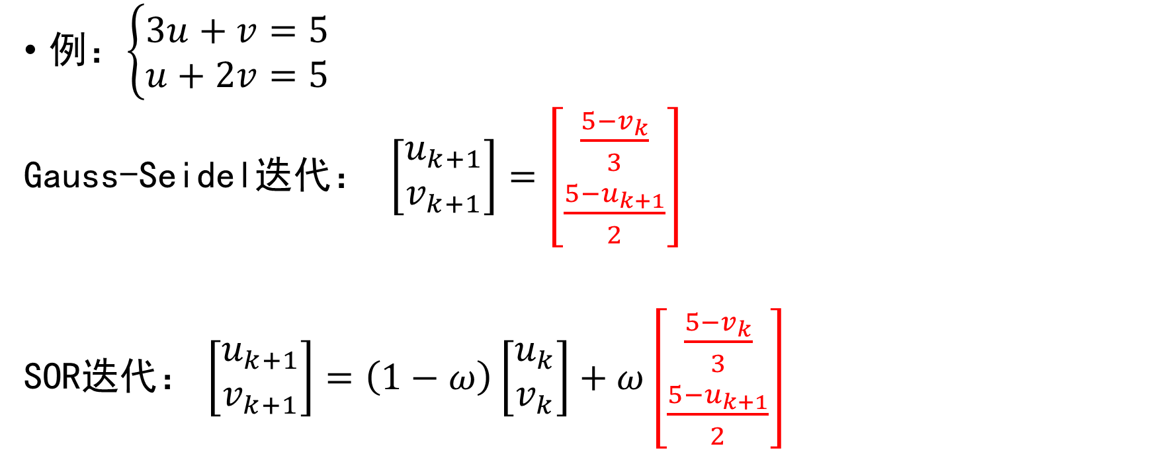
连续超松弛（SOR）迭代
例：$\left\{\begin{aligned}3u+v=5 \\ u+2v=5\end{aligned}\right.$
Gauss-Seidel迭代： $\left[\begin{aligned}u_{k+1} \\ v_{k+1}\end{aligned}\right]=\left[\begin{aligned}\frac{5−v_{k}}{3} \\ \frac{5−u_{k+1}}{2}\end{aligned}\right]$
SOR迭代： $\left[\begin{aligned}u_{k+1} \\ v_{k+1}\end{aligned}\right]=\left(1−ω\right)\left[\begin{aligned}u_{k} \\ v_{k}\end{aligned}\right]+ω\left[\begin{aligned}\frac{5−v_{k}}{3} \\ \frac{5−u_{k+1}}{2}\end{aligned}\right]$

Slide 17
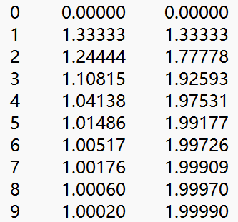
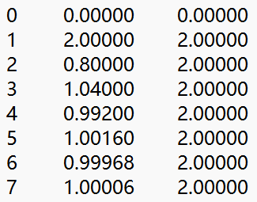
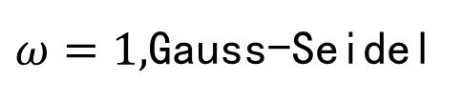
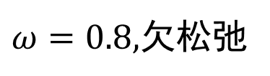
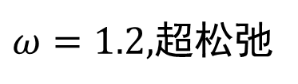






连续超松弛（SOR）迭代
迭代过程
$ω=0.8,$欠松弛
$ω=1,$Gauss-Seidel
$ω=1.2,$超松弛
$$k$$
$$u$$
$$v$$
$$k$$
$$u$$
$$v$$
$$k$$
$$u$$
$$v$$

Slide 18

连续超松弛（SOR）迭代
$ω$取值对收敛步数$N_{iter}$的影响$\left(TOL={10}^{−5}\right)$
$$ω$$ | 0.5 | 0.6 | 0.7 | 0.8 | 0.9 | 1.0 | 1.1 | 1.2 | 1.3 | 1.4 | 1.5
$$N_{iter}$$ | 15 | 12 | 10 | 9 | 7 | 6 | 5 | 7 | 9 | 11 | 14

Slide 19
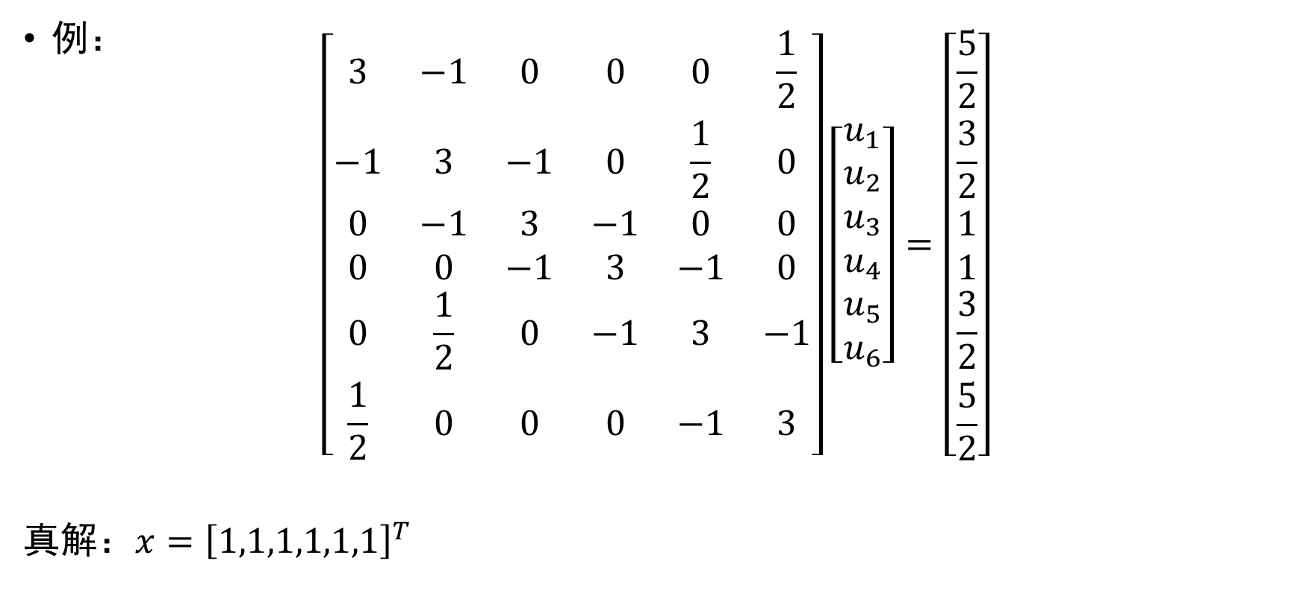
对比不同迭代法
例：
$$\left[\begin{matrix}3 & −1 & 0 & 0 & 0 & \frac{1}{2} \\ −1 & 3 & −1 & 0 & \frac{1}{2} & 0 \\ 0 & −1 & 3 & −1 & 0 & 0 \\ 0 & 0 & −1 & 3 & −1 & 0 \\ 0 & \frac{1}{2} & 0 & −1 & 3 & −1 \\ \frac{1}{2} & 0 & 0 & 0 & −1 & 3\end{matrix}\right]\left[\begin{aligned}u_{1} \\ u_{2} \\ u_{3} \\ u_{4} \\ u_{5} \\ u_{6}\end{aligned}\right]=\left[\begin{aligned}\frac{5}{2} \\ \frac{3}{2} \\ 1 \\ 1 \\ \frac{3}{2} \\ \frac{5}{2}\end{aligned}\right]$$
真解：$x={\left[1,1,1,1,1,1\right]}^{T}$

Slide 20
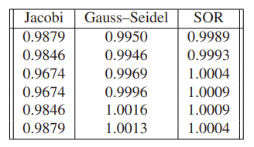
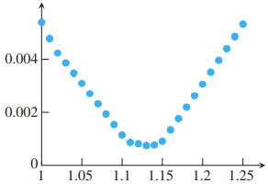

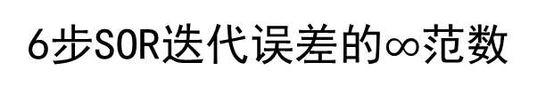
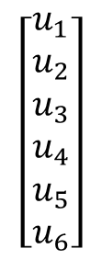
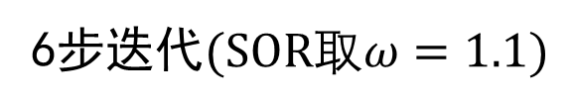

对比不同迭代法
$$x_{0}={\left[0,0,0,0,0,0\right]}^{T}$$
$${\left\|x_{k}−x_{k−1}\right\|}_{∞}$$
$$\left[\begin{aligned}u_{1} \\ u_{2} \\ u_{3} \\ u_{4} \\ u_{5} \\ u_{6}\end{aligned}\right]$$
$$ω$$
6步迭代$(SOR取ω=1.1)$
6步SOR迭代误差的$∞$范数

Slide 21
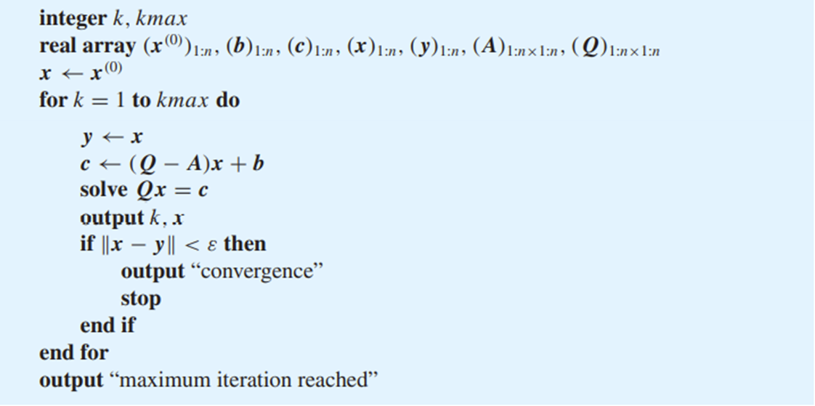

迭代法的代码
伪代码
迭代法则$Qx_{k+1}=\left(Q−A\right)x_{k}+b$
收敛判别

Slide 22
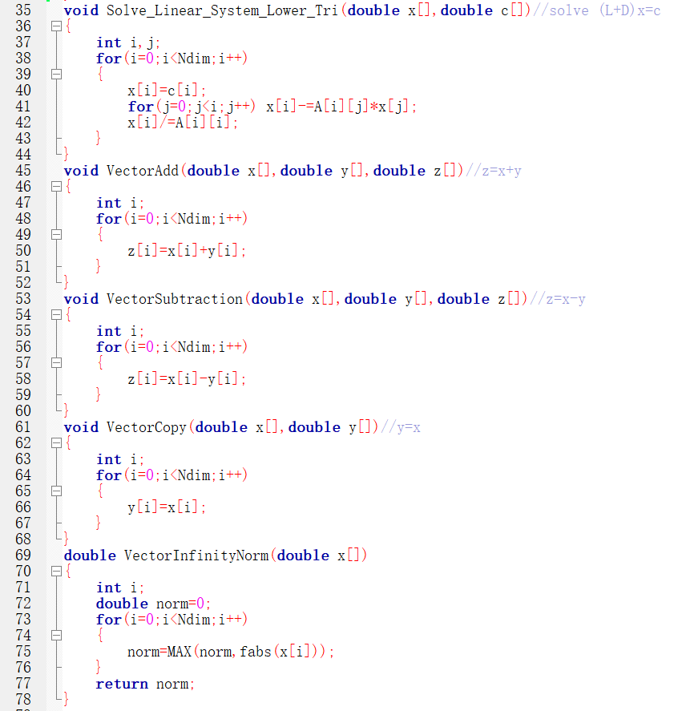
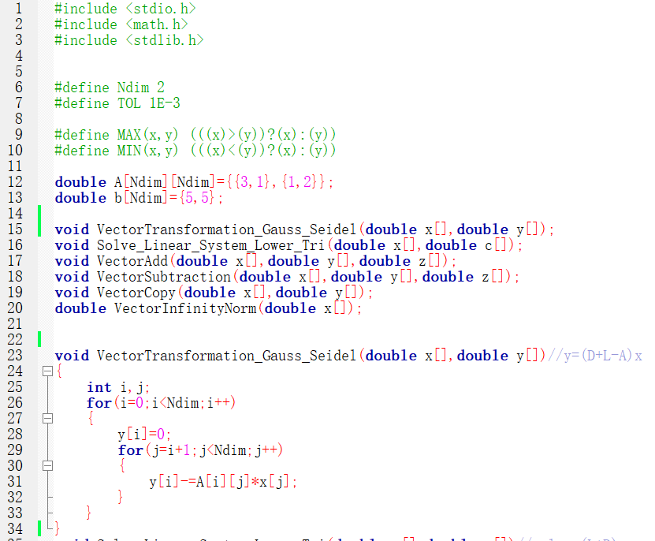


迭代法的代码
求解$\left(D+L\right)x=c$
Gauss-Seidel C Code示例
向量加法
问题定义
向量减法
向量复制
计算$\left(D+L−A\right)x$
向量无穷范数

Slide 23
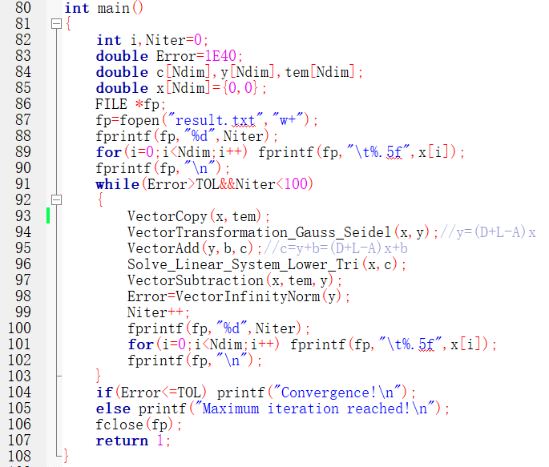






迭代法的代码
$$tem=x$$
$$y=(D+L−A)x$$
主
循
环
$$c=y+b=\left(D+L−A\right)x+b$$
Solve $\left(D+L\right)x=c$
$$y=x−tem$$
$$Error={\left\|y\right\|}_{∞}$$

Slide 24
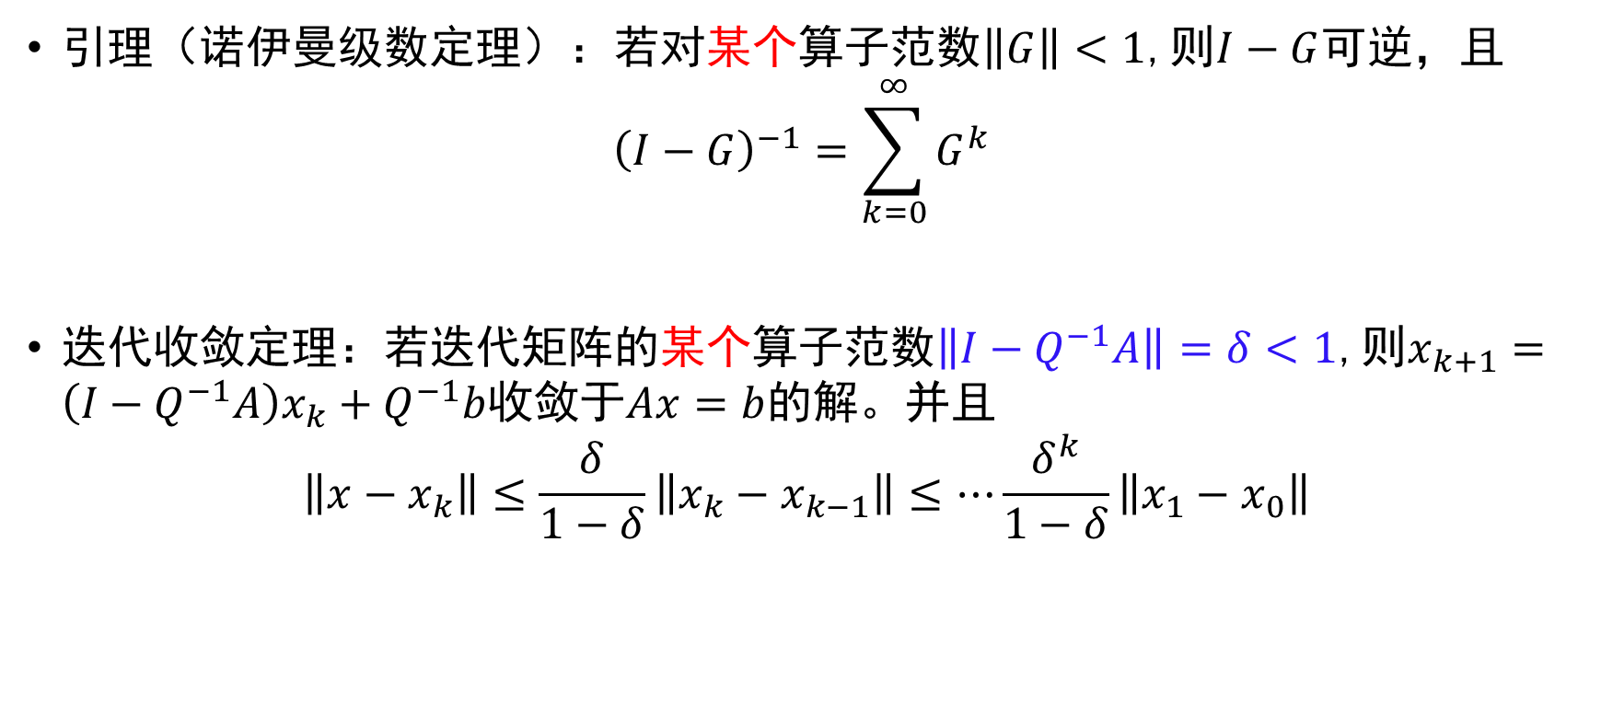
迭代法的收敛性
引理（诺伊曼级数定理）：若对某个算子范数$\left\|G\right\|<1$,则$I−G$可逆，且
$${\left(I−G\right)}^{−1}=\sum_{k=0}^{∞}{G^{k}}$$
迭代收敛定理：若迭代矩阵的某个算子范数$\left\|I−Q^{−1}A\right\|=δ<1$,则$x_{k+1}=\left(I−Q^{−1}A\right)x_{k}+Q^{−1}b$收敛于$Ax=b$的解。并且
$$\left\|x−x_{k}\right\|≤\frac{δ}{1−δ}\left\|x_{k}−x_{k−1}\right\|≤…\frac{δ^{k}}{1−δ}\left\|x_{1}−x_{0}\right\|$$

Slide 25
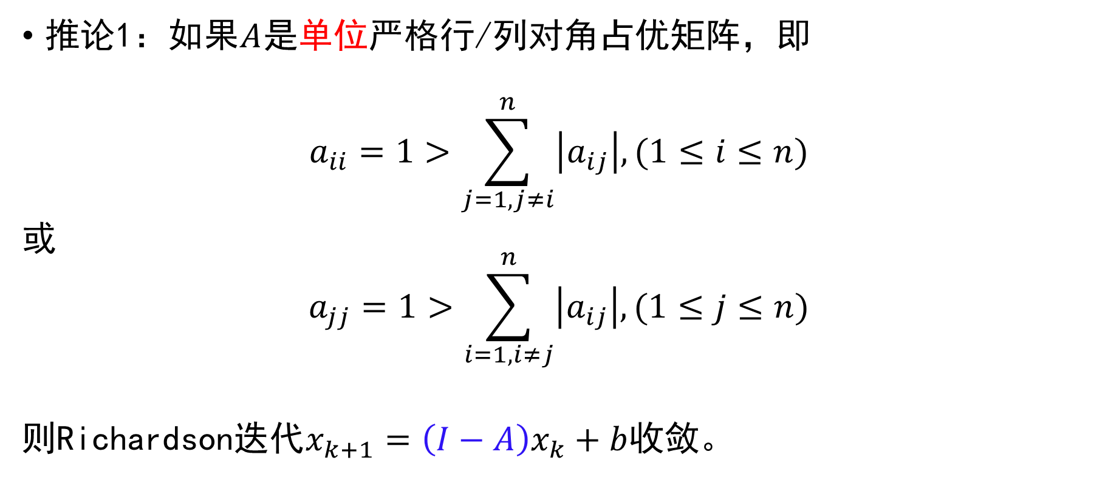
迭代法的收敛性
推论1：如果$A$是单位严格行/列对角占优矩阵，即
$$a_{ii}=1>\sum_{j=1,j≠i}^{n}{\left|a_{ij}\right|, (1≤i≤n)}$$
或
$$a_{jj}=1>\sum_{i=1,i≠j}^{n}{\left|a_{ij}\right|, (1≤j≤n)}$$
则Richardson迭代$x_{k+1}=\left(I−A\right)x_{k}+b$收敛。

Slide 26

迭代法的收敛性
例： 求解$Ax=b$，Richardson迭代能否保证收敛？
$A=\left[\begin{matrix}3 & 1 \\ 1 & 2\end{matrix}\right]$
$$A=\left[\begin{matrix}1 & 1/2 & 1/3 \\ 1/2 & 1 & 1/3 \\ 1/3 & 1/2 & 1\end{matrix}\right]$$
$$A=\left[\begin{matrix}1 & 1/2 & 1/2 \\ 1/2 & 1 & 1/3 \\ 1/3 & 1/3 & 1\end{matrix}\right]$$
×
√
√

Slide 27

迭代法的收敛性
推论2：如果$A$是严格行对角占优矩阵，即
$${|a}_{ii}|>\sum_{j=1,j≠i}^{n}{\left|a_{ij}\right|, (1≤i≤n)}$$
则Jacobi迭代$x_{k+1}=−D^{−1}\left(L+U\right)x_{k}+D^{−1}b$收敛。

Slide 28
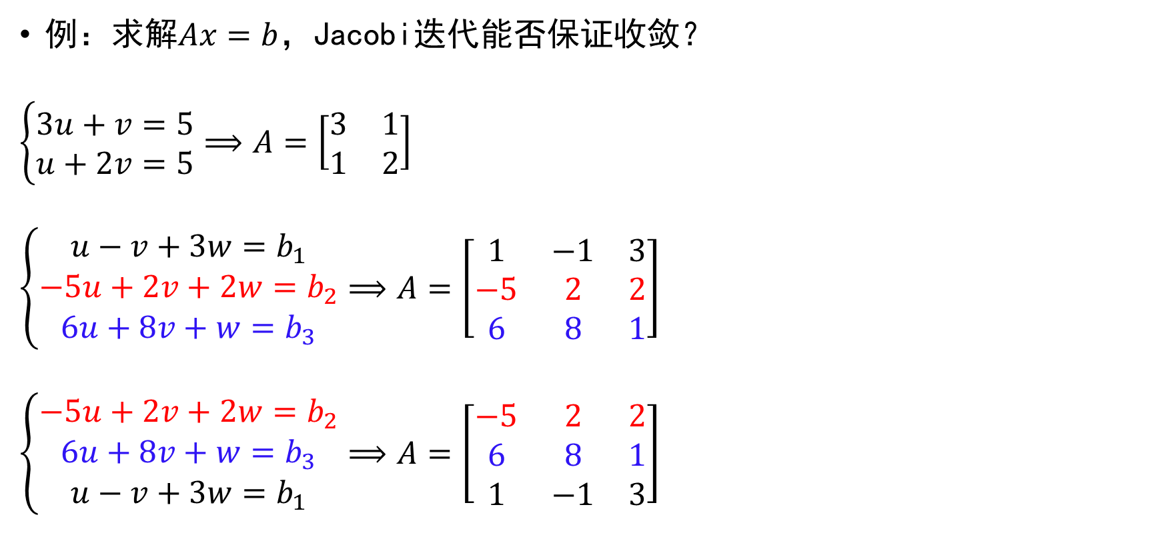
迭代法的收敛性
例：求解$Ax=b$，Jacobi迭代能否保证收敛？
$$\left\{\begin{aligned}3u+v=5 \\ u+2v=5\end{aligned}\right.⟹A=\left[\begin{matrix}3 & 1 \\ 1 & 2\end{matrix}\right]$$
$$\left\{\begin{aligned}u−v+3w=b_{1} \\ −5u+2v+2w=b_{2} \\ 6u+8v+w=b_{3}\end{aligned}\right.⟹A=\left[\begin{matrix}1 & −1 & 3 \\ −5 & 2 & 2 \\ 6 & 8 & 1\end{matrix}\right]$$
$$\left\{\begin{aligned}−5u+2v+2w=b_{2} \\ 6u+8v+w=b_{3} \\ u−v+3w=b_{1}\end{aligned}\right.⟹A=\left[\begin{matrix}−5 & 2 & 2 \\ 6 & 8 & 1 \\ 1 & −1 & 3\end{matrix}\right]$$
√
×
√

Slide 29
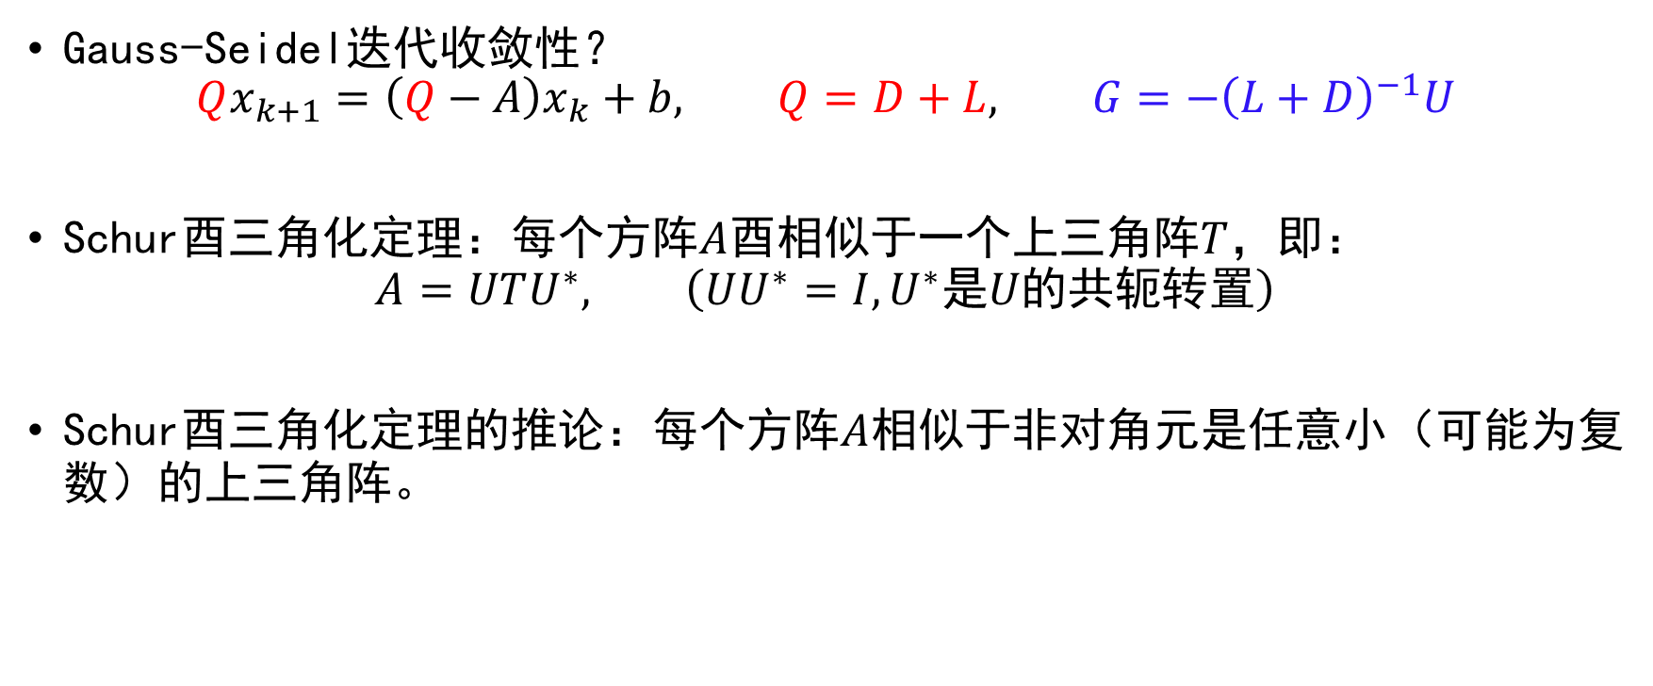
迭代法的收敛性
Gauss-Seidel迭代收敛性？
$$Qx_{k+1}=\left(Q−A\right)x_{k}+b, Q=D+L, G=−{\left(L+D\right)}^{−1}U$$
Schur酉三角化定理：每个方阵$A$酉相似于一个上三角阵$T$，即：
$$A=UTU^{∗}, \left(UU^{∗}=I, U^{∗}是U的共轭转置\right)$$
Schur酉三角化定理的推论：每个方阵$A$相似于非对角元是任意小（可能为复数）的上三角阵。

Slide 30
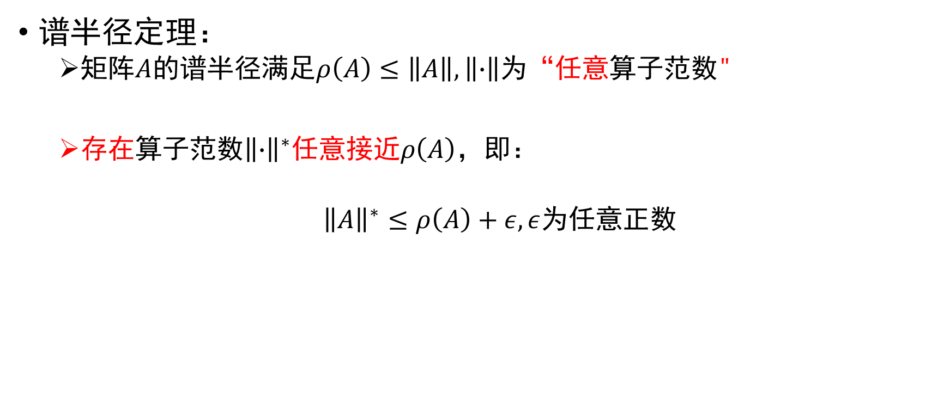
迭代法的收敛性
谱半径定理：
矩阵$A$的谱半径满足$ρ\left(A\right)≤\left\|A\right\|, \left\|∙\right\|$为“任意算子范数"
存在算子范数${\left\|∙\right\|}^{∗}$任意接近$ρ\left(A\right)$，即：
${\left\|A\right\|}^{∗}≤ρ\left(A\right)+ε, ε$为任意正数

Slide 31
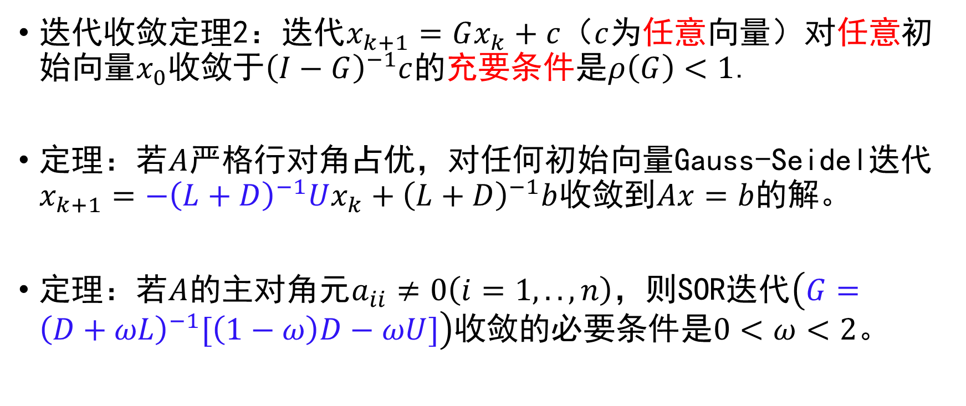
迭代法的收敛性
迭代收敛定理2：迭代$x_{k+1}=Gx_{k}+c$（$c$为任意向量）对任意初始向量$x_{0}$收敛于${\left(I−G\right)}^{−1}c$的充要条件是$ρ\left(G\right)<1$.
定理：若$A$严格行对角占优，对任何初始向量Gauss-Seidel迭代$x_{k+1}=−{\left(L+D\right)}^{−1}Ux_{k}+{\left(L+D\right)}^{−1}b$收敛到$Ax=b$的解。
定理：若$A$的主对角元$a_{ii}≠0\left(i=1,..,n\right)$，则SOR迭代$\left(G={\left(D+ωL\right)}^{−1}[\left(1−ω\right)D−ωU]\right)$收敛的必要条件是$0<ω<2$。

Slide 32
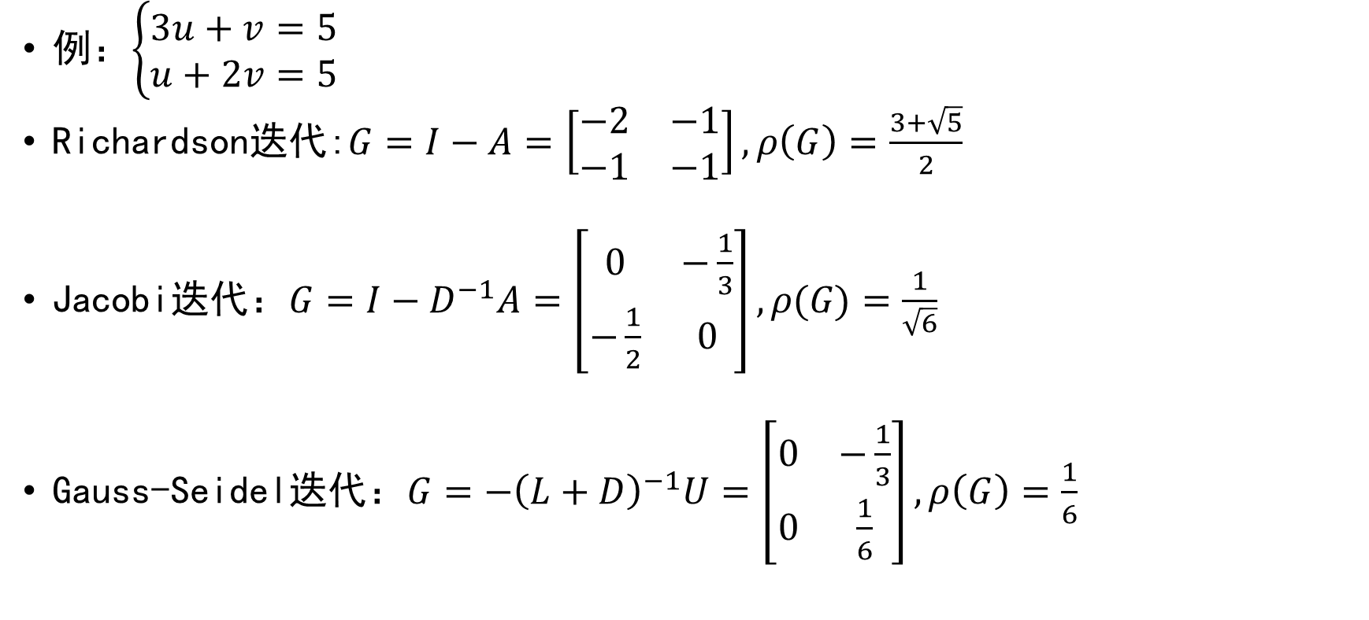
迭代法的收敛性
例：$\left\{\begin{aligned}3u+v=5 \\ u+2v=5\end{aligned}\right.$
Richardson迭代:$G=I−A=\left[\begin{matrix}−2 & −1 \\ −1 & −1\end{matrix}\right],ρ\left(G\right)=\frac{3+\sqrt{5}}{2}$
Jacobi迭代：$G=I−D^{−1}A=\left[\begin{matrix}0 & −\frac{1}{3} \\ −\frac{1}{2} & 0\end{matrix}\right],\text{ρ}\text{(}\text{G}\text{)}=\frac{1}{\sqrt{6}}$
Gauss-Seidel迭代：$G=−{\left(L+D\right)}^{−1}U=\left[\begin{matrix}0 & −\frac{1}{3} \\ 0 & \frac{1}{6}\end{matrix}\right],ρ\left(G\right)=\frac{1}{6}$
×
√
√

Slide 33
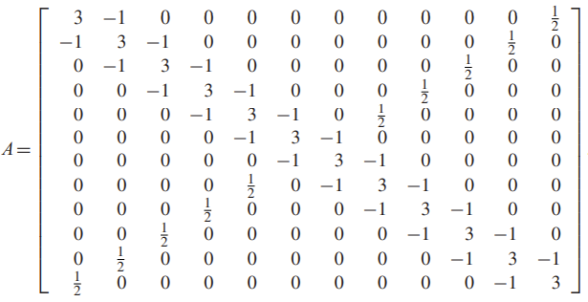
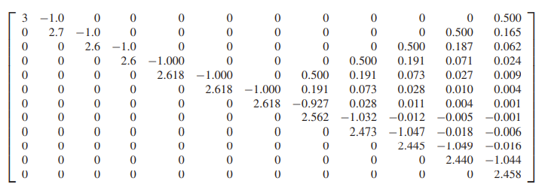

为什么需要迭代方法？
Gauss消元/LU分解复杂度$O(n^{3})$, 矩阵乘法$O(n^{2})，$迭代法复杂度$O(kn^{2}) ，k$为迭代步数。
对于稀疏矩阵,非零元个数为$O(n) ，$迭代法优势明显：更少的内存更快的速度！
消元

Slide 34
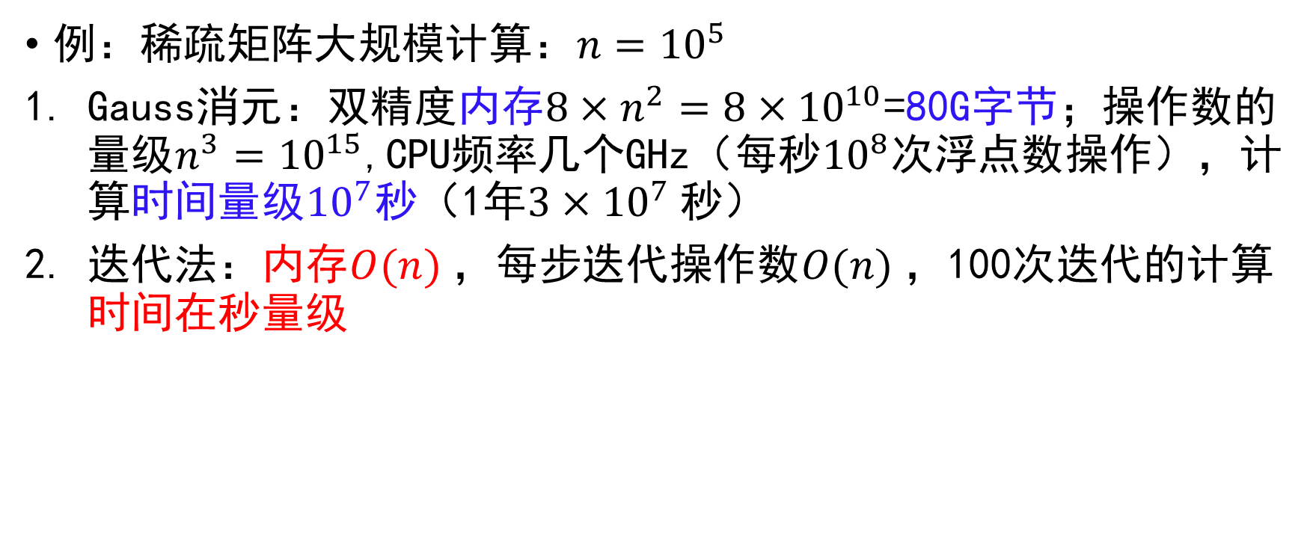
为什么需要迭代方法？
例：稀疏矩阵大规模计算：$n={10}^{5}$
Gauss消元：双精度内存${8×n}^{2}={8×10}^{10}$=80G字节；操作数的量级$n^{3}={10}^{15}$,CPU频率几个GHz（每秒${10}^{8}$次浮点数操作），计算时间量级${10}^{7}$秒（1年${3×10}^{7}$秒）
迭代法：内存$O(n)$，每步迭代操作数$O(n)$，100次迭代的计算时间在秒量级

Slide 35



为什么需要迭代方法？
稀疏矩阵求解，精确解为$\left[0,1,2,…,n−1\right]$：Gauss消元与Gauss-Seidel对比
Gauss-Seidel迭代次数$N_{iter}$随矩阵维度$n$的变化$\left(TOL={10}^{−7}\right)$
$$n$$ | 10 | $${10}^{2}$$ | $${10}^{3}$$ | $${10}^{4}$$ | $${10}^{5}$$ | $${10}^{6}$$ | $${10}^{7}$$
$$N_{iter}$$ | 28 | 56 | 64 | 71 | 78 | 84 | 91
计算时间随矩阵维度$n$的变化$\left(Gauss−Seidel取TOL={10}^{−7}\right)$
$$n$$ | 10 | $${10}^{2}$$ | $${10}^{3}$$ | $${10}^{4}$$ | $${10}^{5}$$ | $${10}^{6}$$ | $${10}^{7}$$
$Gauss$消元 | 0s | 0.001s | 1.02s | 1483.46s | - | - | -
Gauss-Seidel迭代 | 0s | 0s | 0.002s | 0.02s | 0.20s | 2.73s | 22.65s

Slide 36

思考与练习
对方程重新组织，得到一个严格行对角占优系数矩阵，并推导相应的Jacobi迭代和Gauss-Seidel迭代公式
$$\left\{\begin{aligned}u−8v−2w=1 \\ u+v+5w=4 \\ 3u−v+w=−2\end{aligned}\right.$$
编程实现Jacobi迭代、Gauss-Seidel迭代和SOR迭代，并迭代求解以上方程组。所有迭代初始向量取0，误差限取${10}^{−6}$，结果保留8位小数。
（选做）编程实现Jacobi迭代求解课件中的稀疏系数矩阵的线性方程组，并与之前实现的Gauss消元进行比较。

