Slide 1
Remote Controlled Robot
By: Jeffrey Razon and Argenis Jimenez

Slide 2
AIM & ACCOMPLISHMENT
AIM:
Implement a code that can have the Pololu Zumo robot car perform different actions according to what we configured on the keyboard
Show what commands the car was performing on a terminal
ACCOMPLISHMENT
We successfully had the code make the robot car move, have its headlights (LED) blink like turn signals, and have the the car change its speed
We successfully showed the commands on a PuTTY terminal

Slide 3
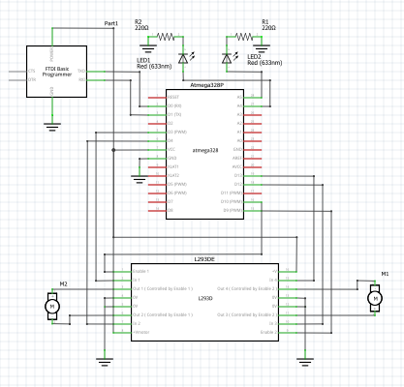
SCHEMATICS

Slide 4
DESIGN STAGES
Components
ATMEGA328p
FTDI USB-to-serial Chip
L293D driver
Pololu Zumo robot car
Interfaces
Atmega328p – Connects to Zumo car through L293D driver
Atmega328p – Connects to PuTTY through FTDI USB
PuTTY – prints with FTDI using USART

Slide 5
CODE DEVELOPMENT
Initialize variables:
- n and m variables (turn signals)
- UART settings (baud rate of 9600 bps)
- timer settings (Timer1)
- PWM settings (fast PWM mode, ICR1 = top, OCR1A/B as speed control)
Write command to terminal (we used PuTTY)
Used if, if-else, and else statements to determine command
Perform the action once determined
Prints command performed on terminal

Slide 6
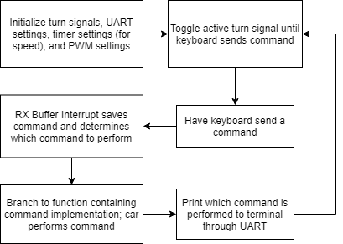
CODE DEVELOPMENT

Slide 7
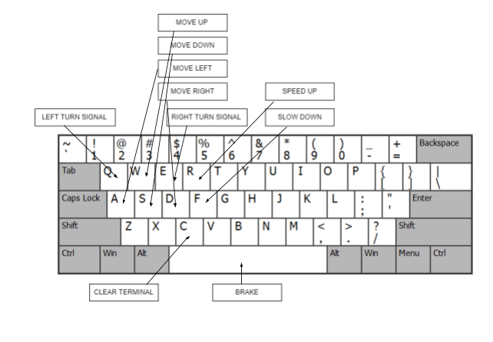
Configurations

Slide 8
DEMO SNAPSHOT/VIDEO
Remote-Controlled Robot Car Demo: https://youtu.be/O5vhrxH784c

