Slide 1
E-Commerce Sales & Customer Analytics
End-to-End Data Analytics Project
Allen Jeffrey
Tools
Entry-level Data Analyst portfolio project focused on sales and customer analytics for a sample e-commerce dataset.
Excel | Python | MySQL | Power BI | PowerPoint

Slide 2
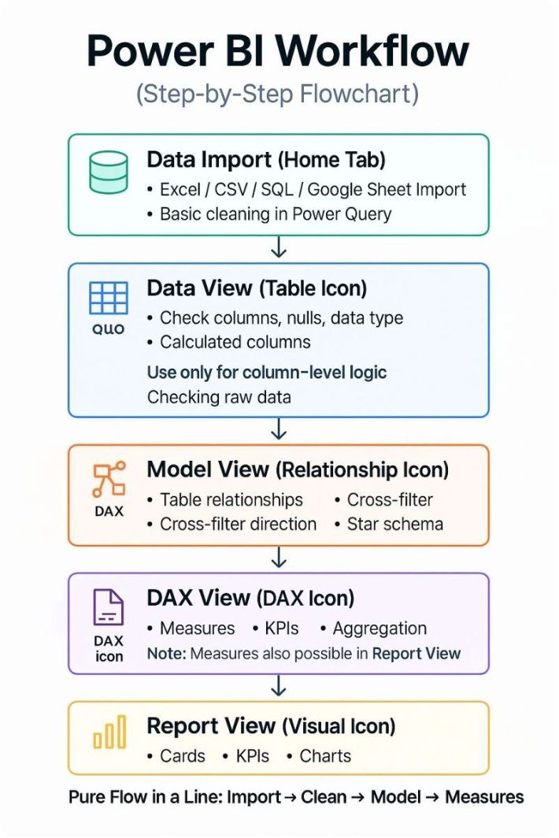
Project Overview
Project Workflow
Excel → Python → MySQL → Power BI → Business Insights
Objective
Analyze sales and profit performance
Understand customer and order behaviour
Assess regional, product and category performance
Explore discount impact on profitability
Identify sales trends over time

Slide 3



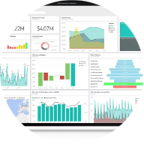
Dataset & Technology Stack
Technology Stack
Dataset
Excel
Python
Sample Superstore Dataset
Data inspection and validation
Pandas, NumPy, EDA, data cleaning
9,994 records
21 columns (order, customer, product, sales, discount, profit)
Time period: 2014–2017
MySQL
Power BI
Business queries, aggregation, analysis
Interactive dashboards, KPI visualisation

Slide 4
Data Cleaning & Exploratory Data Analysis
Data Preparation
Exploratory Analysis
Checked and imputed missing values
Verified and removed duplicate records
Corrected data types; parsed order & shipping dates
Removed unnecessary/blank records and validated numeric fields
Category & sub-category performance
Regional and state-level analysis
Customer segmentation and top customers
Discount vs profit relationship
Yearly and monthly sales trend analysis

Slide 5
Key Business KPIs
Total Sales
Total Profit
Total Orders
$2.30M
$286.40K
5,009
Total Customers
Quantity Sold
Profit Margin
793
37,873
12.47%
Average Order Value
$458.61
These KPIs provide a consolidated view of sales, profitability, customer reach and order activity for stakeholder review.

Slide 6
SQL Business Analysis
Business Questions
Total sales and profit by category, region, state
Top-performing products and customers
Profitable vs loss-making sub-categories
Discount bands and average profit impact
Sales trends by year and month
GROUP BY
SUM / AVG
Aggregate metrics by category, region, customer
Compute totals and averages for KPIs
HAVING / ORDER BY
YEAR / MONTH
Filter and rank top results
Time-based aggregations and trend analysis

Slide 7
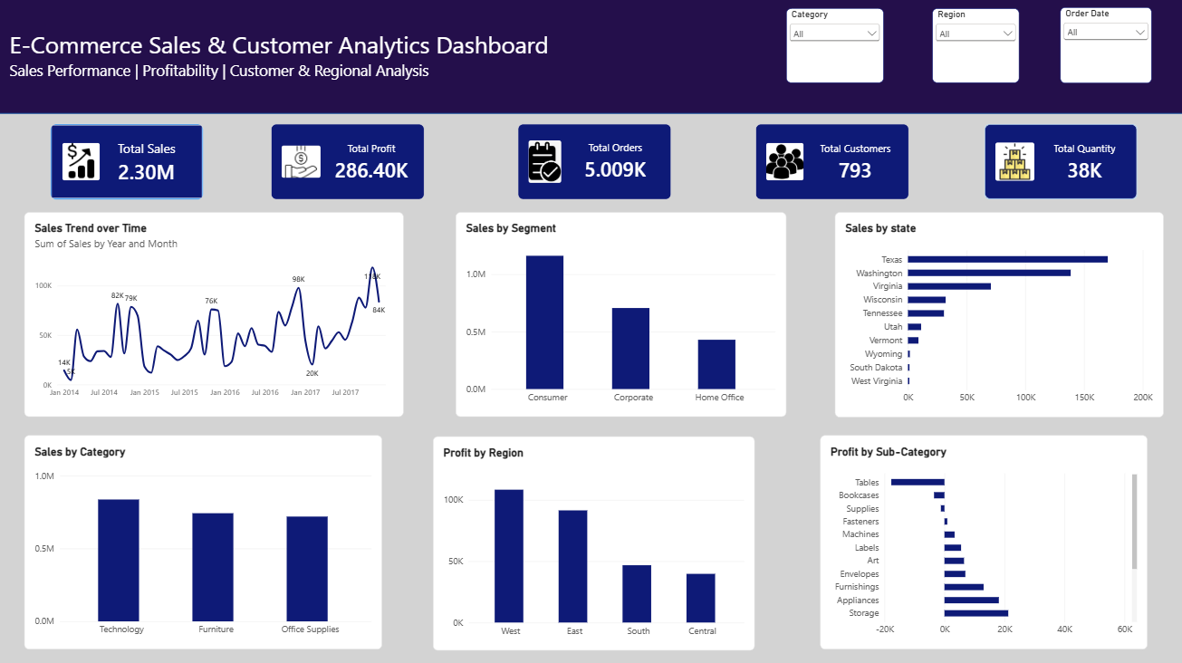
Power BI Dashboard
Dashboard Features
5 KPI cards
Sales by category & customer segment
Profit by region & sub-category
Monthly sales trend visual
Top states by sales
Category, region and date slicers with cross-filtering
Goal
Convert raw analytical results into an easy-to-understand interactive business dashboard for stakeholder decision-making.

Slide 8
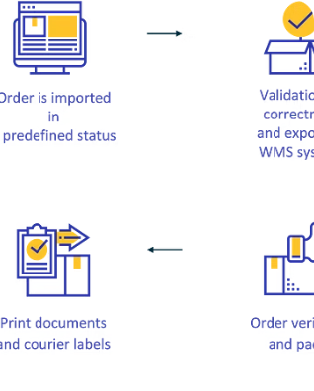
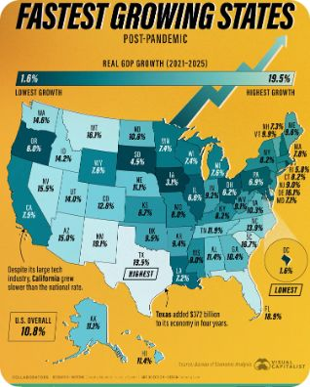
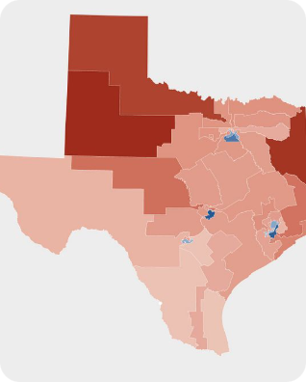
Key Business Insights
Sales & Growth
Profitability
Regional Notes
Technology had the highest category sales. The Consumer segment led by sales. Notable increase in sales from 2015 to 2017, with November as the strongest month.
West region generated the highest profit; Copiers were the top profitable sub-category while Tables showed the largest loss. Higher discounts correlated with lower average profitability.
California led state-level sales. Texas showed high sales volumes but an overall loss when discounts and costs were considered—opportunity for pricing review.

Slide 9

Conclusion & Project Outcome
Project Outcome
Skills Demonstrated
Delivered an end-to-end e-commerce analytics solution covering Data → Cleaning → EDA → SQL → Visualisation → Insights.
Python | SQL | Excel | Power BI | Data Cleaning | EDA | Visualisation | Business Analysis
Key Deliverables
Final statement: This project demonstrates the ability to transform raw business data into actionable analytical insights via a structured end-to-end workflow—making it recruiter-ready for entry-level data analyst roles.
Cleaned analytical dataset (9,994 rows)
Python EDA notebooks
MySQL analysis queries
Interactive Power BI dashboard
Business insights presentation
READY FOR INTERVIEW
PORTFOLIO ASSET

