Slide 1
The Presentation of Enterprise Content Management Solution
Automated Smart ECM
Presented by: ASL
March 2026

Slide 2
Major Features
DMS Functionality
Deployment
Licensing Scheme
Road Map
Why ASL

Slide 3
Major Features
OCR & Data Extraction
English, Traditional/Simplified Chinese full text OCR
Automatically data extraction and metadata filling
Confidence Score calculation
Document Collaboration
Workflow Approval
Batch processing execution regularly
Retention and Reminder
System Auditing
Role-base functionalities
Transaction based audit log (What user do during a period)
Search Audit Log
Audit log Report
Role-based User Management
Role mange functions
Group control permissions
User belongs to specific role and group(s)
Folder Level Access Rights
Authorize different folder permission to respective AD group
Custom metadata for different folder
Document Upload & Scan
Support import electronic document into the system
Support scan paper files into the system
Document Online Preview
Support PDF file online preview page by page
Support watermark
AI assistant
Search document by AI assistant
Summary document by AI assistant
AI-powered Search Capability
Search index values of document
Search keywords in document
Use Natural Language to search document
Notes:
Building dataset > update BR year built
List of Demolished Buildings > update BR status
Index of OC > update name of Owners’ Corporations (OC) 業主立案法團

Slide 4
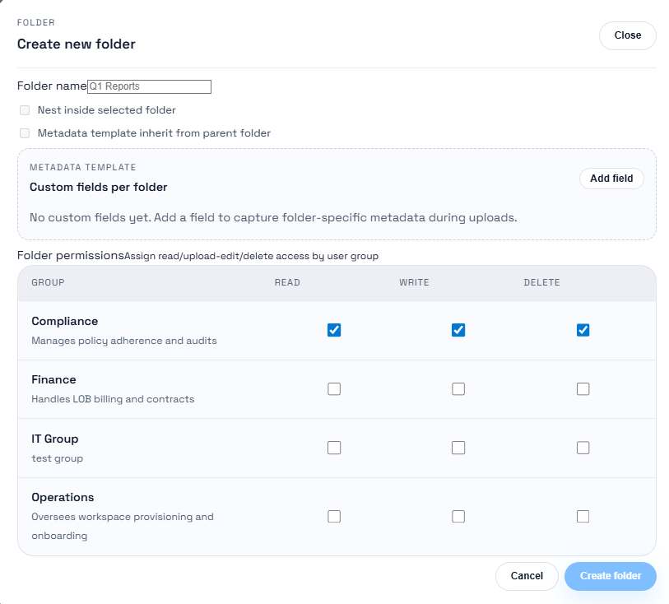
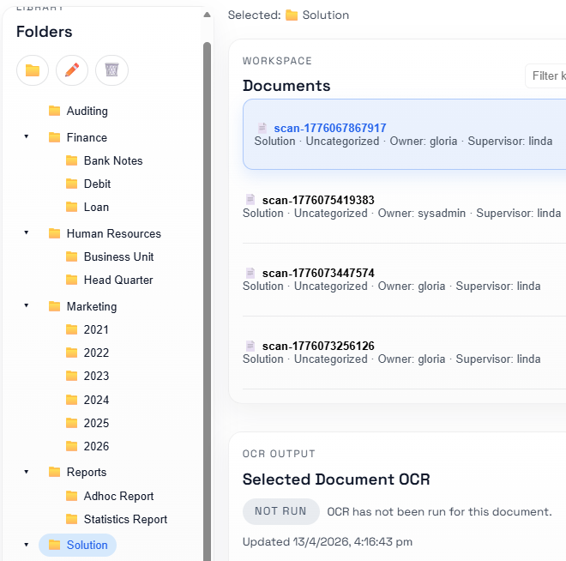
Folder Level Access Rights
Authroize read/write/delete permissions to different groups on each folder
Inherit folder security
Custom metadata for different folder
Notes:
Namespace 1: normal application without GNET/Internet traffic
Namespace 2: Service Mesh
Namespace 3: GNET outbound
Namespace 4: Internet outbound

Slide 5
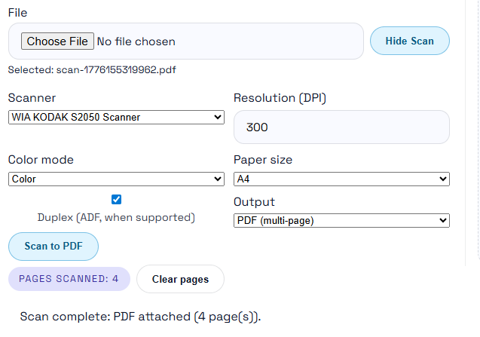
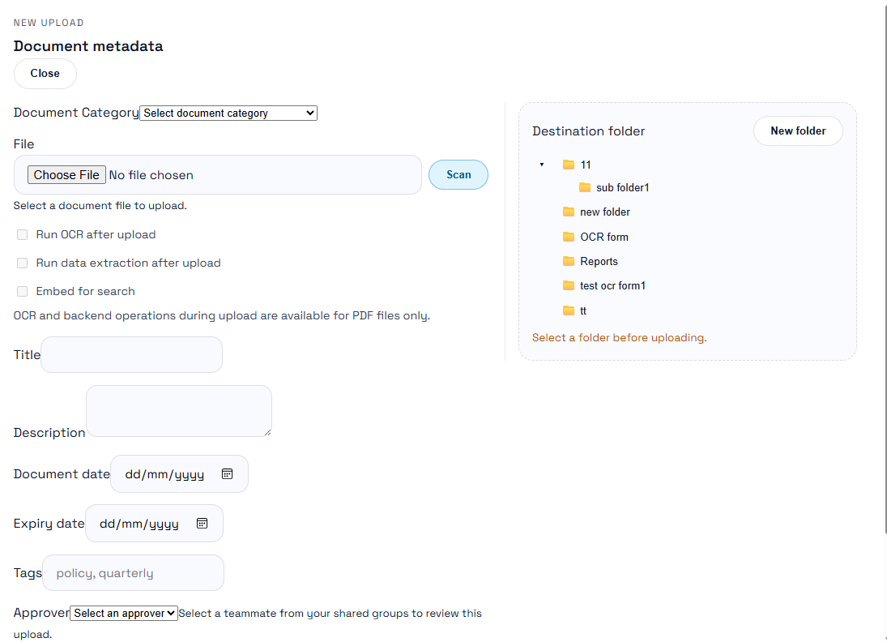
Document Upload & Scan
Support import electronic document into the system
Support scan paper files into the system
Notes:
Application Deployment
1. Build image locally with Docker
2. Push the image to Azure Registry
3. Login OpenShift with Putty, pull image from Azure Registry and push to Nexus Registry of TT (For Production, image is pull from Azure Registry to Object Storage)
4. Run OpenShift command to deploy latest image
Dockerfile: openjdk 17, nginx, tomcat

Slide 6
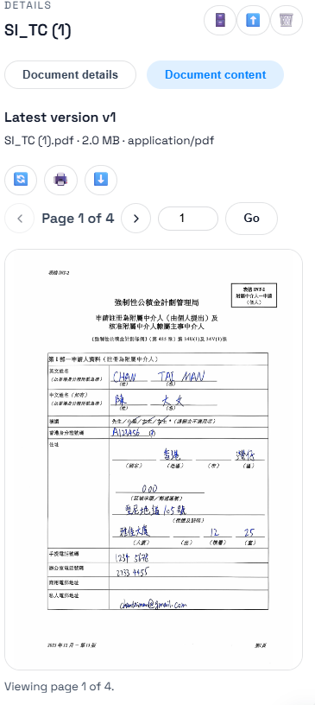
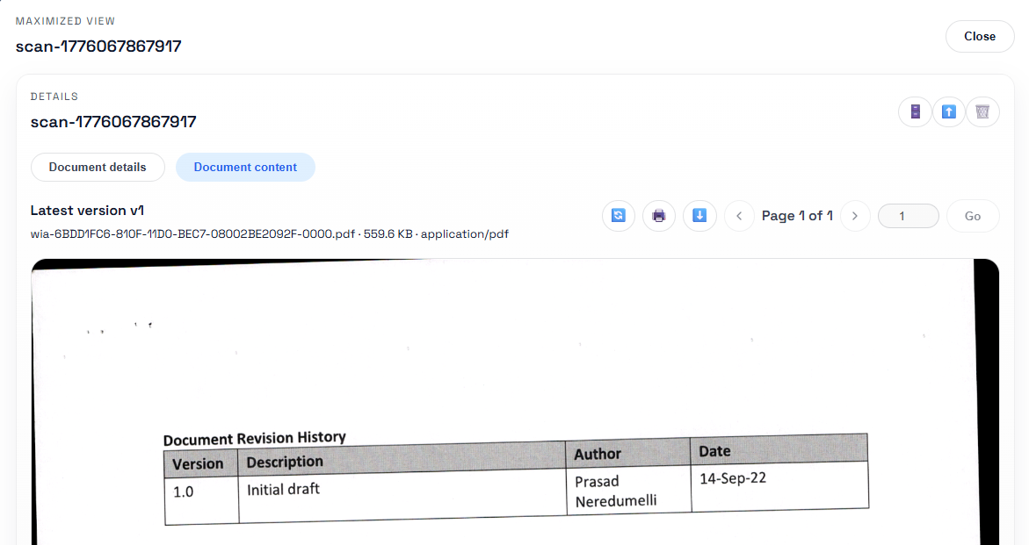
Document Online Preview
Support PDF file online preview page by page
Support Printing/Download documents with access right control
Notes:
Application Deployment
1. Build image locally with Docker
2. Push the image to Azure Registry
3. Login OpenShift with Putty, pull image from Azure Registry and push to Nexus Registry of TT (For Production, image is pull from Azure Registry to Object Storage)
4. Run OpenShift command to deploy latest image
Dockerfile: openjdk 17, nginx, tomcat

Slide 7
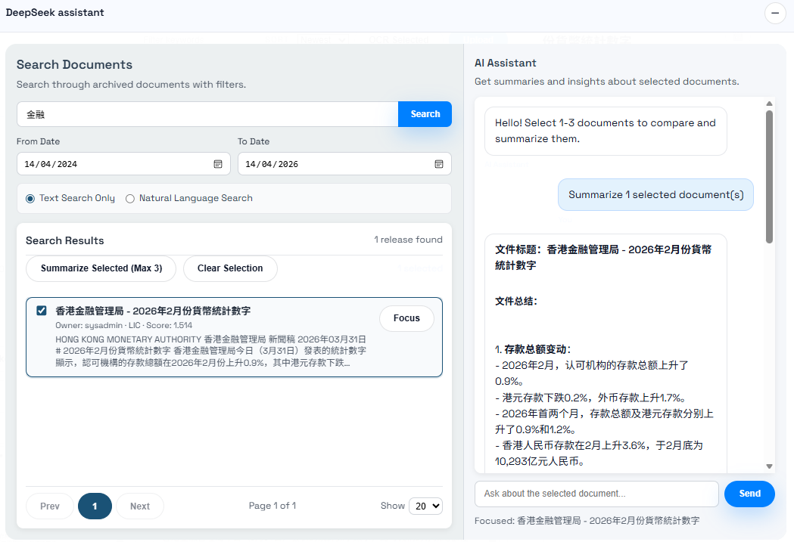
AI Assistant
Search document by AI assistant
Summary document by AI assistant
Ask anything for a document
Notes:
Application Deployment
1. Build image locally with Docker
2. Push the image to Azure Registry
3. Login OpenShift with Putty, pull image from Azure Registry and push to Nexus Registry of TT (For Production, image is pull from Azure Registry to Object Storage)
4. Run OpenShift command to deploy latest image
Dockerfile: openjdk 17, nginx, tomcat

Slide 8
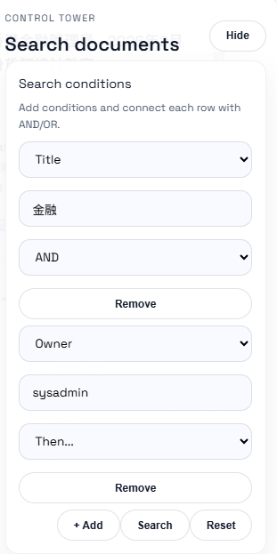
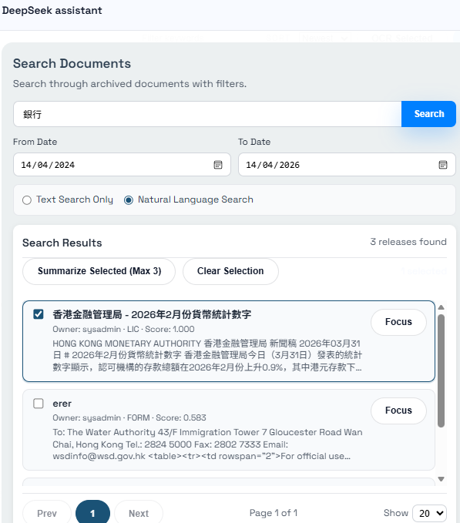
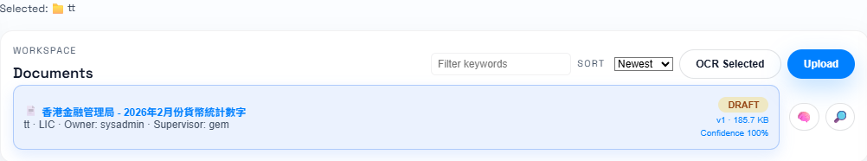
AI-powered Search Capability
Search index values of document
User can freely add conditons to search
Each condition are joint with And/Or
Search keywords in document
Exact keyword match
Patial keyword match
Use Natural Language to search document
use NLP to translate what you want
use LLM to understand the content
Notes:
Application Deployment
1. Build image locally with Docker
2. Push the image to Azure Registry
3. Login OpenShift with Putty, pull image from Azure Registry and push to Nexus Registry of TT (For Production, image is pull from Azure Registry to Object Storage)
4. Run OpenShift command to deploy latest image
Dockerfile: openjdk 17, nginx, tomcat

Slide 9
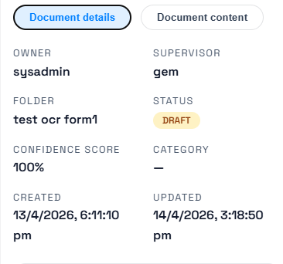
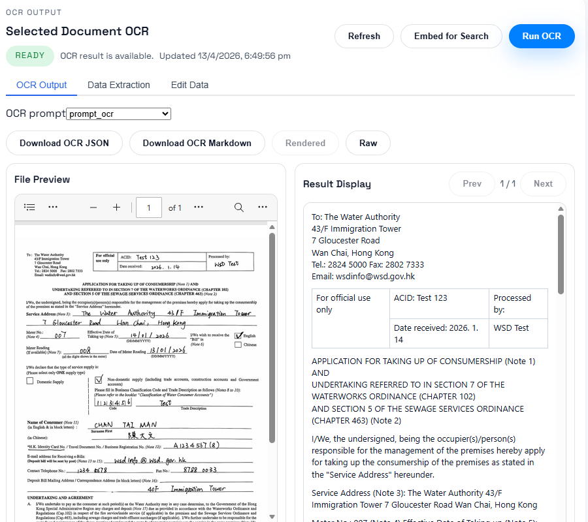
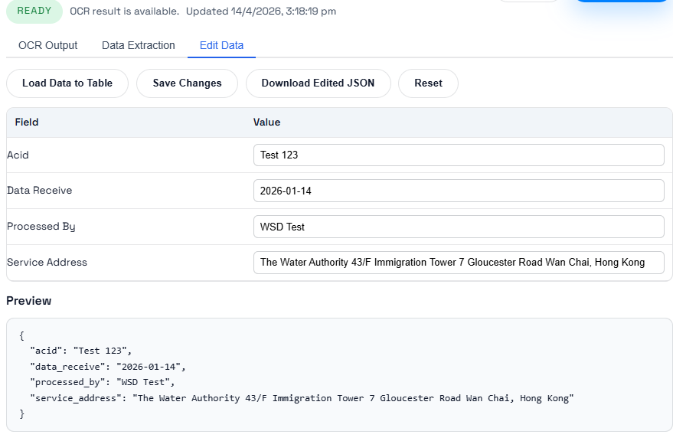
OCR and Data Extraction
English, Traditional/Simplified Chinese full text OCR
Automatically data extraction and metadata filling
Confidence Score calculation
Notes:
Application Deployment
1. Build image locally with Docker
2. Push the image to Azure Registry
3. Login OpenShift with Putty, pull image from Azure Registry and push to Nexus Registry of TT (For Production, image is pull from Azure Registry to Object Storage)
4. Run OpenShift command to deploy latest image
Dockerfile: openjdk 17, nginx, tomcat

Slide 10
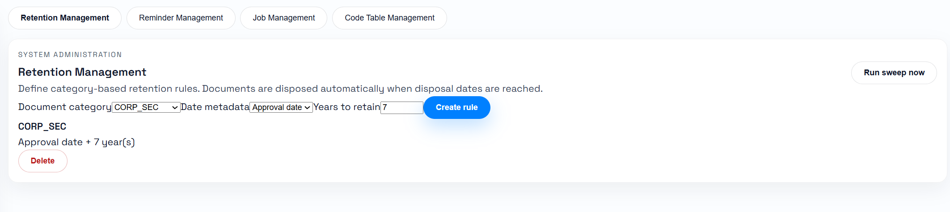
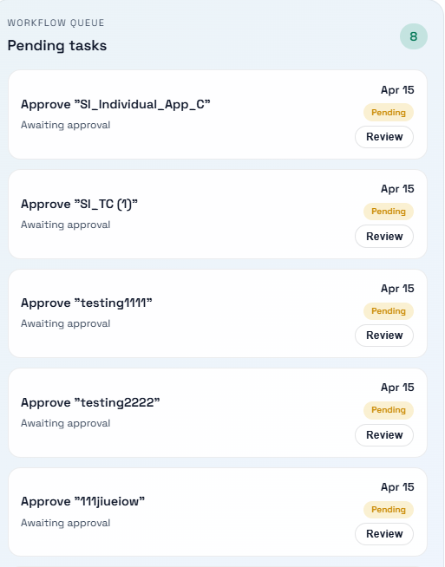
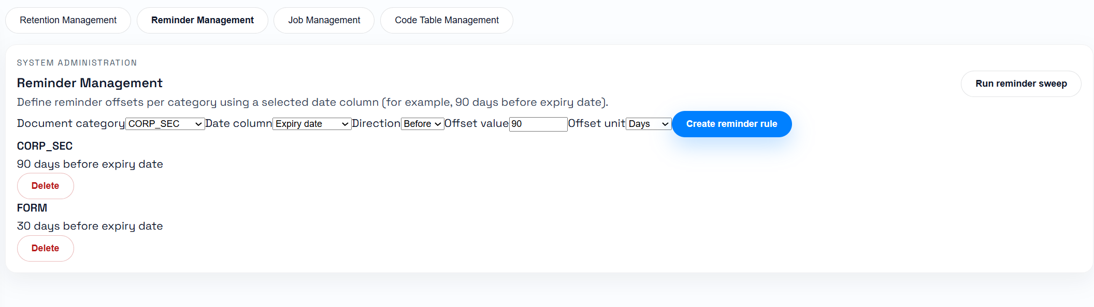
Document Collaboration
Workflow Approval
Batch processing execution regularly
Retention and Reminder
Notes:
Application Deployment
1. Build image locally with Docker
2. Push the image to Azure Registry
3. Login OpenShift with Putty, pull image from Azure Registry and push to Nexus Registry of TT (For Production, image is pull from Azure Registry to Object Storage)
4. Run OpenShift command to deploy latest image
Dockerfile: openjdk 17, nginx, tomcat

Slide 11
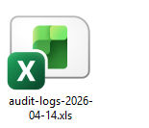
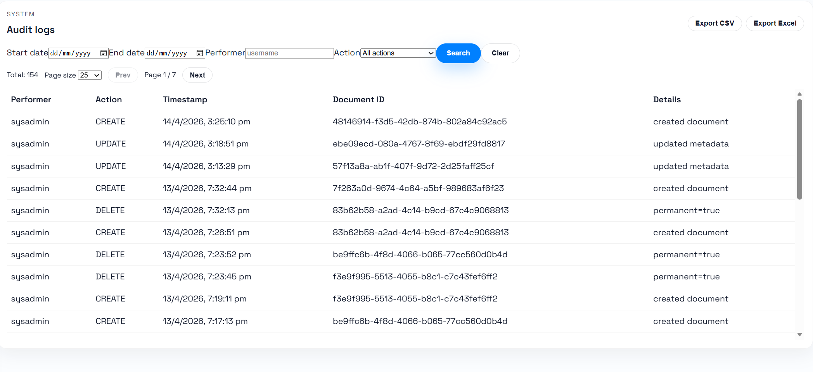
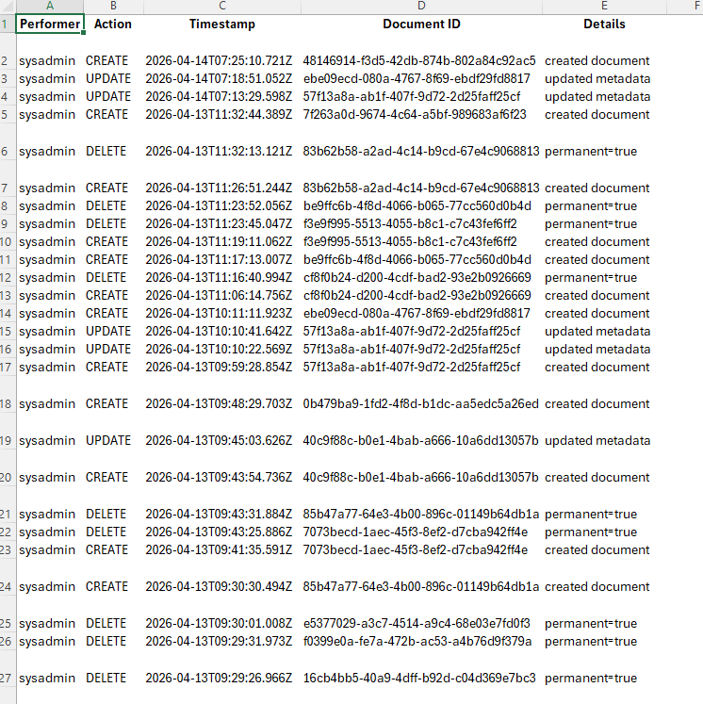
System Auditing
Role-base functionalities
Transaction based audit log (What user do during a period)
Search Audit Log
Audit log Report
Notes:
Application Deployment
1. Build image locally with Docker
2. Push the image to Azure Registry
3. Login OpenShift with Putty, pull image from Azure Registry and push to Nexus Registry of TT (For Production, image is pull from Azure Registry to Object Storage)
4. Run OpenShift command to deploy latest image
Dockerfile: openjdk 17, nginx, tomcat

Slide 12
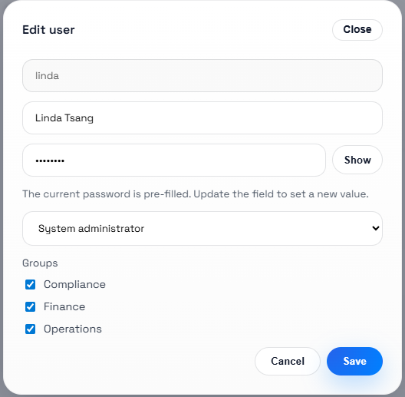
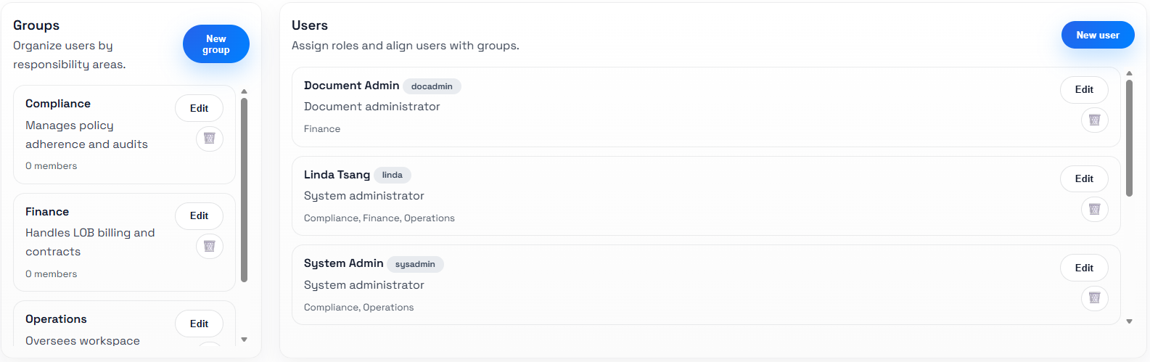
Role-based User Management
Role-base functionalities
Transaction based audit log (What user do during a period)
Search Audit Log
Audit log Report
Notes:
Application Deployment
1. Build image locally with Docker
2. Push the image to Azure Registry
3. Login OpenShift with Putty, pull image from Azure Registry and push to Nexus Registry of TT (For Production, image is pull from Azure Registry to Object Storage)
4. Run OpenShift command to deploy latest image
Dockerfile: openjdk 17, nginx, tomcat

Slide 13
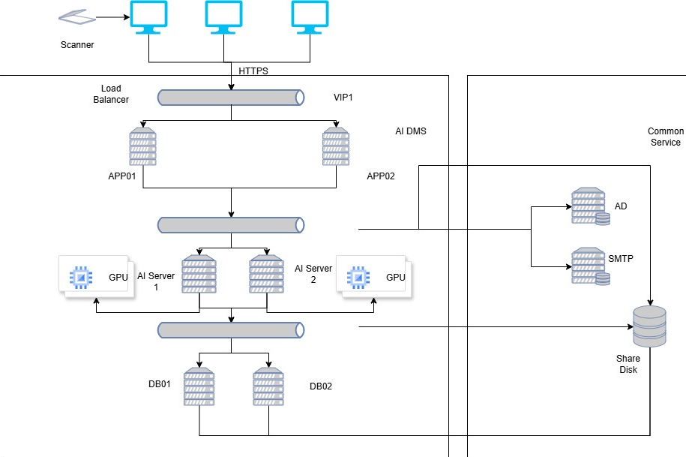
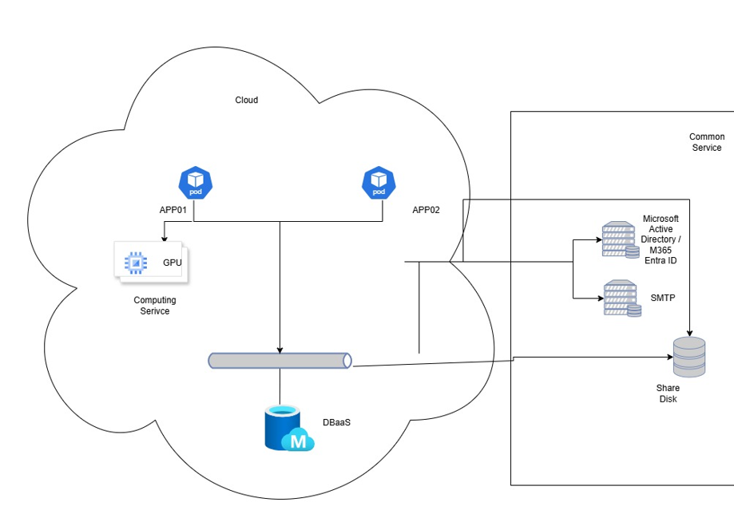
Deployment
On-premisis deploy
The solution can deploy to customer provide hardware platform.
GPU with at least 22GB vRAM is need to run AI-related function
and features.
Hybrid Cloud deploy
The solution can deploy to government cloud or other public cloud in container/K8S.
AI-powered computing subscription is need to run AI-related function and features.
Notes:
Application Deployment
1. Build image locally with Docker
2. Push the image to Azure Registry
3. Login OpenShift with Putty, pull image from Azure Registry and push to Nexus Registry of TT (For Production, image is pull from Azure Registry to Object Storage)
4. Run OpenShift command to deploy latest image
Dockerfile: openjdk 17, nginx, tomcat

Slide 14
Licensing Scheme
ASL provide 2 pricing schemes for purchasing the solution:
Perpetual License
Under perpetual license, user are not limited to named users or concurrent users. One-off implementation cost and yearly maintenance cost are need to pay.
Subscription License
Under subscription license, named users are caculated for a yearly subscription fee. There is no limited to concurrent users during the subscription period.
Notes:
Application Deployment
1. Build image locally with Docker
2. Push the image to Azure Registry
3. Login OpenShift with Putty, pull image from Azure Registry and push to Nexus Registry of TT (For Production, image is pull from Azure Registry to Object Storage)
4. Run OpenShift command to deploy latest image
Dockerfile: openjdk 17, nginx, tomcat

Slide 15
Road Map
Automated Smart ECM is a continious developing solution in enterprise-level content processing domain. We will collect user feedback and wishlist to enhance the solution.
First Launch - 2016
The basic solution of document capturing and processing
Second Release - 2020
Integrate BPM and Chatbot
Thrid Release - 2025
AI focus, NLP and LLM enhanced
Coming release - 2027
AI genertive, AI agent
Notes:
Application Deployment
1. Build image locally with Docker
2. Push the image to Azure Registry
3. Login OpenShift with Putty, pull image from Azure Registry and push to Nexus Registry of TT (For Production, image is pull from Azure Registry to Object Storage)
4. Run OpenShift command to deploy latest image
Dockerfile: openjdk 17, nginx, tomcat

Slide 16
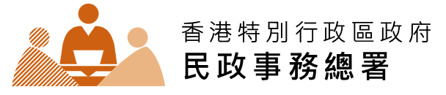






Why ASL
Plenty of project experience for customers in Government and Commercial:
Notes:
Application Deployment
1. Build image locally with Docker
2. Push the image to Azure Registry
3. Login OpenShift with Putty, pull image from Azure Registry and push to Nexus Registry of TT (For Production, image is pull from Azure Registry to Object Storage)
4. Run OpenShift command to deploy latest image
Dockerfile: openjdk 17, nginx, tomcat

Slide 17
Q & A

Slide 18
Thank you.

