Slide 1
The Presentation of Enterprise Content Management Solution
Automated Smart ECM
Presented by: ASL
March 2026

Slide 2
Major Features
DMS Functions and Features
Deployment
Licensing Scheme
Q&A

Slide 3
Major Features
OCR & Data Extraction
English, Traditional/Simplified Chinese full text OCR
Automatically data extraction and metadata filling
Confidence Score calculation
Document Collaboration
Workflow Approval
Batch processing execution regularly
Retention and Reminder
System Auditing
Role-base functionalities
Transaction based audit log (What user do during a period)
Search Audit Log
Audit log Report
Role-based User Management
Role mange functions
Group control permissions
User belongs to specific role and group(s)
Folder Level Access Rights
Authorize different folder permission to respective AD group
Custom metadata for different folder
Document Upload & Scan
Support import electronic document into the system
Support scan paper files into the system
Document Online Preview
Support PDF file online preview page by page
Support watermark
AI assistant
Search document by AI assistant
Summary document by AI assistant
AI-powered Search Capability
Search index values of document
Search keywords in document
Use Natural Language to search document

Slide 4
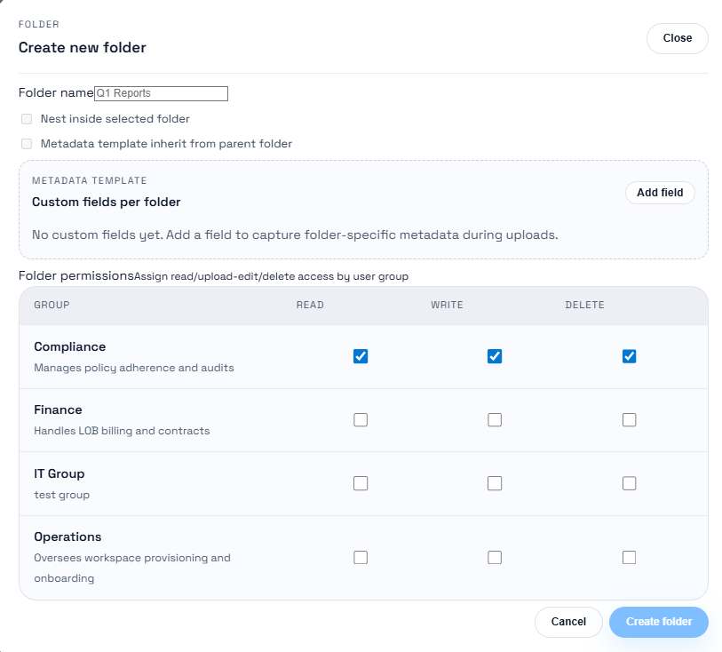
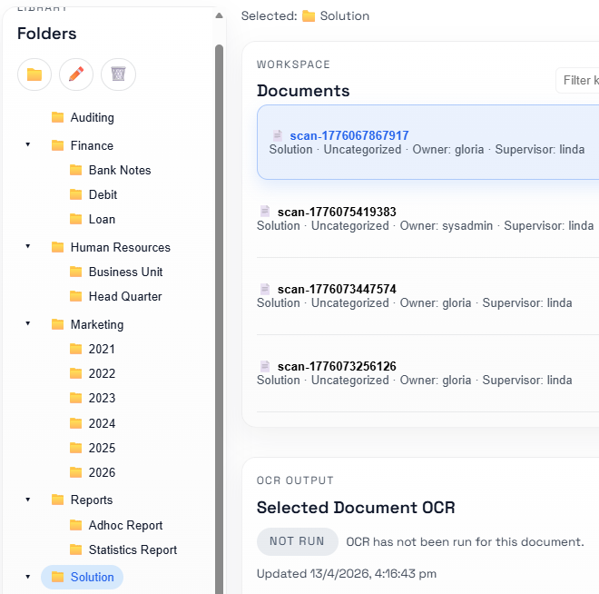
Folder Level Access Rights
Multiple layers of document folders for categorization/classification in
the database
- Categories are organised in a tree structure similar to file
systems
- User interface for navigation of the tree structure
Metadata fields are user-defined per folder
Group base folder level access control

Slide 5
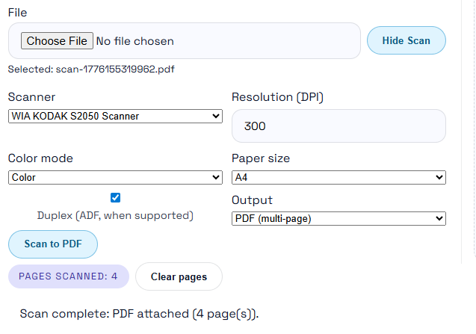
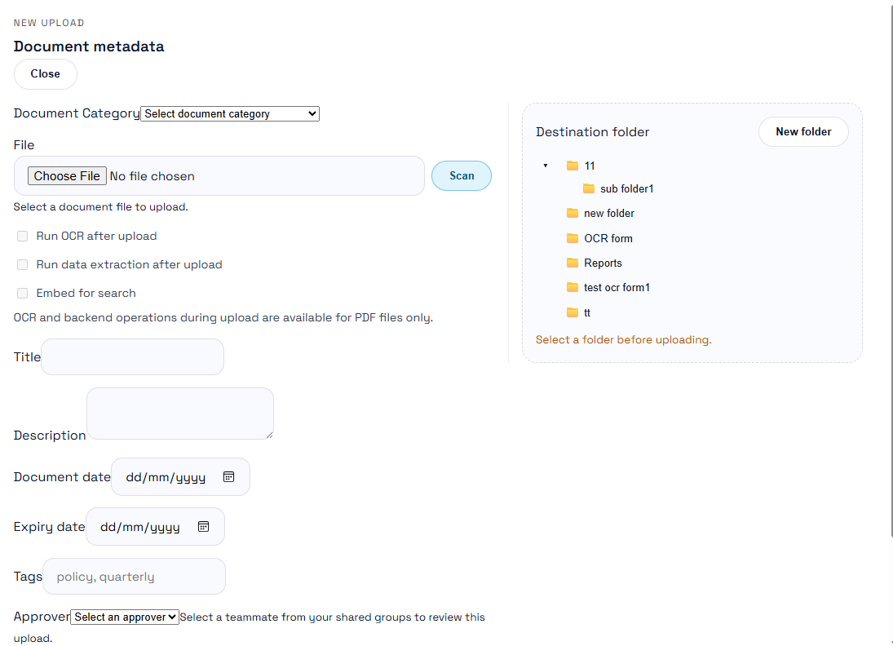
Document Upload & Scan
Documents are filed directly through scanner, or the soft copy
uploaded to the system. For softcopies, support image formats
including multi-page TIFF, PDF, and support common office
document formats including DOCX, XLSX, PPTX, etc.
Allow input of document metadata upon scanning / upload and select folder it should be filed to
Allow further tagging of documents / folders to indicate its category.
- Multiple tags may be assigned to documents and folders
- Tags should be freely input by users

Slide 6
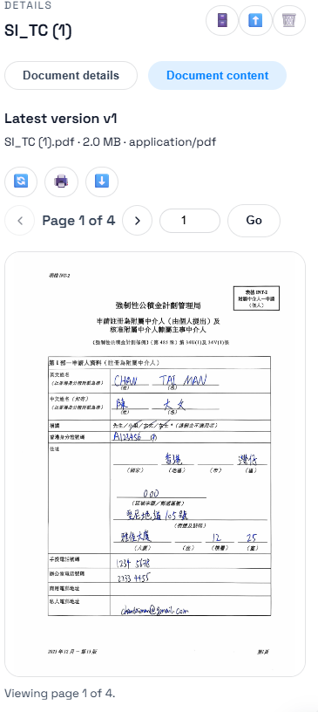
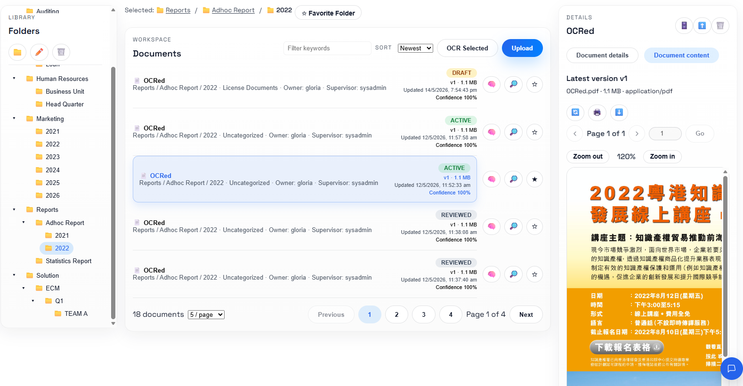
Document Online Preview
Support PDF file online preview page by page or scrolling up/down
Support Printing/Download documents with access right control
Click document from folder / search result list for showing Preview pane
Notes:
Application Deployment
1. Build image locally with Docker
2. Push the image to Azure Registry
3. Login OpenShift with Putty, pull image from Azure Registry and push to Nexus Registry of TT (For Production, image is pull from Azure Registry to Object Storage)
4. Run OpenShift command to deploy latest image
Dockerfile: openjdk 17, nginx, tomcat

Slide 7
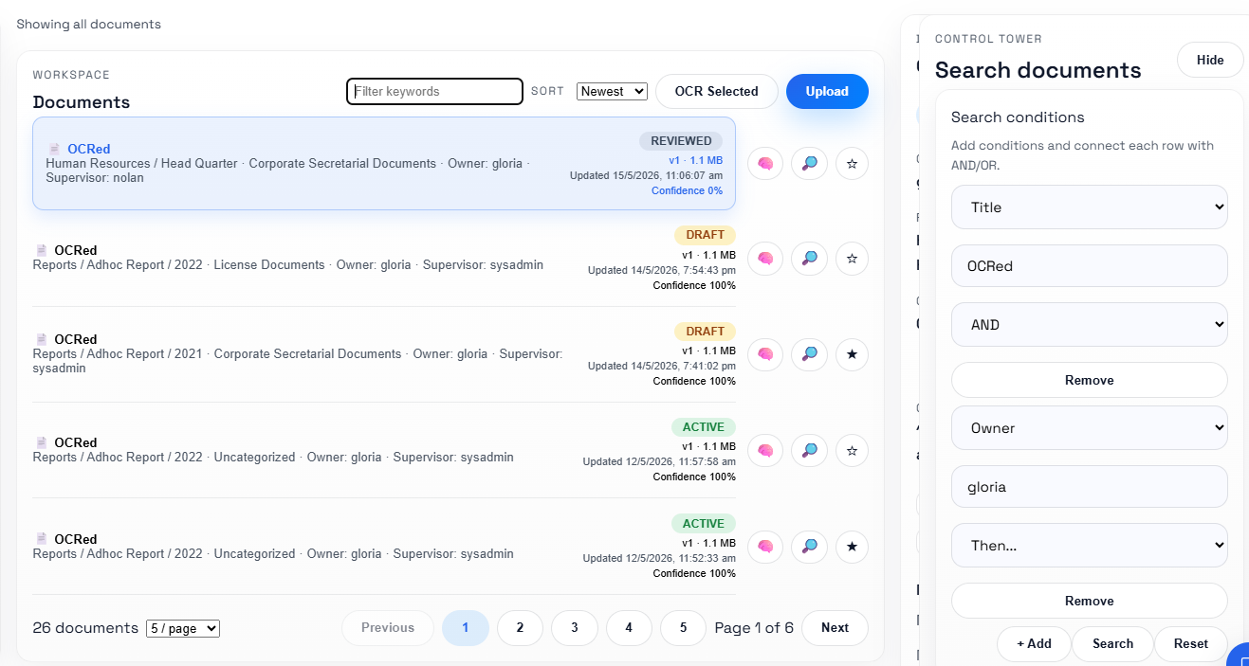
Basic Search
Conventional search engine for documents including
- By exact or partial keywords match, date range, category and metadata fields
- Combination search (and/or) are supported
Search within search results
- Allow further narrow down of search result by providing additional keywords
- Sorting and filtering of search results
Notes:
Application Deployment
1. Build image locally with Docker
2. Push the image to Azure Registry
3. Login OpenShift with Putty, pull image from Azure Registry and push to Nexus Registry of TT (For Production, image is pull from Azure Registry to Object Storage)
4. Run OpenShift command to deploy latest image
Dockerfile: openjdk 17, nginx, tomcat

Slide 8
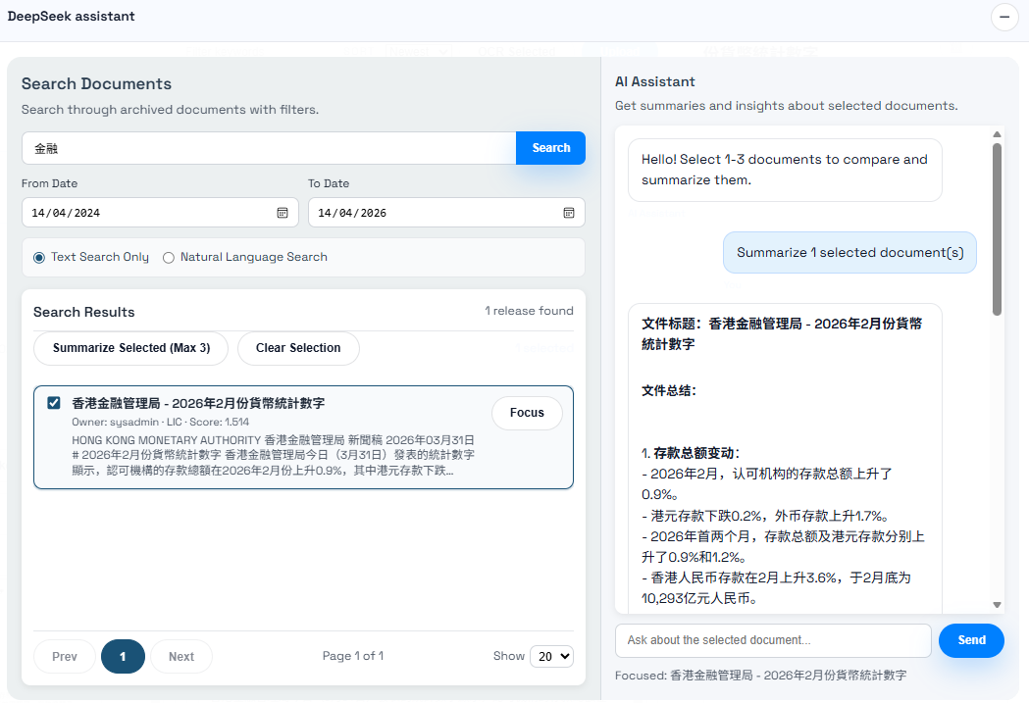
AI Assistant
Search document by AI assistant
Summary document by AI assistant
Ask anything for a document

Slide 9
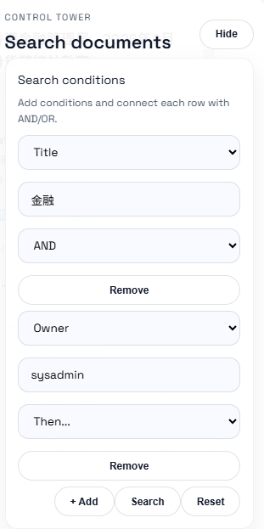
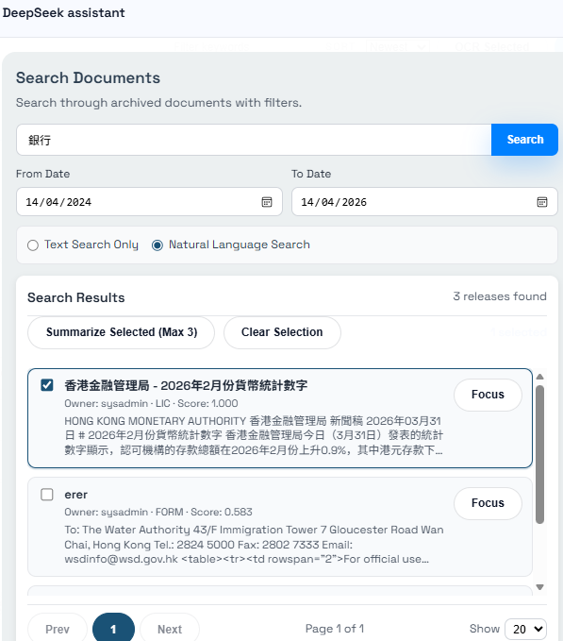
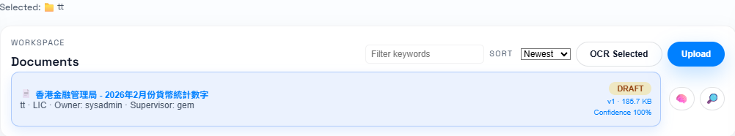
AI-powered Search Capability
Search index values of document
User can freely add conditons to search
Each condition are joint with And/Or
Search keywords in document
Exact keyword match
Patial keyword match
Use Natural Language to search document
use NLP to translate what you want
use LLM to understand the content

Slide 10
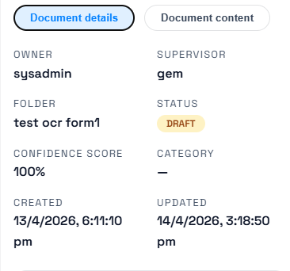
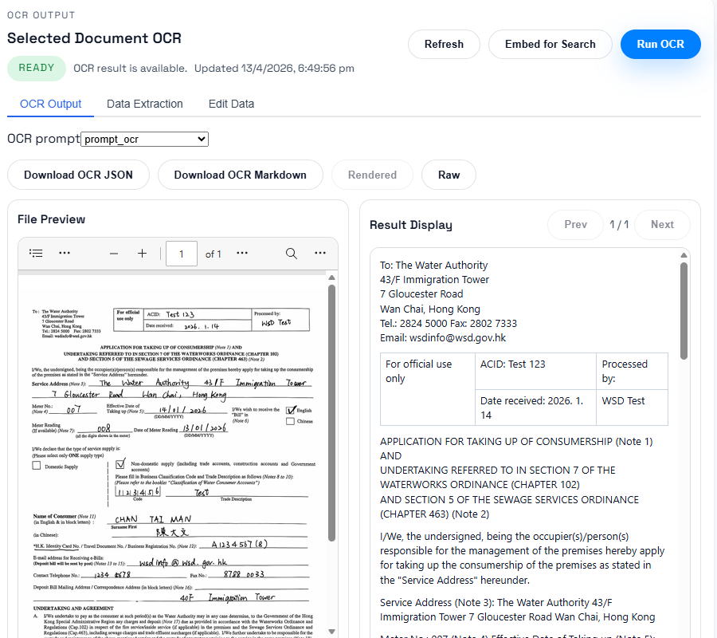
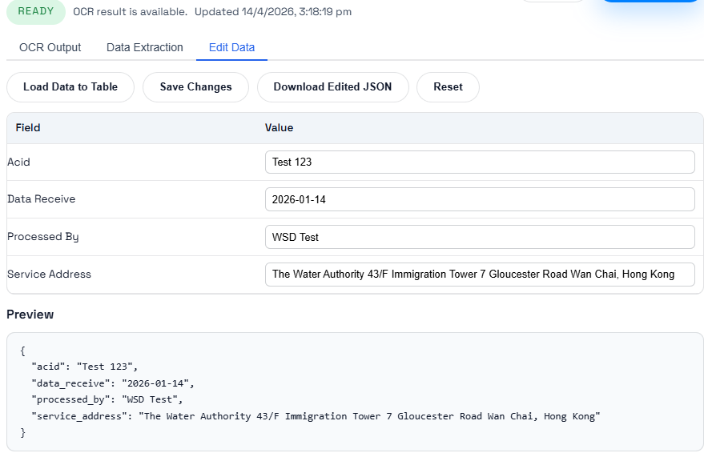
OCR and Data Extraction
English, Traditional/Simplified Chinese full text OCR
Automatically data extraction and metadata filling
Confidence Score calculation

Slide 11
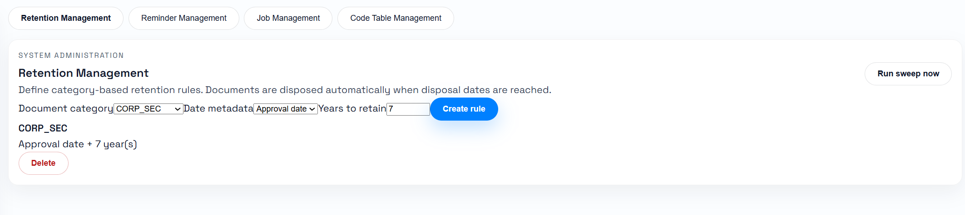
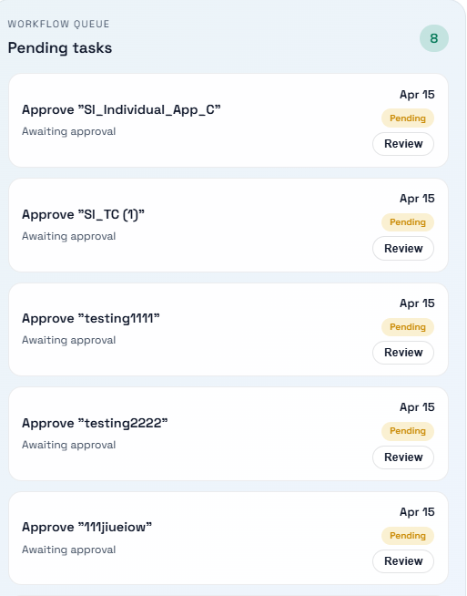
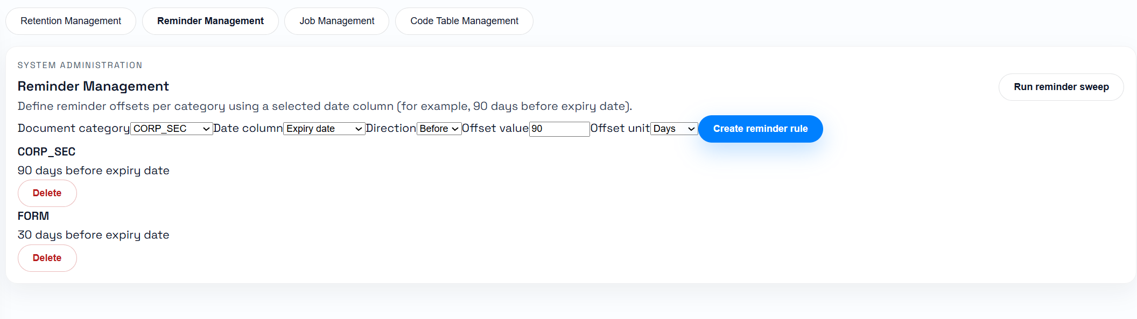
Document Collaboration
Workflow Approval
Batch processing execution regularly
Retention and Reminder

Slide 12
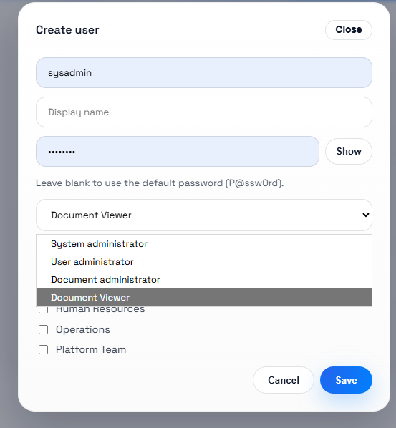
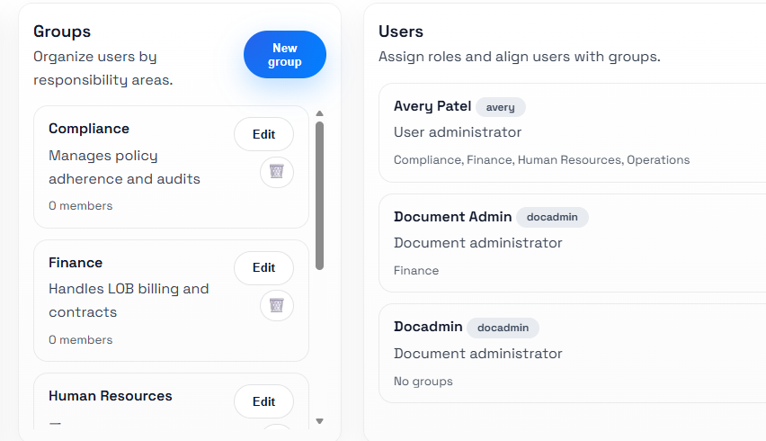
User, Roles and Groups
Fine-grained access control for each folder at every level
- Users assigned to one or more user group
- Group based access control
- Role based (administrator, editor, reader)
- Inherited or specific access rights of folder

Slide 13
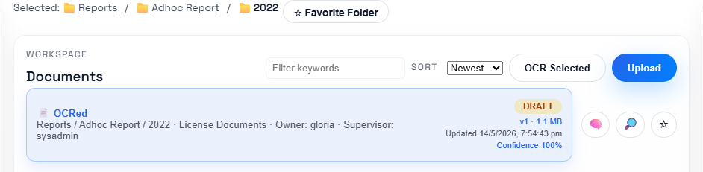
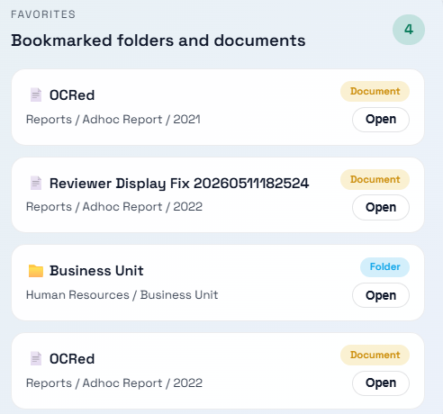
Favorite Folders and Documents
User can define their own bookmarks to certain folder for quick access of frequently used folders / documents
Add personnal Favorite Folder/Document
Quick Access of bookmarked folders and documents in each user’s dashboard

Slide 14
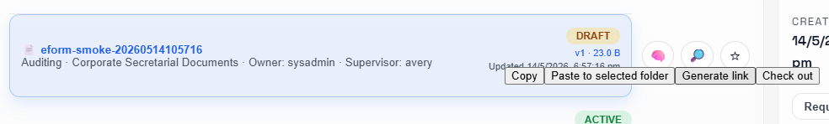
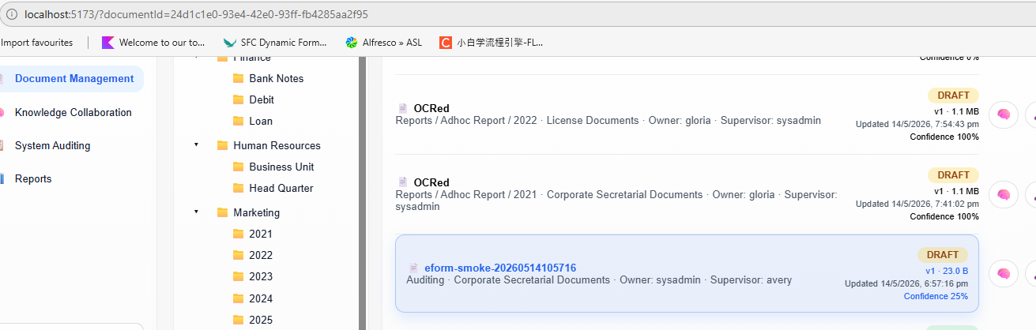
Quick Link of document accessing
User can generate a link for each document and share to another user for quick access
The document can be easily found by pasting the link into browser under access right control

Slide 15
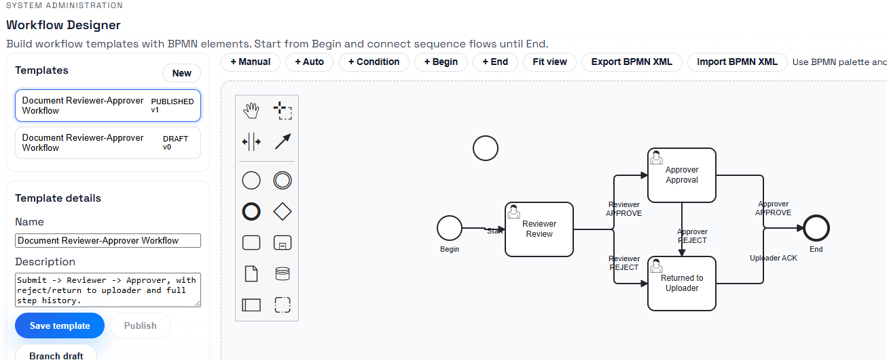
Workflow Designer
On-demand drag & drop approval workflow designing

Slide 16
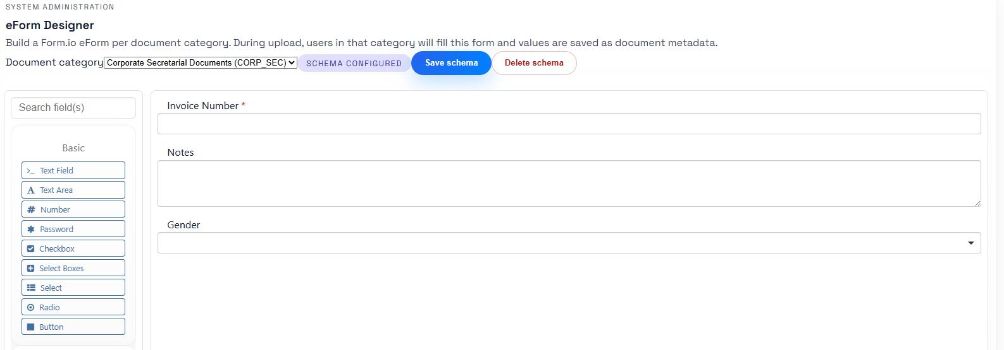
Form Designer
On-demand drag & drop form designer for each document category

Slide 17
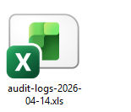
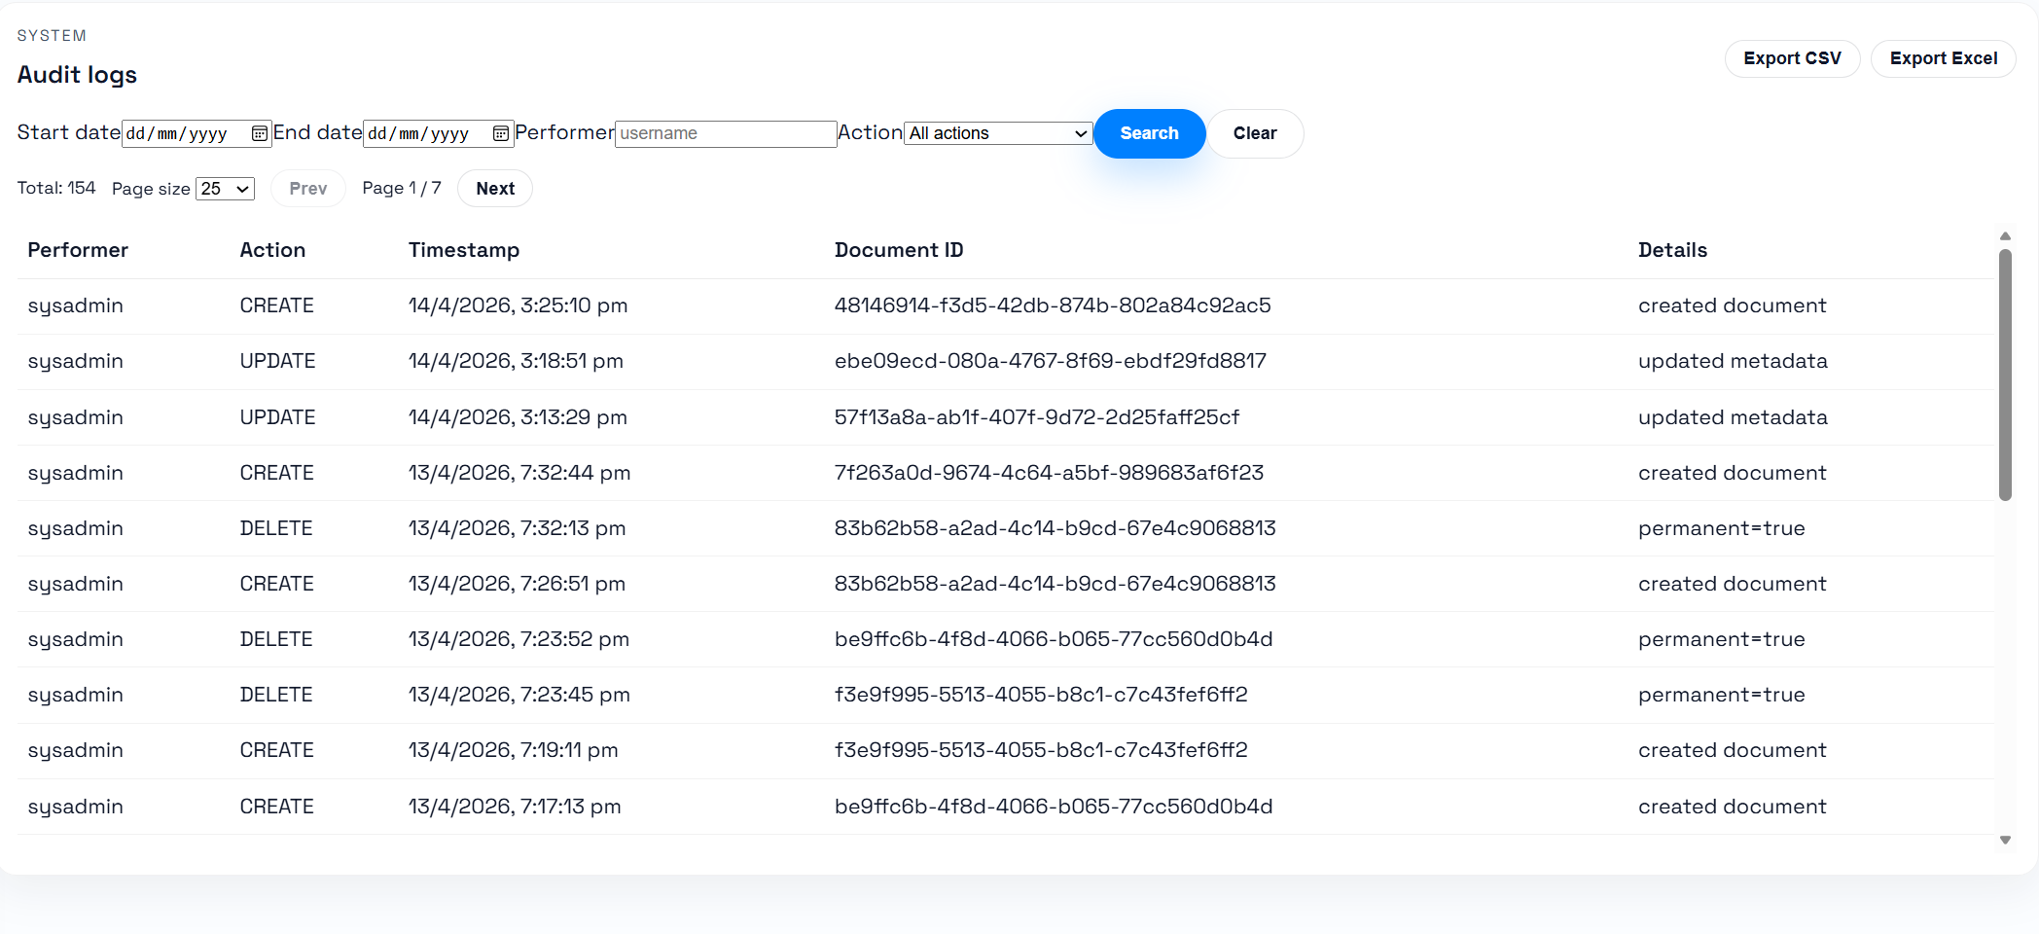
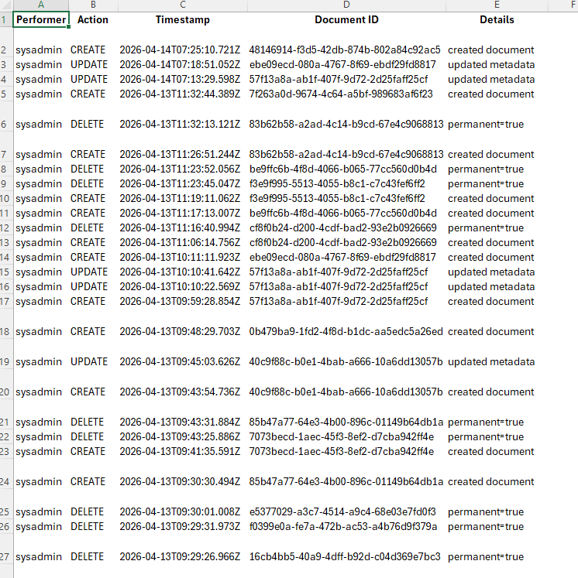
System Auditing
Role-base functionalities
Transaction based audit log (What user do during a period)
Search Audit Log
Audit log Report

Slide 18
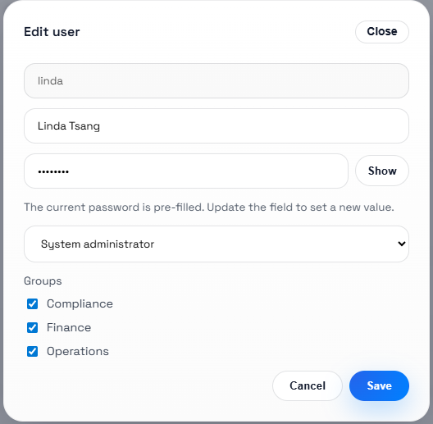
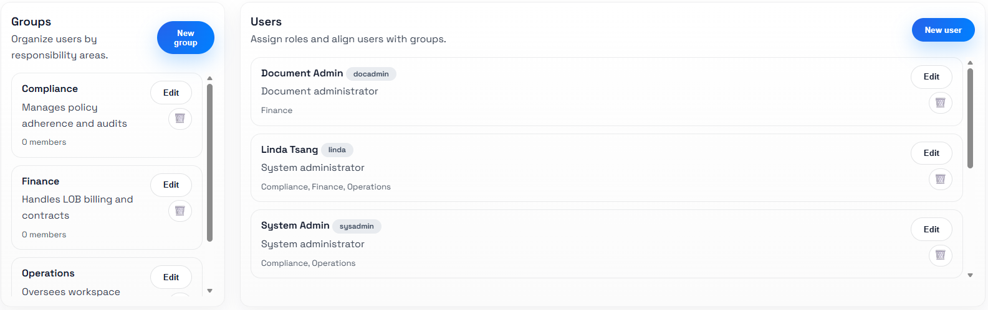
Role-based User Management
Role-base functionalities
Transaction based audit log (What user do during a period)
Search Audit Log
Audit log Report

Slide 19
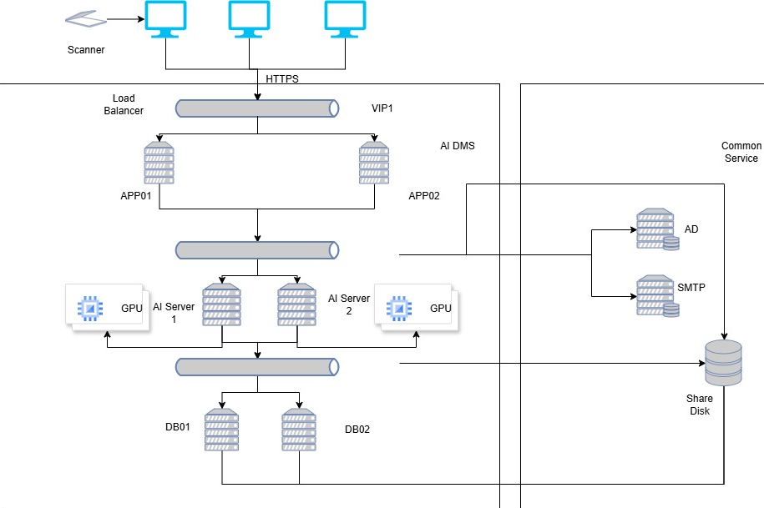
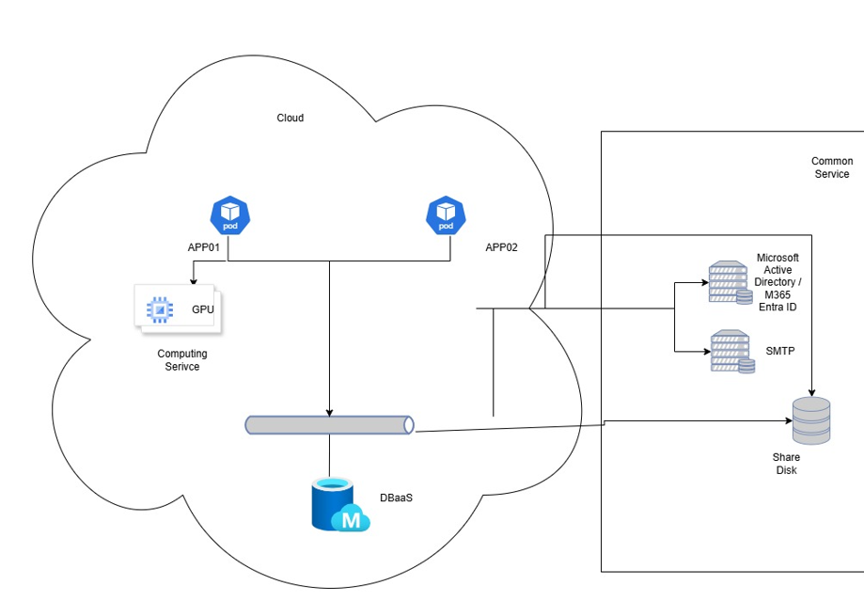
Deployment
On-premisis deploy
The solution can deploy to customer provide hardware platform.
GPU with at least 24GB vRAM is need to run AI-related function
and features.
Hybrid Cloud deploy
The solution can deploy to government cloud or other public cloud in container/K8S.
AI-powered computing subscription is need to run AI-related function and features.

Slide 20
Licensing Scheme
ASL provide 2 pricing schemes for purchasing the solution:
Perpetual License
Under perpetual license, user are not limited to named users or concurrent users. One-off implementation cost and yearly maintenance cost are need to pay.
Subscription License
Under subscription license, named users are caculated for a yearly subscription fee. There is no limited to concurrent users during the subscription period.

Slide 21
Q & A

Slide 22
Thank you.

