Slide 1
The Presentation of Enterprise Content Management Solution
Automated Smart ECM
Presented by: ASL
Apr 2026

Slide 2
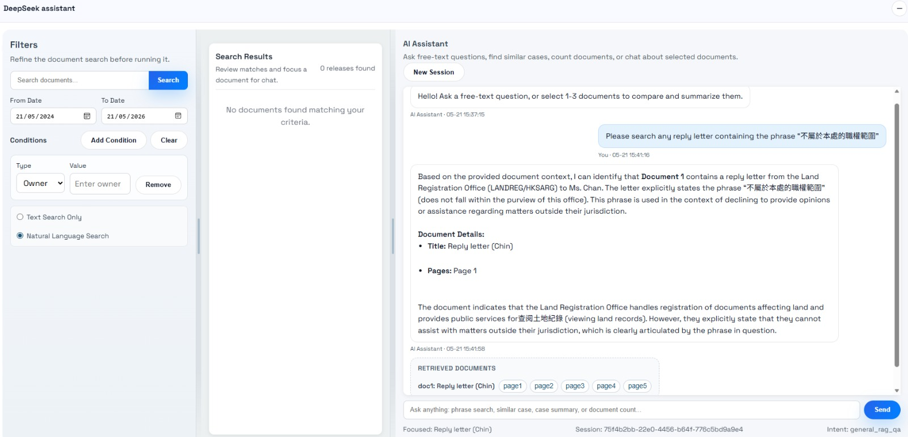
Scenario 1
Search a specific document category with exact keyword
Notes:
Namespace 1: normal application without GNET/Internet traffic
Namespace 2: Service Mesh
Namespace 3: GNET outbound
Namespace 4: Internet outbound

Slide 3
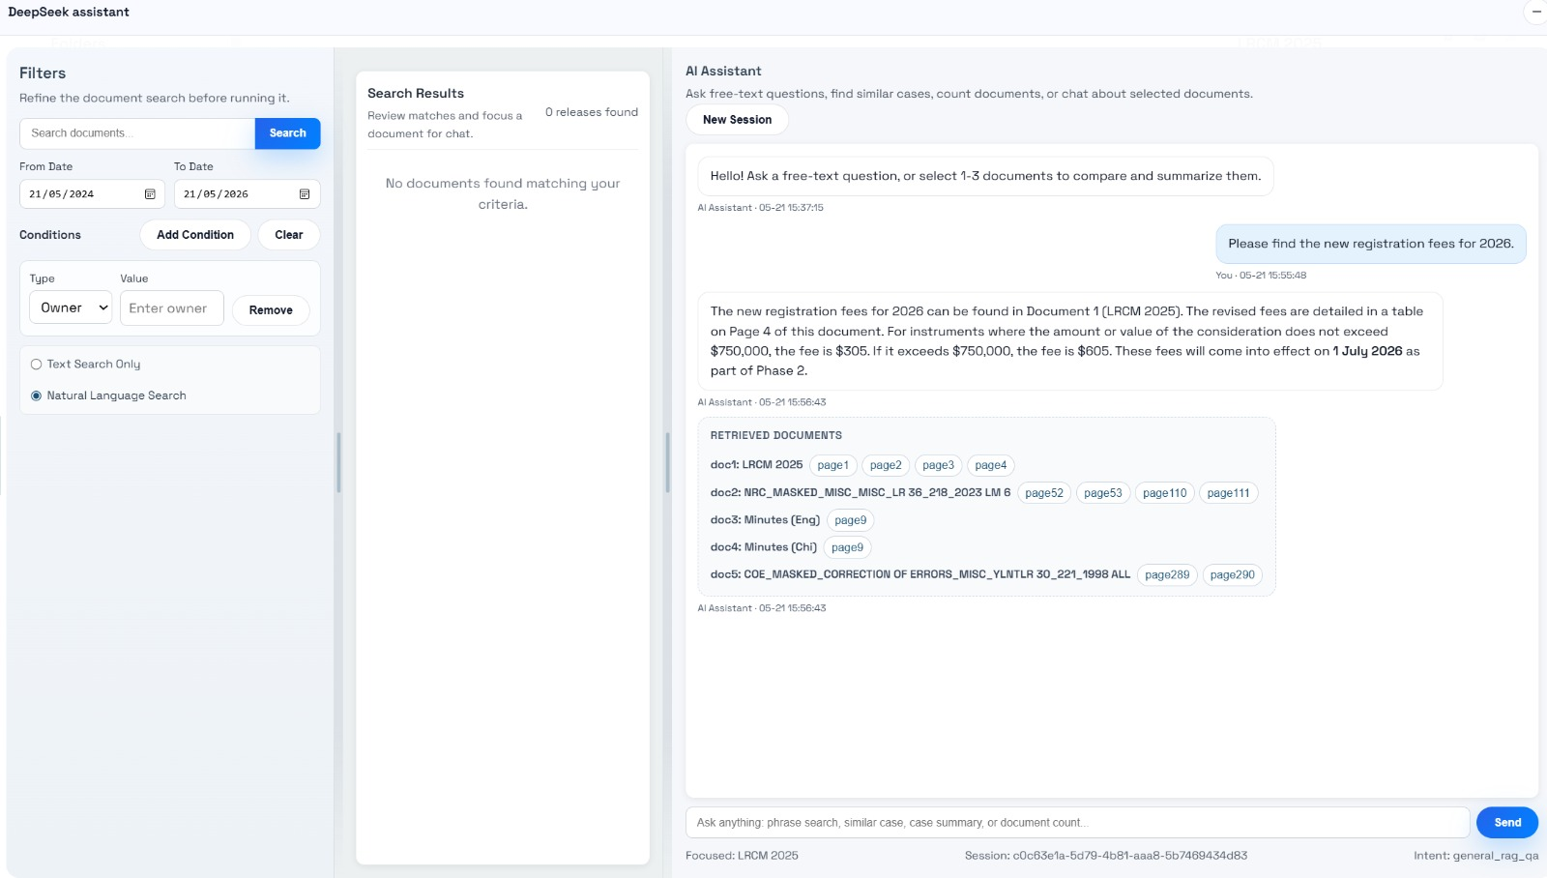
Scenario 2
Search a specific document category with date range condition
Notes:
Namespace 1: normal application without GNET/Internet traffic
Namespace 2: Service Mesh
Namespace 3: GNET outbound
Namespace 4: Internet outbound

Slide 4
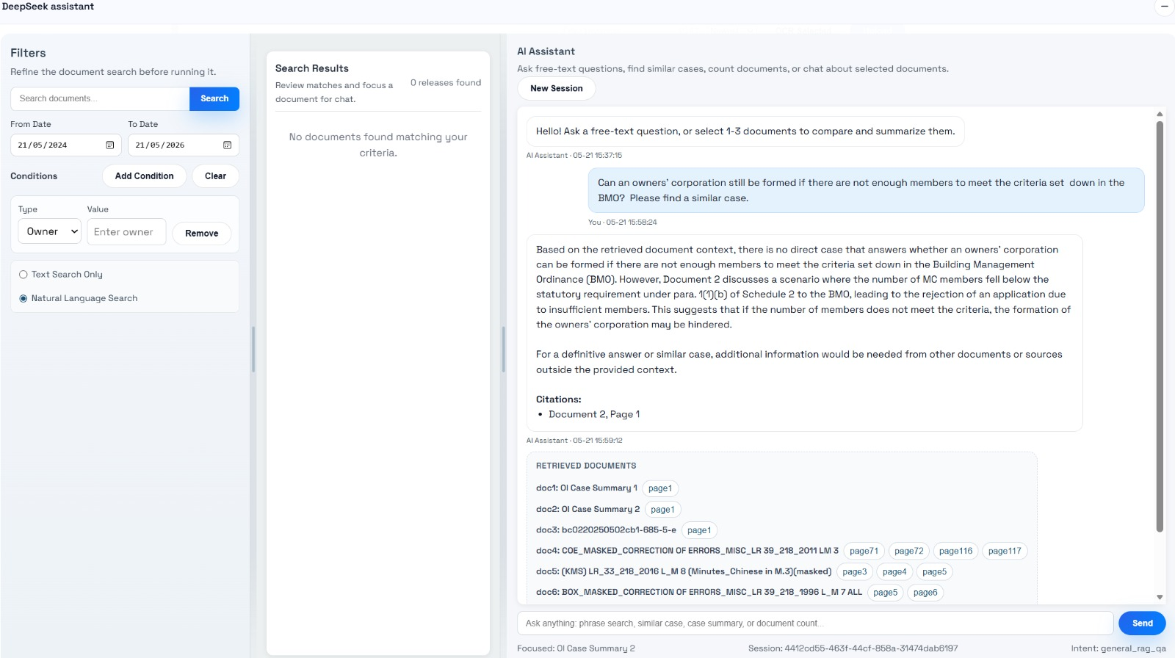
Scenario 3
Find similar case
Notes:
Namespace 1: normal application without GNET/Internet traffic
Namespace 2: Service Mesh
Namespace 3: GNET outbound
Namespace 4: Internet outbound

Slide 5
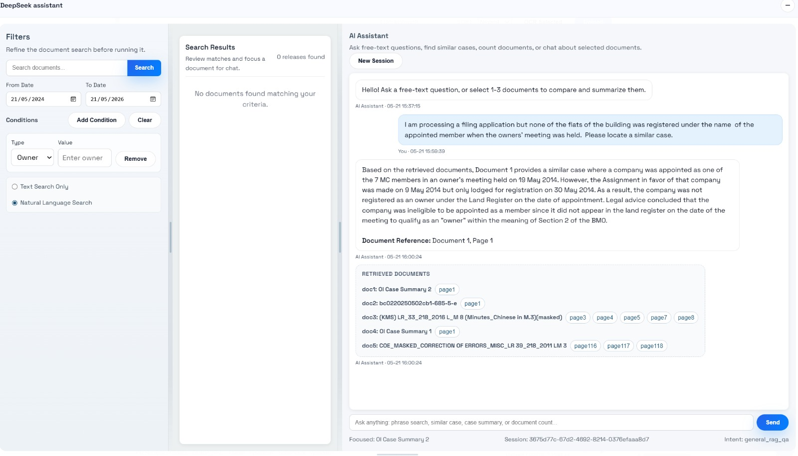
Scenario 4
Find similar case according to prompt
Notes:
Namespace 1: normal application without GNET/Internet traffic
Namespace 2: Service Mesh
Namespace 3: GNET outbound
Namespace 4: Internet outbound

Slide 6
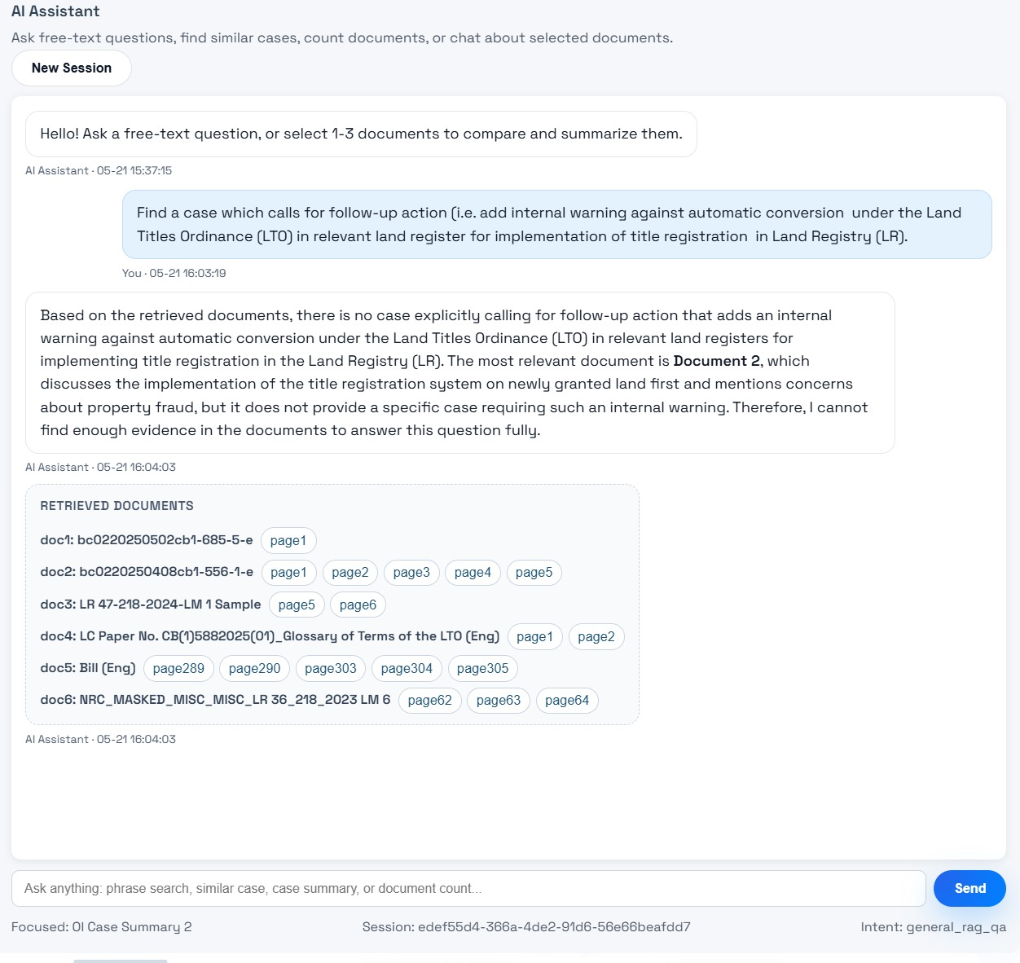
Scenario 5
AI assisting decision making
Notes:
Namespace 1: normal application without GNET/Internet traffic
Namespace 2: Service Mesh
Namespace 3: GNET outbound
Namespace 4: Internet outbound

Slide 7
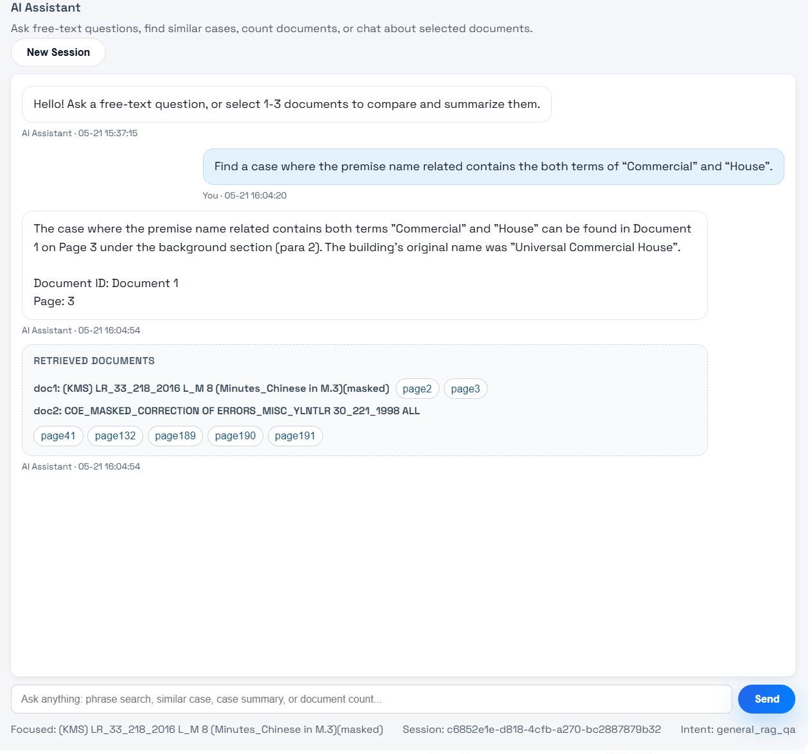
Scenario 6
Complex condition search
Notes:
Namespace 1: normal application without GNET/Internet traffic
Namespace 2: Service Mesh
Namespace 3: GNET outbound
Namespace 4: Internet outbound

Slide 8
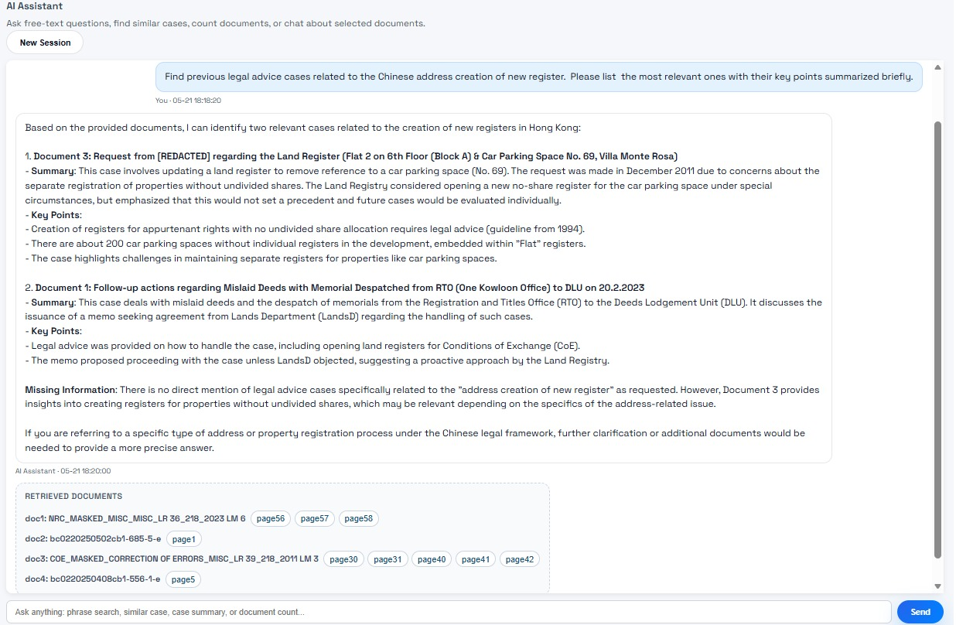
Scenario 7
Find and summarize document
Notes:
Namespace 1: normal application without GNET/Internet traffic
Namespace 2: Service Mesh
Namespace 3: GNET outbound
Namespace 4: Internet outbound

Slide 9
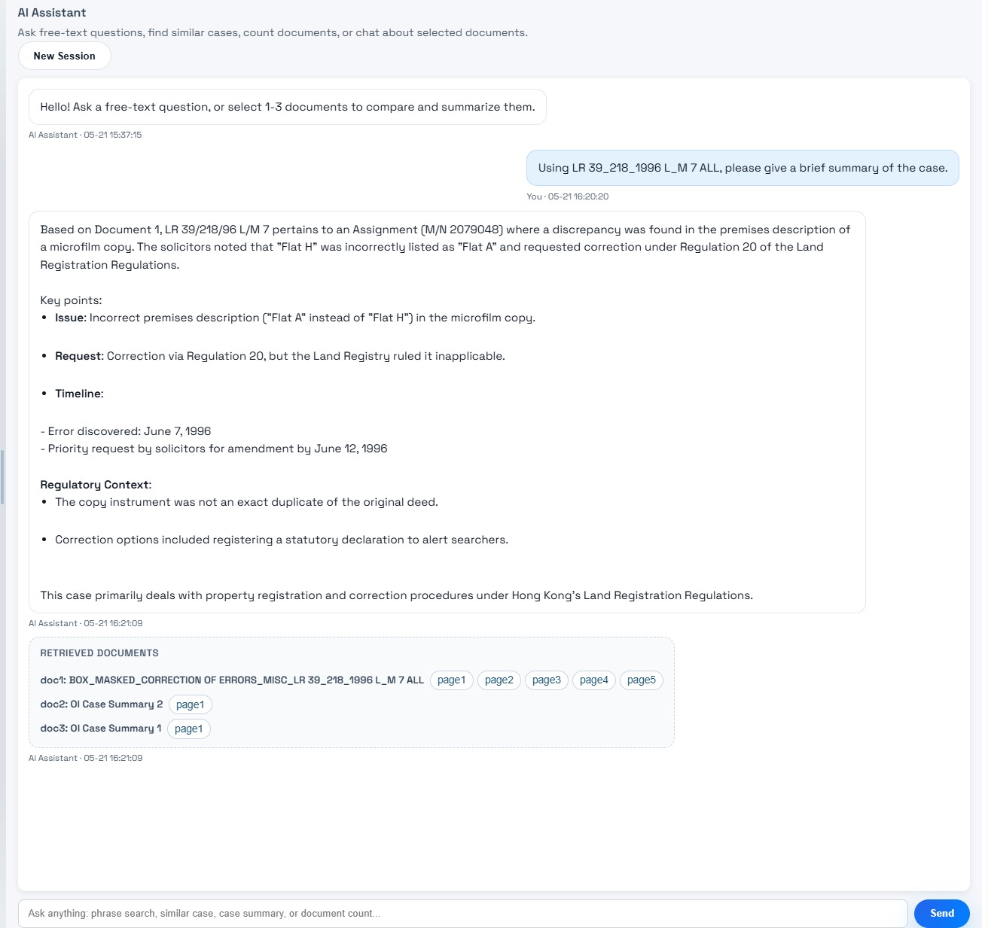
Scenario 8
Find and summarize a document
Notes:
Namespace 1: normal application without GNET/Internet traffic
Namespace 2: Service Mesh
Namespace 3: GNET outbound
Namespace 4: Internet outbound

Slide 10
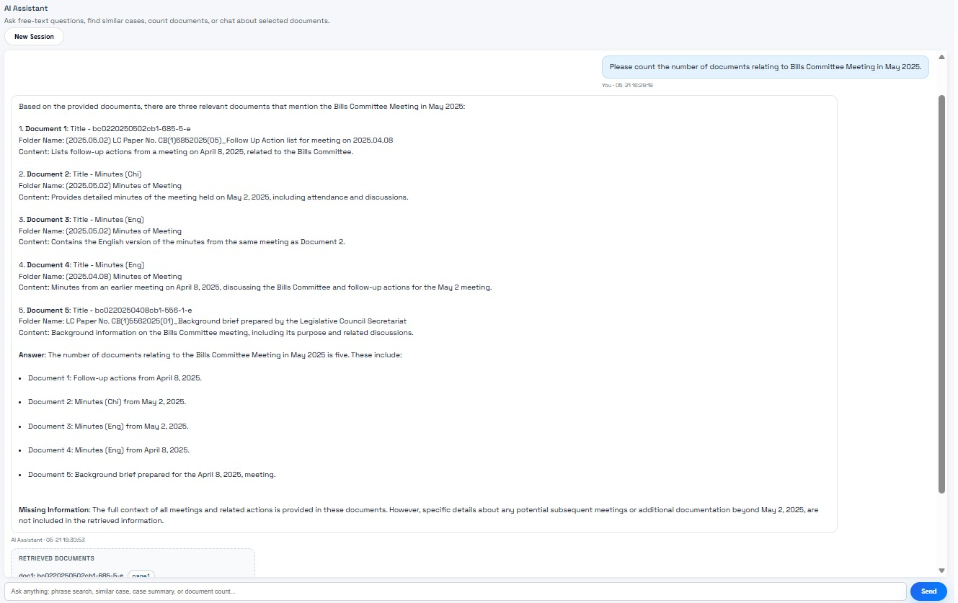
Scenario 9
Count the number of documents
Notes:
Namespace 1: normal application without GNET/Internet traffic
Namespace 2: Service Mesh
Namespace 3: GNET outbound
Namespace 4: Internet outbound

Slide 11
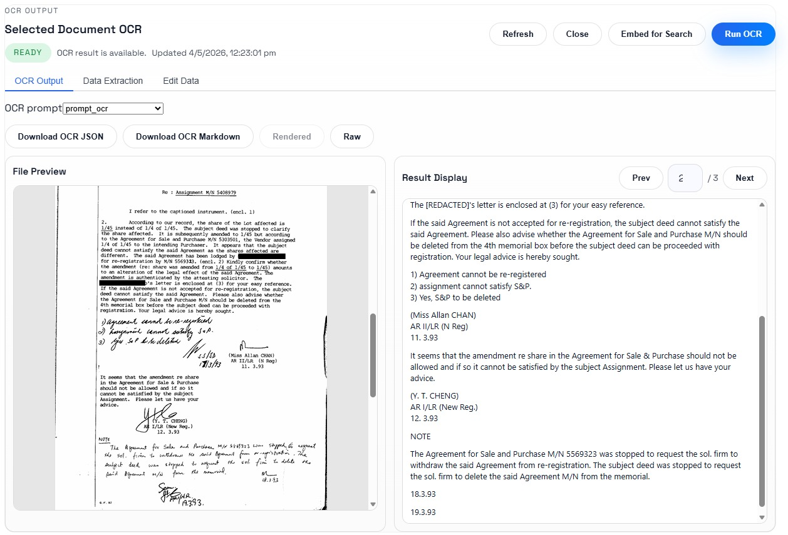
Scenario 10
OCR capabilities to extract the field contents (including those handwritten ones) shown on the document (e.g. form) after scanning
Notes:
Namespace 1: normal application without GNET/Internet traffic
Namespace 2: Service Mesh
Namespace 3: GNET outbound
Namespace 4: Internet outbound

Slide 12
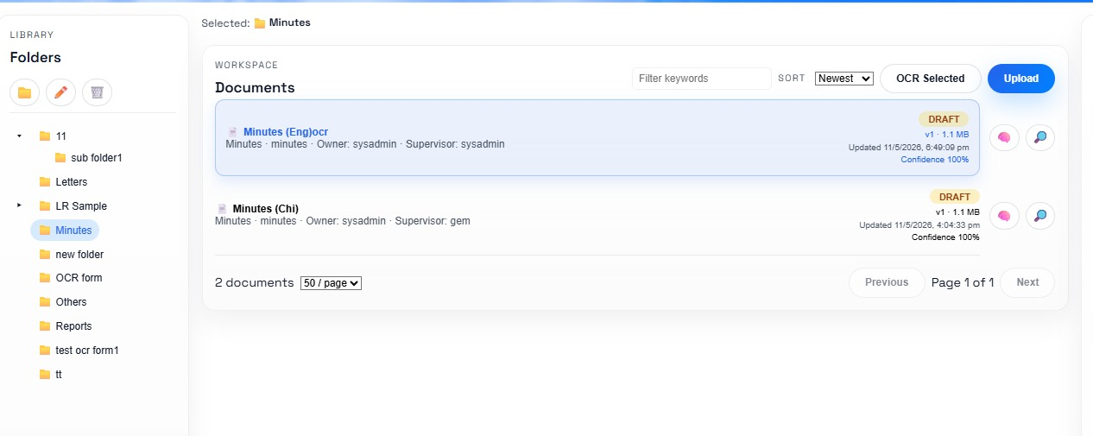
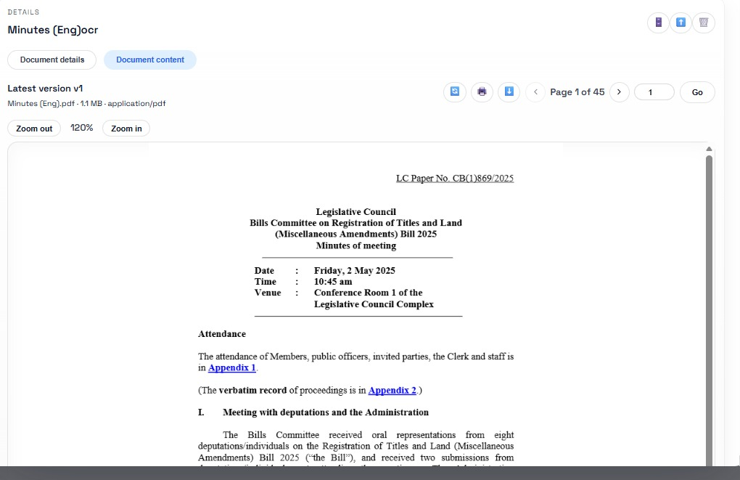
Scenario 11
Correct filing of the uploaded documents to the designated folder.
The system will file the document to correct folder according to the OCRed content
Notes:
Namespace 1: normal application without GNET/Internet traffic
Namespace 2: Service Mesh
Namespace 3: GNET outbound
Namespace 4: Internet outbound

Slide 13
Thank you.

