Slide 1
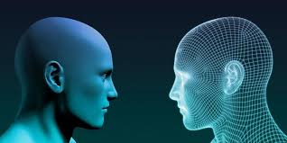
NLPAI GENERATED TEXT DETECTION
TITLE

Slide 2
OVERVIEW
This project aims to detect AI-generated academic content.
The model is trained to classify text as either human-written or AI-generated using several machine learning technique.

Slide 3
BUSINESS UNDERSTANDING
As more AI-powered tools that can produce essays, reports, and other academic content become available, students might be employing these technologies to do their assignments.
While in some situations AI can improve learning, when these tools are abused for academic dishonesty, the educational process is compromised. Schools must recognize assignments that were created by AI instead of by students in order to protect academic integrity.

Slide 4
DATA UNDERSTANDING
This dataset is sourced from Github.
The dataset comprises text samples categorized as AI-generated or human-written.

Slide 5
RESULTS
The models demonstrated impressive accuracy rate of 0.9793, effectively distinguishing between human-written and AI-generated text.
The project reported key metrics which are :
Precision = 0.9848
Recall = 0.9738
indicating strong model performance.

Slide 6
RECOMMENDATIONS
Use of softcopy which will enable easier detection of human-written or AI-generated content.
Install the software so that it can detect human-written or AI-generated content.

Slide 7
NEXT STEPS
User Interface Development:
Create a user-friendly interface for end-users to easily access and utilize the text detection features.
Ongoing Evaluation:
Regularly update the model based on new text generation techniques to maintain effectiveness.
User Testing:
Conduct extensive user testing to gather insights and optimize the application.

