Slide 1

SMART INDIA HACKATHON 2026
IDEA SUBMISSION
Problem Statement ID SIH26002
Problem Statement AI-Based Smart Logistics and Accessibility Intelligence Platform for the North Eastern Region
Theme Smart Automation | MDoNER
PS Category Software
Team ID <your team ID>
Team Name <your registered team name>
Notes:
Start with the place, not the software. Nobody in the room has driven these roads.
Say: the eight North Eastern states are joined to the rest of India by one
strip of land about 22 km wide, near Siliguri. The highways are mostly single
lane and they run through hills that slide. Assam floods every year. And for
four months of the year the monsoon shuts the roads that the other eight months
depend on.
MDoNER asked for a platform that plans freight across all of that and tells
them which places are cut off. We built both halves, and it is running
software - the screenshots later in this deck are from the live app, not
mock-ups.

Slide 2
Plan freight for the North East the way the region actually works
Your Team Name
Proposed solution
The problem, plainly
Kohima to Guwahati in July, as the app reports it
The eight North Eastern states reach the rest of India through one 22 km strip of land at Siliguri. Highways run single-lane through hills that slide. Assam floods every year. The Brahmaputra is a national waterway that is barely used. For four months the monsoon closes the roads the other eight months depend on.
A shipper today picks a route off a map and a rate card. Neither of them knows any of this.
One tonne of general cargo. Figures taken from the running system.
Way of moving it | Days | Cost/tonne | Delay
Road, then rail (chosen) | 2.0 | ₹928 | 22.3 h
Road, then air | 1.4 | ₹5,954 | 19.1 h
Road only | 7.6 | ₹1,661 | 5.8 d
Cheapest on paper | 2.0 | ₹922 | 22.3 h
What we built
One web application that answers two questions. First, what is the cheapest sensible way to move this consignment this month — road, rail, river, air, or a mix — and what does it cost in rupees and days? Second, which towns and villages are cut off, how much worse does the monsoon make it, and where should the next market or cold store go?
Between the best and the worst choice on this one lane there is ₹5,032 per tonne and 6.2 days. Road only — the obvious answer — is the worst of the four. That gap is what the platform is for.
Why this is not a map with a route on it
What is different about it
Changing vehicle is charged, not free. Risk is a cost in hours and rupees, not a warning label. And the chance a road shuts sometime in July is kept separate from the chance this lorry meets it.
We do not pick the shortest road. We score every stretch on what it costs, how long it takes, and how likely the monsoon is to shut it — then compare whole journeys, charging for every change of vehicle.
Notes:
One sentence to land here: everyone else finds the shortest road; the North
East punishes that.
Walk the left side first, then let the table do the work.
The table is the whole argument. The same one tonne, Kohima to Guwahati, in
July. Road then rail is 2 days and ₹928. Air is faster but ₹5,954. Road only -
which is what most people would say - is 7.6 days, the worst of the four.
So the gap between a good choice and an obvious choice on this single lane is
₹5,032 a tonne. Multiply that across a season.
If asked what is new: three things. Changing vehicle costs money and time in our
model, not zero. Risk is converted into hours and rupees instead of a warning
colour. And we keep 'this road shuts sometime in July' separate from 'this lorry
will be stopped' - which sounds like a detail and is not, and there is a whole
slide on it later.

Slide 3
TECHNICAL APPROACH
Your Team Name
How the system is put together
OPEN DATA
OpenStreetMap
roads, towns, villages
NASA POWER
monthly rainfall, per place
Copernicus DEM
ground height, per node
BUILD (offline)
Road network builder
OSM ways contracted to 7,181 segments over 6,502 junctions · 25,360 km
Settlement builder
5,594 towns and villages joined to their nearest road
ENGINE
Risk model
landslide + flood per segment, per month
Cost model
₹ per tonne, hours, handling at every transfer
Layered graph
road / rail / water / air joined by transfer edges
Plan a shipment
best route + alternatives
Compare options
seven ways, side by side
Monsoon risk map
every road, any month
Who is cut off
hours to market, siting
ANSWERS
One FastAPI process serves the API and the dashboard
Python · NetworkX · scikit-learn (optional) · MapLibre GL vendored locally · no build step, no CDN, no API key
Everything left of the dashboard runs offline. The built network, the rainfall and the elevation are committed to the repository, so a fresh clone works with no internet.
Notes:
Do not read every box. Point at the shape and give it four sentences.
Top: three free, open data sources. No licences, no keys.
Middle: we turn OpenStreetMap into something a computer can route on.
OpenStreetMap is a drawing, not a road network - one highway is hundreds of
separate pieces - so we join them into 7,181 real segments.
The engine is three parts: what a road costs, how likely it is to be blocked,
and a graph where road, rail, river and air are separate layers joined by
transfer links.
Bottom: one Python process serves both the API and the dashboard. No build step,
nothing downloaded at runtime. Point at that line and say: this is why the demo
will work even if the venue wifi does not.

Slide 4
FEASIBILITY AND VIABILITY
Your Team Name
It is already built, and it runs on nothing but free data
What exists today
What could go wrong, and what we did about it
What | How much | Where it came from
Road network | 25,360 km | OpenStreetMap
Road segments scored | 7,181 | built here
Towns and villages | 5,594 | OpenStreetMap
Rainfall, per place | 12 months | NASA POWER
Ground elevation | 8 – 4,016 m | Copernicus DEM
Automated tests | 261 + 30 | written here
Cost of the data | ₹0 | all of it is open
India has no live road-closure feed.
No state PWD publishes closures in a form software can read. So we predict from rainfall and terrain instead of observing, and the app is built to take driver reports later and learn from them.
Population is missing for most villages.
OpenStreetMap has a population figure for only 15% of them. Ranking by population would rank where volunteers typed a number — on the real network that reversed our cold-store answer. So we rank by how many settlements a site reaches. Census 2011 would fix it properly.
Only 35 markets are mapped for 5,594 villages.
It runs offline. The built network, the rainfall and the elevation are committed to the repository, so a fresh clone starts with no API key, no account and no download. Two commands and it is on screen.
So the 'hours to a market' figures are pessimistic and many places score zero. It is the first thing to fix, and Agmarknet has the data.
The free map and elevation services rate-limit.
Cost to run it for a year
₹0 for data. One free-tier web service hosts it. The heaviest computation is a graph search that finishes in about a second.
Downloading is a separate step with an offline path. One person fetches once; everyone else builds from the saved file.
Notes:
This is the slide that separates a working thing from an idea.
Left table: read out two numbers only - 25,360 km of road, and ₹0 for data.
Everything else is on the slide if they want it.
Then say it runs offline: clone it, install, two commands, it is on screen.
Right side is the honest half, and judges reward it. The strongest one is the
first: India has no live road-closure feed. No state publishes closures in a
form software can read. So we predict from rainfall and terrain, and we built
the app so that driver reports can be collected later and used to correct it.
The third one - only 35 markets mapped - is the weakness in our own numbers, and
we say so before anyone asks.

Slide 5
IMPACT AND BENEFITS
Your Team Name
Numbers the running system produced, not estimates
One lane, one month: Kohima to Guwahati in July
Who this helps
How you move it | Door to door | Cost per tonne | Delay expected
Road, then rail — recommended | 2.0 d | ₹928 | 22.3 h
Cheapest on paper | 2.0 d | ₹922 | 22.3 h
Road, then air — fastest | 1.4 d | ₹5,954 | 19.1 h
Road only | 7.6 d | ₹1,661 | 5.8 d
Farmers and FPOs
Billbari in Assam is 1.3 days from a market in the monsoon. Knowing that before harvest changes what you plant and when you sell it.
Transporters and 3PLs
A defended mode mix per consignment, with handling charged and the monsoon delay priced, instead of a rate card and a guess.
Choosing badly on this one lane costs ₹5,032 per tonne, or 6.2 days. Road only — the answer most people would give — is the worst of the four.
What the monsoon does, on the same plan
MDoNER, NEC and state PWDs
Aizawl to Guwahati, road and rail | January | July | Change
Door to door | 64.5 h | 135.3 h | +70.8 h
Cost per tonne | ₹1,715 | ₹2,102 | +₹387
Worst stretch, chance of closing | 8% | 48% | +40 pts
Rank corridor spending by the risk that is actually there. In July, 1,309 of 4,033 major roads are at severe risk — and on 1,055 of them the problem is flooding, not landslides. You do not fix a flood with slope netting.
Disaster management cells
See which places lose their road link first, before the season starts.
Notes:
Numbers first, people second.
Top table: the cost of choosing badly on one lane is ₹5,032 a tonne.
Second table: the monsoon adds 70.8 hours and ₹387 a tonne to the same Aizawl
to Guwahati plan, and the worst stretch on it goes from an 8% chance of closing
to 48%.
Right side, pick the one that suits the panel. For a policy audience, use the
MDoNER line: in July, 1,309 of 4,033 major roads are at severe risk, and on
1,055 of them the problem is flooding, not landslides. You cannot fix a flood
with slope netting - so knowing which is which changes what gets built.
For a general audience use Billbari: 1.3 days to reach a market in the monsoon.
That is a farmer's decision about what to plant.

Slide 6
RESEARCH AND REFERENCES
Your Team Name
Everything used here is open, free and cited in the repository
Data
Policy and method
Source | Used for
OpenStreetMap (ODbL) overpass-api.de | Roads, towns and villages
NASA POWER power.larc.nasa.gov | Monthly rainfall for each place
Copernicus DEM via Open-Meteo open-meteo.com | Ground height, which drives the flood model
NASA COOLR landslide catalog maps.nccs.nasa.gov | Past landslides, for training (download pending)
Reference | Why it matters here
MDoNER / NEC Regional Plan | The connectivity priorities this is built against
IWAI, National Waterway 2 | Brahmaputra navigability and terminal locations
Dijkstra (1959) | Shortest path — how the plan is found
Yen (1971), Management Science 17(11) | k shortest loopless paths — how alternatives are found
Sagarmala and Bharatmala NE corridors | Planned infrastructure the model can be re-run against
Code, tests and the full method notes: github.com/Jeffrey2600/Logistics_sih
Notes:
Keep this short. The point is that nothing here is bought, scraped or
restricted, so the platform can actually be deployed.
Mention that the landslide catalogue download is still pending rather than
implying it is loaded - if a judge checks, they will find it, and saying it
first is worth more than hiding it.
End on the repository link: the code, the tests and the method notes are
public.

Slide 7
How one road gets its risk number
Your Team Name
Worked through on a real segment: Nolikata – Ranikor, Meghalaya, in July
Terrain
plain, from how much the road bends
Rainfall
NASA POWER, this place, this month
Ground height
Copernicus DEM, metres above sea
Carriageway
1 lane, from the OSM tags
Landslide susceptibility
steepness + rainfall + how narrow the road is
Flood susceptibility
how low and flat the ground is + the season
0.2821
0.3981
Combine them as two independent hazards
1 − (1 − 0.2821) × (1 − 0.3981) = 0.5679
57% chance of being blocked
at some point in July — this is what the map colours
11% chance this lorry meets it
a trip crosses in hours, not all month
5.1 hours of expected delay
which is what enters the cost of the route
Why the middle box matters. Treating 'this road is blocked sometime in July' as 'this lorry will be blocked' prices every hill route as if the closure were certain. Every mountain road then looks unusable rather than merely expensive, and the plan flies everything.
Notes:
This is the technical depth slide. Take it slowly, it is worth it.
We take one real road - Nolikata to Ranikor in Meghalaya - and show exactly how
it gets its number.
Four inputs across the top. Two separate models: landslides come from steepness
and rain, floods come from low flat ground and the season. They are different
roads, so they are different models.
Then we combine them the way you combine two independent risks: 0.28 and 0.40
give 0.57, not 0.68.
Now the three boxes at the bottom, and the middle one is the important one.
There is a 57% chance this road is blocked at some point in July. But a lorry
crosses it in a few hours, not all month - so the chance this particular trip
is affected is 11%. That works out to about 5 hours of expected delay, and it is
the 5 hours, not the 57%, that goes into the cost of the route.
Why it matters: if you use 57% as the trip risk, every hill road looks
impassable and the software tells everyone to fly. That is the mistake this
avoids.

Slide 8
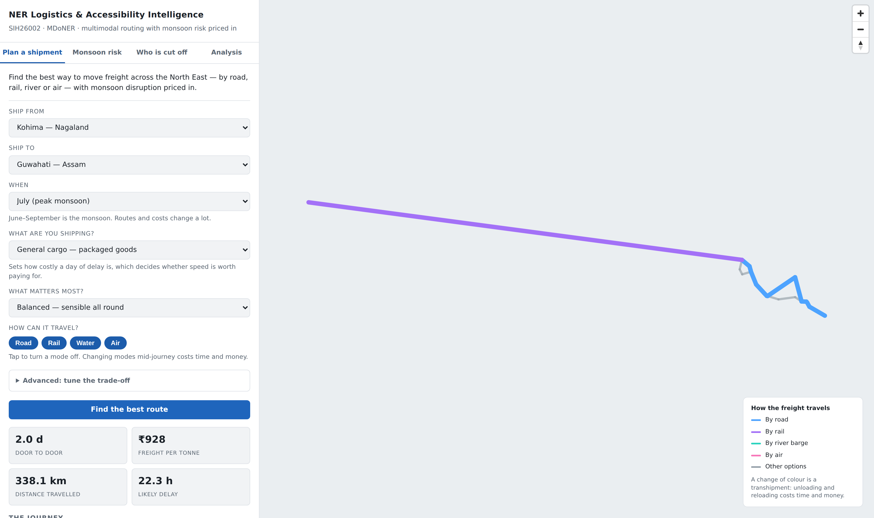
Result 1 — Plan a shipment
Your Team Name
Kohima to Guwahati, July, one tonne of general cargo
You pick five things
Where from, where to, which month, what you are shipping, and what matters most. Modes can be switched off one by one.
It answers in four numbers
2.0 days door to door, ₹928 a tonne, 338.1 km travelled, and 22.3 hours of delay already counted inside the 2.0 days.
The colour change is the point
Blue is road, purple is rail. Where the line changes colour the cargo is unloaded and reloaded, and the app charges 6 hours and ₹250 a tonne for it at Dimapur.
Below the fold, leg by leg
“Transhipment at Dimapur, road to rail, 6.0 h, ₹250/t.” Then “Dimapur to Guwahati, rail, NFR, 290 km, 12.3 h, elevated risk.” Every leg, with its highway number and its risk band.
Screenshot taken from the running application. The basemap tiles are blocked on this network, so the map draws our own data on a blank ground — by design.
Notes:
First of four screenshots from the live app.
Five inputs: from, to, when, what you are shipping, and what matters most. Modes
can be switched off - useful for 'what if the rail line is down'.
Four answers: 2 days, ₹928 a tonne, 338 km, and 22.3 hours of expected delay
which is already inside the 2 days.
Point at the map where the line changes from blue to purple. That is Dimapur.
The cargo comes off a lorry and onto a train, and we charge 6 hours and ₹250 a
tonne for doing it. Most tools treat that as free, which is why their
multimodal plans look better than they turn out to be.
If someone asks why the map has no background: the tile server is blocked on
this network. Our own data still draws. That is deliberate - the map is built to
work without internet.

Slide 9
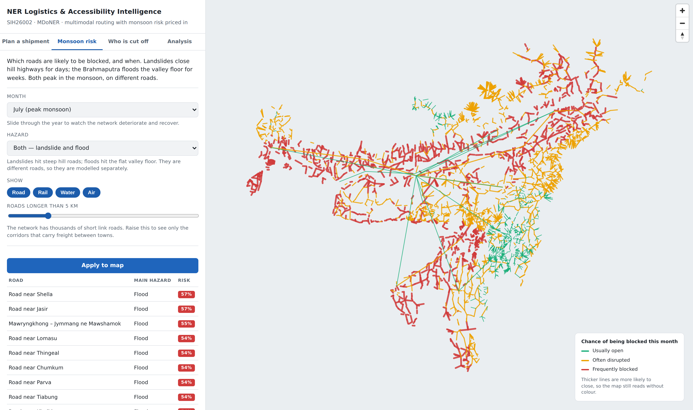
Result 2 — Monsoon risk, every road
Your Team Name
The whole network in July, coloured by the chance of being blocked
4,067 roads over 5 km
Shorter link roads are hidden by the slider, because thousands of 30-metre stubs make the picture unreadable.
Green, amber, red
Usually open, often disrupted, frequently blocked. Line thickness repeats the same information, so the map still works for a colour-blind viewer and in black and white.
Slide the month
Watch the network deteriorate through June to September and recover. The hazard box separates landslides from floods, because they hit different roads.
The worst list is Meghalaya, and it is flood
Shella and Jasir at 57%. Of all the roads shown, 6,316 are at more risk from flooding than from landslides.
Notes:
This is the picture people remember. Give them a moment to look at it.
Every road in the region longer than 5 km, coloured by how likely it is to be
blocked this July. Green usually open, amber often disrupted, red frequently
blocked.
Two things to point out. The thickness of the line repeats the colour, so it
still reads if you are colour-blind or if the deck is printed in black and
white. And the month is a dropdown - you can watch the network fall apart
through June to September and recover in October.
The finding worth stating: the worst roads on the list are in Meghalaya and the
hazard is flood, not landslide. Across the whole network 6,316 roads are at more
risk from water than from slopes.

Slide 10
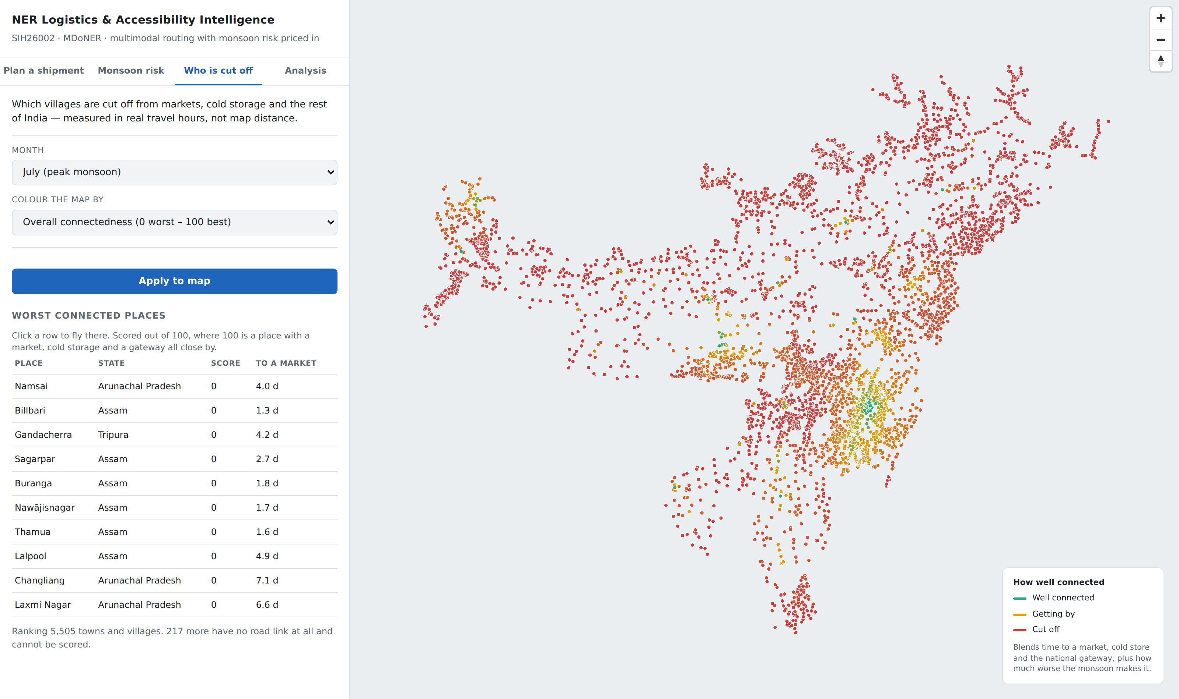
Result 3 — Who is cut off
Your Team Name
5,505 towns and villages scored on travel hours, not map distance
Scored out of 100
100 is a place with a market, cold storage and the national gateway all close by. The score blends travel time to each, plus how much worse the monsoon makes it.
Hours, never kilometres
The score comes from a search over the real network. A village 20 km away across a gorge is not 20 km away.
Namsai is 4.0 days from a market
Changliang in Arunachal is 7.1 days. Billbari in Assam is 1.3 days — and that is in the monsoon.
Mostly red, and we say why
Only 35 markets are mapped in the whole region, so the scores are pessimistic. Loading the Agmarknet market list is the single biggest improvement left.
Notes:
This is the half of the problem statement most teams skip, and it is the half
MDoNER spends money on.
5,505 towns and villages, each scored on how many hours it actually takes to
reach a market, cold storage and the national gateway - travelling over the real
network, not measured across a map.
Namsai is 4 days from a market. Changliang is 7.
Be honest about the red. Only 35 markets are mapped in the entire region, so
most places score badly. It is the first thing we would fix and we know exactly
how - the Agmarknet market list. Saying that is stronger than pretending the
map is finished.

Slide 11
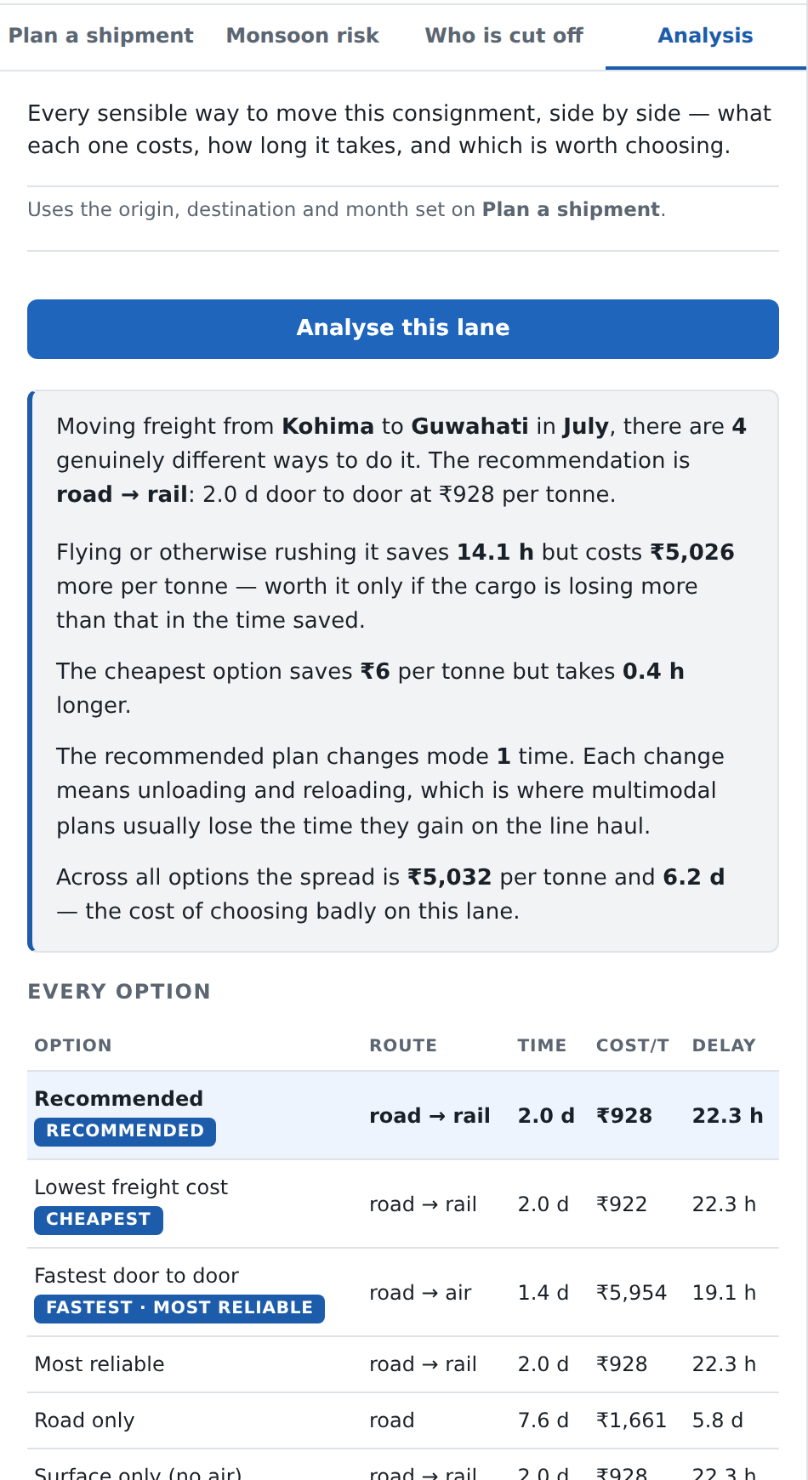
Result 4 — Compare every option
Your Team Name
The same consignment, seven ways, with the app's own plain-English reading
Every option, as the app lists it
Option | Route | Time | Cost/t
Recommended | road → rail | 2.0 d | ₹928
Lowest freight cost | road → rail | 2.0 d | ₹922
Fastest door to door | road → air | 1.4 d | ₹5,954
Most reliable | road → rail | 2.0 d | ₹928
Road only | road | 7.6 d | ₹1,661
Surface only | road → rail | 2.0 d | ₹928
Rail and waterway | road → rail | 2.0 d | ₹928
Why several options look identical
Reading the fastest row
Because on this lane they are. Only 4 of the 7 are genuinely different journeys, and the app says so rather than padding the table out to look busy.
Air saves 14.1 hours and costs ₹5,026 a tonne more. Worth it only if the cargo loses more than that while it waits — which is exactly the judgement a rate card cannot make for you.
The app writes this itself: “Across all options the spread is ₹5,032 per tonne and 6.2 days — the cost of choosing badly on this lane.”
The Analysis panel, full height
Notes:
Last screenshot. This is the app arguing with itself, in English.
It has laid out every sensible way to move the consignment and written the
comparison for you: only 4 of the 7 are genuinely different journeys, air saves
14 hours and costs ₹5,026 a tonne more, and across all of them the spread is
₹5,032 a tonne.
That last sentence is generated by the software, not written by us. Read it out.
Then the judgement it leaves to the human: is the cargo losing more than ₹5,026
a tonne while it waits? If it is perishable, yes. If it is cement, no. A rate
card cannot make that call.

Slide 12
What is finished, and what comes next
Your Team Name
Stated plainly, because the gaps are as informative as the features
Working now
Next, in the order we would do it
Capability | State
Multimodal route planning | Working
Alternative routes | Working
Dry season vs monsoon comparison | Working
Option comparison, seven scenarios | Working
Risk map, landslide and flood | Working
Accessibility scoring, 5,505 places | Working
Facility siting | Working
Closure simulation (shut a road, re-plan) | Working
Load the Agmarknet market list
35 mapped markets for 5,594 villages is why most places score zero. This is the one change that most improves the accessibility answer.
Join the Census 2011 village directory
Replaces the 15% of population figures OpenStreetMap happens to carry.
Add observed flood extent (Sentinel-1)
Replaces the single constant that stands in for how much floodplain road is actually cut in a normal monsoon.
Collect closure reports in the app
The only way to turn a prediction into something that learns.
Not modelled, and worth saying out loud
Earthquakes. The North East is in Seismic Zone V, India's highest, so a major quake is the single largest threat to these corridors — and this platform says nothing about it. Nor about bandhs, blockades or bridge failures.
Notes:
Close on honesty. Left column: eight things that work today.
Right column: what we would do next, in order, and why. The first one - loading
the Agmarknet market list - is the single change that most improves the
accessibility answer, and we know it.
Then the box at the bottom left, and say it out loud rather than waiting to be
asked: we do not model earthquakes. The North East is in Seismic Zone V, India's
highest, so a major quake is the biggest single threat to these corridors and
this platform says nothing about it. That needs a hazard model crossed with
structural survey data, which is a research project, not a data join.
Finish with: everything in this deck came out of the running system, and the
repository is public if you want to check any of it.

