Slide 1

SMART INDIA HACKATHON 2026
IDEA SUBMISSION
Problem Statement ID SIH26002
Problem Statement AI-Based Smart Logistics and Accessibility Intelligence Platform for the North Eastern Region
Theme Smart Automation | MDoNER
PS Category Software
Team ID <your team ID>
Team Name <your registered team name>

Slide 2
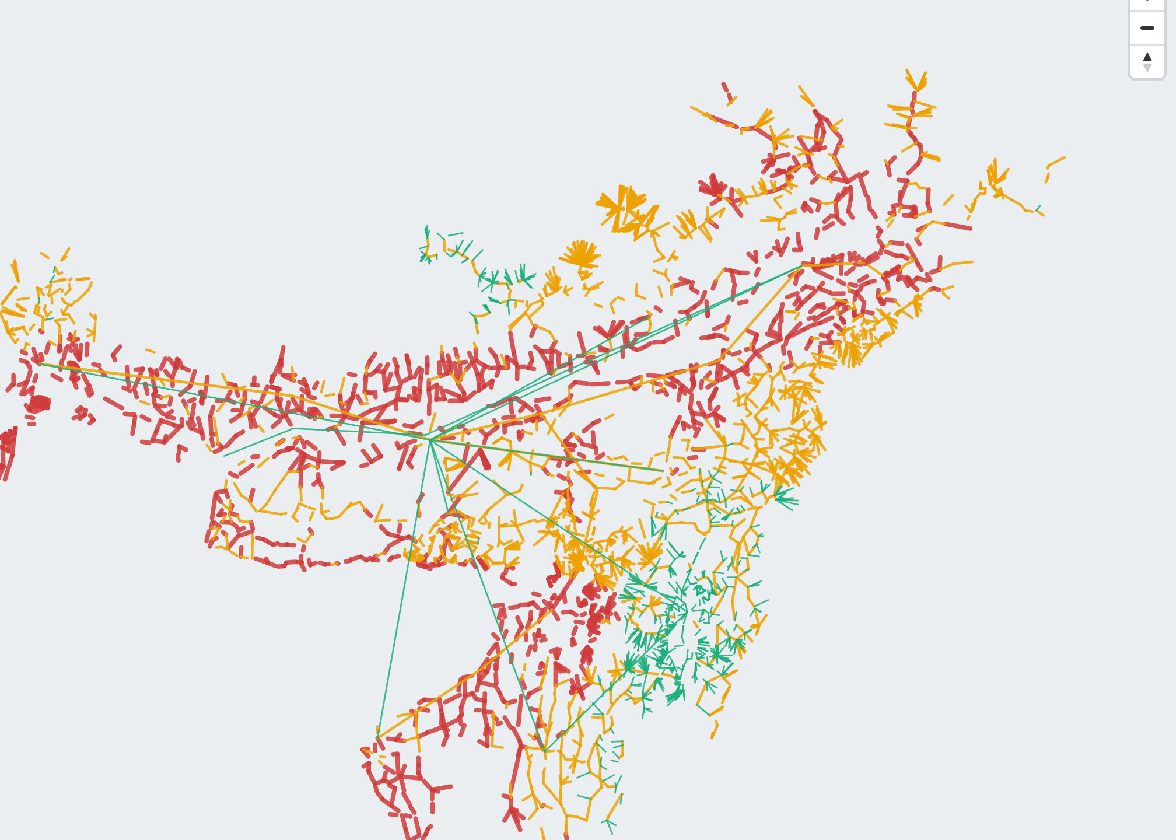
PROPOSED SOLUTION
Your Team Name
Input
AI Processing
Output
• OpenStreetMap - roads & villages
• NASA POWER - monthly rainfall
• Copernicus DEM - ground elevation
Terrain
Rainfall
Elevation
Graph
search
Risk
score
• Best route + alternatives
• Monsoon risk map
• Village accessibility score
• Live shipment tracking
Landslide + flood scored independently, then combined into a generalised cost: rupees, hours, and risk together.
INNOVATION AND UNIQUENESS
Screenshot from the running app.
Multimodal Routing
Road, rail, water, air as one graph; every mode change charged real cost and time.
Dual-Hazard Pricing
Landslide + flood scored separately, priced into rupees and hours per route.
Accessibility Score
5,594 villages ranked by real travel-hours, not straight-line map distance.
Live Shipment Tracking
A marker animates leg by leg, timed to the plan's own real transit hours.
Voice + 5 Languages
Search by voice; use the whole app in Hindi, Assamese, Bengali or Nepali.
HOW IT ADDRESSES THE PROBLEM
• Manual planning: shippers pick a route off a map and guess the monsoon - we compute cost, time and risk together, before dispatch.
• Hidden monsoon cost: risk is priced in rupees and hours, not a vague colour warning.
• Blind villages: 5,594 villages are scored for real accessibility, worst-connected first.
• Multimodal blindness: every transhipment is charged real handling cost and time, never free.
• Nothing to show: live tracking and a satellite view let a viewer watch the plan happen, not just read numbers.

Slide 3
TECHNICAL APPROACH
Your Team Name
METHODOLOGY AND PROCESS
Technical Approach
OPEN DATA
OSM + NASA + DEM
• Data ingestion: OSM (roads/villages), NASA POWER (rainfall), Copernicus DEM (elevation) - all free, no key.
• Network builder: contracts raw OSM ways into 7,181 usable segments over 6,502 junctions.
• Risk engine: terrain + rainfall + elevation combine into landslide and flood probability, per segment, per month.
• Cost engine: ₹/tonne + hours + risk-adjusted delay blended into one generalised cost.
• Graph engine: NetworkX mode-layered graph; Dijkstra for the plan, Yen's algorithm for alternatives.
• Frontend: MapLibre GL (vector + satellite), Web Speech API for voice, in-app translation for 5 languages.
NETWORK BUILDER
7,181 segments · 5,594 villages
RISK + COST ENGINE
landslide, flood, ₹/t, hours
MODE-LAYERED
GRAPH
ACCESSIBILITY
INDEX
LIVE
TRACKER
Working Process
DIJKSTRA +
YEN'S ALGORITHM
• Data collection - pull roads, rainfall and elevation from open sources.
• Network construction - merge into one mode-layered graph (road/rail/water/air).
• Risk scoring - compute landslide + flood probability for every segment, every month.
• Route optimisation - run Dijkstra + Yen's k-shortest paths for the best route and alternatives.
• Accessibility scoring - rank 5,594 villages by real travel-hours to a market, cold store or gateway.
• Live visualisation - animate the chosen plan on the map, mode by mode, in the viewer's own language.
DASHBOARD (API + MAP)
Working prototype: all five stages run today against the real 25,360 km network - not a plan.

Slide 4
FEASIBILITY AND VIABILITY
Your Team Name
FEASIBILITY AND VIABILITY
STRATEGIES FOR OVERCOMING CHALLENGES
Data Challenges
Technical Feasibility
NetworkX handles the 7,181-segment multimodal graph at proven scale; Dijkstra + Yen's run sub-second; MapLibre GL renders vector + satellite at zero backend cost.
Financial Feasibility
Every data source is free and key-less - ₹0 spent on data. Open-source stack throughout: Python, NetworkX, MapLibre, no paid API.
Operational Feasibility
Runs offline after setup; a single process serves the API and the dashboard. 261 backend tests + 51 browser checks pass today.
Data Feasibility
25,360 km built from OSM, cross-checked against 46 seed alignments. Honest gap: only ~15% of villages carry a population figure, so ranking uses reach, not population.
• No live road-closure feed - predict closure risk from rainfall and terrain today; add driver-reported closures next.
• Sparse market data - 35 markets cover 5,594 villages; loading Agmarknet mandi prices is the next data source.
• Incomplete population data - rank villages by settlements reached instead of guessing population.
Coverage Challenges
• Free tile hosts rate-limit - cache tiles for offline use in poor-connectivity field conditions.
• 399 villages unreachable by any mapped road - reported explicitly in the accessibility tab, never hidden.
Adoption Challenges
• Language barrier - 5 regional languages plus voice search remove the English-only barrier.
• Trust in a black-box score - every number traces back to a real terrain or rainfall input shown in the UI.

Slide 5
IMPACT AND BENEFITS
Your Team Name
IMPACTS
BENEFITS
Farmers and FPOs
Billbari's market access falls from 3.9 days in the dry season to 1.3 days once monsoon risk is priced in - no surprise transit cost.
Smarter Freight Decisions
Transporters and 3PLs
A defensible mode choice backed by real cost, time and risk: ₹5,032/tonne and 6.2 days separate the best from the worst choice on one lane.
Reduced Manual Planning
AI Multimodal Logistics Engine
Real Network Data, Not Guesswork
Free Open-Data
Reuse
Real-Time Risk
Pricing
Faster, Safer
Delivery
MDoNER, NEC and State PWDs
1,309 of 4,033 major roads flagged severe-risk in July; 1,055 of those flood-driven, not landslide - facility siting ranks sites by settlements reached.
Every arrow above is a real, running data path in the app today - not a roadmap.
General Public and Villages
399 'invisible' villages, 20+ km from any mapped road, now show up in the data. The whole app works by voice, in 5 regional languages.

Slide 6
RESEARCH AND REFERENCES
Your Team Name
Research Basis
Reference Papers / Sources
• Shortest-Path Routing - Dijkstra's algorithm finds the lowest-cost path on a weighted graph; it is the direct basis of the route optimiser, in use since 1959.
• Alternative Route Discovery - Yen's algorithm enumerates the k shortest loopless paths, used here to offer genuinely different route options, not near-duplicates.
• Terrain-Based Hazard Modelling - landslide susceptibility is commonly modelled from slope, rainfall and land cover; the same terrain-first approach is used here in the absence of a historical closure dataset.
• DEM-Based Flood Susceptibility - elevation derived from the Copernicus DEM is a standard proxy for flood-prone terrain where observed flood extent is unavailable.
• Dijkstra, E. W. (1959). “A note on two problems in connexion with graphs.” Numerische Mathematik, 1, 269-271.
• Yen, J. Y. (1971). “Finding the k shortest loopless paths in a network.” Management Science, 17(11), 712-716.
• OpenStreetMap Foundation - overpass-api.de
• NASA POWER Project - power.larc.nasa.gov
• Copernicus DEM via Open-Meteo - open-meteo.com
• MDoNER / North Eastern Council Regional Plan
• Inland Waterways Authority of India - National Waterway 2
Research Gap
Existing tools optimise route distance alone, or model a single hazard in isolation. None combine multimodal freight optimisation, per-trip hazard pricing and real accessibility scoring in one open, free platform for the North East. This is the gap our platform closes.

