Slide 1

SMART INDIA HACKATHON 2026
IDEA SUBMISSION
Problem Statement ID SIH26002
Problem Statement AI-Based Smart Logistics and Accessibility Intelligence Platform for the North Eastern Region
Theme Smart Automation | MDoNER
PS Category Software
Team ID <your team ID>
Team Name <your registered team name>
Notes:
Start with the place, not the software. The eight North Eastern states
reach the rest of India through one narrow strip of land near Siliguri.
Highways are mostly single lane through hills that slide, Assam floods every
year, and for four months the monsoon shuts the roads the other eight months
depend on. That is the problem we are solving, and what follows is already
built and running, not a plan.

Slide 2
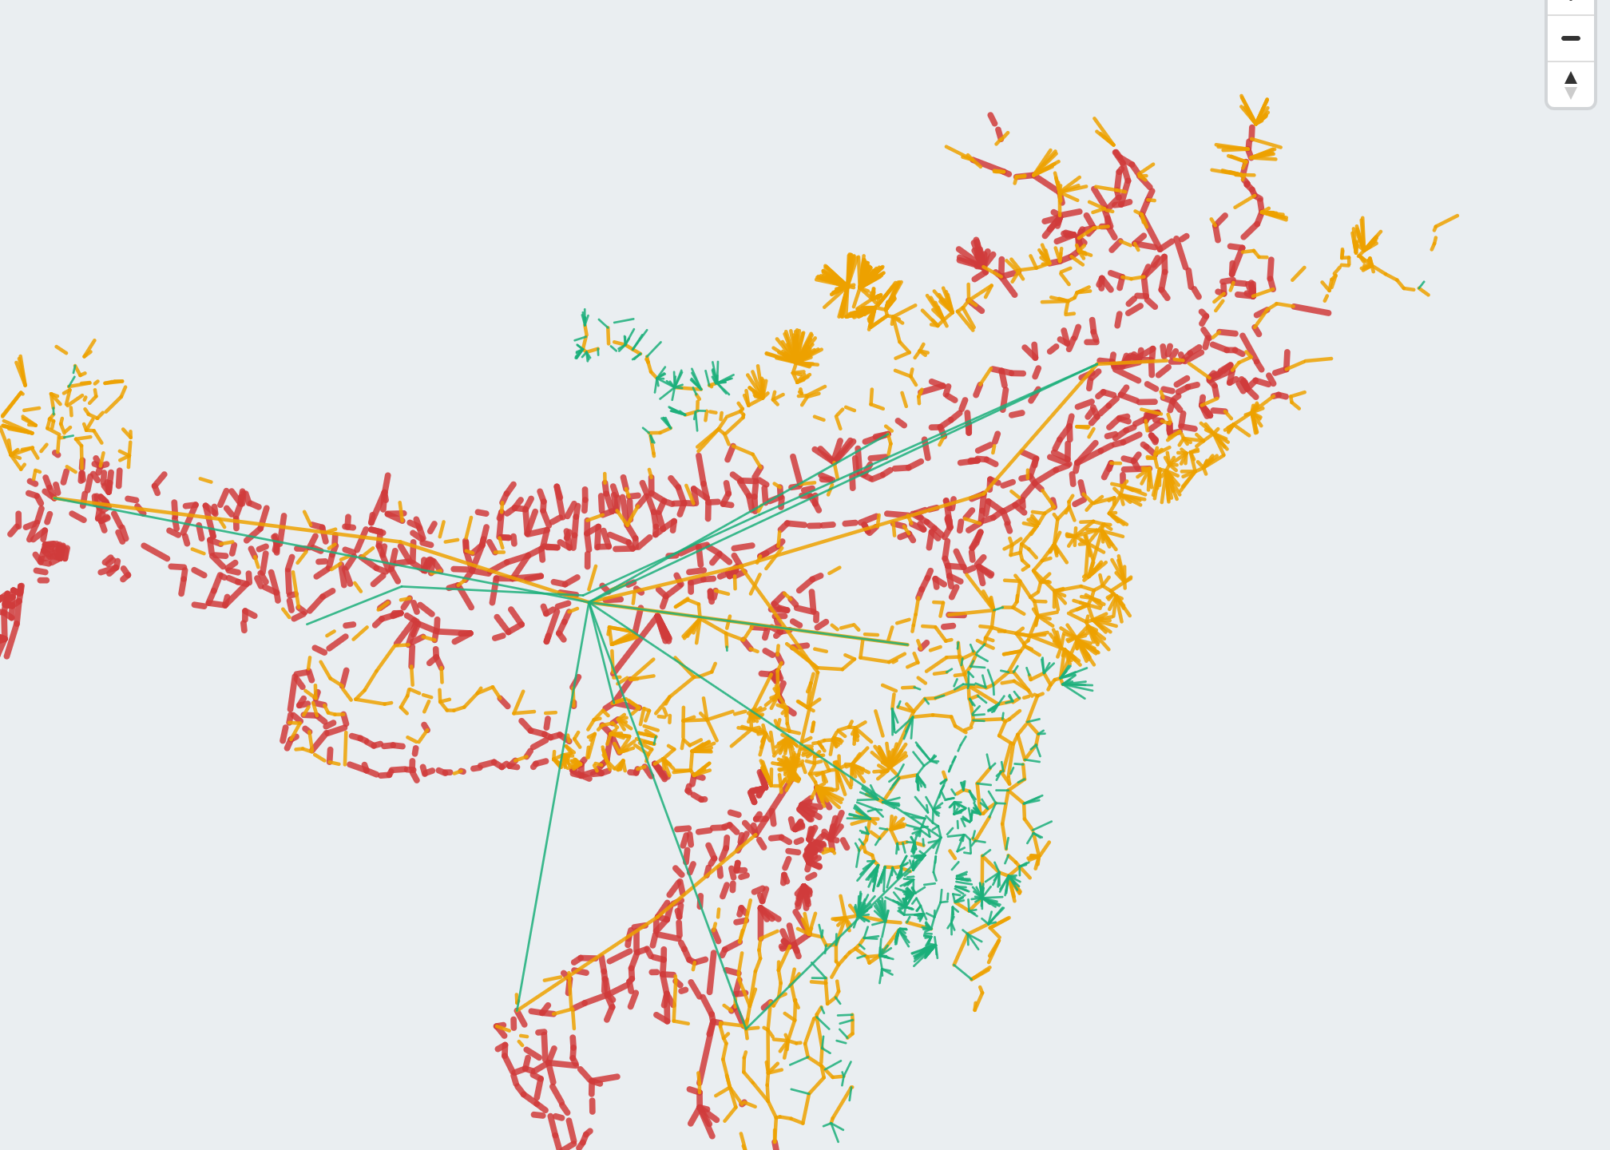
AI-Based Route Planning and Accessibility Mapping for the North East
Your Team Name
Proposed Solution (Describe your Idea/Solution/Prototype)
01
Detailed explanation of the proposed solution
- We built one web application that does two things: it plans the best way to move a shipment across the North East, and it shows which villages are hard to reach.
- It treats road, rail, the Brahmaputra waterway and air as one connected network, so it can suggest part road and part rail when that works out cheaper or safer.
02
How it addresses the problem
- Right now people plan routes off a map and guess how bad the monsoon will be. We turn that guess into a number - extra hours and rupees - before the truck leaves.
- We also rank villages by how many hours they actually need to reach a market or hospital, so it is clear which ones need help first.
03
Innovation and uniqueness of the solution
A real screenshot from our app: all 7,181 road segments we track, coloured by monsoon risk.
- Most tools say a road might be blocked this month and stop there. We also work out the chance a specific trip gets caught in it, so a hill route shows up as costly, not impossible.
- Landslides and floods are scored separately, since they happen on different terrain in different seasons - and the whole thing runs on free data, so there is no cost to keep it running.
A few numbers that sum it up
7,181 road segments · 25,360 km scored
5,594 villages ranked by real access
₹0 data cost · 261 tests · 30 UI checks
Notes:
Point at the map on the right first and say plainly: this is a screenshot
of our own application, not an illustration. Then walk the three points on
the left in order.
Point one is what we built. Point two is why it matters - we turn a guess
about the monsoon into an actual number before the truck leaves. Point three
is the one thing worth slowing down for: we separate "this road might close
this month" from "this specific trip will be stopped by it." Treating those
as the same thing is the usual mistake, and it makes every hill road look
unusable instead of just more expensive.

Slide 3
TECHNICAL APPROACH
Your Team Name
Technologies used, and how the system works end to end
01
Technologies to be used
(e.g. programming languages, frameworks, hardware)
BACKEND
Python · FastAPI · NetworkX · scikit-learn (optional)
DATA
OpenStreetMap · NASA POWER · Copernicus DEM
FRONTEND
MapLibre GL - vendored, zero build step
TESTING
pytest - 261 tests · Playwright - 30 UI checks
02
Methodology and process for implementation
(Flow Charts / Images / working prototype)
1. Open data
2. Build (offline)
3. Engine
4. Answer
5. Serve
OSM roads and places
NASA rainfall
Copernicus elevation
Turn OSM ways into
7,181 scored segments
plus 5,594 villages
Risk model (landslide
and flood), cost model,
mode-layered graph
Plan a route, compare
options, show risk,
show who is cut off
One FastAPI process:
api and dashboard,
no build, no CDN
This is not a plan. All five stages run today against the real 25,360 km network we built - the map on the previous slide is a screenshot from it.
Notes:
Top: four groups of tools, ten seconds each - point and move on, no need
to read every word out loud.
Bottom: the same idea as a flow chart. Data comes in, we build a scored
network from it offline, an engine turns that into risk and cost, four
features answer real questions, and one process serves all of it. When you
reach box five, mention there is no build step and no CDN - that is why the
demo still works even if the venue's wifi blocks something.

Slide 4
FEASIBILITY AND VIABILITY
Your Team Name
What already works, and what we are upfront about
01
Analysis of the feasibility of the idea
25,360 km
of road network we already built from open map data
₹0
spent on data - every source we use is free and public
261 + 30
automated tests and browser checks, all passing today
02
Potential challenges and risks
03
Strategies for overcoming these challenges
Challenge | Strategy
There is no official, live feed anywhere in India that says when a road is actually closed | So we predict risk from rainfall and terrain for now, and the app is being designed to also take reports from drivers directly
OpenStreetMap has population numbers for only about 15% of villages in the region | We rank villages by how many other places they help connect, not population, and plan to add the Census 2011 directory next
Only 35 markets are mapped for all 5,594 villages we track | Loading the Agmarknet market list is the very next thing we plan to do - it is the single biggest gap right now
The free map and elevation services we use limit how much can be downloaded at once | We download once, build the network offline, and save the result - so the app itself never depends on those services being up
Notes:
Left: three numbers that show this already exists - 25,360 km built, zero
rupees spent on data, 261 tests passing. Say them and move on.
Right is the table judges will look at closest. Every challenge sits right
across from what we are doing about it. Lead with the first row: India has
no live road-closure feed anywhere, so we predict from rainfall and terrain
instead, and we are designing the app to learn from driver reports later.
Naming that gap yourself, before anyone asks, is stronger than waiting to be
caught out.

Slide 5
IMPACT AND BENEFITS
Your Team Name
Who this helps, and why it matters
01
Potential impact on the target audience
Farmers and FPOs
In Billbari, Assam, reaching a market takes 1.3 days in the monsoon. Knowing that ahead of time changes what a farmer plants and when they sell it.
Transporters and 3PLs
Instead of guessing which route to take, they get a real comparison of cost, time and risk for every option available.
MDoNER, NEC and State PWDs
In July, 1,309 of 4,033 major roads are at serious risk, and on 1,055 of them the real problem is flooding, not landslides - so money goes to the right fix.
02
Benefits of the solution
(social, economic, environmental, etc.)
SOCIAL
399 villages more than 20 km from any mapped road finally show up in the data, instead of being invisible to planners.
ECONOMIC
On a single route, the best and worst choice differ by ₹5,032 a tonne and 6.2 days - money currently lost to guesswork.
ENVIRONMENTAL
Where rail or water transport works out better, the app recommends it - cutting road-only trips that take nearly four times as long.
Notes:
Three audiences, three examples. Read the Billbari line out loud - it is
the most human one, a farmer knowing it takes 1.3 days to reach a market in
the monsoon changes what they plant. For a policy-focused panel, use the
MDoNER card instead: 1,309 of 4,033 major roads at serious risk in July, and
on 1,055 of them the real cause is flooding, not landslides - so money gets
spent fixing the right problem.
Bottom row is social, economic, environmental, one line each - only read all
three if asked, they are there to show we thought about it.

Slide 6
RESEARCH AND REFERENCES
Your Team Name
Details / Links of the reference and research work
Data we use
Policy and method we build on
Source | Used for
OpenStreetMap (ODbL) overpass-api.de | Roads, towns and villages
NASA POWER power.larc.nasa.gov | Monthly rainfall for each place
Copernicus DEM via Open-Meteo open-meteo.com | Ground height, which drives the flood model
NASA COOLR landslide catalog maps.nccs.nasa.gov | Past landslides, for training (download pending)
Reference | Why it matters here
MDoNER / NEC Regional Plan | The connectivity priorities we build against
IWAI, National Waterway 2 | Brahmaputra navigability and terminal locations
Dijkstra (1959) | Shortest path - how we find the plan
Yen (1971), Management Science 17(11) | k shortest loopless paths - how we find alternatives
Sagarmala and Bharatmala NE corridors | Planned infrastructure we can re-run the model against
Code, tests and full method notes: github.com/Jeffrey2600/Logistics_sih
Notes:
Keep this one short. Everything we used is open and free, so there is
nothing to license before this can be deployed anywhere. Be upfront that the
landslide catalogue download is still pending rather than implying it is
already loaded - if someone checks, honesty here counts for more than
looking complete. Close by pointing at the GitHub link: the code and tests
are public.

